Slide 1
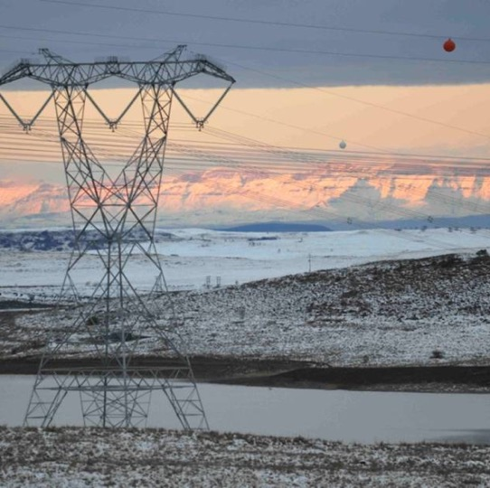
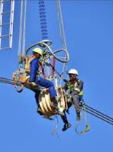
Supply and installation of Cable Trench Covers at Hermes Substation for once-off purchase
Tender No:E1609NTCSAMWPR
Presented by: Asnath Baloyi
Date: 20 October 2025

Slide 2
CONTENTS
INTRODUCTION
Commercial Process/ ITT
SDL & I Requirements
Technical Requirements
Safety Requirements
Environmental Requirements
Quality Requirements

Slide 3
COMMERCIAL PROCESS
  Tender Folder can be uploaded in the following format:
  1 Commercial folder separate ( i.e Tender Returnable/ Statutory docs/ SDL&I )
  1 Technical folder separate ( NEC, BOQ )
  1 Safety folder separate
  1 Quality folder separate
  1 Environmental folder separate

Slide 4
COMMERCIAL PROCESS
Tender submission
Electronic Tender Submissions
-The tenderer must upload the tender via NTCSA Tender bulletin site on the NTCSA E- tendering page. The documents need to be uploaded under the folder Technical, Commercial, Financial, and other.
-All documents need to be submitted in a PDF format. The price list needs to be submitted in PDF and a copy in excel format

Slide 5
COMMERCIAL PROCESS
Tender submission
-No Zip/condense files can be uploaded
-No hard copy will be accepted
-If for some reason you resubmit your tender, then the latest version of the tender submitted will only be accepted and all previous submission/s will be null and void.
-Please ensure that the submission status is indicated as complete.

Slide 6
COMMERCIAL PROCESS
Tender submission
-Supplier Help Manual guide is uploaded with the tender-on-tender portals. And video can be found on NTCSA E-Tendering page

Slide 7
COMMERCIAL PROCESS
  All tenders to be evaluated for functionality – Technical requirements (min threshold =80%)
  All functional tenders will be evaluated on the 80/20 principle
      80 points for Price
      20 points for B-BBEE
  Single point of communication to be addressed to the Procurement Officer via e-mail: BaloyiAT@ntcsa.co.za)
  Tel: 015 299 0242.
  In terms of Eskom's Policy and Procedure, all questions and queries received will be answered in writing to all the bidders.
  Closing date is 03 November 2025 at 10H00 South African Time. Late tenders will not be accepted

Slide 8
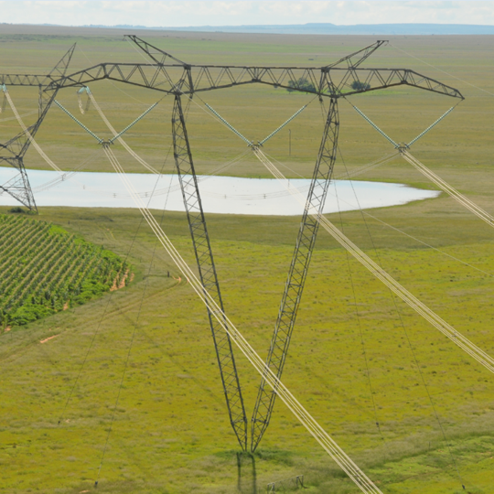
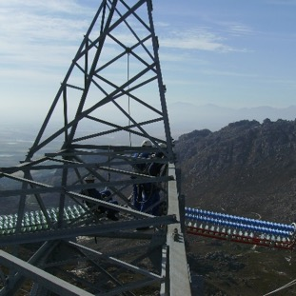
QUESTIONS?

