Slide 1
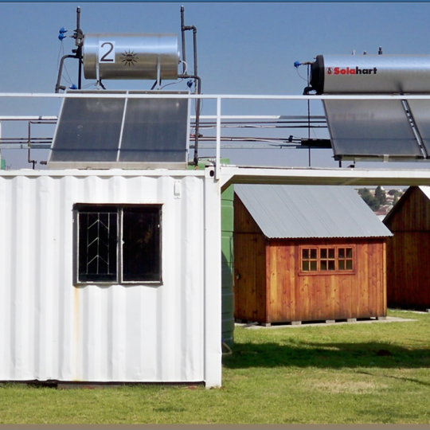
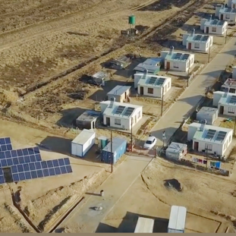
BID CLARIFICATION MEETING: OCCUPATIONAL HEALTH & SAFETY
Presented By: Kgaugelo Sedibeng
18 November 2024

Slide 2
GENERAL
Zero harm is one of ESKOM values.
Eskom will strive to ensure that zero harm befalls its employees, contractors, the public and the natural environment.
Zero fatalities
Zero injuries
Zero environmental incidents
This can be achieved through an effective OHS Management System.

Slide 3
OCCUPATIONAL HEALTH AND SAFETY REQUIREMENTS (Document # 240-155704525, )
Sets out the minimum OHS requirements for the Bid.
The Bidder is expected to provide an OHS plan based on the requirements of document #240-155704525,
The successful Bidder shall not commence work on site until the Site specific OHS plan has been approved by the Client.
It is the duty of all contractors to ensure that:
they are familiar with the relevant OHS legislations required in accordance with the scope of the project.
all appointees fully understand their responsibilities and are trained and competent to execute their duties.
Please note that there are Eskom Site Specific requirements that will be made available to the Contractor for consideration where scope of work will be conducted on the premises of Eskom .

Slide 4
NATURAL GAS PIPELINE
Where the Contractor decides to provide a Natural Gas Pipeline to the relevant Eskom Power Station, it will be the responsibility of the Contractor to comply with applicable statutory requirements.
When the activities fall within the definition of Construction Work in accordance with the Construction Regulations. The Contractor would be required to comply with applicable Construction Regulations ensure that adherence to this is strictly enforced.
Where a Construction Work permit is required , apply for such permit from the relevant government authority. Appoint a Construction Health and Safety Agent to manage Health and Safety.
Fulfil duties in terms of CR 5

Slide 5
Tender Returnable (Annexure A Document #
240-167094369
Eskom’s minimum Occupational Health & Safety requirements that bidders must address and respond to when submitting their bidding returnable are as per Annexure A of Document # 240-167094369.
REMINDER: Annexure A of Document # 240-155704525 : Acknowledgement Form for Eskom OHS Rules & Other Legislative Requirements to be signed by Top Management

Slide 6
Conclusion

