Slide 1

Emergency Vehicles& Plant Equipment
TPL/2026/05/0301/5169/RFP
NON-COMPULSORY TENDER CLARIFICATION MEETING
SUPPLY AND DELIVERY OF ONE (1) BRAND-NEW TRACTOR LOADER BACKHOE (TLB), THREE (3) BRAND-NEW WHEELED MINI TLBs WITH THEIR TRAILERS, AND TWO (2) BRAND-NEW TLB TRAILERS, ON A ONCE-OFF PURCHASE BASIS .
NEC CONTRACT
Date: 16 September 2026
TIME: 10H00 -12H30
1

Slide 2
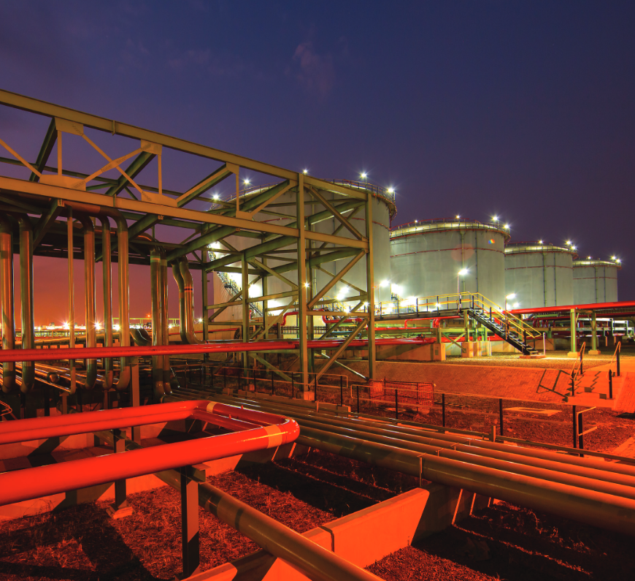
Contents
Emergency Vehicles and Plant Equipment Tender Briefing
01 | Welcome & Safety
02 | Introduction of TPL Team | .
03 | Project Purpose | .
04 | Scope of Supply and Specifications/Annexures | .
05 | Commercial - Tender Process: Tendering Procedure and clarification of Returnables
06 | Pricing Instructions & Pricing Schedule and Contract Data
07 | Technical Evaluation Criteria
08 | Questions
09 | Closing
 | Please note that this meeting is recorded for meeting minutes purposes
2

Slide 3
Emergency Vehicles and Plant Equipment– Introduction TPL Team Members
Benedict Phungula : Senior Incident Response Specialist
Thembelani Emmanuel : Contracts Lead
Rolivhuwa Mugivhi : Quantity Surveyor: Projects
Khulekani Ngqulunga : Commodity Analyst/SD
Tholakele Mzolo : Senior Strategic Sourcing Manager

Slide 4
Contents
Emergency Vehicles and Plant Equipment Tender Briefing
01 | Welcome
02 | Introduction of TPL Team | .
03 | Project Purpose | .
04 | Scope of Supply and Specifications/Annexures | .
05 | Commercial - Tender Process: Tendering Procedure and clarification of Returnables
06 | Pricing Instructions & Pricing Schedule and Contract Data
07 | Technical Evaluation Criteria
08 | Questions
09 | Closing
 | Please note that this meeting is recorded for meeting minutes purposes
4

Slide 5
Emergency Vehicles and Plant Equipment Tender Briefing - PPA110288 – Project Purpose
Purpose of the RFP
Transnet Pipelines is procuring new vehicular equipment to support maintenance and repair activities across its operations.
Equipment Required
Once-off purchase of:
1 × Brand-New Tractor Loader Backhoe (TLB)
3 × Brand-New Mini TLBs with their trailers
2 × Brand-New TLB Trailers
Intended Application
The TLB will be used for:
Excavation
Backfilling
Loading of soil
Handling concrete and sand
Maintenance and repair of infrastructure
The Mini TLBs will primarily support:
Excavation
Backfilling
Maintenance and repair of infrastructure

Slide 6
Contents
Materials & Equipment Management - TPL IVW TM1 – Tender Briefing
01 | Welcome & Safety
02 | Introduction of TPL Team | .
03 | Project Purpose | .
04 | Scope of Supply and Specifications/Annexures | .
05 | Tender Process: Tendering Procedure and clarification of Returnables
06 | Pricing Instructions & Pricing Schedule and Contract Data
07 | Technical Evaluation Criteria
08 | Questions
09 | Closing
 | Please note that this meeting is recorded for meeting minutes purposes
6

Slide 7
Emergency Vehicles and Plant Equipment - PPA110288 – Scope of Supply
The successful bidder will be required to provide:
Brand-new equipment
Supply and delivery to specified TPL workshops
Commissioning
Endurance / working-load testing
Induction / training
Technical documentation
Warranty and service support
Licensing and roadworthy documentation where applicable
NATIS and homologation requirements
Complete data pack.
DELIVERY LOCATIONS
Four TPL Workshop Locations
Location
Equipment to be Delivered
Alrode
1 × TLB
Ladysmith
1 × Wheeled Mini TLB + Trailer
Jameson Park
1 × Wheeled Mini TLB + Trailer + 1 × TLB Trailer
Pinetown
1 × Wheeled Mini TLB + Trailer + 1 × TLB Trailer
Delivery Addresses
Alrode
3 Akasia Road, General Alberts Park, Alberton, 1449
Ladysmith
7 Hamilton Road, Ladysmith, 3770
Jameson Park
Corner R42 Nigel Road and Poortjie Road, Jameson Park
Pinetown
10 Kirk Road, Pinetown CBD, Pinetown, 3620

Slide 8
Emergency Vehicles and Plant Equipment - PPA110288 – Scope of Supply
TECHNICAL SPECIFICATION
Brand-New TLB
Key requirements include:
Diesel engine
Minimum 4-cylinder, water-cooled engine
4 × 4 configuration
Hydraulic torque converter
Minimum hydraulic flow requirement
Adjustable outriggers
Air-conditioning and radio
Minimum 36-month / 5,000-hour warranty
Service plan included in equipment price
Front loader and rear backhoe capability
Yellow main body, arm and boom
Black buckets, tracks and seating area
Wheeled Mini TLB With Trailer
Key Requirements:
Operating weight: 1,500 kg and above
Engine power: minimum 8.6 kW
Suitable for excavation and backfilling
Trailer included
Trailer must be towable by a standard bakkie
Trailer must comply with applicable South African road traffic requirements
Two-line air braking system with ABS
Minimum 12-month warranty / guarantee
Heavy-duty tyres
Spare wheel
24V electrical system with 7-pin connection
Robust steel platform
Side boards and tail boards

Slide 9
Emergency Vehicles and Plant Equipment - PPA110288– Scope of Supply
TLB TRAILERS
Key Requirements:
Gross trailer weight: 18,000 kg
Two-axle configuration
Approved suspension system
Two-line air braking system with ABS
Minimum 12-month warranty / guarantee
Heavy-duty tyres
Spare wheel
24V electrical system with 7-pin connection
Robust steel platform
Side boards and tail boards
Lashing equipment for securing loads
TECHNICAL COMPLIANCE
Critical Evaluation Datasheets
Bidders must:
Complete the applicable Critical Evaluation Datasheets.
Respond to each requirement.
Provide supporting OEM technical specifications / brochures.
Ensure that technical submissions clearly demonstrate compliance.
Important
Simply ticking “YES” or “COMPLY” is not sufficient.
Technical compliance must be supported by appropriate technical evidence.

Slide 10
Emergency Vehicles and Plant Equipment - PPA110288– Scope of Supply
DELIVERY, COMMISSIONING & HANDOVER
The successful supplier will be required to undertake:
Delivery to designated TPL workshops
Commissioning
Endurance testing
2-hour working-load test
Rectification of identified faults
Induction / training
Handover
Data Pack
The equipment data pack must include, amongst others:
Operational and maintenance manuals
Logbook
Data plate details
Proof of licensing and roadworthy certificates
Bumper-to-bumper handover
Service book
Warranty and guarantee documentation
Homologation
NATIS information

Slide 11
Contents
Emergency Vehicles and Plant Equipment– Tender Briefing
01 | Welcome & Safety
02 | Introduction of TPL Team | .
03 | Project Purpose | .
04 | Scope of Supply and Specifications/Annexures | .
05 | Commercial – Tender Process, Tendering Procedure & Clarification Of Requirements
06 | Pricing Instructions & Pricing Schedule and Contract Data
07 | Technical Evaluation Criteria
08 | Questions
09 | Closing
 | Please note that this meeting is recorded for meeting minutes purposes
09

Slide 12
Commercial – Tender Process, Tendering Procedure & Clarification Of Requirements - PPA110288
Key Tender Dates
Activity | Date / Requirement
RFP Issue Date | 10 September 2026
Clarification Meeting | 16 September 2026 @ 10:00
Tender Closing | 12 October 2026 @ 16:00
Tender Validity | 180 working days
Submission Method | Transnet e-Tender Submission Portal
Submission
Tenders must be submitted through the Transnet e-Tender Submission Portal.
No email submissions will be accepted.
Late submissions will not be accepted.
Bidders are encouraged to upload their submissions at least one day before closing.
Each upload is limited to 30 MB, with multiple uploads permitted.

Slide 13
Commercial – Tender Process, Tendering Procedure & Clarification Of Requirements - PPA110288
THE RFP is structured into:
Part T1: Tendering Procedures
T1.1 Tender Notice and Invitation to Tender
T1.2 Tender Data
Part T2: Returnable Documents
T2.1 List of Returnable Document
T2.2 Returnable Schedules
Part C1: Agreements and Contract Data
C1.1 Form of Offer and Acceptance
C1.2 Contract Data (Parts 1 & 2)
Part C2: Pricing Data
C2.1 Pricing Instructions
C2.2 Pricing Schedule
Part C3: Scope
C3.1 Purchaser’s Goods Information

Slide 14
Emergency Vehicles and Plant Equipment– PPA110288– New Electronic Submission Procedures
Transnet has implemented a new electronic tender submission system, the e-Tender Submission Portal, in line with the overall Transnet digitalization strategy where suppliers can view advertised tenders, register their information, log their intent to respond to bids and upload their bid proposals/responses on to the system.
SUBMITTING YOUR BID
Log on to the Transnet eSupplier website/Portal (https://esupplierportal.transnet.net/portal/ ) ;
Click on “SIGN IN/REGISTER –to register new bidder information and ensure that all (must fill in all mandatory information is completed) OR; to sign in if already registered;
Click on “ADVERTISED TENDERS” to view advertised tenders;
Toggle (click to switch) the “Log an Intent” button to submit a bid;
Submit bid documents by uploading them into the system against each tender selected.
Bidders to note that all pricing must be completed in the eSupplier portal, electronic pricing. No paper pricing schedule should be accepted.
No late submissions will be accepted. The bidder guide can be found on the Transnet Portal transnetetenders.azurewebsites.net
Considerations
Time your submissions so that if there are any issues, there is time to escalate & resolve
Nobody has access to the bids until after the bid has closed
There is no physical tender box.
Should you experience challenges with the system, urgently contact: Tholakele.mzolo@transnet.net

Slide 15
Emergency Vehicles and Plant Equipment– PPA110288– Communication
Respondents are warned that a Proposal will be liable to disqualification should any attempt be made by a Respondent either directly or indirectly to canvass any officer or employee of Transnet in respect of this RFP between the closing date and the date of the award of the business.
For specific queries relating to this RFP should be submitted onto the system and to Tholakele.mzolo@transnet.net Before 12:00 pm on 23 September 2026.
In the interest of fairness and transparency, Transnet’s response to such a query will be published on the e-tender portal and Transnet website.
After the closing date of the RFP, a Respondent may only communicate with (Tholakele Mzolo), at telephone number (+27 31 308 8230), email Tholakele.mzolo@transnet.net on any matter relating to its RFP Proposal. Respondents are to note that changes to its submission will not be considered after the closing date.
Respondent found to be in collusion with one another will be automatically disqualified and restricted from doing business with Transnet in the future.

Slide 16
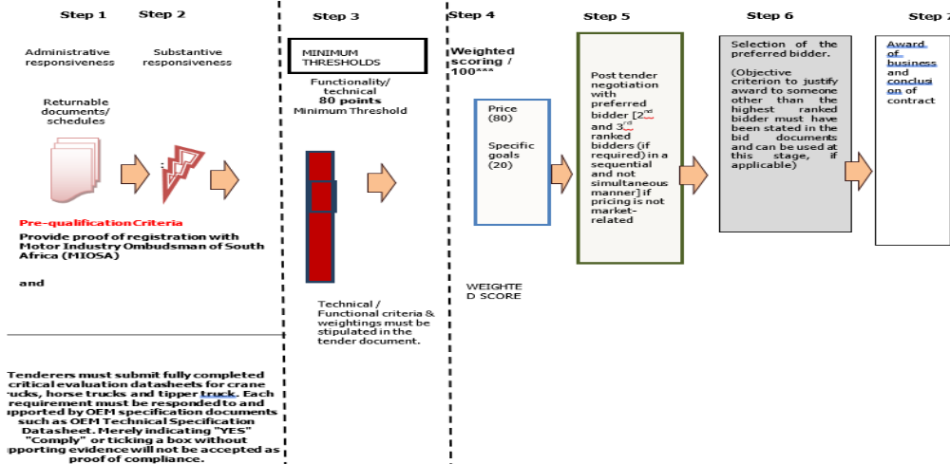
Emergency Vehicles and Plant Equipment– PPA110288– Evaluation Methodology

Slide 17
Emergency Vehicles and Plant Equipment– PPA110288 - Technical Threshold
Only tenders that are Administratively and Substantively Responsive will be evaluated for Technical Functionality
Thresholds | Minimum Threshold
Technical / functionality | 80

Slide 18
Emergency Vehicles and Plant Equipment– PPA110288 - Pricing & Specific Goals
Only tenders that achieve the minimum qualifying score for functionality will be evaluated / further in accordance with the 80/20 points systems as described in Preferential Procurement Regulations.
80 where the financial value of one or more responsive tenders received have a value equal to or below R50 million, inclusive of all applicable taxes
Evaluation Criteria | Final Weighted Scores
Price | 80
Specific goals - Scorecard | 20
TOTAL SCORE: | 100

Slide 19
Emergency Vehicles and Plant Equipment– PPA110288 - Selected Specific Goals
Selected Specific Goal | Number of points allocated (20)
B-BBEE Level of contributor (1 or 2) | 10
30% BLACK WOMEN OWNED ENTITIES | 10

Slide 20
Emergency Vehicles and Plant Equipment– PPA110288 - Evidence For Specific Goals
Selected Specific Goal | Acceptable Evidence
B-BBEE Level of contributor (1 or 2) | B-BBEE Certificate / Sworn-Affidavit B-BBEE Certificate (in case of JV, a consolidate scorecard will be accept) as per DTIC guidelines
30% Black Women Owned Entities | B-BBEE Certificate / Sworn-Affidavit / CIPC B-BBEE Certificate (in case of JV, a consolidate scorecard will be accept) as per DTIC guidelines

Slide 21
Contents
Emergency Vehicles and Plant Equipment– PPA110288– Tender Briefing
01 | Welcome & Safety Share
02 | Introduction of TPL Team | .
03 | Project Purpose | .
04 | Scope of Services and Specifications/Annexures | .
05 | Commercial - Tender Process: Tendering Procedure and clarification of Returnables
06 | Pricing Instructions & Pricing Schedule and Contract Data
07 | Technical Evaluation Criteria
08 | Questions
09 | Closing
 | Please note that this meeting is recorded for meeting minutes purposes
21

Slide 22
Emergency Vehicles and Plant Equipment– PPA110288– Contracting Data
CONTRACTING & PRICING FRAMEWORK
Contract Form
NEC3 Supply Contract
December 2009
Amended April 2013
Core clauses apply
Additional Option:
X7 – Delay Damages
Additional Z clauses:
Z1 – Joint Venture
Z2 – Additional Termination Obligations
Z3 – Collusion and/or Tender Rigging
Z4 – Protection of Personal Information
Z5 – State Security Agency Screening

Slide 23
Emergency Vehicles and Plant Equipment– PPA110288– Contracting Data
CONTRACT DATA: GENERAL
Purchaser
Transnet SOC Ltd
Transnet Corporate Centre
138 Eloff Street
Braamfontein
Johannesburg
Supply Manager
To Be Advised (TBA)
202 Anton Lembede Street
Durban, 4001
Goods
Supply and delivery of:
1 × Brand-New TLB
3 × Brand-New Mini TLBs with Trailers
2 × Brand-New TLB Trailers
Once-off purchase
Contract Administration
Law: Republic of South Africa
Contract language: English
Period for reply: 2 weeks
Goods Information: Part C3
Risk Register: Matters notified under Clause 16

Slide 24
Emergency Vehicles and Plant Equipment– PPA110288– Contracting Data
DELIVERY & PROGRAMME UNDER THE CONTRACT
Delivery Locations
Location
Equipment
Alrode
1 × TLB
Ladysmith
1 × Mini TLB + Trailer
Jameson Park
1 × Mini TLB + Trailer + 1 × TLB Trailer
Pinetown
1 × Mini TLB + Trailer + 1 × TLB Trailer
Delivery dates: TBA
Programme Requirements
First programme to be submitted for acceptance within 2 weeks of the Contract Date.
Revised programmes must be submitted at intervals of not more than 2 weeks.
Programme must support monitoring of delivery and progress.

Slide 25
Emergency Vehicles and Plant Equipment– PPA110288– ContractingData
TESTING, DEFECTS & PAYMENT
Testing & Defects
Defects Date: 52 weeks after Delivery
Defect Correction Period: 2 weeks
Payment
Assessment interval: Monthly
Assessment date: 15th of each successive month
Currency: South African Rand
Payment is made on or before the last day of the month following the month in which a valid Tax Invoice and Statement are received.
Interest: Prime lending rate of Rand Merchant Bank of South Africa

Slide 26
Emergency Vehicles and Plant Equipment– PPA110288– Pricing Data
CONTRACT PRICE
Price Basis
The Contract Data confirms:
The Tendered Total of the Prices is exclusive of VAT.
The Price Schedule is contained in Part C2.
The Form of Offer and Acceptance provides for:
    Total Prices excluding VAT
    VAT at 15%
    Total amount inclusive of VAT
  Pricing Principle
  The bidder's offered price must cover the obligations required under the contract and the complete scope of supply and delivery.

Slide 27
Emergency Vehicles and Plant Equipment– PPA110288– Pricing Data
PRICING DATA / C2
Part C2 – Pricing Data
C2.1 – Pricing Instructions
The RFP Contents identifies C2.1 Pricing Instructions.
C2.2 – Price List
The RFP identifies C2.2 Price List as the applicable pricing schedule.
Bidder Requirements
Bidders must ensure that:
The applicable Price List is fully completed.
All required rates and amounts are provided.
Pricing corresponds with the required equipment and scope.
The pricing submission is consistent with the Form of Offer and Acceptance.
Prices are submitted exclusive of VAT.
VAT is calculated separately at the applicable rate

Slide 28
Emergency Vehicles and Plant Equipment– PPA110288– Pricing Data
PRICE LIST EQUIPMENT BEING PRICED
Pricing Considerations
The price should accommodate the complete contractual requirement, including applicable:
Supply
Delivery
Commissioning
Testing
Training / induction
Warranty
Service plan
Required documentation
Licensing / roadworthy requirements
Homologation / NATIS requirements
Other obligations necessary for completion of the scope
Item | Quantity
Brand New TLB | 1
Brand New Wheeled Mini TLB with Trailer | 3
Brand New TLB Trailer | 2

Slide 29
Emergency Vehicles and Plant Equipment– PPA110288– Contracting Data
HOW PAYMENT / PROGRESS IS ASSESSED
This is the part you were remembering.
Contract Assessment
Under the Contract Data:
Assessment Interval: Monthly
Assessment Date: 15th of each successive month
The amount due is therefore determined through the contractual assessment process rather than simply paying an invoice because equipment has been ordered.
Payment
Payment follows receipt of:
A valid Tax Invoice
Statement
Supporting contractual documentation / evidence required for the relevant assessment
Payment deadline: Last day of the month following the month in which the valid Tax Invoice and Statement were received

Slide 30
Emergency Vehicles and Plant Equipment– PPA110288– Contracting Data
IMPORTANT: DELAY DAMAGES
Option X7 – Delay Damages
Late Delivery
R5,000 per calendar day
for late delivery of the Goods and Services.
Maximum
Capped at 10% of the Contract Value

Slide 31
Emergency Vehicles and Plant Equipment– PPA110288– Contracting Data
CONTRACT RISK & LIABILITY
Purchaser's Additional Risks
None
No additional Purchaser risks are accepted other than those provided for in the Contract.
Liability
Indirect / consequential loss: R0
Loss or damage to Purchaser's property: Total of the Prices
Defects arising from Supplier design: Cost of correcting the defect / Total of the Prices
Overall Supplier liability: Total of the Prices
End of liability: 3 years after delivery of the whole of the Goods and Services

Slide 32
Emergency Vehicles and Plant Equipment– PPA110288– Contracting Data
INSURANCE REQUIREMENTS
Motor Vehicle Liability
Minimum indemnity:
R10 million
Including applicable third-party, passenger and unauthorised passenger liability.
Employee Injury Liability
As prescribed by the Compensation for Occupational Injuries and Diseases Act, together with applicable common-law liability.
Minimum indemnity:
R5 million

Slide 33
Emergency Vehicles and Plant Equipment– PPA110288– Contracting Data
OPTION Z1: JOINT VENTURE
Where the Supplier is a Joint Venture:
Within 4 weeks of the Contract Date
The Supplier must provide:
Certified Joint Venture Agreement; or
Memorandum of Incorporation for an Incorporated Joint Venture.
Agreement must address:
Contract and deliverables
Names and addresses of JV constituents
Domicilium
Constituent interests
Insurance
Sureties
Indemnities
Guarantees
Internal dispute resolution
Joint and several liability and Lead partner and authority to bind the JV

Slide 34
Emergency Vehicles and Plant Equipment– PPA110288– Pricing Data
OPTION Z2: TERMINATION
Additional Termination Obligations
The Contract extends the termination provisions to include circumstances such as:
Business rescue proceedings
Repudiation of the Contract
The termination table is amended accordingly to incorporate these additional termination reasons.
OPTION Z3: COLLUSION & TENDER RIGGING
The contract award is made without prejudice to Transnet's rights to take appropriate action in relation to:
Collusion
Tender rigging
Other related prohibited conduct
Potential blacklisting / restriction

Slide 35
Emergency Vehicles and Plant Equipment– PPA110288– Contracting Data
OPTION Z4: PROTECTION OF PERSONAL INFORMATION
Z4 – POPIA
The Purchaser and Supplier are required to process information obtained during the Agreement in a manner aligned with the:
Protection of Personal Information Act (POPIA).
Key Principle
Personal information must be:
Properly protected
Processed lawfully
Used only for legitimate contractual purposes
Protected against unauthorised access or processing

Slide 36
Emergency Vehicles and Plant Equipment– PPA110288– Contracting Data
OPTION Z5: SSA SCREENING
State Security Agency Screening
The Purchaser reserves the right to conduct State Security Agency (SSA) screening for suppliers who require access to National Key Points.
Potential Documentation
Company registration number
CIPC registration
Tax Clearance / TCS PIN
Directors' IDs
Directors' fingerprints
IDs of employees working on site
Employee fingerprints

Slide 37
Emergency Vehicles and Plant Equipment– PPA110288– Contracting Data
CONTRACT DATA: SUPPLIER INFORMATION
Supplier to Complete
The Supplier must provide:
Supplier name
Address
Telephone number
Fax number, where applicable
Other Contract Data
Supplier's design information: Part C4.
Tendered Total of Prices: Exclusive of VAT.
Price Schedule: Part C2.
Risk Register: Matters notified under Clause 16.
Access restrictions: None.
Delivery: As stated in Contract Data.
Overheads and profit percentage: To be completed by Supplier where applicable.

Slide 38
Emergency Vehicles and Plant Equipment– PPA110288– Contracting Data
CONTRACT DOCUMENT HIERARCHY
Contract Documents
The Form of Offer and Acceptance confirms that the contract terms are contained in:
C1 – Agreements & Contract Data
Form of Offer & Acceptance
Contract Data
C2 – Pricing Data
C3 – Goods Information
Scope of Work
Supply requirements
Drawings and other incorporated documents
Deviations
Any agreed deviations or amendments must be captured in the Schedule of Deviations.
No amendment or deviation is valid unless contained in the applicable Schedule

Slide 39
Emergency Vehicles and Plant Equipment– PPA110288 - Contract Data
Conditions of Contract – NEC3 Engineering and Construction Contract June 2005 (amended June 2006 and April 2013)

Slide 40
Emergency Vehicles and Plant Equipment– PPA110288 - Contract Data
Z:Additional conditions of contract Secondary Options
X7: Delay Damages – Refer to Core Clause
Z: Additional Condition of Contract
Z1: Additional clauses relating to Joint Venture
Z2: Additional obligations in respect of Termination
Z3: Additional Clause Relating to Collusion and/or Tender Rigging
Z4: Protection of Personal Information Act
Z5: Right Reserved by the Purchaser to conduct screening through SSA

Slide 41
Emergency Vehicles and Plant Equipment– PPA110288– Pricing Data
Item no | Description | Unit | Quantity | Rate | Price
1 | TLB with engine power which must range from minimum of 64 kW to a minimum of 86hp. Minimum of 4-cylinder in-line and water-cooled diesel engine configurations. Must be a 4X4 with hydraulic torque convertor for smooth power transfer. Must have multiple forward and reverse speeds, sometimes with high/low ranges. Hydraulic system flow rate must range from minimum of 80 L/min. Working pressure must be around 22.5 MPa. Must have adjustable outrigger width. Fuel tank capacity must range from minimum of 125 liters. Minimum of 36-month/5 000 hours warranty. | Ea. | 1
2 | Wheeled Mini TLB with a trailer operating weight ranging from 1500kg and above. Engine power minimum rating of 8.6 Kw and above. Dig depths must range from 2.19 meters (7ft 2in) and above. Maximum reach must be at least 4 meters and above. Lifting capacity must be between 1 000 to 10 000 pounds or more. Travel speed and digging forces must be between 1.6 mph and above. Minimum of 3 - 4 years or 4 000 hours warranty. Hydraulic system with a 3-pump system feature or more. Must have adjustable track width. Critical components must be easily accessible for routine maintenance. | Ea. | 3

Slide 42
Emergency Vehicles and Plant Equipment– PPA110288– Pricing Data
3 | TLB Trailer with a gross trailer weight of 18 000 kg. Draw bar length must be within the range to ensure stability and clearance during turns. Minimum trailer dimensions are as below: 1. Length – 7200 mm; 2. Height – 1213 mm; 3. Width – 2385 mm; 4. Ramps length – 2650 mm; 5. Draw bar length - 1850 mm. Two axles’ configurations. Suspension systems must be leaf’s springs, air suspension, or independent suspension systems to provide optimal ride quality and load-bearing capacity. Braking system must be a two-line air brake system with ABS (Anti-lock braking System). They must have a minimum warranty and guarantee of 12 months. The draw bar eye must have an external diameter of 100 mm and an internal diameter of 50 mm and be fitted with a standard bush to connect the trailer to the truck's Pin coupling. The trailer must be fitted with heavy duty tyres, and the spare wheel must be fitted on the trailer. 24-volt electrical system with a 7-Pin connection. Robust steel platform design with features like side boards, tail boards, and lashing equipment for securing loads. | Ea. | 2
 | Total excl. VAT
 | VAT @ 15%
 | Total incl. VAT
The total of the Prices: To be carried over to form of offer & acceptance.

Slide 43
Contents
Emergency Vehicles and Plant Equipment– PPA110288– Tender Briefing
01 | Welcome & Safety
02 | Introduction of TPL Team | .
03 | Project Purpose | .
04 | Scope of Services and Specifications/Annexures | .
05 | Commercial - Tender Process: Tendering Procedure and clarification of Returnables
06 | Pricing Instructions & Pricing Schedule and Contract Data
07 | Technical Evaluation Criteria
08 | Questions
09 | Closing
 | Please note that this meeting is recorded for meeting minutes purposes
43

Slide 44
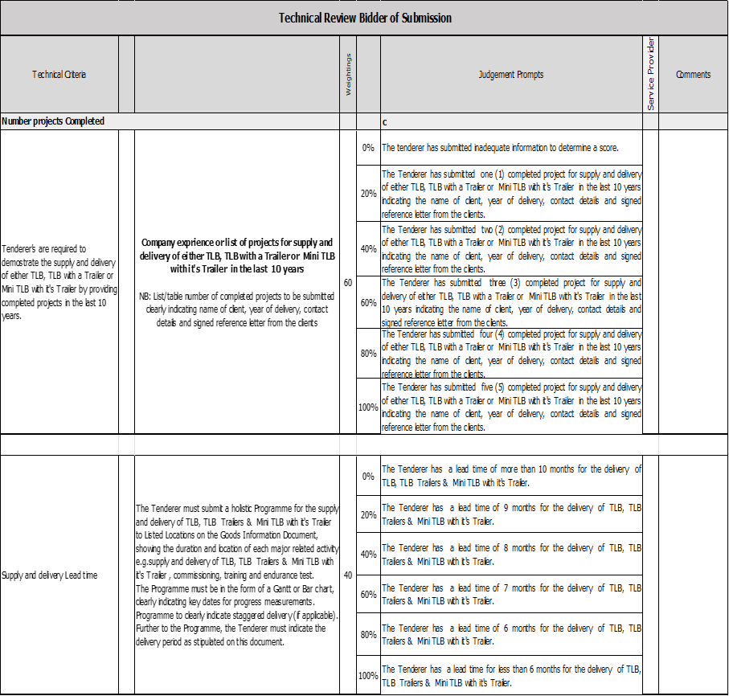
Emergency Vehicles and Plant Equipment– PPA110288– Technical Evaluation Criteria
Failure to provide supporting documentation to support an assertion will result in a score of 0 being awarded for that particular criterion
Failure to achieve a minimum score of 80 points (out of 100) will result in disqualification

Slide 45
Contents
Emergency Vehicles and Plant Equipment– PPA110288– Tender Briefing
01 | Welcome & Safety Share
02 | Introduction of TPL Team | .
03 | Project Purpose | .
04 | Scope of Services and Specifications/Annexures | .
05 | Commercial - Tender Process: Tendering Procedure and clarification of Returnables
06 | Pricing Instructions and Pricing Schedule
07 | Technical Evaluation Criteria
08 | Questions
09 | Closing
 | Please note that this meeting is recorded for meeting minutes purposes
45

Slide 46
Contents
Emergency Vehicles and Plant Equipment– PPA110288– Tender Briefing
01 | Welcome & Safety Share
02 | Introduction of TPL Team | .
03 | Project Purpose | .
04 | Scope of Services and Specifications/Annexures | .
05 | Commercial - Tender Process: Tendering Procedure and clarification of Returnables
06 | Pricing Instructions and Pricing Schedule
07 | Technical Evaluation Criteria
08 | Questions
09 | Closing
 | Please note that this meeting is recorded for meeting minutes purposes
46

Slide 47
Thank you

