Slide 1
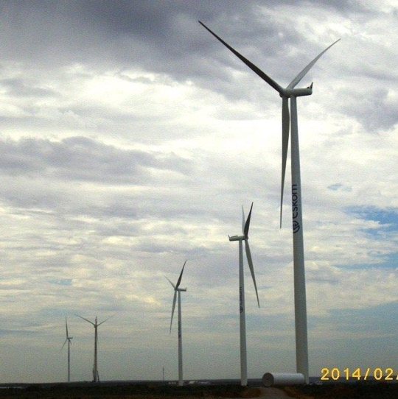
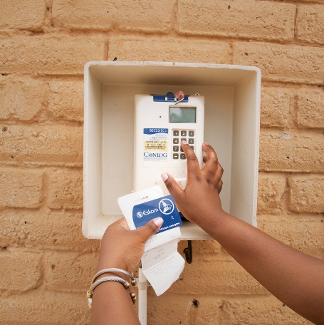
Clarification Meeting For Tenders E2037DXGP, E2038DXGP & E2009DXGP: The design, manufacture, supply and delivery of estimated quantities of Fibre Optic Cables on an “as and when” required basis for five (5) years
Presented by: Kebone Mogase
28 November 2025

Slide 2
Housekeeping Rules
Keep your microphone muted when not speaking to minimize background noise.
Questions may be asked once a presentation is finished.
Use the “Raise Hand” feature on your screen
Identify yourself when speaking, by stating your name and company.
Keep your questions brief and to the point.
Meeting scheduled for two & half hours; attendees are encouraged to take comfort breaks whenever needed.

Slide 3
Agenda
# | Items | Responsible Person
1 | Opening and Welcoming of Attendees | Kebone Mogase
2 | Housekeeping Rules
3 | Safety Procedure
4 | Introduction of Attendees | All
5 | Purpose of the meeting | Kebone Mogase
6 | Invitation To Tender: E2037DXGP, 2038DXGP & E2009DXGP
7 | Supplier Development Localization & Industrialization (SDL&I) | Ayanda Ramokolo
8 | Safety and Health | Annette Mosekwa
9 | Environmental | Xolani Gumede
10 | Quality | Bongi Tshabalala
11 | Technical | Lesiba Buthane/Tshepiso Moloisane
12 | Commercial: NEC SC Terms & Conditions Pricing & BOQ Annexure F Financial Analysis Logistics | Yolisa Mpeta Tebatso Keetse Takalani Singo Malebo Segwai Bongani Mosimanga
13 | Timelines | Kebone Mogase
14 | Closure

Slide 4
Purpose of the meeting
High level explanation of Eskom’s requirements to prospective tenderers;
Provide responses to the questions received from prospective tenderers and new ones if any;
Confirm addendum published post issuing of enquiries

Slide 5
Invitation To Tender: E2037DXGP, E2038DXGP & E2009DXGP
Representative during Tender period: Ms Kebone Mogase
E-mail: mogasekk@eskom.co.za
Landline: +27 11 800 3214
Timelines
Issued: 21 November 2025
Tender initial Closing Date & Time: 12 December 2025 @ 10H00 South African Standard Time (SAST)
Tender New Closing Date & Time: 26 January 2026 @ 10H00 South African Standard Time (SAST)
(No Late Submission will be accepted)
Clarification Session Date & Time: 28 November 2025 @ 10h00 South African Standard Time (SAST
Clarification queries closing Date: 21 January 2026, two (2) working days before the deadline for tender submission
Tender Submission Address: Electronically via Eskom eTendering site, https://etendering.eskom.co.za/login
Tender Free of Charge

Slide 6
Tender Returnables
* Returnables required at Tender closing (disqualifiable): -
These returnables are required to be fully completed, signed (if required on the returnable) and submitted with the tender at Tender closing date and time. If not fully completed, signed (if required on the returnable) and/or submitted by tender closing, the tenderer will be disqualified.
** Returnable required at Tender closing (non-disqualifiable): -
These returnables are required to be fully completed, signed (if required on the returnable) and submitted with Tender at Tender closing date and time; however, if not submitted by Tender closing, or submitted with incomplete information or without a required signature, the Procurement Practitioner will, in writing request the tenderer to submit the returnable within 5 working days. If the returnable is not fully completed, signed if required and/or received by the Procurement Practitioner within 5 working days of the request, the tenderer will be disqualified.

Slide 7
Tender Returnables Cont.
# Returnables required at Tender Closing date and time for evaluation: -
These returnables are required to be submitted at tender closing date and time. These returnables will not be requested by the Procurement Practitioner. A tenderer that does not submit the required returnable at stipulated deadline or submits an incomplete returnable; will not be disqualified but will score zero.

Slide 8
Tender Conditions
Contracts may be awarded to one or more suppliers/s which are technically, commercially, financially acceptable and where possible, it is justified by objective criteria.
Prices may be negotiated where necessary.

Slide 9
Submission of a Tender
Tender submission must be uploaded on the Eskom eTendering site https://etendering.eskom.co.za/login using the below folders:
Tender No.
• Commercial,
• Due Diligence (Financial Statements),
• Pricing (BOQ),
• SHEQ,
• SDL&I,
• Technical.

Slide 10
Questions Received from Tenderers.
Commercial: E2037DXGP & 2038DXGP
Question: We note that the clarification meetings for both tenders are scheduled for the same date and time.
Please confirm, will the meetings be hosted together for both tenders or if this was an error?
Response: The clarification meeting will be hosted for both tenders.

Slide 11
Addendum To The Enquiries
Commercial
Tender Closing Date extended to 26 January 2026 @10H00 SAST

Slide 12


Thank You

