Slide 1

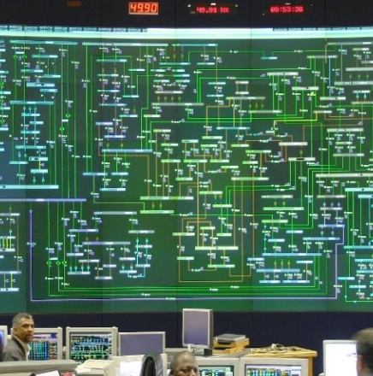
Quality Presentation for the Non-Compulsory Clarification Meeting -Supply and delivery of Chairs
By Nosimilo Mbele
19 October 2023

Slide 2
Quality requirements fall under contractual requirements
Contractual Requirement:
No scoring during Contractual Requirement, but an indication if the supplier has met the Quality minimum requirements listed on the Tender Quality Returnable. Suppliers that have met all the functional requirements will ONLY be evaluated, should there be any outstanding information, the buyer will be informed to request the outstanding information from the supplier and to resubmit within 5 days, the Quality rep will indicate if the information is acceptable or not.

Slide 3
Quality requirements
QM 58 Specification
Section A: Quality Management System Requirements ISO 9001
Objective evidence of documented QMS that complies with ISO 9001
  Quality Method statement based on scope.
  Quality Policy Approved by top management.
  Quality Objectives Approved by top management.

Slide 4
Quality requirements
Section B: Evidence of QMS in operation (Tender Quality Requirements -Ref 240-105658000 /240-105658000)
Documented information for defined roles, responsibilities and authorities
Documented information for Control of Externally Provided Processes, Products and Services

Slide 5
Quality requirements
Section C: User defined additional Requirements & miscellaneous (Ref 240-105658000)
Customer specific requirements & other standards and required can be listed and evaluated here
Form A is completed and signed.

Slide 6


Thank you

