Slide 1






MWP2486CX
PROVISION OF INTELLIGENT BUSINESS PROCESS MANAGEMENT TOOL INCLUDING SUPPORT AND MAINTENANCE FOR A PERIOD OF 7 YEARS

Slide 2
MWP2486CX
Agenda | Presented by:
Safety and Evacuation | Tamara Mda
Introduction | Tamara Mda
Commercial | Tamara Mda
SDL&I | Rojane Qacha
Safety Requirements | Pumeza Mabunda
Quality Requirements | Feziwe Mogamisi
SOW & Technical requirements | Thabo Mashegoane Johan Scholtz
Pricing | Rendani Nevondo
Closing | Tamara Mda

Slide 3
Rules of Engagement/Commercial Process
MWP2486CX
Content
  Point of contact
  Tender closing Date and Address
  Submission format.
  Mandatory Documents
  Evaluation Method and Criteria
  Contractual requirements
  Approach to this tender (Timeline).

Slide 4
Point of contact and the closing Date for
MWP2486CX
Single point of contact is Tamara Mda (E-mail: MdaT@eskom.co.za)
  011 800 3599
In terms of Eskom's Corporate Policy, all questions and queries received will be answered in writing and published on both the Eskom Tender Bulletin and as well as the National etender portal.
Closing date for clarification questions 3 working days before the deadline for tender submission
Closing date to submit tender returnables is 26 April 2024, at 10H00 South African Time.
Address: Tender office
      Eskom Megawatt Park
01 Maxwell Drive, Sunninghill
Northside
Late tenders will not be accepted.

Slide 5
Contents
Introduction
Commercial
SDL&I
Safety Requirements
Quality Requirements
SOW &Technical requirements
Pricing Schedule

Slide 6
Commercial – Submission Format
Original
(Hardcopy)
Documents
Duplicate
Hardcopy
File A–Commercial response (including SHEQ & SDL&I)
1
1
1
1
File B–Technical response
1
1
File C–Pricing response
Flash Disk (with file A,B & C)
1
Electronic documents should be in a read only format in MS Word and MS Excel to enable cut and paste of content. The Excel spreadsheets must be in electronic format The spreadsheets are to be completed and sent back as returnable.
Three copies: Two hard copies, being an original and one copy and a flash disk. The copies must be the exact replica of the originals.
Please note: Annexure F (The pricing workbook) MUST be submitted in excel format.
1 Electronic documents should be in a read only format in MS Word and MS Excel to enable cut and paste of content.

Slide 7
Commercial continue - Returnable required at Tender closing (disqualifiable)
Description | Annexure
Basic Compliance | One (1) hard copy of the
Pricing Schedule | Annexure F
Technical returnables and evaluation criteria | Annexure J
All mandatory requirements must be submitted at tender closure. Should these requirements not be met, the tender will be deemed non-responsive, and therefore disqualified.

Slide 8
Commercial continue - Returnable required at Tender closing. (Non-disqualifiable)
Description | Annexure
Acknowledgement Form | Annexure A
Tenderers Particulars | Annexure B
Integrity Pact Declaration form | Annexure C
CPA for local goods/services (if applicable) | Annexure D
CPA(IG) for imported goods/services | Annexure E
SBD 1 | Annexure G
SBD 6.1 | Annexure H
SBD 4 | Annexure I
Letter of intent to form a JV/consortium or Valid joint Venture Agreement
Separate written confirmation that the joint venture will operate as a single business entity (incorporated) for the duration of the contract or this may be included as an obligation within the JV agreement
Shareholding
All mandatory requirements must be submitted at tender closure. however, if not submitted by Tender closing, the Procurement Practitioners must request in writing the outstanding returnable to be submitted within 5 working days. If the requested returnable are not fully completed, signed (if required on the returnable) and/or received by the Procurement Practitioner within 5working days of the request; the tender must be disqualified.

Slide 9
Commercial continue-Evaluation Process and Criteria
    Evaluation process will be conducted in accordance with the Preferential Procurement Policy Frame Act, No 5 of 2000 (PPPFA)
      The following five (5) steps will be applied during the evaluation of this tender.
      Step 1: Basic compliance;
      Step 2: Mandatory tender returnables;
      Step 3: Technical gatekeepers
      Step 4: Functionality
      Step 5: Price and Preference scoring;
      Step 6: Contractual requirements.
        Pricing and preference
    The 80/20 or 90/10 Preference point system will apply to this tender. Proposals will be evaluated on (a) price which will be allocated 80 /90 points and (b) B-BBEE status (specific goals) which will be allocated 20/10 points
              Note: Eskom reserves its right to:
    To cancel the tender if agreement cannot be reached on the market-related price.
    “Eskom reserves the right to award to a supplier who may not be the highest scoring or highest ranked supplier, in line with Section (2) (1) (f) of the PPPFA

Slide 10
Commercial continue-Contractual Requirements
  Contractual requirements include the following:
      Safety;
      Quality;
      SDL&I;
      Financial statements.
Please Note:
Contractual requirements are not evaluation criteria. They are required to be met and assessed after the evaluation and ranking of the tenders. Proof that the highest ranked tenderer is able to meet the contractual requirements, must be submitted prior to contract award.
Failure to not meet the “Contractual Requirements “by the stipulated deadlines, Eskom will not conclude a contract with the recommended tenderer

Slide 11
Contents
Introduction
Commercial Process
SDL&I
Safety Requirements
Quality Requirements
SOW & Technical requirements
Pricing Schedule

Slide 12

Contractual requirements - SDL&I
Refer to Annexure O

Slide 13
Contents
Introduction
Commercial Process
SDL&I
Safety Requirements
Quality Requirements
SOW & Technical requirements
Pricing Schedule

Slide 14

Contractual requirements-SHE
Refer to Annexure N

Slide 15
Contents
Introduction
Commercial Process
SDL&I
Safety Requirements
Quality Requirements
SOW & Technical requirements
Pricing Schedule

Slide 16


Contractual requirements-Quality
Refer to Annexure M

Slide 17
Contents
Introduction
Commercial Process
SDL&I
Safety Requirements
Quality Requirements
SOW & TECHNICAL REQUIREMENTS
Pricing Schedule

Slide 18


Intelligent Business Process Management Suite (iBPMS) – Technical Clarification session
.
Johan Scholtz and Thabo Mashegoane
08 April 2024
.

Slide 19
Background
Eskom implemented K2 around 2003 as an Enterprise Workflow platform (iBPMS). The platform was used to develop numerous applications such as eForms workflows, ACNAC, GENTLC, SET, Top100 and IRCAMS. The platform was developer intensive with the requirement for specialist scarce K2 developers whenever changes are required. As per the Eskom’s system lifecycle, we need to source the platform that is in the cloud, supports low code/ No code development and uses analytical information to support process management.
Approach:
Replace the current BPA platform with a modern solution to advance Eskom’s Process automation objectives.
The Vendor is responsible for the delivery of a full end to end solution and the project within the required timelines.
The project and solution must comply with Eskom stage gates and governance milestones and deliverables.
A phased rollout approach with quick to market deliverables (agility) is mandatory.
The project must be fully completed & system fully operational within twenty-four to thirty-six months of the kick-off meeting. A six-month stabilisation period must be included in this timeframe.

Slide 20
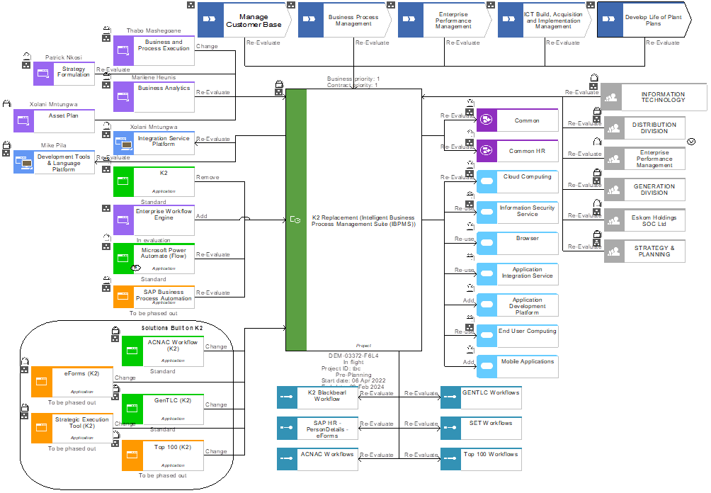
Scope

Slide 21
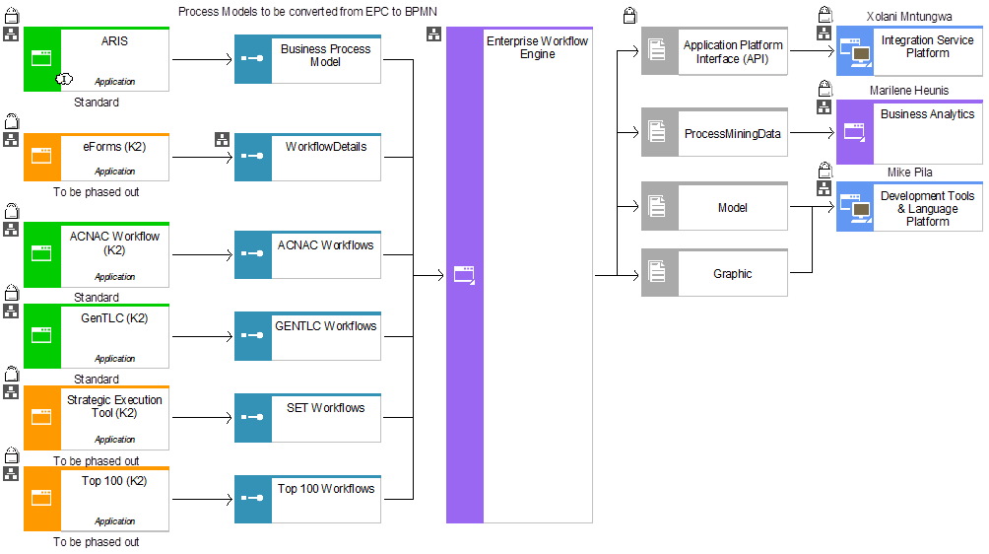
Application Interactions

Slide 22
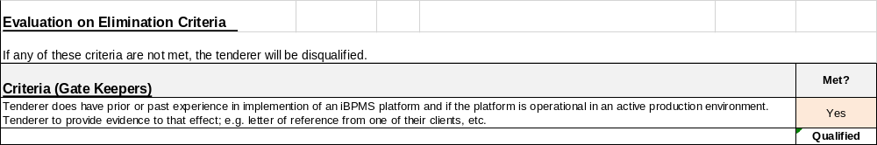
Gate Keepers and Evaluation criteria
Notes regarding Table Below
The total for the RFP (Paper Exercise) evaluation is 100%
The Demo will count 100%
Weighting for Final score: 50% of the RFP will be added to 50% of the demo to get the final score
Evaluation will take place in two stages, 1. Response evaluation, and 2. Product Demo evaluation. The responses will be evaluated and the threshold is 75%. Only the service providers who manage to score 75% and above will qualify to be invited to the second leg, i.e. Product demo of the proposed product, to be presented to Eskom.
Stage | Weighting |  | Total | RFP Total | Final Score RFP+Demo
Technical | Functional | 40% | 0.00% | 0.00%
 | Technial | 15% | 0.00% |  | 0.00%
 | integration and Testing | 25% | 0.00%
 | Cloud | 20% | 0.00%
DEMO |  | 100% | 0.00%

Slide 23
Evaluation Guideline
# | Response section | Important notes
1. | Part 1 – Functional | Three responses can be given, 1. FULLY compliant, 2. PARTIALLY compliant, or 3. NO compliance. Elaborate with more details / information, and preferably refer to the sections of your proposal in the comments column to support your responses.
2. | Part 1 – Technical evaluation
3. | Part 1 – Integration and Testing
4. | Part 1 – Cloud
5. | Part 2 – Demo | This tab gives an indication of what needs to be demonstrated if the vendor meets the Part 1 threshold of 75%.

Slide 24
High level Scope
Scope Item | Description and Deliverable
Software Licensing | Provision of the necessary software licenses with maintenance & support for a 5-year period
Cloud Requirements | Cloud infrastructure provisioning for QA, Pre-prod, Development, Production and DR. Service provider to ensure provisioning is done for QA, and other environments which will be needed for development, testing, training, and go-live as and when required. Eskom is going to continue with changes as and when needed by Business so the provisioning of these environments when required is important. The solution must be platform as a service that should operate in a hybrid IT environment. Service Provider to ensure that it secures the user’s or customer’s consent to process their personal information. Confirm how the solution will adhere to POPI Act so that Eskom and Eskom Customer will be protected. Confirm how Eskom data will be secured in line with POPIA and where will be stored . Eskom requires a confirmation letter that the cloud storage will be within the borders of South Africa or European Union.

Slide 25
High level Scope
Scope Item | Description and Deliverable
Solution Design | Provide BPA solution designs for approval by Group IT Architecture
Solution Capabilities | The BPA platform should at the minimum have the following capabilities: Process Modeling Capability of a BPA tool to enable enterprises to model their simple and complex business processes. The platform must have a capability to also accept processes built in other modeling toolsets. Process Orchestration Capability of a BPA tool to orchestrate a complex process comprising multiple stakeholders, including humans, applications, and machines. Decision Automation Capability of a BPA tool to define business rules, recommendations, or decision automation engines, which provide guidance for making human or automated operational decisions according to business directives or policy statements.

Slide 26
High level Scope
Scope Item | Description and Deliverable
Solution Capabilities | Integrations Capability of a BPA tool to integrate with the application landscape of the enterprise. The product is to be able to integrate via the Eskom Architectural approved Integration Bus, (using one of the approved patterns), during the interaction with other Eskom applications. Connectors for branded off-the-shelf applications, such as CRM, ERP, SAP etc., or customized connectors for in-house-built customized applications may also be considered in certain cases. Continuous Intelligence Continuous intelligence is a design pattern in which real-time analytics are integrated into a business operation, processing current and historical data to prescribe actions in response to business moments and other events. It provides decision automation or decision support. Collaboration and Task Management Capability of the BPA tool to enable process stakeholders to collaborate with other stakeholders in support of achieving the desired business outcomes. Collaboration between process stakeholders may be facilitated through a variety of methods, including content-specific events related to annotations, redactions, or creation; real-time chat; case or process instance documents; co-browse sessions; or integration with telephony and video chat services. The platform must have capability to use email notifications.

Slide 27
High level Scope
Scope Item | Description and Deliverable
Solution Capabilities | Document Handling Capability of a BPA tool to intelligently handle documents by reading, classifying and routing them to the stakeholders . The solution should also make provision to interact where required with an enterprise document management system (OpenText). Low-Code Workflow Automation Capability of a BPA tool to enable visual design of UI, process models and data models.
Development | Low Code – No Code. development of the existing solutions such as, Specification, ACNAC Replacement Project - Direct Customer Minor Functional Specification), and any additional change requests that might be implemented on the platform. Top 100 (R17640130 -Group IT Technical Specification - BiTop100) GENTLC (Workflow only) MBSA (Workflow only) SET (DEM-02945-X5B8) ACNAC (ACNAC Replacement Project - Direct Customer Major Functional BRSC_SET system changes_Signed), IRCAM (IRCAM GIT FRS 042022 Review-signed). eForm (URS_eForms Portal_Final_Signed, URS_eForms Portal_Final_Signed, and URS_R17322787_eForms Invariable Views_Signed). All current eForms.

Slide 28
High level Scope
Scope Item | Description and Deliverable
Configuration | Configure all required functional and non-functional settings in the solution to ensure optimal and secure operations
Data Take On/Migration | Data Migration is seen as part of the scope of the work and considering the complexity and volume of data to be migrated, enough time and resources should be allowed for the data migration. The data migration scope of work needs to address the following: Data Assessment to understand the existing data formats, structures and any potential data quality issues Data Mapping and Transformation Transfer data from the current systems to the new solution without loss or corruption. Ensure data accuracy, quality and consistency (i.e data integrity) during and after the migration process. Minimize downtime and business disruption during the migration. Validate and reconcile migrated data to confirm successful transfer.
Process Updates & Improvements | Updates to existing processes and integration with existing processes & systems (as required) to ensure the solution is robust, extensible and sustainable
Implementation | Implement the solution on all of the stated non-prod & production environments; Deployments into production as required (phased, agile)

Slide 29
High level Scope
Scope Item | Description and Deliverable
Integration | The Tenderer must provide technical resources to build, modify and implement all required interfaces. Refer to the logical design for systems that must integrate to the solution.
 | The Integration into the Eskom applications will be done within a phased approach. Integration scope and deliverables is listed below:
 | Analyse, design, develop, test, and deploy integration solutions based on the logical design. External interfaces to integrate using Oracle Fusion 12c and IBM WebSphere (Data Power), thus the vendor should be well skilled to work with the mentioned technologies. The Integration Centre of Excellence (ICOE) governance process must be followed for all approvals. Kindly reference “SOA Workgroup artefacts”. All diagrams and processes are to be captured in the Eskom Enterprise Architect (EA). All CIM message artefacts (including Mapping Document) to be placed in the Eskom defined CIM SVN. All code to be placed in Eskom defined Code SVN repository All artefacts to be placed in the Eskom share point.
 | Sparx Enterprise Architecture and Altova XMLSpy licences are to be provided by the Vendor for the staff that will be executing the formulation or updating of the Diagrams and Process during the Design
 | The following are the integration and Testing activities and artefacts to be produced and presented at the committee for approval and sign off:

Slide 30
High level Scope
Scope Item | Description and Deliverable
Integration (continue) | Business test case document. Integration specification document. Mapping Document. CIM message artefacts including WSDL’s and XSD’s. Code and unit testing review. Deployment Guide. SIT testing review of results in ALM. SIT test case sign-off. Performance testing review of results in ALM. Performance testing sign-off. Pre-transfer documents for go-live approval. Test requirements in ALM. Test cases and results in ALM. Defects managed in ALM. Test plan Document. Non-functional Test plan document. Test closure reports documents. Performance test scripts and results.
 | Provide an Integration message modeller to complete the following:
 | Analysis of message requirements. Model or update integration message which follow a Common information model. Create payloads and envelopes. Generate xsd, message model and model dictionary.

Slide 31
High level Scope
Scope Item | Description and Deliverable
Testing | A signed off test closure report is required before a test milestone is completed. The following testing and testing milestones must be completed:
 | Unit Testing – test results from the Tenderer’s team. System Integrated Testing, Functionality testing (in QA – end to end functional testing and integration testing. That means testing with other systems and ensuring that all requirements have been successfully configured). This testing must be driven & executed by the Vendor but must include Eskom staff for completeness & authenticity. Non-Functional Testing (performance testing and disaster recovery testing). This testing must be driven & executed by the Vendor but must include Eskom staff for completeness & authenticity. User Acceptance Testing (Testing by the Eskom customer team that the system is working and meets requirements). This testing must be driven by the Tenderer but must be executed by Eskom staff for completeness & authenticity.
 | All testing requirements must cover all identified interfaces that have been identified. The testing team must adhere to the TCoE Turnkey Project Requirements Guideline provided as part of the RFP document.

Slide 32
High level Scope
Scope Item | Description and Deliverable
Testing | Acquire the testing requirements, develop the test cases and conduct testing to ensure that the solution is comprehensively evaluated for implementation in the Eskom IT environment; Complete all testing milestones The testing staff may not be the same staff as the configuration, development and implementation staff assigned to the Project. The following testing milestones must be completed. Unit Testing – test results from the Vendor team System Integrated Testing (in QA – functional testing and integration testing. That means testing with other systems and ensuring that all requirements have been successfully configured). This testing must be driven & executed by the Vendor but must include Eskom staff for completeness & authenticity. Non-Functional Testing (performance testing and disaster recovery testing). This testing must be driven & executed by the Vendor but must include Eskom staff for completeness & authenticity. User Acceptance Testing (Testing by the Eskom customer team that the system is working and meets requirements). This testing must be driven by the Vendor but must be executed by Eskom staff for completeness & authenticity.

Slide 33
High level Scope
Scope Item | Description and Deliverable
Security | Refer to the “240-170007584 Rev 2 - Web Services Security Standard.pdf” Document. Authentication security capability for administration, support and management need to use MS AD (Chatbot)/ Azure. Employees can use same org credentials. Role based access mechanism should be adopted.
Human Change & Communication Management | Prepare all internal stakeholders and employees for the adoption of the new solution. Develop the change/communications management strategy & plan and share with key project stakeholders. Empower and capacitate the change champions & the divisional technical workgroups (change network) with adequate information to successfully drive alignment on the expectations of the project. Develop communication material (e.g roadmap; stakeholder engagement presentations; training communications; quick reference guides; go-live communications). Should include security awareness training on NIS stated under the Security Scope of work. Assess the effectiveness of the change/communications management strategy and respond to the issues being raised.
End User Training | End User Training at all levels as required. Classroom-based and/or web-based training is required. Refer BRS for full requirements.

Slide 34
High level Scope
Scope Item | Description and Deliverable
Eskom Support Staff Training | Support Staff Training. Knowledge transfer of assigned Eskom staff through all stages of the project lifecycle and using a defined skills transfer program. Classroom-based and/or web-based training is also required. Training must be for both Eskom Users and Eskom technical staff. At least two technical resources must be certified on a toolset
Stabilisation | A Pilot site will be established to ensure all bugs and errors are attended to as they arise. This will ensure most of the business scenarios can be experienced in real life. Once the solution is fully implemented in production a six-month stabilisation period is required by the Vendor. During this time Vendor must develop the monthly reports that will be submitted to Eskom reporting on the SLA metrics achieved
Support and Maintenance | Ensure SLA is concluded and includes all SLA metrics / requirements. SLA kicks in during the stabilisation period and thereafter. During this time Vendor must develop the monthly reports that will Monthly reporting of SLA metrics achieved. Contract will be drawn up with penalties for not meeting SLA metrics. SLA to be drawn up such that Eskom reserves the right to terminate the contract and/or apply penalties if service quality levels are repeatedly not met and if issues encountered induce long term service disruptions .

Slide 35
High level Scope
Scope Item | Description and Deliverable
Project Management Activities, Responsibilities & Deliverables as Stipulated. | Deliver project documentation required by the Eskom Group IT Product Delivery. This includes but is not limited to: Detailed integrated schedule for both Phase 1 (Core) and Phase 2 implementations. Regular update meetings to discuss project progress, address concerns, and ensure alignment with project goals. Weekly progress reports. Provide information required by Eskom team members to facilitate governance of the project and its deliverables. Integrate the current application support teams into the project delivery team. Deliverable Breakdown Structure indicating all fixed cost deliverables with the cost of each deliverable and the total cost of all deliverables. Payment milestones will be agreed with Vendor at contract time but will be based on completed signed off milestones only which are aligned to agreed baseline schedule (schedule submitted as part of Tender documents will be used as guideline). Payment schedule forecast and actuals tracking against the forecast. Delivery Acceptance Certificates with supporting documents. Project Management documents e.g project management plan, project close-out report.

Slide 36
High level Scope
Scope Item | Description and Deliverable
Change Control | Project change control refers to the changes in project scope, time, and cost. Changes will follow the process below: Changes must be approved by the requester, business owner, project manager, and project sponsor. Approved changes must be noted in steering committee minutes and scope document must be compiled and signed off. Depending on the scale of the change, other approvals external to the project may be required. Guidance in this regard will be provided by Eskom. Failure to carry out any of the following will not constitute a scope, time or cost change request. Failure to execute on an instruction that later creates a delay because the instruction was not adhered to Delays due to poor coordination and planning by the tenderer with internal and/or external Stakeholders. Delays due to poor communication by the tenderer with internal and/or external Stakeholders and/or through not involving the correct stakeholders from beginning of the project and/or not getting stakeholder buy in upfront & throughout. Delays due to the as-is analysis not being properly accomplished. Delays due to requirements not being understood and correctly implemented. Delays due to tenderer created rework (for example rework caused by poor quality reviews, and potentially creating a delay) Delays created by tenderer by not troubleshooting, not identifying root causes and not fixing. Delays due to non-availability of Eskom key staff as a result of poor tenderer planning. Delays due to rework because of poor quality or not delivering on all requirements. Delays to inadequate staffing or non-productive staffing by the tenderer Delays due to not having segregated development and testing teams.

Slide 37



APPENDIX

Slide 38
Contents
IBPM - Applications
Acquire Customer Network Asset Creation (ACNAC)
eForms / Top 100 KPI’s / Strategic Execution Tool (SET)
Industrial Relations Chairperson Allocation Management (IRCAM)
Generation Technical Life Cycle (GenTLC) (Workflow – ONLY)
Maintenance Basis Standardisation Application (MBSA) (Workflow – ONLY)

Slide 39
Contents
IBPM - Applications
Acquire Customer Network Asset Creation (ACNAC)
eForms / Top 100 KPI’s / Strategic Execution Tool (SET)
Industrial Relations Chairperson Allocation Management (IRCAM)
Generation Technical Life Cycle (GenTLC) (Workflow – ONLY)
Maintenance Basis Standardisation Application (MBSA) (Workflow – ONLY)

Slide 40
Acquire Customer Network Asset Creation (ACNAC)
Electrification process of customer requests
Landing portal
Input forms
Workflow approvals
Rules and conditions govern approvals
Dashboards and reports
Integration to other applications
Automatic creation of letters
Support → configurations and changes

Slide 41
Contents
IBPM - Applications
Acquire Customer Network Asset Creation (ACNAC)
eForms / Top 100 KPI’s / Strategic Execution Tool (SET)
Industrial Relations Chairperson Allocation Management (IRCAM)
Generation Technical Life Cycle (GenTLC) (Workflow – ONLY)
Maintenance Basis Standardisation Application (MBSA) (Workflow – ONLY)

Slide 42
eForms / TOP 100 KPIs / SET
Manual forms → Electronic forms
Landing portal
Electronic forms
Workflow approvals
Rules and conditions govern approvals
Reports
Integration to other applications
Automatic creation of letters
Support → configurations and changes

Slide 43
Contents
IBPM - Applications
Acquire Customer Network Asset Creation (ACNAC)
eForms / Top 100 KPI’s / Strategic Execution Tool (SET)
Industrial Relations Chairperson Allocation Management (IRCAM)
Generation Technical Life Cycle (GenTLC) (Workflow – ONLY)
Maintenance Basis Standardisation Application (MBSA) (Workflow – ONLY)

Slide 44
Industrial Relations Chairperson Allocation Management (IRCAM )
Landing portal
Input forms
Workflow approvals
Rules and conditions govern approvals
Reports
Integration to other applications
Support → configurations and changes

Slide 45
Contents
IBPM - Applications
Acquire Customer Network Asset Creation (ACNAC)
eForms / Top 100 KPI’s / Strategic Execution Tool (SET)
Industrial Relations Chairperson Allocation Management (IRCAM)
Generation Technical Life Cycle (GenTLC) (Workflow – ONLY)
Maintenance Basis Standardisation Application (MBSA) (Workflow – ONLY)

Slide 46
GenTLC & MBSA – Workflow ONLY
Workflow approvals
Rules and conditions govern approvals
Integration to other applications

Slide 47
Contents
Introduction
Commercial Process
SDL&I
Safety Requirements
Quality Requirements
SOW & Technical requirements
Pricing

Slide 48

Pricing
Refer to Annexure F

Slide 49

Questions

Slide 50
Thank You

