Slide 1


TENDER SUPPORT PACK
BLINDS
15 August 2025 - Rev F

Slide 2
CONTENTS
FITTINGS, AND EQUIPMENT SCHEDULE: BLINDS PAGE 3
PROPOSED LAYOUTS PAGE 4

Slide 3
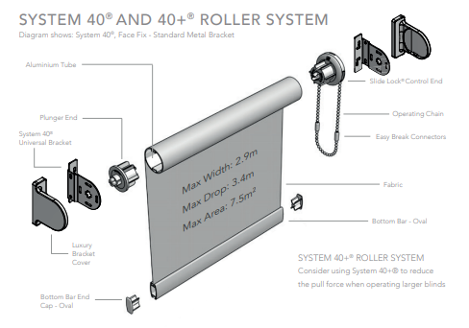
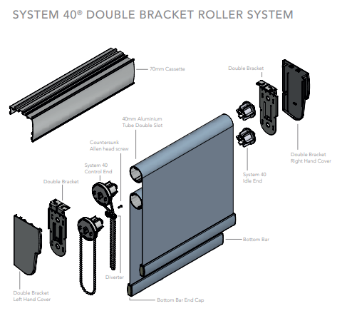
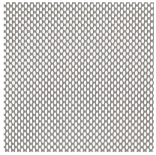
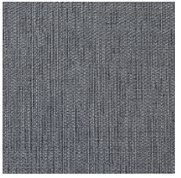
BLINDS SPECIFICATIONS
BLINDS LEGEND
CODE | REFERENCE IMAGE & DESCRIPTION
WT1 | THROUGHOUT SINGLE BRACKET SHEERWEAVE ROLLER BLIND GRADE: SUITABLE FOR COMMERCIAL USE BRACKET COLOUR: BLACK MECHANISM COLOUR: BLACK BOTTOM BAR COLOUR: BLACK CHAIN : STAINLESS STEEL WIDTH: TO BE MEASURED ON SITE TO ALIGN TO WINDOW SIZES MAX WIDTH: 3000mm MAX HEIGHT: 3000mm FABRIC: FABRIC TYPE: SCREEN SHEERWEAVE COLOUR: WHITE GREY FABRIC ORIENTATION: MULTI-DIRECTIONAL OPENESS FACTOR: 5% SCREENING UV RESISTANT TREATMENT: ~ 95% WEAVE: BASKETWEAVE 2X2 COMPOSITION: MINIMUM 25% POLYESTER, 75% Vinyl on Polyester FABRIC WEIGHT: MINUMUM 410GRAMS/M2 LEAD FREE NO PVC SMELL CLIENT TO CONFIRM SAMPLE BEFORE WORK COMMENCES. WARRANTY: 2 YEARS
BLINDS LEGEND
CODE | REFERENCE IMAGE & DESCRIPTION
WT2 | MEETING ROOMS, BOARDROOMS & TRAINING ROOM DOUBLE BRACKET ROLLER BLIND WITH SHEERWEAVE & BLOCKOUT BLIND GRADE: SUITABLE FOR COMMERCIAL USE BRACKET COLOUR: BLACK MECHANISM COLOUR: BLACK BOTTOM BAR COLOUR: BLACK CHAIN : STAINLESS STEEL WIDTH: TO BE MEASURED ON SITE TO ALIGN TO WINDOW SIZES MAX WIDTH: 3000mm MAX HEIGHT: 3000mm SHEERWEAVE FABRIC: TO MATCH WT1 BLOCK OUT FABRIC: FABRIC TYPE: BLOCKOUT SHEERWEAVE COLOUR: DARK GREY FABRIC ORIENTATION: MULTI-DIRECTIONAL UV RESISTANT TREATMENT COMPOSITION: 100% POLYESTER WITH ACRYLIC COATING PVC FREE | LEAD FREE NOMINAL WEIGHT: MINIMUM 431GSM NOMINAL THICKNESS: MINIMUM 0.65MM OPACITY: 100% BLACKOUT CLIENT TO CONFIRM SAMPLE BEFORE WORK COMMENCES. WARRANTY: 2 YEARS
NOTE: WINDOW TREATMENT QUANTITIES TO BE MEASURED ON SITE.

Slide 4
PROPOSED LAYOUTS
GROUND FLOOR
FIRST FLOOR
SECOND FLOOR

Slide 5
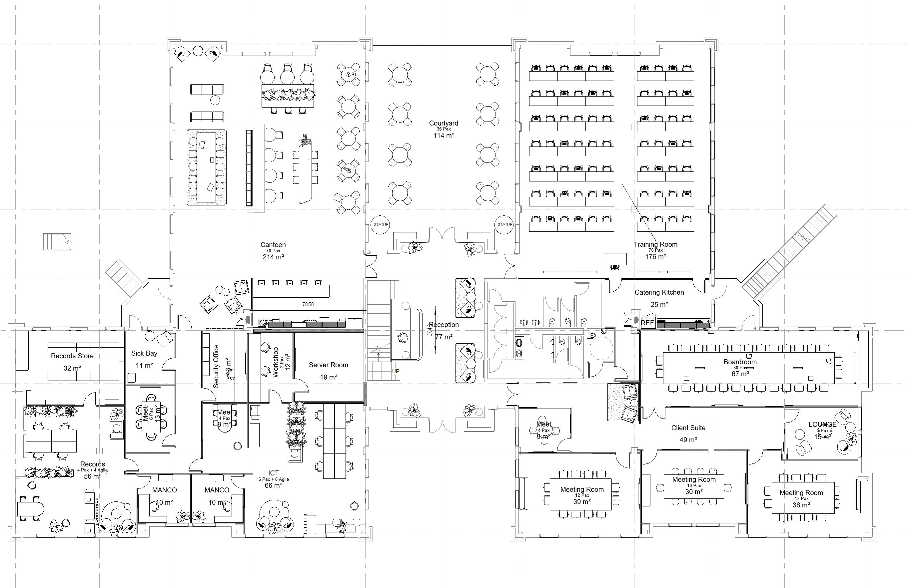
GROUND FLOOR
PROPOSED SPACE PLAN
WT 1
SHEERWEAVE
WT 2
SHEERWEAVE & BLOCKOUT COMBINATION

Slide 6
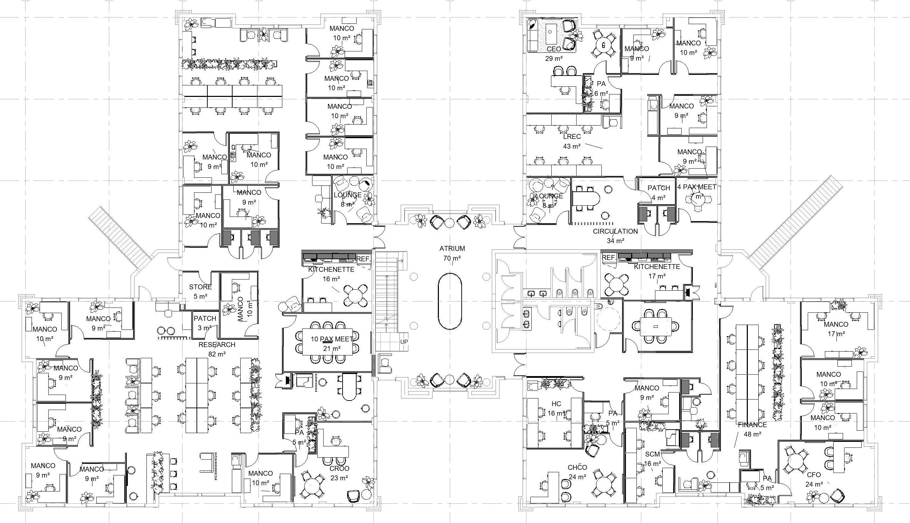
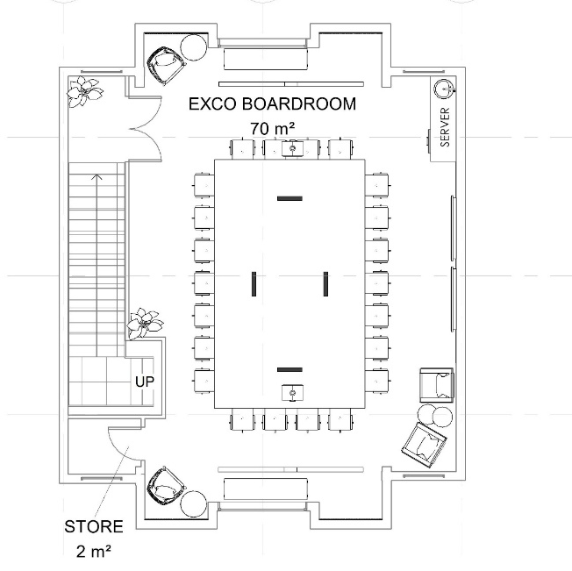
FIRST FLOOR
PROPOSED SPACE PLAN
WT 1
SHEERWEAVE
WT 2
SHEERWEAVE & BLOCKOUT COMBINATION

Slide 7

THANK YOU

