Slide 1
RFI NO: RFI/RBF/2023/1
RFI TITLE: Request for Information for Fiber links between Parliament and Sea Point

Slide 2
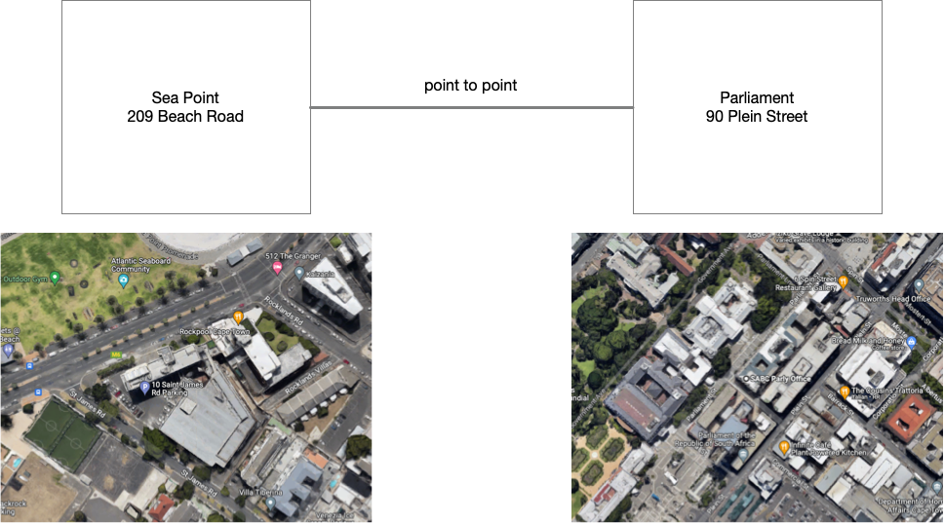
Locations

Slide 3
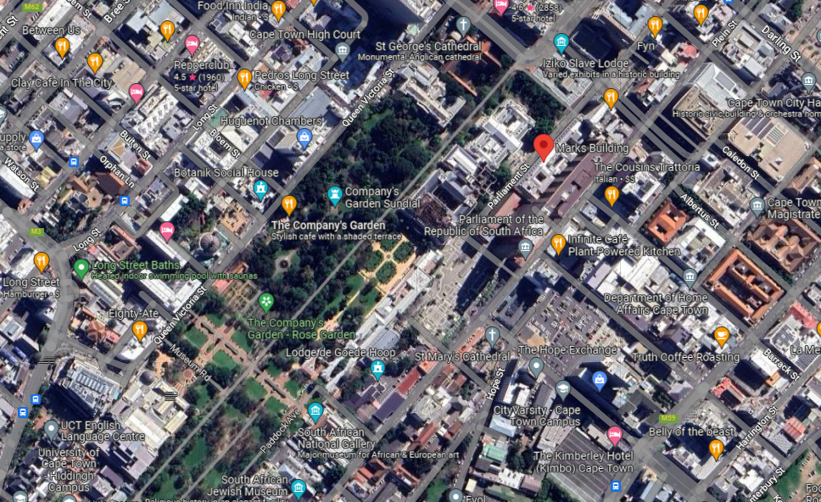

Slide 4
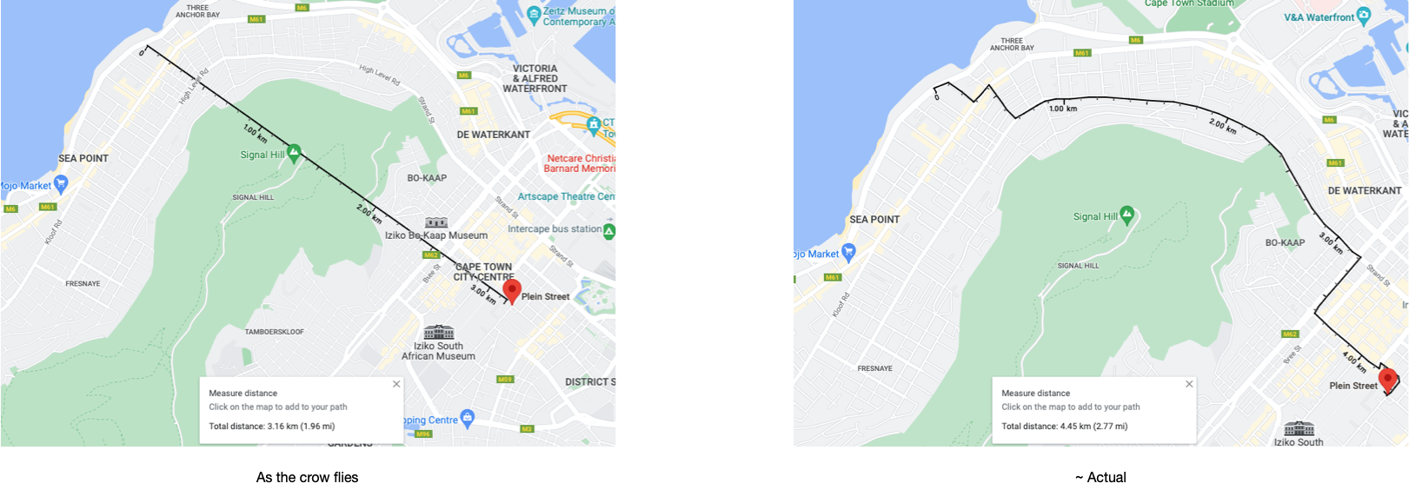
Distances

Slide 5
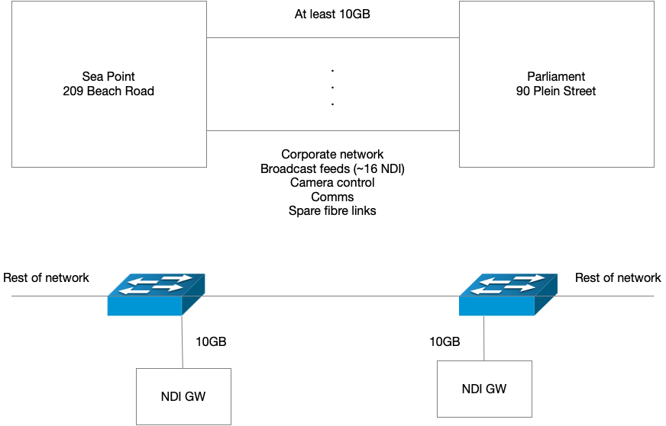
Requirements

