Slide 1
VIRTUAL BRIEFING SESSION
RFB 2493/2021
Procurement of a Contact Centre Telephony Solution for SITA with Maintenance and support for a period of 5 years.
Date: 30 November 2021
Presented by:
Part 1 (SCM Administrative Matters): SCM SITA
Part 2 (Technical Matters): SITA Line of Business

Slide 2

Part 1: Acquisition Administration and Compliance matters
Bid Identification
Evaluation Criteria
Submission of Bid Responses
Disqualification of bids
Bid Administration

Slide 3
BID identification
Bid No | RFB 2493/2021
Bid Title | Procurement of a Contact Centre Telephony Solution for SITA with Maintenance and support for a period of 5 years

Slide 4
Evaluation criteria
Evaluations will be based on the following:
NB: The bidder must qualify for each stage to be eligible to proceed to the next stage of the evaluation.
NOTE: ALL BIDDERS ARE REQUIRED TO REGISTER ON CENTRAL SUPPLIER DATABASE (CSD).
Stage | Description | Applicable for this bid
Stage 1 | Administrative pre-qualification verification | YES
Stage 2A | Technical Mandatory requirement evaluation | YES
Stage 2B | Functional Technical Requirements | YES
Stage 3 | Special Conditions of Contract verification | YES
Stage 4 | Price / B-BBEE evaluation | YES

Slide 5
Submission of bid responses
One (1) original file inclusive of everything
Two (2) hard copy inclusive of everything;
An electronic copy in USB in Portable Document Format (PDF).

Slide 6
Disqualification of bids
Bidders shall be disqualified if they fail to:
  Complete questionnaires in full,
  Submit true and correct information,
  Comply with all mandatory requirements, and
  Comply with prescribed response format.
Bidders must ensure that TCC is valid as per CSD report when submitting bid responses (grace period of 7 days). Failure to comply with mandatory documents shall lead to disqualification

Slide 7
BID administration
CLOSING DATE FOR QUESTIONS / QUERIES | 08 December 2021 Submitted to: Shalati.mabunda@sita.co.za and Bidsadverts@sita.co.za
RFB CLOSING DETAILS | DATE: 15 December 2021 TIME: 11:00 (SOUTH AFRICAN TIME) PLACE: TENDER OFFICE, PONGOLA IN APOLLO, 459 TSITSA STREET, ERASMUSKLOOF, PRETORIA (HEAD OFFICE)
PUBLIC OPENING OF RFB RESPONSES | Not Applicable due to Covid-19
RFB VALIDITY PERIOD | 120 DAYS FROM THE CLOSING DATE
Bid responses sent by post or courier must reach the tender office at least 36 (thirty six) hours before the closing date to be deposited into the bid box.
Late bids will not be considered

Slide 8
Account Details:
Standard Bank
Account Name: SITA (Pty) Ltd
Account Number: 410298158
Branch number: 012645
Branch Name: Centurion
Ref: Relevant tender/RFB number.
International: Bank Sort Code ZA 012645
Swift Code SBZAZAJJ
www.sita.co.za

Slide 9
UPDATED RFB DOCUMENT
Banking details is applicable only should you wish to buy the documents.
Tender documents can be downloaded on the website.
Kindly check the documents on www.etenders.gov.za and www.sita.co.za .

Slide 10
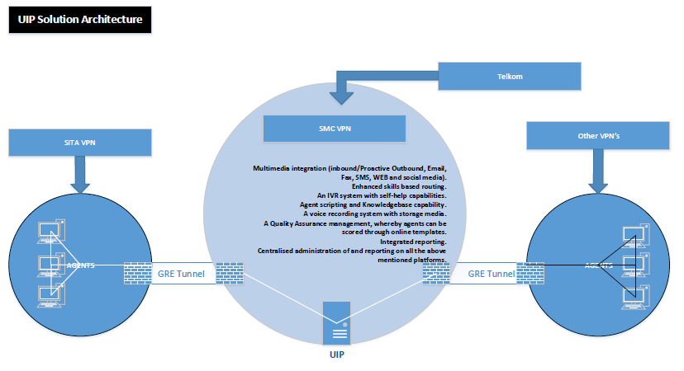
Solution architecture

Slide 11
Multimedia integration (inbound/Proactive Outbound, Email, SMS, WEB and social media)
Enhanced skills-based routing
IVR system with self-help capabilities
Agent scripting and Knowledgebase capability
A voice recording system with storage media
Quality Assurance management, whereby agents can be scored through online templates
Centralised administration of, and reporting on all the above mentioned platforms, Integrated reporting
Workforce Scheduling
Work from home capability
Hardware
Training

Slide 12
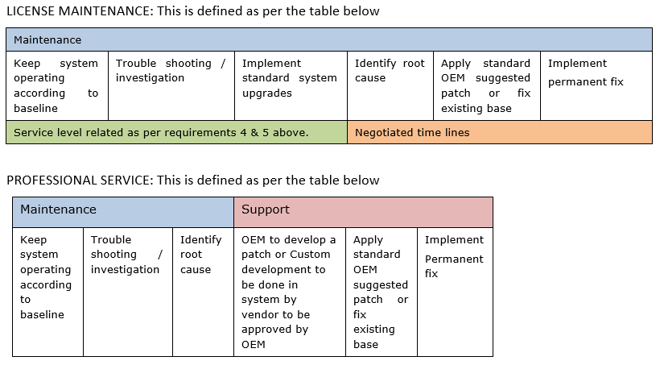
Maintenance VS professional services

Slide 13
Thank You
Questions?

