Slide 1
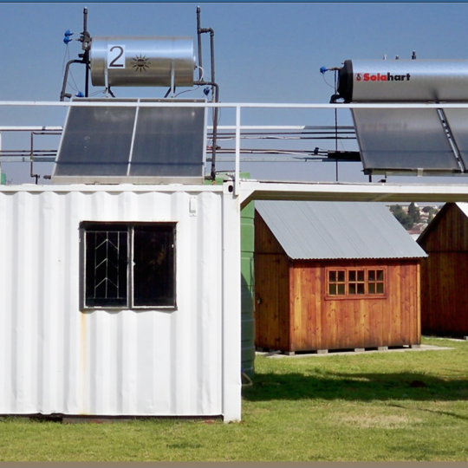
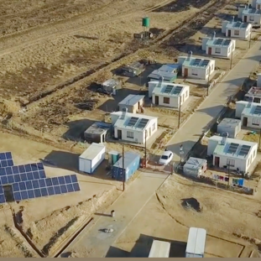
Enquiry no. MWP2120TX
Technical CLARIFICATION SESSION
The manufacture, testing, supply, shipping and installation of various quantities of capacitor voltage transformers.
Sibongile Maphosa
23 August 2023

Slide 2
Contents
List of items
Technical Documents
Technical Evaluation Standard
Desktop Evaluation
Factory Evaluation
Submission Documents
General

Slide 3
List of Items
Item | Short Description | Rated Capacitance | SAP Number
Item 1 | CVT 66kV/110V 1P1M 100/50VA (3P/0.2) 31mm/kV | 10000 | 9015
Item 2 | CVT 88kV/110V 1P1M 100/50VA (3P/0.2) 31mm/kV | 9000 | 9017
Item 3 | CVT 132kV/110V 1P1M 100/50VA (3P/0.2) 31mm/kV | 8000 | 637042
Item 4 | CVT 220kV/110V 2P1M 150/50VA (3P/0.2) 31mm/kV | 7000 | 4282
Item 5 | CVT 275kV/110V 2P1M 150/50VA (3P/0.2) 31mm/kV | 6000 | 8546
Item 6 | CVT 400kV/110V 2P1M 150/50VA (3P/0.2) 31mm/kV | 4400 | 8544
Item 7 | CVT 765kV/110V 2P1M 150/50VA (3P/0.2) 31mm/kV | 4400 | 637043

Slide 4
Technical Documents
240-56030645 – Eskom Standard for Capacitor Voltage Transformers
240-146088685 – Eskom Standard for Coupling Capacitors used for Powerline Carrier Applications
IEC 61869-1: Instrument Transformers – Part 1: General
IEC 61869-3: Additional requirements for inductive voltage transformers
IEC 61869-5: Instrument Transformers – Part 2: Additional requirements for current transformers
240-170000783 – Technical Evaluation Standard for Capacitor Voltage Transformers
Over and above the standards, there are technical schedules for all CVTs which must to be completed.

Slide 5
Technical Evaluation Standard
The standard (170000783) is based on Eskom Procurement and Supply Management Procedure (32-1034).
It has two main parts i.e., the desktop and factory evaluations. The following documents are required to execute the desktop evaluation:
  Completed technical schedule and deviation schedule (in case of deviations)
  Outline drawing of CVT
  Outline drawing of post insulator used for the CVD
  User manual (packaging, transportation, installation, storage & maintenance)
  Test reports
Bidders who are currently supplying CVTs to Eskom or were awarded the previous contract and have not changed their product and manufacturing plant shall be exempted from technical evaluation but must submit all required technical documents (Arteche, GE & Hitachi Energy).
NB: Documents must be written in English and units be in SI unit system (dimensions preferably in mm).

Slide 6
Desktop Evaluation
The evaluation will be based on documents submitted and will carry a score of 100 percentage points (see breakdown).
Important Scoring aspects to note
  Technical Schedule - Non-compliance to one or more key technical requirements listed in page 5 of (240-170000783) carries a 35 points penalty.
  Test reports will be rationalized to give a score of 50 points
  The minimum threshold required to pass desktop evaluation is 70%.
Document Type | Score / Weight
Completed Technical Schedule | 35
Instrument Transformer Outline drawing | 5
Insulator drawing | 5
User Manual | 5
Test Reports | 50

Slide 7
Factory Evaluation
Factory evaluation will be done post contact award and Eskom reserves the right to waive the evaluation where the factory was evaluated previously.
Factory evaluation is based on two parts namely, factory Assessment and practical assessment.
Factory assessment is done using the “Quality and Work practices assessment checklist” (Annexure B of 240-170000783).
The checklist has 35 points and compliance to each point gives a supplier one point and non-compliance is zero point.
At the end of the exercise the points will be tallied and divided by 35 to give percentage points.
The practical assessment is based on routine tests of a sample CVT, and it must pass all routine tests.
The minimum threshold required to pass the factory evaluation is a 70% score for factory assessment and a successful practical assessment.

Slide 8
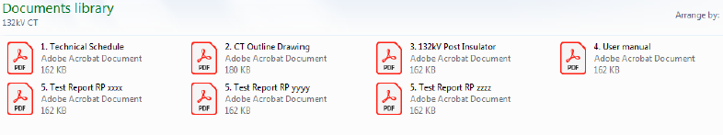
Submission Documents
We request suppliers to do the following in order to make the evaluation process easy:
  Suppliers must please ensure that the electronic documents and hardcopies are exactly the same. NB: technical team prefers to use electronic copies for evaluation.
  Technical schedules to be completed and saved in PDF format.
  Test report numbers to be written next to tests required in the technical schedule.
  Supplier must use folders to divide electronic documents see e.g. below.

Slide 9
General
Suppliers are encouraged to pose questions if they require clarity.
All communication and questions based on this tender must be sent through the cross-functional team leader (Musiiwa Gidi)
We will compile a spreadsheet with questions and answers as they are posed.
These will be published / circulated to all suppliers in order to avoid repeating same questions.

Slide 10
Thank you

