Slide 1

NON COMPULSORY RFP BRIEFING:
TNPA/2026/03/0528/3062/RFP
PROVISION OF WATER QUALITY SAMPLING SERVICES AT VARIOUS LOCATIONS WITHIN THE PORT OF DURBAN ON AN “AS AND WHEN REQUIRED” BASIS FOR A PERIOD OF SIXTY (60) MONTHS
DATE: 07 SEPTEMBER 2026
TIME: 10H00
PRESENTED BY: NOZIPHO KHUMALO
Notes:
Growth and Reinvent

Slide 2
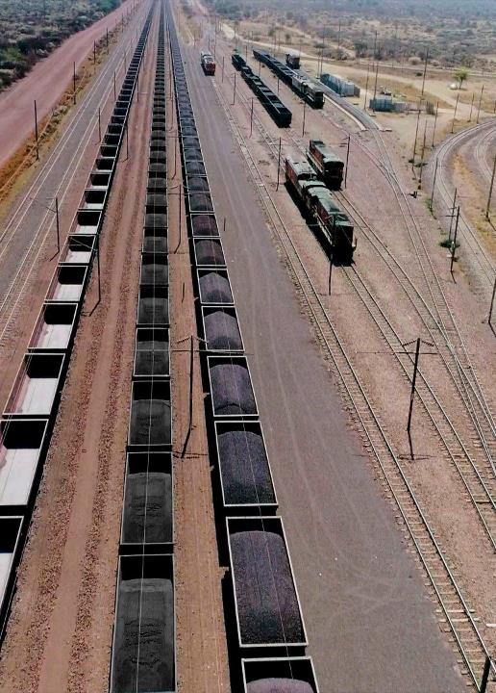
Contents
Agenda
01 | Welcome and Introduction | Nozipho Khumalo
02 | Safety Briefing and Evacuation Procedure
03 | Project background and Overview | Nomonde Ngcongo
04 | Session rules of engagement | Nozipho Khumalo
05 | Procurement process | Nozipho Khumalo
06 | TPPP Specific Goals | Siseko Gwazela
07 | Scope of Work and Pricing schedule | Nomonde Ngcongo
08 | Questions and Answers session
2

Slide 3
Project Background- Nomonde Ngcongo

Slide 4
PROJECT BACKGROUND
The Port of Durban currently receives its potable water supply from the eThekwini Municipality. However, due to the Port's operational activities and exposure to various environmental conditions, there is a need to periodically assess the quality of water supplied and distributed within the Port precinct. Drinking water quality testing is therefore required to determine whether the water complies with applicable health, safety, and regulatory standards.
In addition to supporting Port operations, the Port of Durban supplies freshwater to berthed vessels for use by crew members and passengers. Vessel operators and shipping agents frequently request water quality information and certification to verify that the supplied water is safe for drinking and domestic use onboard.
Regular testing and monitoring will provide assurance that the water meets required potable water standards, identify any potential contamination risks, and demonstrate compliance with health and safety requirements. The results of the water quality assessment will enable the Port to maintain confidence in the potable water supplied to employees, contractors, visitors, vessels, and ensure that freshwater supplied remains fit for human consumption.

Slide 5
RULES OF ENGAGEMENT
This briefing session is non-compulsory, despite the briefing session being non-compulsory, Transnet nevertheless encourages all Respondents to attend. Transnet will not be held responsible if any Respondent who did not attend the non-compulsory session subsequently feels disadvantaged as a result thereof.
Bidders are requested to remain online for the entire duration of the briefing session as important information pertaining to the RFP will be presented. An approximate time allocation is +- 1 hour.
The minutes of the meeting will be shared with those that attended the meeting and will be uploaded onto the Transnet e-Supplier portal and National Treasury’s e-Tender Portal .

Slide 6
RULES OF ENGAGEMENT
The cut-off date for any additional clarification questions in writing will be before 12h00 on 18 September 2026.
The Procurement Lead will provide written response to all additional questions received in writing. Written response/s will be provided as a consolidated response of all question/s received will be re-distributed again to all those prospective Bidders that attended this briefing meeting.
Bidders may communicate using TNPAtenderenquiriesdbn@transnet.net on any clarifications relating to this RFP. A copy of this presentation will be uploaded onto the Transnet e-tender portal.
The closing date for this RFP is 29 September 2026 at 14h00 ( The tender closes at the Transnet eSupplier website/Portal (https://esupplierportal.transnet.net/portal/ )

Slide 7
Commercial- Nozipho Khumalo

Slide 8
EVALUATION METHODOLOGY:
Stage 1 Step 1: Test for Administrative and Substantive Responsiveness:
Whether the Bid has been lodged on time
Whether all Returnable Documents and/or schedules were completed and returned by the closing date and time
Verify the validity of all returnable documents
Whether the Bid contains a priced offer and all items listed in the pricing schedule have been fully priced.
Whether the Bid materially complies with the scope and/or specification given
Whether any Technical Pre-qualification Criteria/minimum requirements/legal requirements have been met as follows:
Valid certificate of Accreditation from SANAS for the laboratory for chemical analysis in accordance with ISO/IEC 17025
The test for responsiveness [Step One] must be passed for a Respondent’s Proposal to progress to Step Two for further evaluation

Slide 9
TPPP Specific Goals
Siseko Gwazela

Slide 10
The following preference points were allocated to selected specific goals in accordance with provision 5.7.14 of the TPPP policy
STAGE 2: STEP 2 – PRICE AND SPECIFIC GOALS
Specific Goals | Number of points (80/20 system | Number of points (90/10 system
B-BBEE Status Level of Contributor 1 or 2 | 5 | 3
EME or QSE 51% Black Owned | 15 | 7
Non-compliant and/or B-BBEE Level 3-8 contributors | 0 | 0

Slide 11
EVIDENCE REQUIRED FOR CLAIMING SPECIFIC GOALS
In terms of Transnet Preferential Procurement Policy (TPPP) and Procurement Manuals, preference points must be awarded to a bidder for providing evidence in accordance with the table below:
Specific Goals | Acceptable Evidence
B-BBEE Status Level of Contributor 1 or 2 | B-BBEE Certificate / Sworn- Affidavit / B-BBEE CIPC Certificate (in case of JV, a consolidated scorecard will be accepted) as per DTIC guideline
EME or QSE 51% Black Owned Entities | B-BBEE Certificate / Sworn- Affidavit / B-BBEE CIPC Certificate (in case of JV, a consolidated scorecard will be accepted) as per DTIC guideline
Should the evidence required for any of the Specific Goals applicable in this tender not to be provided, a tenderer will score zero (0) preference points for that particular “Specific Goal”

Slide 12
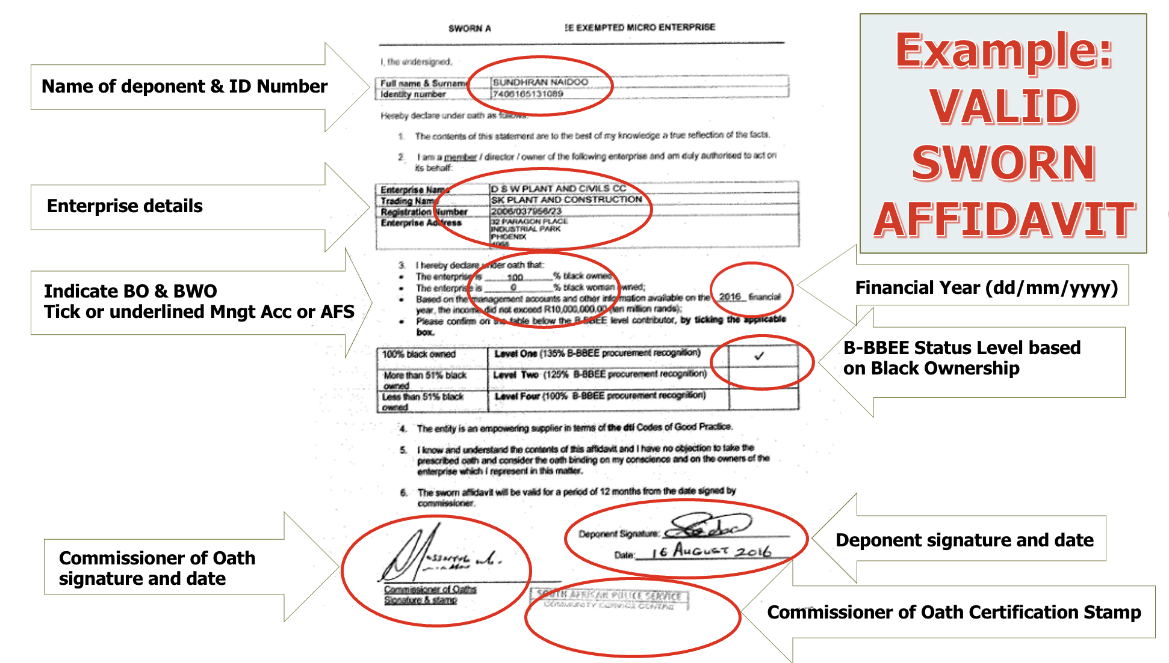
VALID B-BBEE SWORN AFFIDAVIT

Slide 13
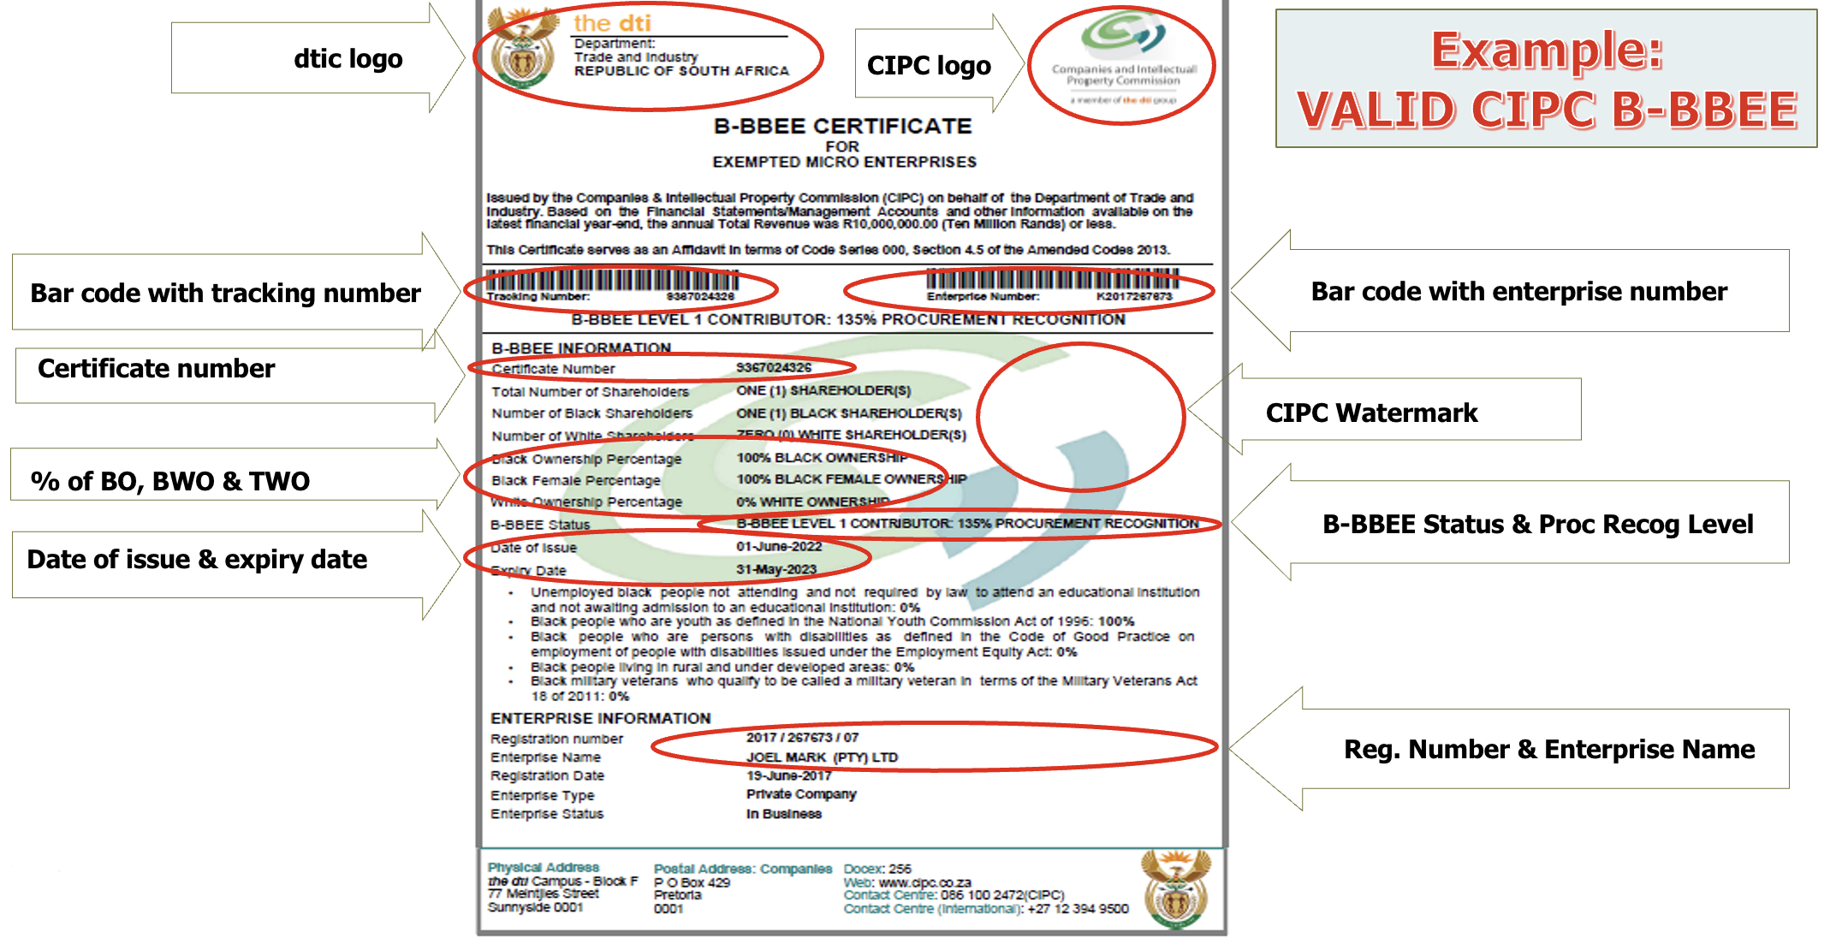
VALID CIPC B-BBEE CERTIFICATE

Slide 14
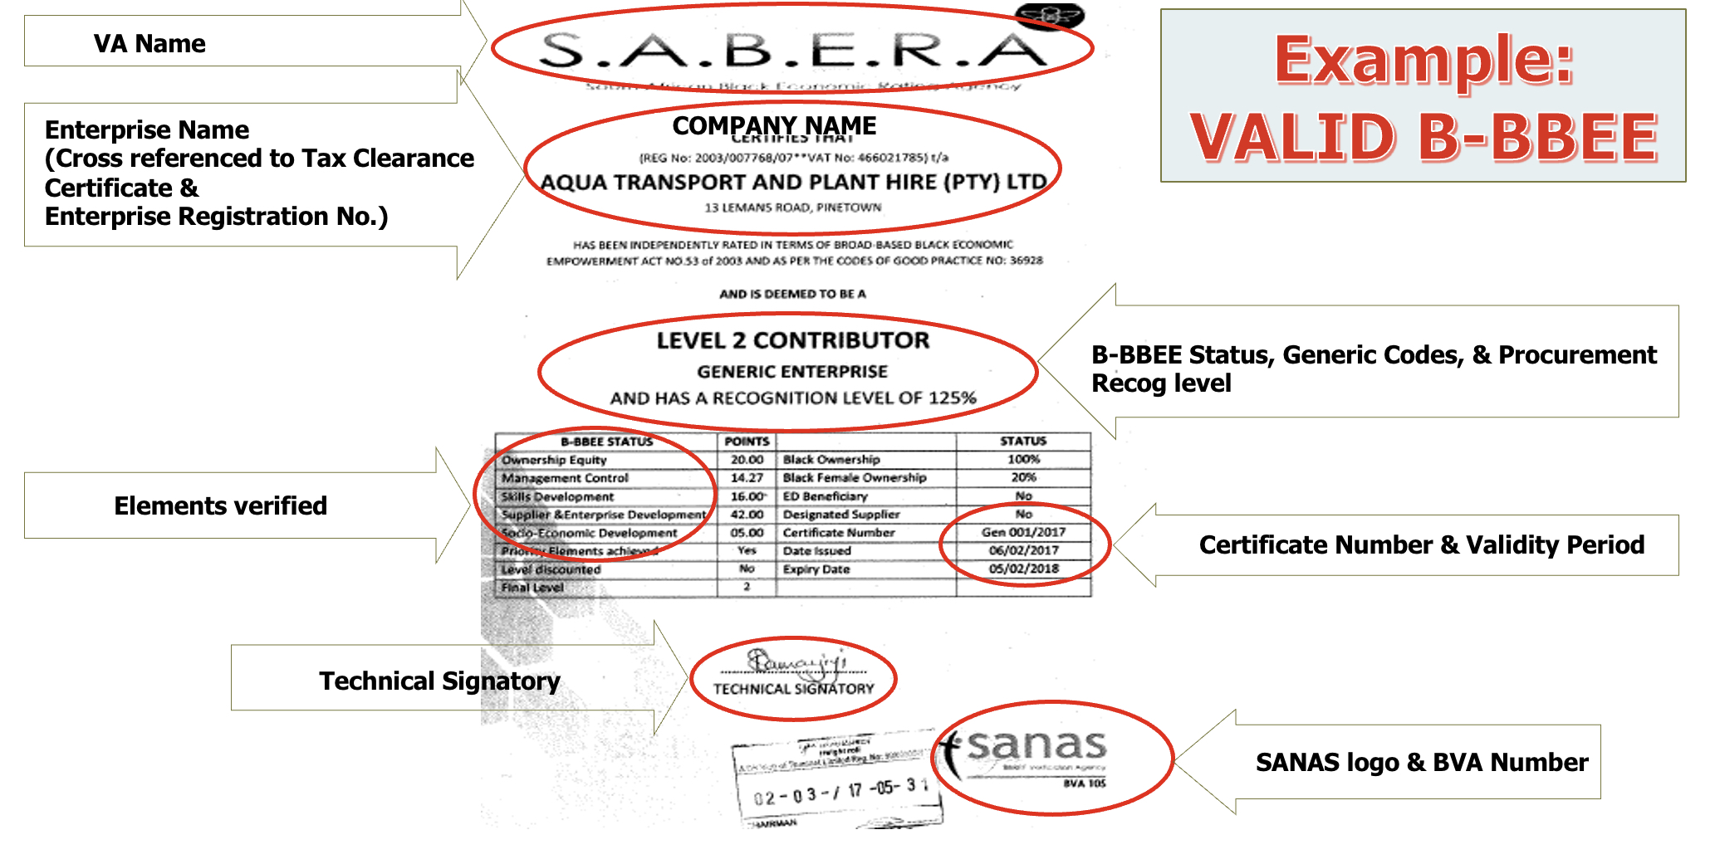
VALID B-BBEE CERTIFICATE

Slide 15
KEY POINTERS DETERMINING THE VALIDITY OF A SWORN AFFIDAVIT (continued)
Name/s of deponent as they appear in the identity document and the identity number.
Designation of the deponent as either the director, owner or member must be indicated in order to know that person is duly authorized to depose of an affidavit.
Name of enterprise as per enterprise registration documents issued by the CIPC, where applicable, and enterprise business address.
Percentage of black ownership, black female ownership and designated group.
Indicate total revenue for the year under review and whether it is based on audited financial statements or management account.
Financial year end as per the enterprise’s registration documents, which was used to determine the total revenue.
B-BBEE Status level. An enterprise can only have one status level.

Slide 16
KEY POINTERS DETERMINING THE VALIDITY OF A SWORN AFFIDAVIT (continued)
Empowering supplier status must be indicated. For QSEs, the deponent must select the basis for the empowering supplier status.
Date deponent signed and date of Commissioner of Oath must be the same.
Commissioner of Oath cannot be an employee or ex officio of the enterprise because, a person cannot by law, commission a sworn affidavit in which they have an interest.
Valid B-BBEE certificate from SANAS accredited verification agency, CIPC B-BBEE certificate or BBBEE sworn affidavit complying with the following requirements.
In case of Joint Ventures, a Venture Agreement SANAS approved B-BBEE certificate must be submitted. The individual company sworn Affidavits/certificates will not be considered for JV’s.
Letters from the verification agency stating that the bidder is on the process of being verified will not be acceptable.
The B-BBEE certificate/affidavit must be submitted on the date and time of closing of tender.

Slide 17
STEP 3: FINANCIAL EVALUATION
The Finance and team shall conduct financial and price evaluation to check the following:
  Financial stability of the bidder
  If the bid price is market related or falls within the budget
  The pricing activities to be checked for any discrepancies and/or arithmetical errors.
  Price negotiation if applicable. (eg Market Related Price negotiation or Best And Final Offer)

Slide 18
SUBMISSION OF DOCUMENTS
Bidders must submit all mandatory returnable document and supporting documents.
Bidders must complete electronic pricing schedule.
Bidders must submit a tendered price which is fixed and firm for the duration of 180 business days from closing date.
In case of a Joint Venture [JV] Bidders must submit a signed JV or agreement between the parties clearly stating the percentage [%] split of business and the associated responsibilities of each party and consolidated JV B-BEEE certificate.

Slide 19
TENDER SUBMISSION
TENDER SUBMISSION Transnet has implemented a new electronic tender submission system, the e-Tender Submission Portal, in line with the overall Transnet digitalization strategy where suppliers can view advertised tenders, register their information, log their intent to respond to bids and upload their bid proposals/responses on to the system.
The Transnet Digital Procurement System (TDPS) Supplier Submission Portal can be accessed as follows:
a) Log on to the Transnet eSupplier website/Portal (https://esupplierportal.transnet.net/portal/)
b) Click on “SIGN IN/REGISTER –to register new bidder information and ensure that all (must fill in all mandatory information is completed) OR;
- to sign in if already registered;
c) Click on “ADVERTISED TENDERS” to view advertised tenders;
d) Toggle (click to switch) the “Log an Intent” button in order to be able to activate the submission of a bid;
e) Respondents are to submit bid documents by uploading them onto the system against each tender selected. A Bidder can upload 30mb per upload and multiple uploads are permitted

Slide 20
TENDER SUBMISSION
f) Bidders to note that all pricing must be completed in the eSupplier portal, electronic pricing. No paper pricing schedule should be accepted.
g) Bidders should ensure that electronic bid submissions are submitted at least a day before the closing date and bidders should not wait for the last hour before the deadline to submit. This is to enable them to timeously address issues which they may encounter due to internet speed, bandwidth or the size of the number of uploads being submitted. Transnet will not be held liable for any challenges experienced by bidders as a result of their own technical challenges.
h) No late submissions will be accepted.
i) Each company must register its own profile using its company details and use the corresponding registered profile to log an intent to bid as well as submitting any bid.

Slide 21
TENDER SUBMISSION
j) Transnet will not accept a bid or will disqualify a bidder who submits a bid in the Transnet e-supplier portal submission through another bidders’/Company’s profile. In other words, each bidder must register the intent to bid and submit its bid through its own profile under the same company name that will eventually bid for the tender. No company shall submit a bid on behalf of another company regardless of the company being a subsidiary or holding company.
k) In case of a Joint Venture, any of the parties/companies to the Joint Venture may use its registered profile to submit a bid on behalf of the Joint Venture.
L) A detailed bidder guide can be found on the Transnet Portal transnetetenders.azurewebsites.net

Slide 22
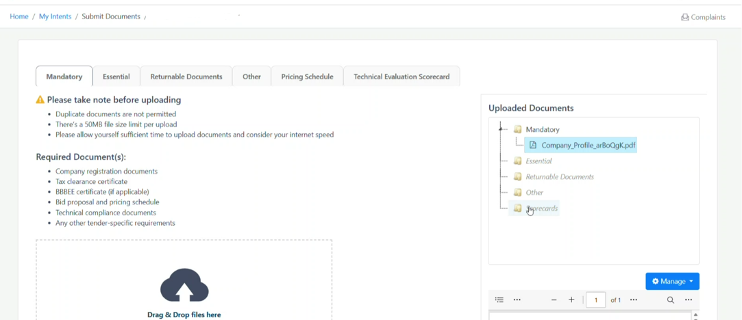
TENDER SUBMISSION

Slide 23
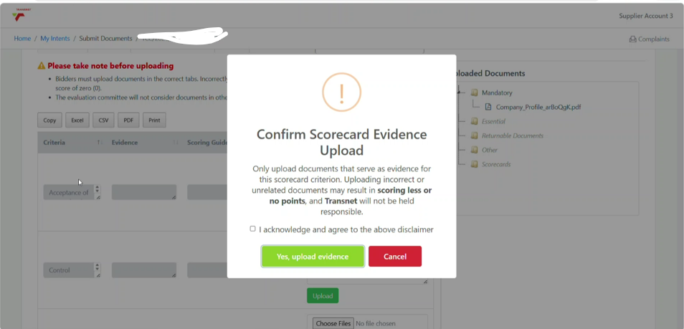
TENDER SUBMISSION

Slide 24
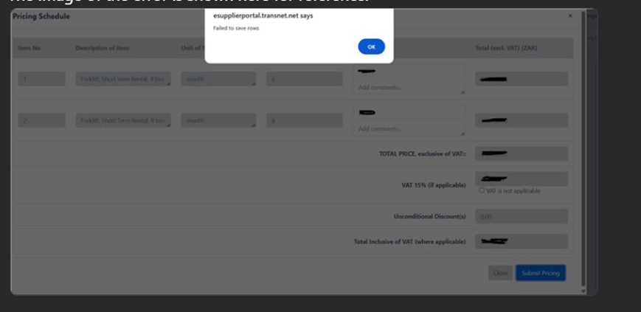
Common issue that may be experienced by suppliers
Since the TDPS system was recently updated, service provider users would need to do a hard refresh on their web browser.
To do so, please hold Ctrl and Shift keys and press R on the keyboard.
To do so, please hold Ctrl and Shift keys and press R on the keyboard.

Slide 25
CLOSING DATE AND TIME
Closing date: 29 SEPTEMBER 2026
Closing time: 14H00
Location: Transnet Digital Procurement System : (https://esupplierportal.transnet.net/portal/)
NB: No alternative platform for submission!!!

Slide 26
Scope of Work and BOQ
Nomonde Ngcongo

Slide 27

QUESTIONS AND ANSWERS SESSION:

Slide 28
Thank you

