Slide 1
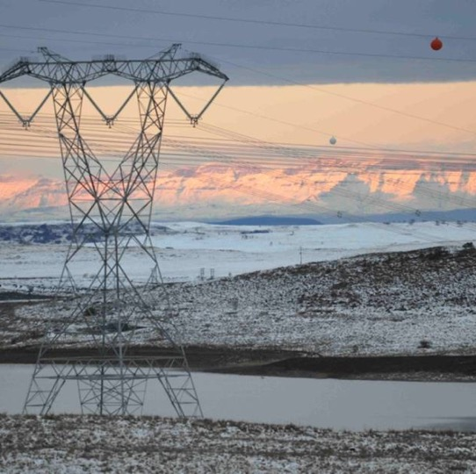
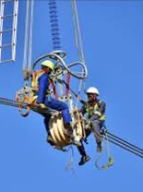
Power Line carriers Equipment
Presented by: Hlekani Motjiyeng
10 September 2026

Slide 2
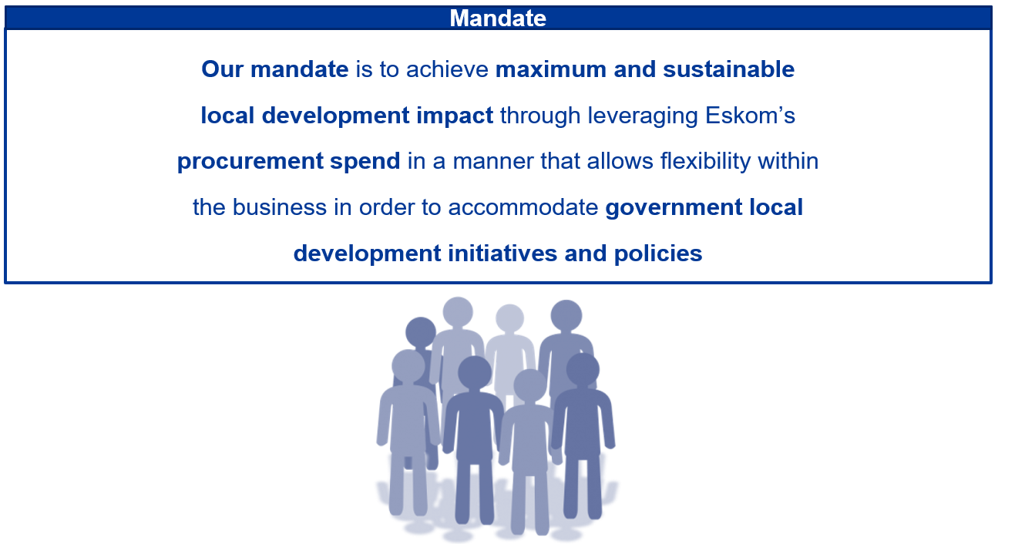
Eskom Supplier Development and Localisation Mandate

Slide 3
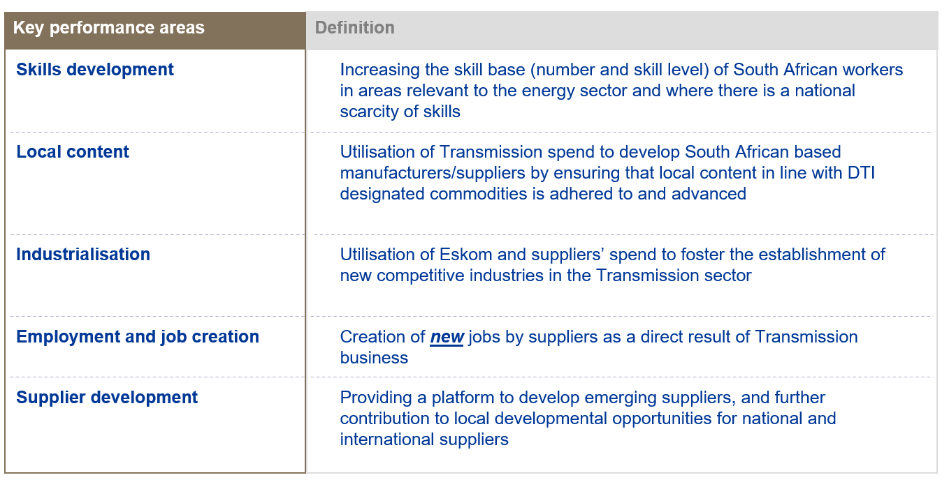
SD&L measures impact along 5 key performance areas
S

Slide 4
Designated secto-DTIc
Commodity | Components | Local Content Threshold
Steel | Steel Products and Component for Construction | 100%

Slide 5
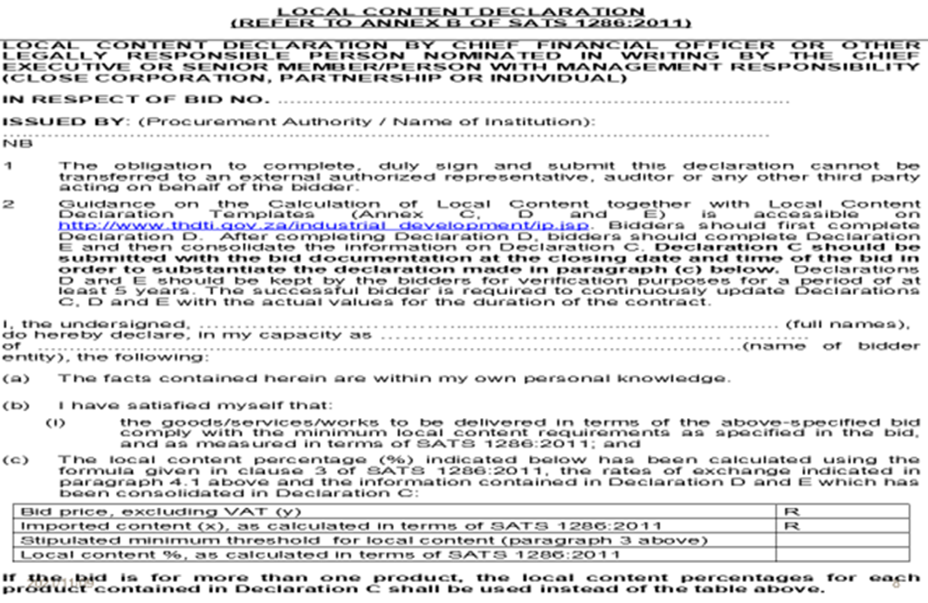
SBD6.2

Slide 6
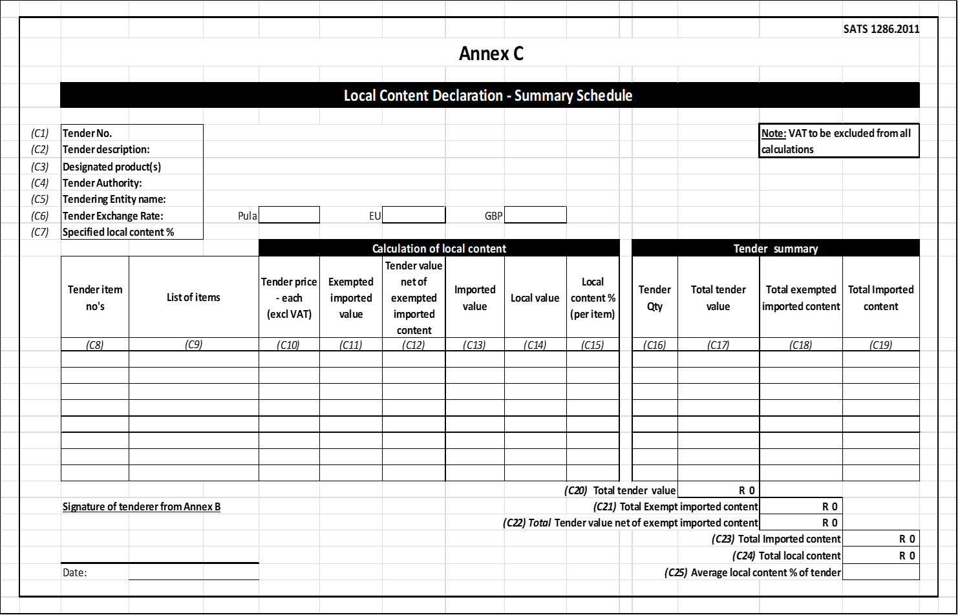
Annexure C

Slide 7
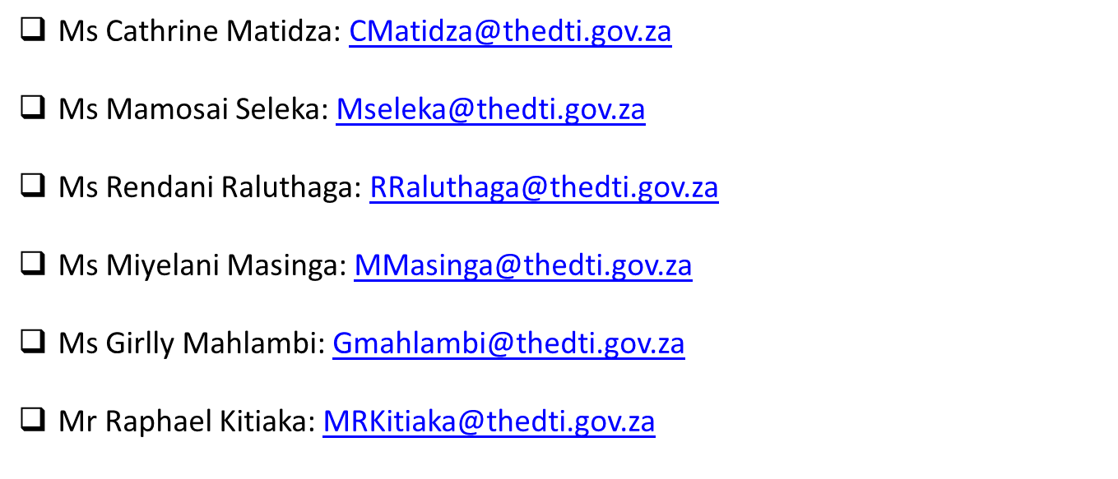
Local Content Enquiries: Bidding Documents, Calculations & Annexures

Slide 8
Evaluation criteria
The 80:20 or 90:10 rule will apply in this project:
B-BBEE = 20 or 10
Price = 80 or 90

Slide 9
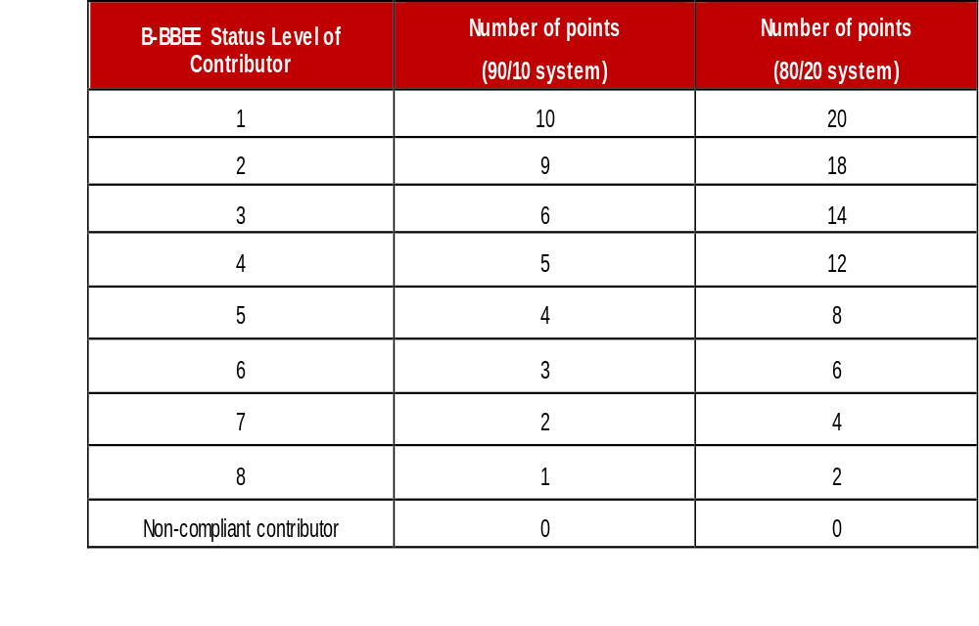
Preference Points B-BBEE

Slide 10
B-BBEE requirements
The certificate must be valid.
Verification Agency must be SANAS accredited.
There should be a logo of SANAS on the certificate.
QSEs and EMEs – Sworn affidavit is acceptable

Slide 11

Sub - contracting
Subcontracting
Mandatory subcontracting on contracts above R30 million as a condition for contract award
If feasible to subcontract for a contract above R30 million, Eskom:
a) must apply subcontracting to previously designated groups.
b) must advertise the tender with a specific condition for contract award that the successful
tenderer must subcontract a minimum of 30% of the value of the contract to:
An EME or QSE which is at least 51% owned by black people.
An EME or QSE which is at least 51% owned by black people who are youth.
An EME or QSE which is at least 51% owned by black people who are women.
An EME or QSE which is at least 51% owned by black people with Disabilities.
An EME or QSE which is 51% owned by black people living in rural or underdeveloped areas or townships.
A cooperative which is at least 51% owned by black people.
An EME or QSE which is at least 51% owned by black people who are military veterans;
Tender Returnable if the above element is a requirement;
Proof of a sub-contract agreement/s must be submitted.
CSD report of subcontractors
Sub-contractor/s B-BBEE certificate / sworn affidavit must be submitted.

Slide 12
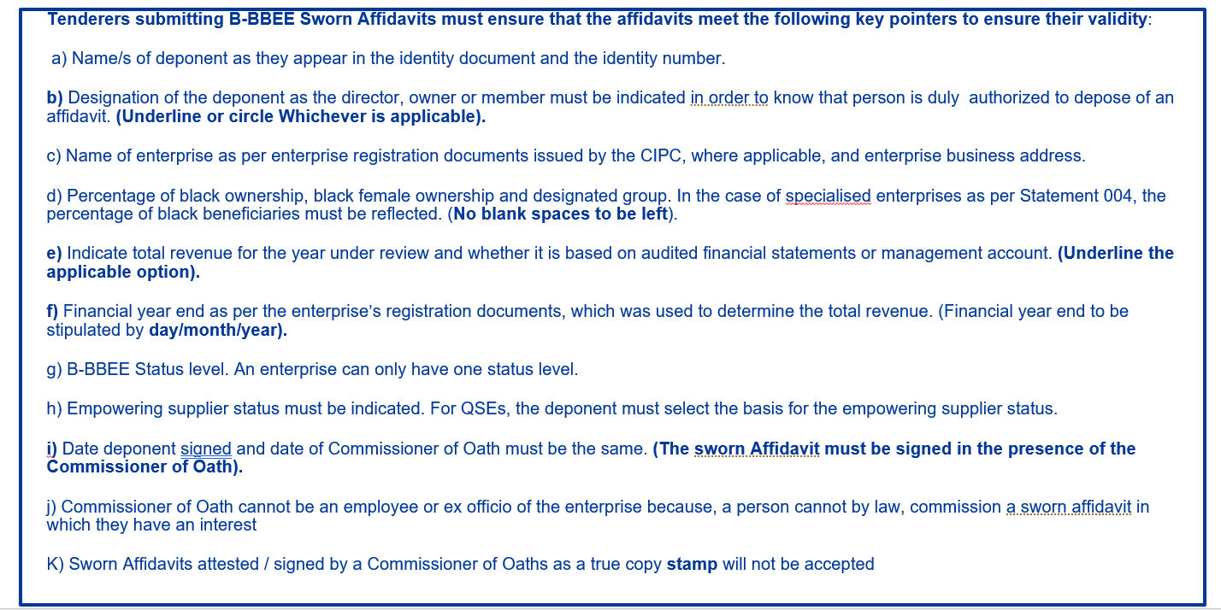
Validity of a BBBEE affidavit

Slide 13
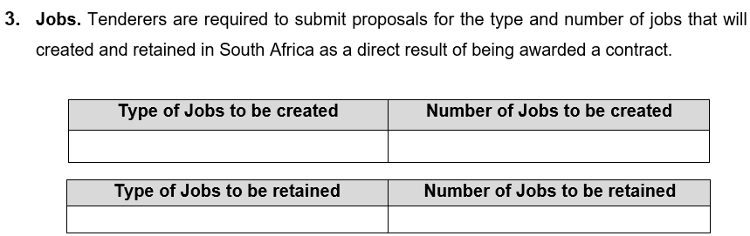
SDL&I Contractual requirement/undertakings

Slide 14
Skills development
Criteria | Eskom Target | Tenderer commitment
Electrical technicians | 3
Artisans | 3

Slide 15
Monitoring
Implementation schedule to be submitted within a month of contract signing.
Quarterly or monthly reports on progress of implementation of SD&L to be submitted to the PM.
SDL&I penalty (2.5% retention / Performance Bond)

Slide 16

Implementation schedule to be submitted within a month of contract signing.
Quarterly or monthly reports on progress of implementation of SD&L to be submitted to the PM.
SDL&I penalty (2.5% retention / Performance Bond)

Slide 17
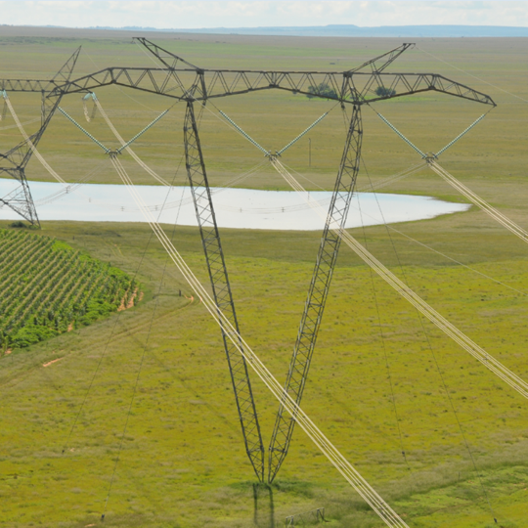
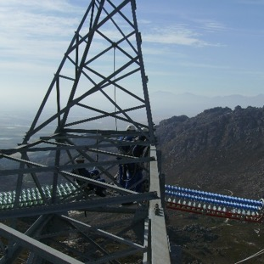
Conclusion

