Slide 1
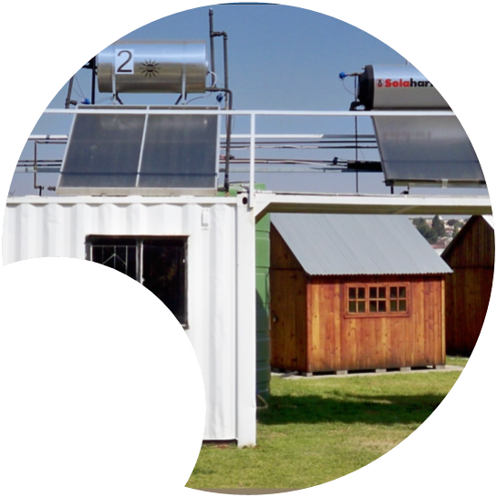
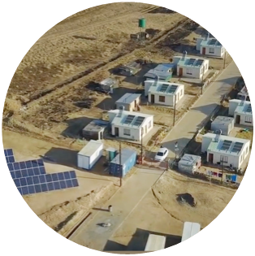
OPGW, ADSS & DUCT CABLES
Low Risk Environmental Requirements
SHEQS & Properties: Environmental Management
28 November 2025 Presented by Xolani Gumede

Slide 2
OPGW, ADSS DUCT CABLES
Environmental requirements for the manufacture, supply and delivery of estimated quantities of All-Dielectric Self-Supporting Cables
The contract is rated a low category

Slide 3
1. ENVIRONMENTAL POLICY
1. Environmental Policy (or SHEQ Policy) must be NAMED & SIGNED the by CEO or a Managing member of the contractor company
Commitment to: (1) compliance to environmental compliance obligations; and (2) environmental duty of care.
2. Environmental Management Plan for the Scope of work addressing the following as a minimum:
Waste management (reduction, re-use, recycling, disposal).
Environmental induction.
Environmental incident management.
Emergency planning for environmental incidents.

