Slide 1

eTENDER PORTAL e-SUBMISSION USER MANUAL
FOR SUPPLIERS
Suppliers’ guide to submitting e-Submission Bids

Slide 2
TABLE OF CONTENTS
HOW TO LOGIN TO THE PORTAL………………………………………………………..2- 3
HOW TO FIND AN E-SUBMISSION TENDER ………………………………….…….5 - 6
HOW TO APPLY FOR AN E-SUBMISSION TENDER………………………..………7 - 13
HOW TO EDIT OR WITHDRAW YOUR E-SUBMISSION BID……………………14 - 15

Slide 3
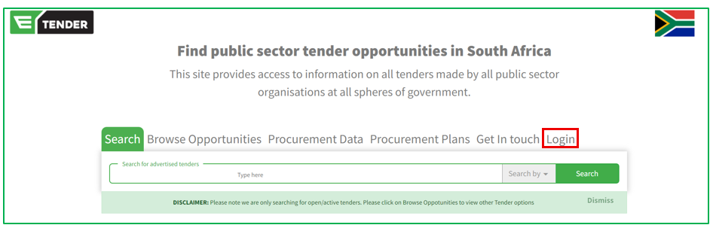
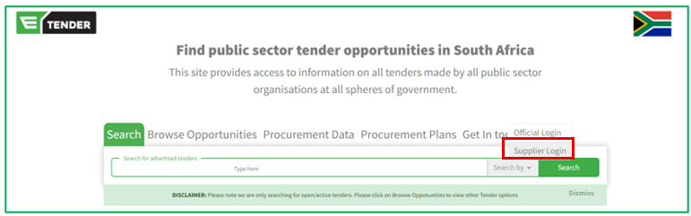
HOW TO LOGIN TO THE PORTAL
Go to https://etenders.gov.za
Click on Login
Select Supplier Login

Slide 4
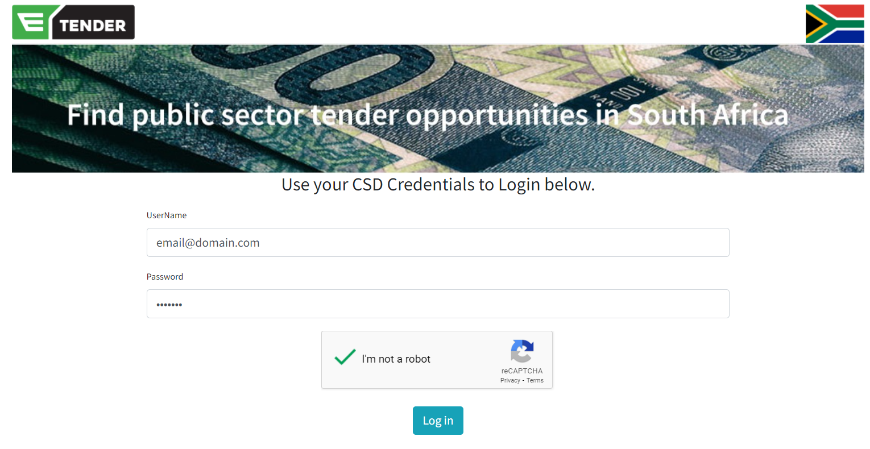
HOW TO LOGIN TO THE PORTAL …continued
Type in your Central Supplier Database (CSD) registered email address
Type in your Central Supplier Database (CSD) login password
Complete the CAPTCHA verification
Click Log in

Slide 5
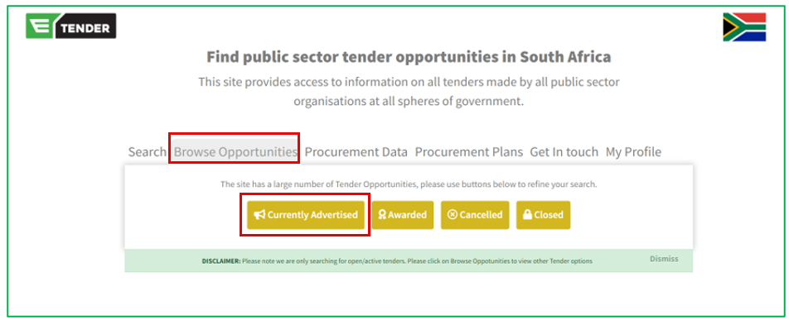
HOW TO FIND AN E-SUBMISSION TENDER
Click Browse Opportunities
Select Currently Advertised

Slide 6
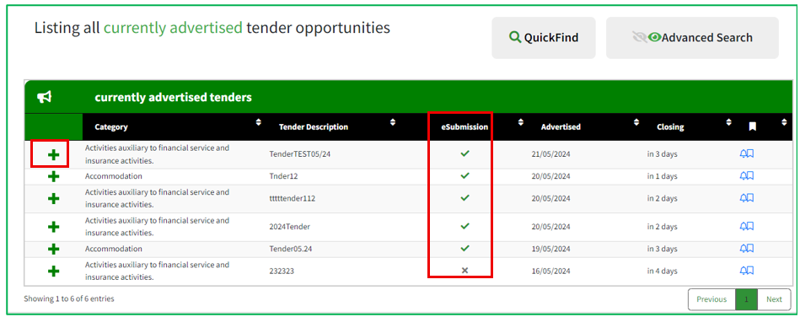
HOW TO FIND AN E-SUBMISSION TENDER…continued
Click “+” on any tender opportunity you wish to apply for.
Please note; eSubmission Tenders will have a tick (✓) under the eSubmission Column

Slide 7
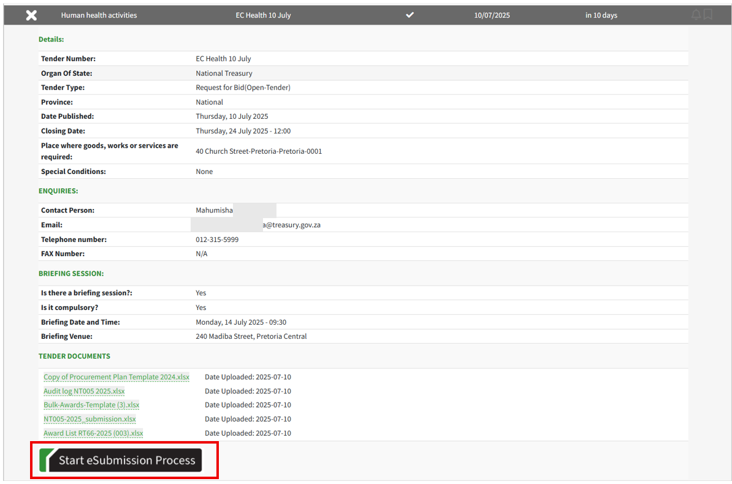
HOW TO APPLY FOR AN E-SUBMISSION TENDER
The full details of the tender opportunity (including the Tender Documents) will be displayed.
Click on “Start eSubmission Process”

Slide 8
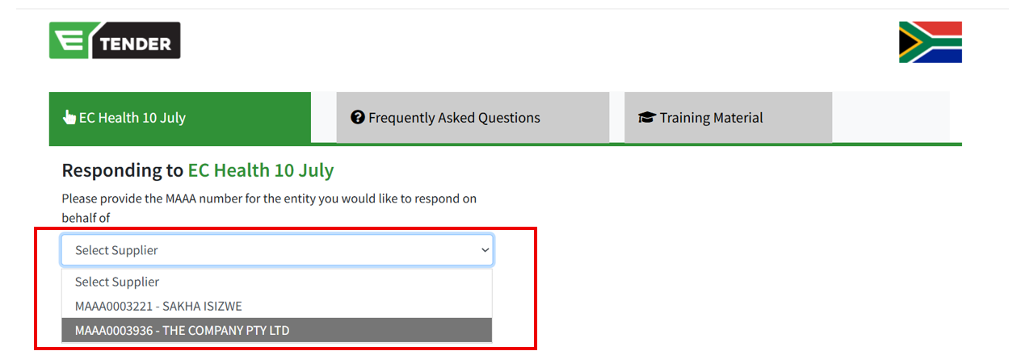
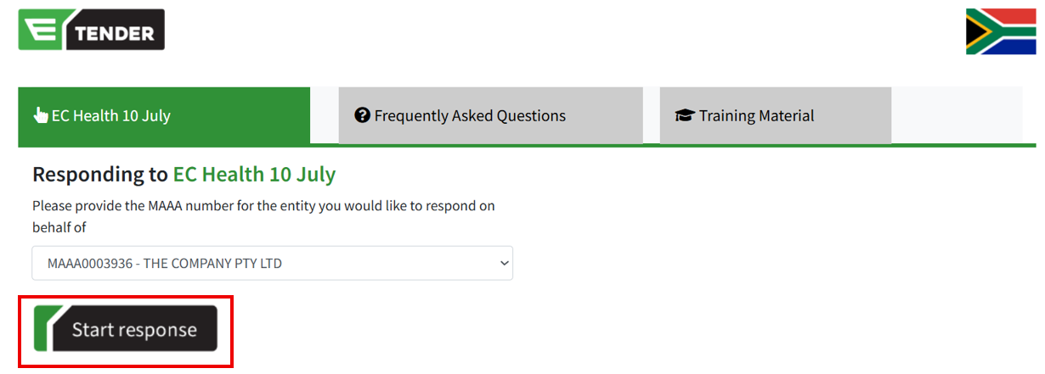
HOW TO APPLY FOR AN E-SUBMISSION TENDER…continued
Click the dropdown button on “Select Supplier”
All your registered Supplier Numbers will be displayed
Select the Supplier Number you wish to use to apply for the bid
Click “Start response”

Slide 9
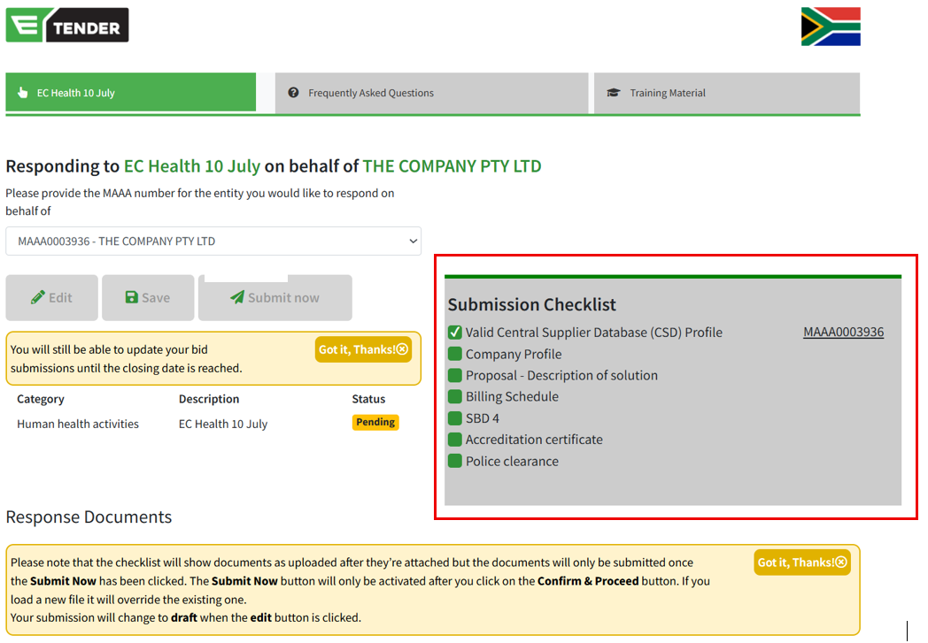
HOW TO APPLY FOR AN E-SUBMISSION TENDER…continued
A Submission Checklist will be displayed towards the right on the page.
  Ensure all required documents are uploaded to be able to submit your bid.

Slide 10
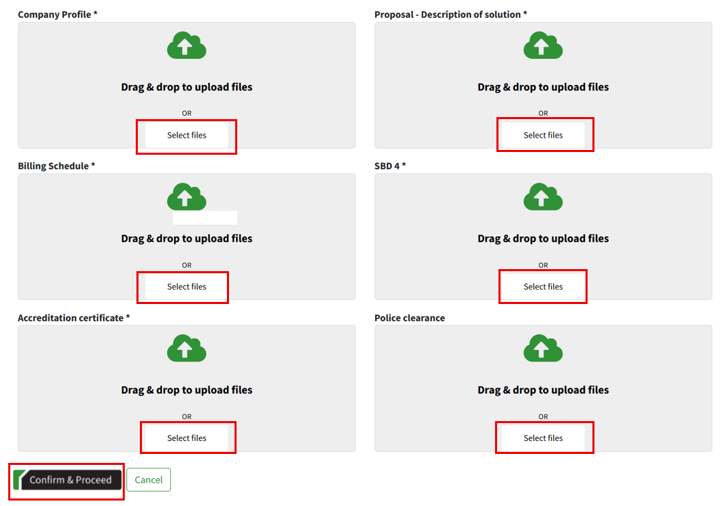
HOW TO APPLY FOR AN E-SUBMISSION TENDER…continued
Click on “Select files” or drag and drop your files according to the respective response document headings
Click “Confirm & Proceed” after uploading all required documents
  Note: Only one document can be uploaded at a time, should you upload more than one document, only the recently uploaded document will be saved

Slide 11
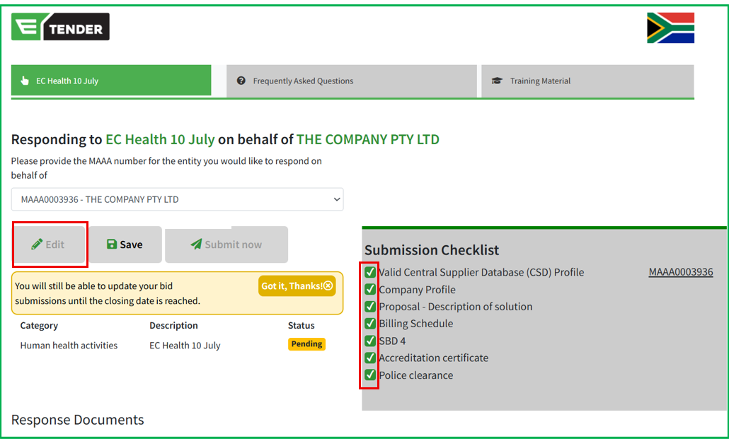
HOW TO APPLY FOR AN E-SUBMISSION TENDER…continued
After clicking “Confirm & Proceed”, the Submission checklist should be all ticked
Click “Edit” should you wish to upload a different document (the edit button will be disabled when the Tender closes and no changes can be made after that)
Click “Submit now” to complete your eSubmission application

Slide 12
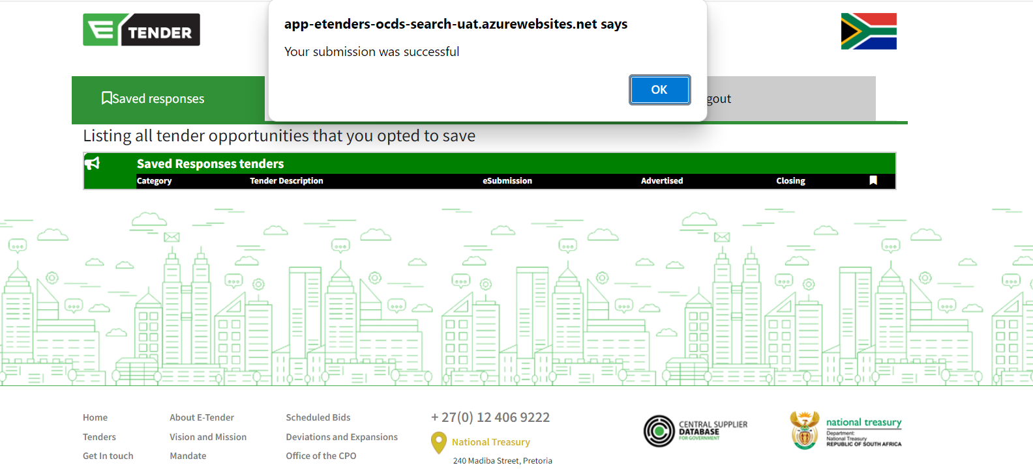
HOW TO APPLY FOR AN E-SUBMISSION TENDER…continued
A pop up confirming a successful submission will appear after you click Submit

Slide 13
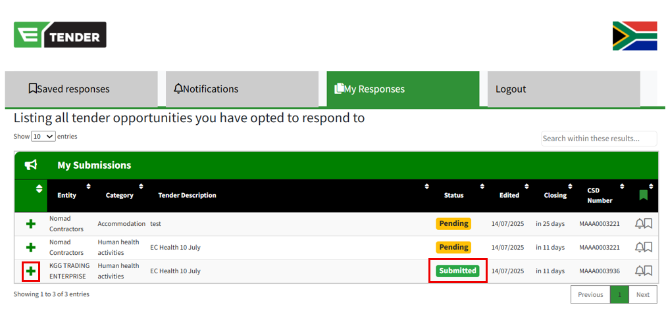
HOW TO APPLY FOR AN E-SUBMISSION TENDER…continued
The status of your submission will appear as Submitted.
Should the status be Pending, please note that you have not yet submitted all the required documents and will need to do so to ensure a successful submission.
Click the “+” button to edit or withdraw your submission

Slide 14
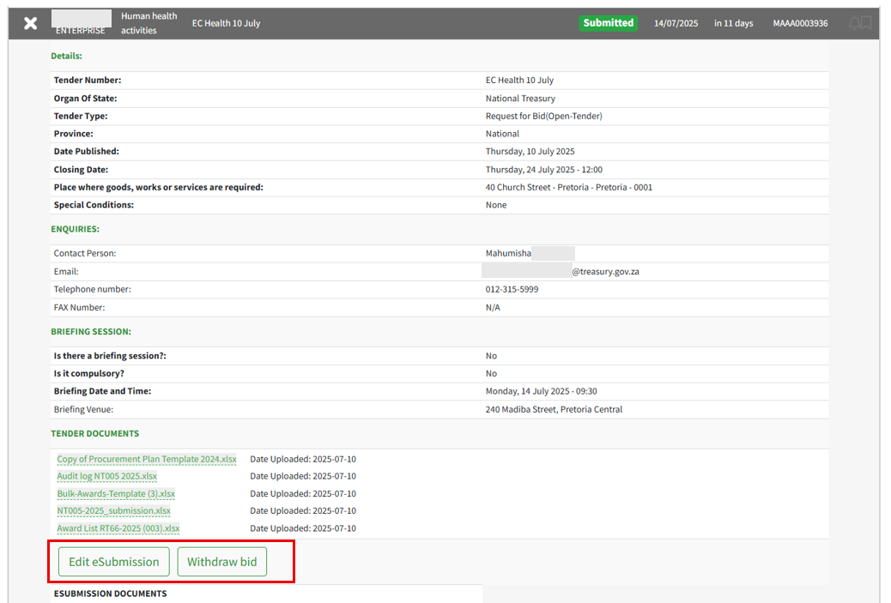
HOW TO EDIT OR WITHDRAW YOUR E-SUBMISSION BID
Click “Edit eSubmission” to edit your bid (upload different documentation)
Click “Withdraw bid” to withdraw your bid/submission

Slide 15
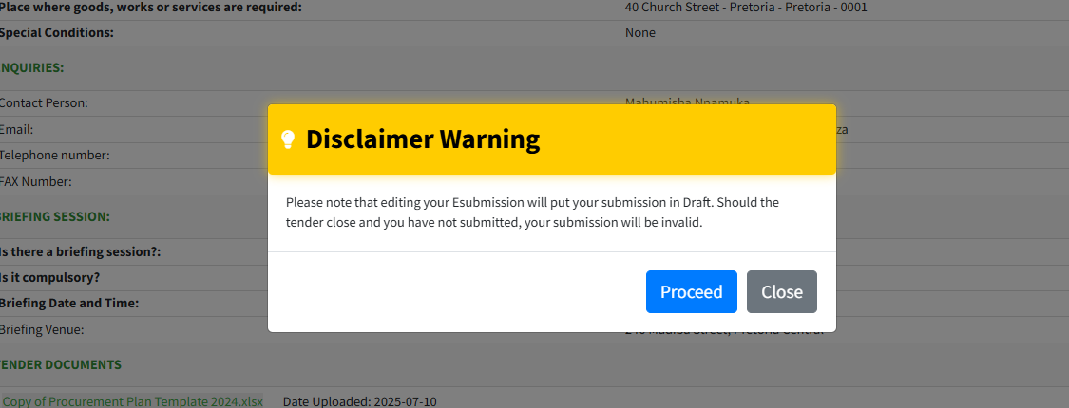
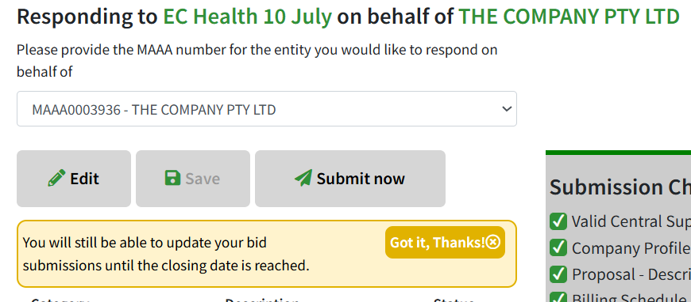
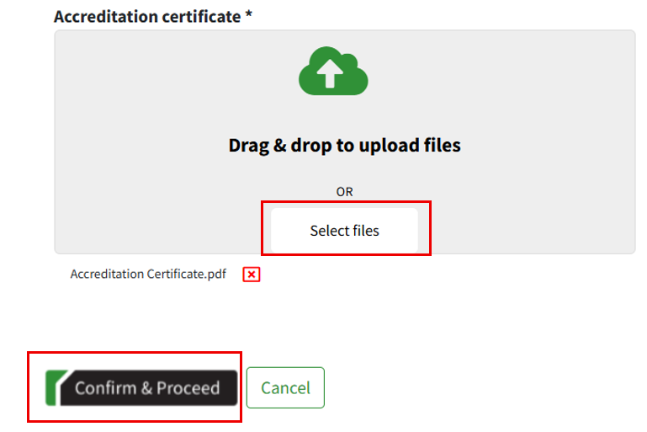
HOW TO EDIT OR WITHDRAW YOUR E-SUBMISSION BID…continued
After clicking “Edit eSubmission”, acknowledge the disclaimer pop-up by clicking “Proceed”.
Click the “Edit” button and select file or drag and drop to upload different documentation
Click “Confirm & Proceed” thereafter
After clicking “Withdraw bid” on the previous page, the application will disappear from your list.

Slide 16

THE END

