Slide 1

THE MAINTAINANCE AND CLEANING OF PORT ROADS IN THE PORT OF DURBAN
COMPULSORY TENDER CLARIFICATION MEETING
21 AUGUST 2025
10H00
Notes:
Growth and Reinvent

Slide 2
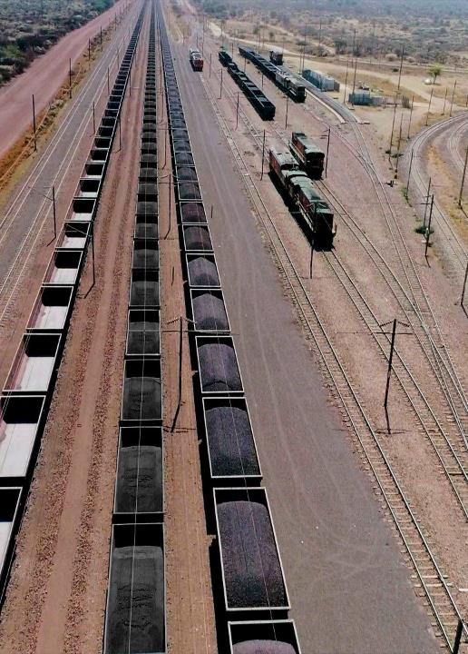
Contents
Agenda
01 | Welcome
02 | Introduction and Agenda
03 | Safety Briefing and Evacuation Procedure
04 | Project Overview
05 | Commercial Presentation
06 | Enterprise and Supplier Development
07 | Technical Presentation
08 | Question and Answer
2

Slide 3
Project Background-Mncedisi

Slide 4
PROJECT BACKGROUND
This project is part of the Port’s clean up strategy, which aims to clean up and improve the current state of the Port. The Engineering team conducted visual inspections as well as a condition assessment in all Durban Port precinct's, including Maydon wharf, Island view, Bayhead Park and Point and identified the need of maintaining the roads to prevent further deterioration as well as to extend life span and maintain existing assets.
Due to the distress observed during the assessment, the condition assessment identified roads that require attention in terms of maintenance. Maydon wharf Precincts has more roads than other Precincts that require extensive maintenance and prioritization, followed by Bayhead Park, Island View and Point.

Slide 5
Commercial- Hlengiwe

Slide 6
COMMERCIAL REQUIREMENTS
PLEASE GO TO NATIONAL TREASURY eTENDER PUBLICATION PORTAL AT www.etenders.gov.za and the Transnet website at https://transnetetenders.azurewebsites.net TO DOWNLOAD ALL PDF’S
CLARIFICATION REGISTERS
ADDENDUMS

Slide 7
TENDERING PROCEDURES
All communications whether general, commercial or technical to go via the Procurement
Department, HLENGIWE DLAMINI in writing.
Email – TNPAtenderenquiriesdbn@transnet.net
All communication will be sent via a clarification register and will be e-mailed to all attendees of this clarification meeting and posted on the Transnet Portal.
Please complete the attendance register and ensure that the contact details are correctly recorded (as these contact details will be used to issue all clarifications and addendums).
Last day for Clarification – Five working days before the closing date (28 August 2025 14:00).
Electronic Tenders Documents must be legible.

Slide 8
TENDERING PROCEDURES (Continued)
TENDERING PROCEDURES
Tender closing date: 4 September 2025 at 14h00 via the new electronic tender submission system, the e-Tender Submission Portal
“HOW TO” GUIDE FOR BIDDERS IS INCLUDED IN THE TENDER (ALLOW TIME)
NO EXTENSIONS TO THIS DATE WILL BE ENTERTAINED
NO LATE TENDERS WILL BE CONSIDERED

Slide 9
TENDERING PROCEDURES (Eligibility Criteria)
Stage One – Test for Administrative and Substantive Responsiveness:
The test for administrative and Substantive responsiveness will include the following:
Checks on whether the bid has been logged on time.
Whether all returnable documents and/or schedules were completed and returned by the closing date and time.
Verify the validity of all returnable documents.
Verify if the bid document has been duly signed by the authorised respondent.
Whether any general and legislation qualification criteria set by Transnet, have been met.
Whether the bid contains a priced offer. Respondents are required to complete the BOQ in full, failure to complete may result in disqualification.
Whether the bid materially complies with the scope and/or specification given.

Slide 10
TENDERING PROCEDURES (Eligibility Criteria Continued)
Stage Two – Eligibility with regards to attendance at the compulsory clarification meeting:
An authorized representative of the tendering entity or a representative of a tendering entity that intends to form a Joint Venture (JV) must attend the compulsory clarification meeting in terms C2.7
Stage Three – Eligibility in terms of the Construction industry development board
CIDB Registration 7CE or Higher or higher class of construction work
Account to be “Active”

Slide 11
TENDERING PROCEDURES (Eligibility Criteria continued)
Stage Four- Functionality
Only those tenderers who obtain the minimum qualifying score for functionality will be evaluated further in terms of price and the applicable preference point system. The minimum qualifying for score for functionality is 60 points.
The evaluation criteria for measuring functionality and the points for each criteria and, if any, each sub-criterion are as stated in C.3.11.3:
T2.2-03 Previous Experience
T2.2-04 Method Statement
T2.2-05 Management & CV’s of Key Personnel
T2.2-06 Health and Safety Management
T2.2-08 Environmental Management

Slide 12
TENDERING PROCEDURES (Eligibility Criteria Continued)
The tenderer is required to submit all documents as stated in C.2.23 of the tender data and the
tender offer will only be accepted if the tenderer complies with C3.13 of the tender data such as:
A valid Tax Clearance Certificate issued by the South African Revenue Services. Tenderers also to provide Transnet with a TCS PIN to verify Tenderers compliance status.
A valid B-BBEE Certificate from a Verification Agency accredited by the South African Accreditation System [SANAS], or sworn affidavit confirming annual turnover and level of black ownership in case of all EMEs and QSEs with 51% black ownership or more together with the tender;
A valid CIDB certificate in the correct designated grading;
Proof of registration on the Central Supplier Database
Letter of Good Standing with the Workmen’s compensation fund by the tendering entity or separate Letters of Good Standing from all members of a newly constituted JV.

Slide 13
CONTRACT DATA
NEC 3 ECC
Main Option B – Priced Contract with Bill of Quantities
Secondary Clauses
  X1: Price adjustment for inflation
  X2: Changes in the law
  X7: Delay damages: R6 000.00 per day
  X13: Performance Bond = 5% of the total of the Prices
  X16: Retention = 10% on certified payments
  X18: Limitation of liability
  Z: Additional conditions of contract

Slide 14
Enterprise & Supplier Development- (Specific Goals)

Slide 15
TRANSNET PREFERENTIAL PROCUREMENT POLICY SPECIFIC GOALS
The following preference points must be awarded to a bidder who provides the relevant required evidence for claiming points:
The following specific goals will apply for this transaction.
Specific Goals | Number of points (80/20 system) | Number of points (90/10 system)
B-BBEE Status Level of Contributor 1 or 2 | 06 | 03
30% Black women Owned entities | 04 | 02
The promotion of supplier development through subcontracting for a minimum of 30% of the value of a contract to South African companies which are: I. EMEs and/or QSEs black owned | 10 | 05
Non-Compliant and/or B-BBEE Level 3-8 contributors | 00 | 00

Slide 16
EVIDENCE REQUIRED FOR CLAIMING SPECIFIC GOALS
In terms of Transnet Preferential Procurement Policy (TPPP) and Procurement Manuals, preference points must be awarded to a bidder for providing evidence in accordance with the table below:
Specific Goals | Acceptable Evidence
B-BBEE Status Level of Contributor 1 or 2 | (1) A valid B-BBEE Certificate / Sworn - Affidavit / CIPC B-BBEE Certificate (in case of JV, a consolidated scorecard will be accepted) as per DTIC guidelines
30% Black women Owned entities | Certified copy of ID Documents of the Owners.
The promotion of supplier development through subcontracting for a minimum of 30% of the value of a contract to South African companies which are: I. EMEs and/or QSEs black owned | Sub-contracting agreement(s). Subcontractors B-BBEE Certificate / Sworn - Affidavit / CIPC B-BBEE Certificate as per DTIC guidelines.
Note: Tenderers who fail to submit acceptable evidence for specific goals applicable in this tender will be allocated zero (0) preference points.

Slide 17
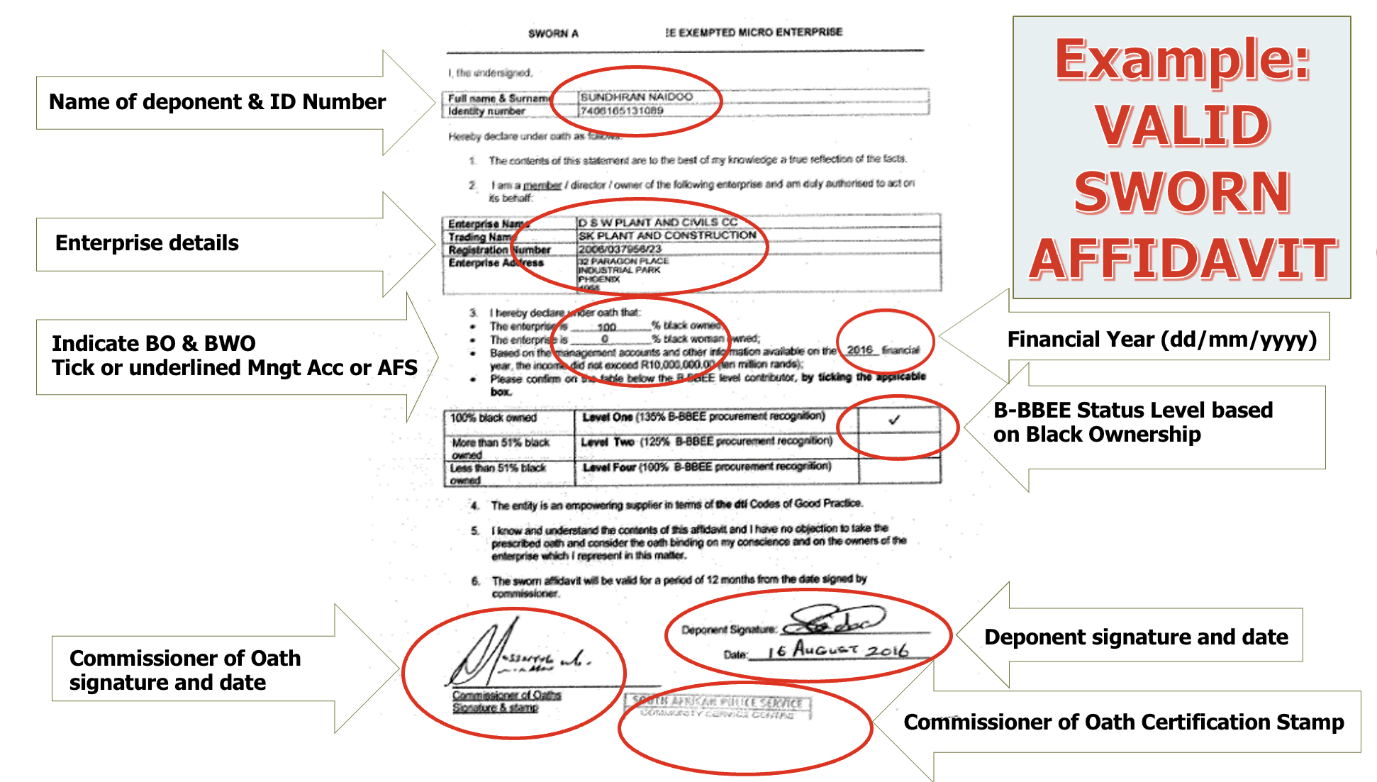
VALID B-BBEE SWORN - AFFIDAVIT

Slide 18
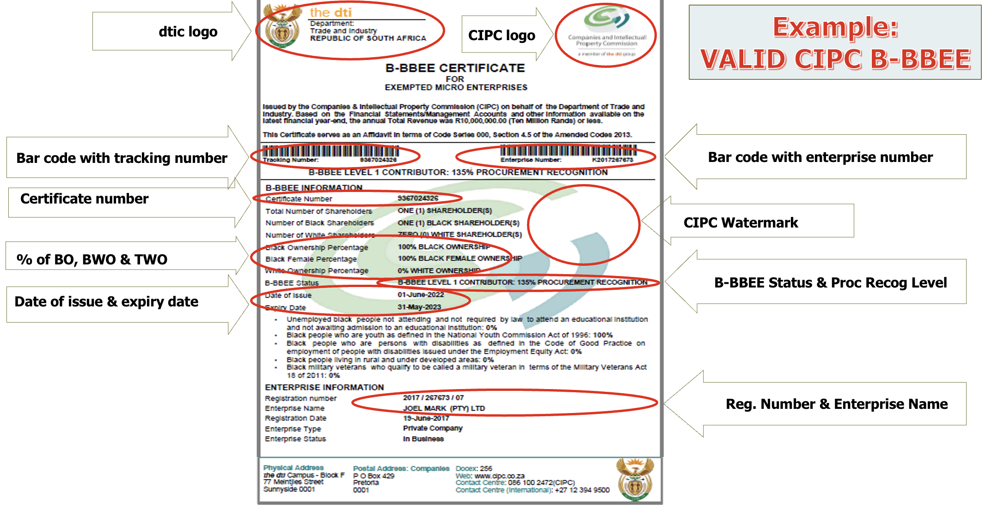
VALID CIPC B-BBEE CERTIFICATE

Slide 19
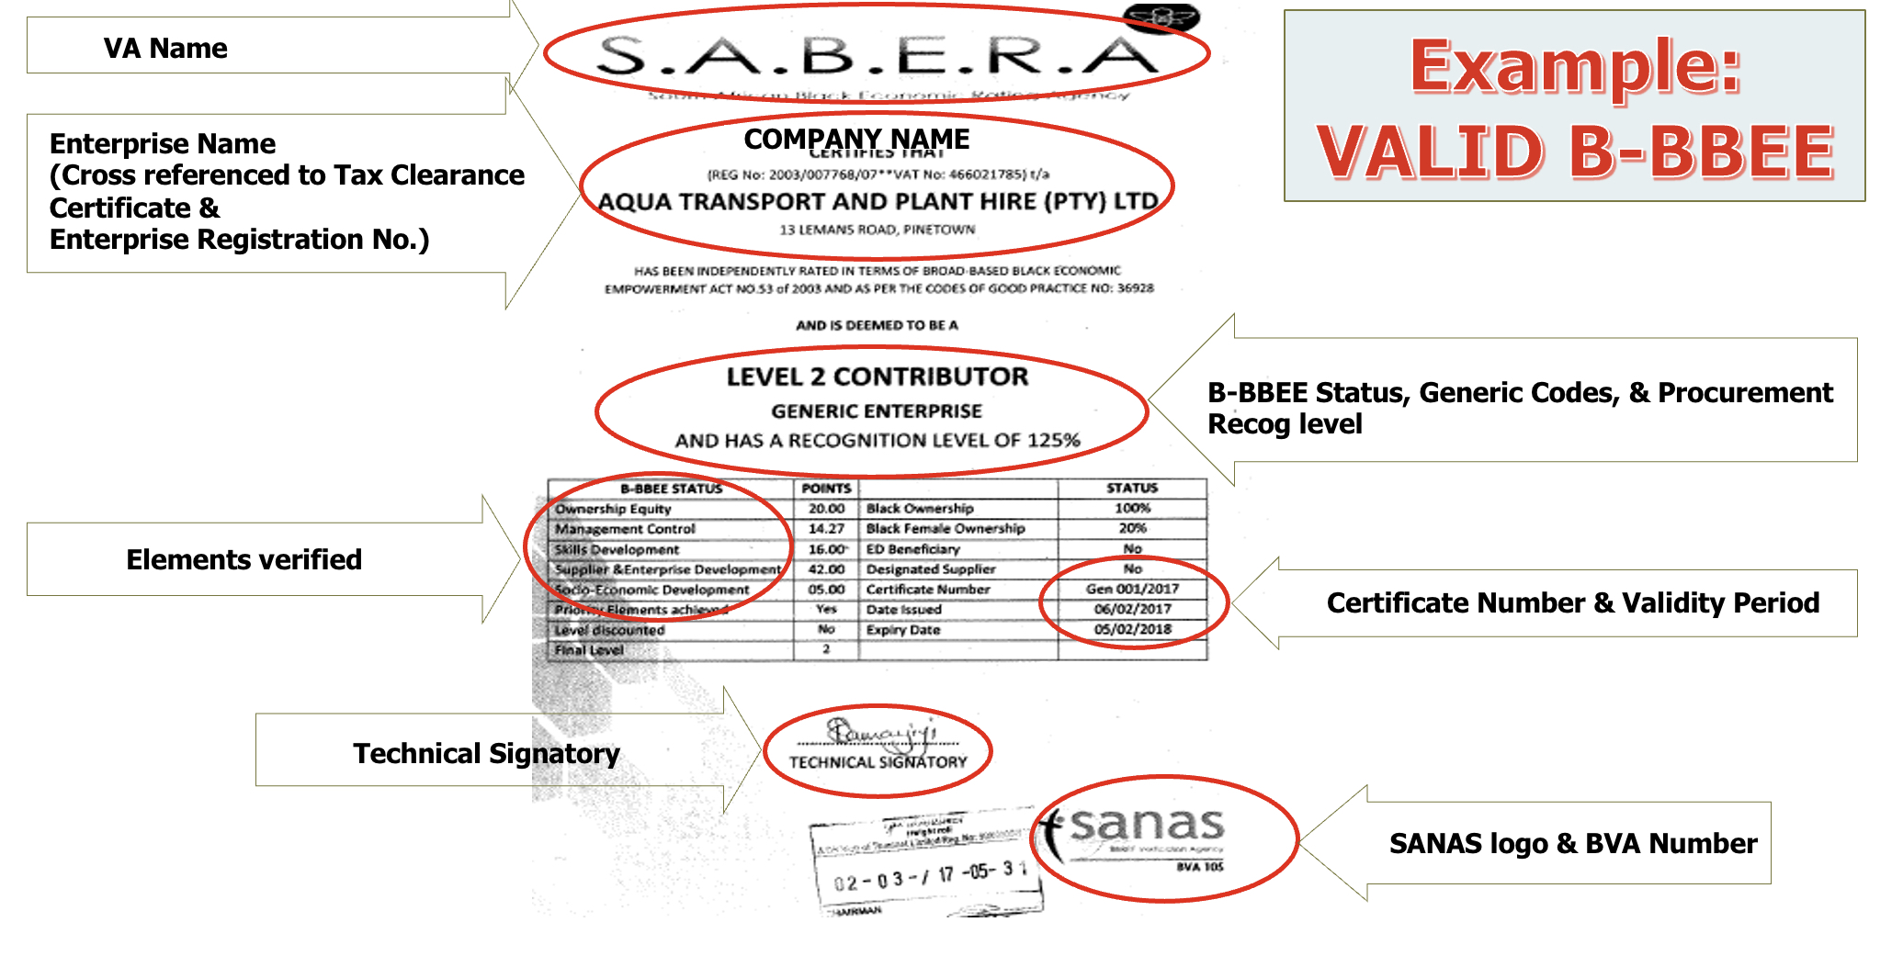
VALID B-BBEE CERTIFICATE

Slide 20
Technical Presentation - Mncedisi

Slide 21
SCOPE OF WORK
The overview of the scope entails, but not limited to:
Employer’s Objectives:
The Employer’s objective are to achieve Completion of the works by meeting the Completion Date whilst still maintaining the highest environmental quality and safety standards and minimize disruptions to ongoing port and terminal operations.
Emphasis is placed on the Employer’s commitment to environmental management and safety and their objectives of “Zero Harm”, of achieving a zero LTI and a zero environmental legal contravention construction contract.

Slide 22
SCOPE OF WORK Continued
The Employer’s project specific objectives are to:
Provide Port infrastructure ahead of demand,
Increase longevity and reliability of Port infrastructure,
Improve performance and efficiency of Port operations,
Maintain road infrastructure to ensure customer satisfaction and operational safety
Limit congestion and disruptions to operations within the Port.

Slide 23
SCOPE OF WORK Continued
The following shows scope of work for the roads to be reconstructed during construction stage:
Pothole repairs
Replacement of damaged kerbs
Cleaning and repair of sidewalks
Cleaning and jetting of storm water manholes including channels
Road markings
Road signage erection
Installation of guardrails
Mill and overlay of roads

Slide 24
Questions and Answers

