Slide 1
Site map
Home
Pre colonial
Colonial
Contemporary / Post Colonial
Future
Podcasts
Objects: Photo, etc
Articles
Discussions
Seminars
VR Room
Podcasts
Objects: Photo, etc
Articles
Discussions
Seminars
VR Room
Podcasts
Objects: Photo, etc
Articles
Discussions
Seminars
VR Room
Podcasts
Objects: Photo, etc
Articles
Discussions
Seminars
VR Room

Slide 2


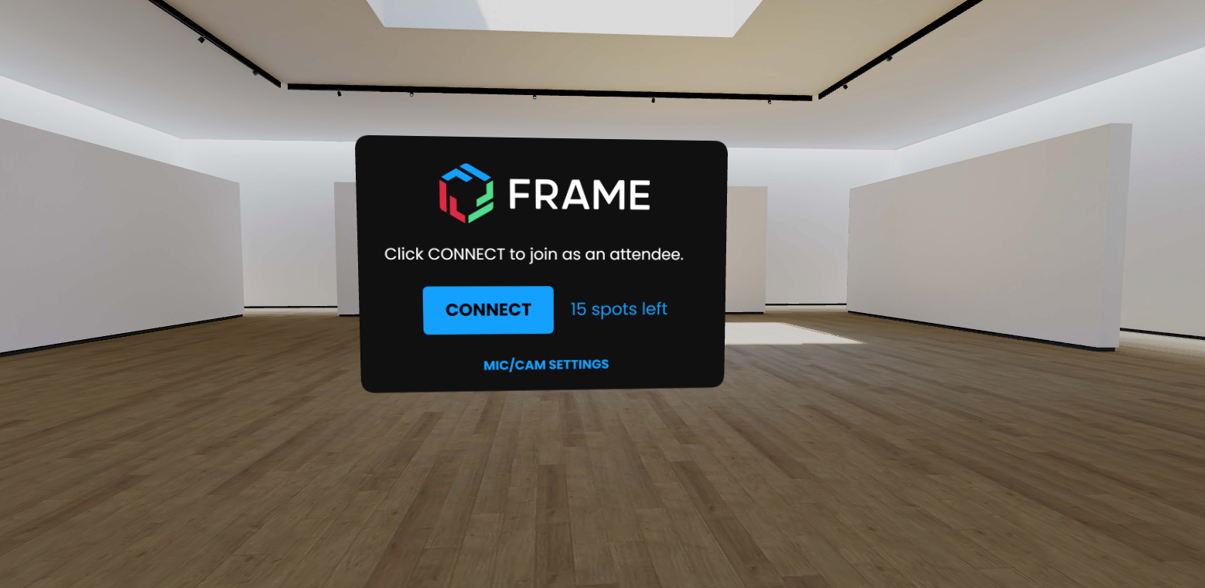
Home: Virtual Museum – Youth Livelihoods
Menu:
Frame: Linking to Virtual Reality Platform
Pre colonial
Colonial
Post colonial
Future
Podcasts, other material
Links to other virtual museums that focus on Youth Livelihoods…

Slide 3
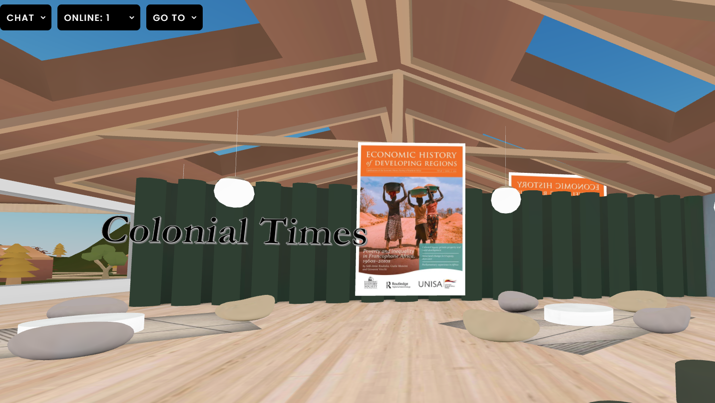





Youth Livelihoods in Colonial times
Menu:
Frame: Linking to Virtual Reality Platform
Pre colonial
Colonial
Post colonial
Future
Podcasts
Photo gallery
Articles
Discussion Board
Seminars

