Slide 1

SACAA ICT OVERVIEW

Slide 2
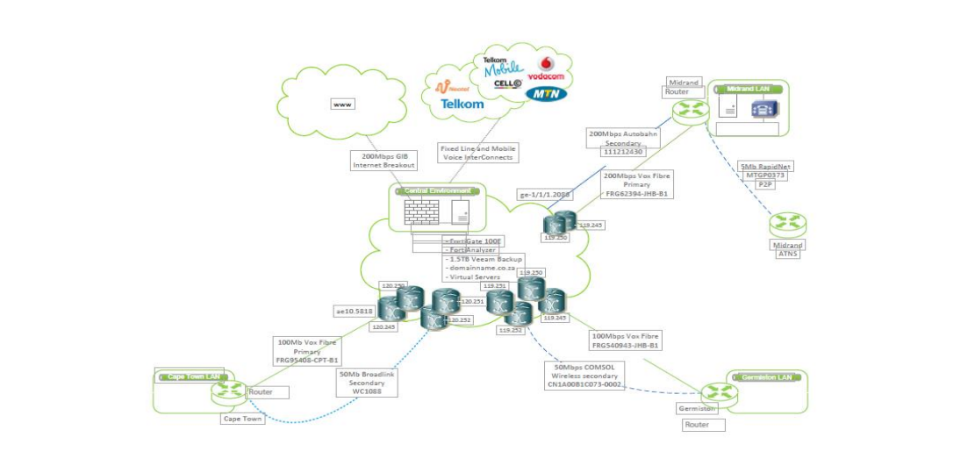
SACAA WAN DIAGRAM

Slide 3
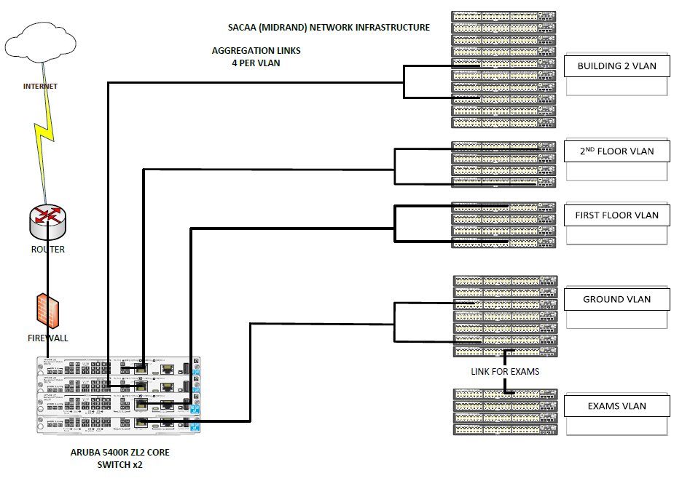
CURRENT SACAA LAN OVERVIEW

Slide 4
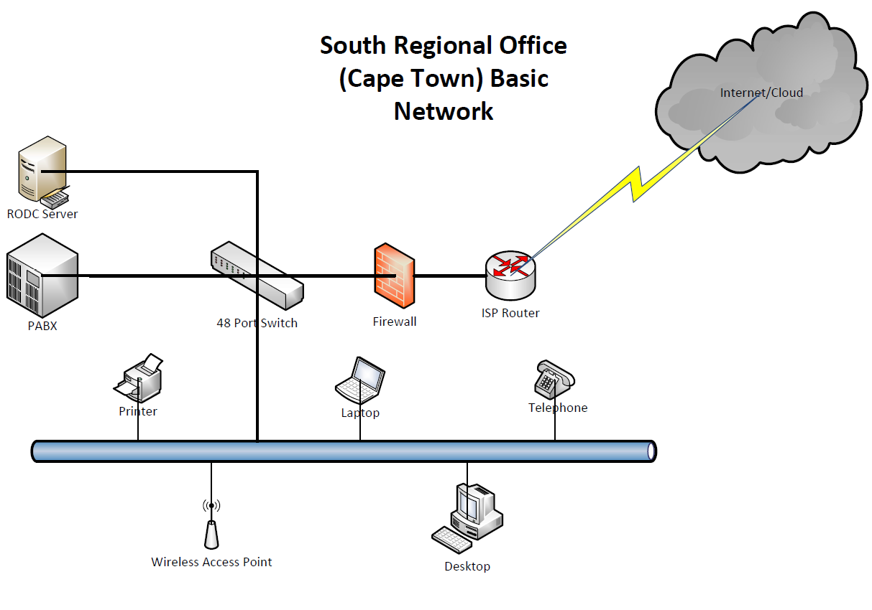
CURRENT SACAA LAN OVERVIEW

