Slide 1





Clarification Session: MWP1495CX-R
Provision of Engineering Network Schematics (ENS) Implementation, Maintenance and Support
Date: 06 October 2022

Slide 2
Agenda for clarification
1 | Welcome of Attendees | Mbulelo Mncengani
2 | Objective of the Session | Mbulelo Mncengani
3 | Technical | Kabelo/Esther
4 | Pricing | Kabelo/Esther
5 | Supplier Development, Localisation & Industrialisation | Rojane Qacha
6 | Quality | Sipho Sambo
7 | Commercial Information | Mbulelo Mncengani
8 | Closure | Mbulelo Mncengani

Slide 3

REQUEST FOR PROPOSAL (RFP)

Slide 4


TECHNICAL REQUIREMENTS

Slide 5

PRICING SCHEDULE

Slide 6
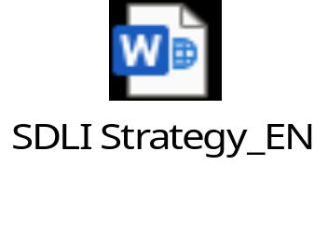
SDL&I Requirements

Slide 7


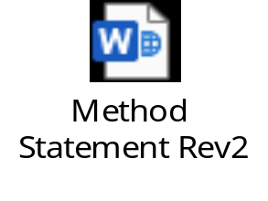

Quality Requirements

Slide 8
COMMERCIAL REQUIREMENTS
Tender documents should be clearly as follows:
MWP1495CX-R
Provision of Engineering Network Schematics (ENS) Implementation,
Maintenance and Support
Delivery address:
Eskom Megawatt Park Tender Office
Northside
1 Maxwell Drive
Sunninghill
  Late tenders will not be accepted.

Slide 9
COMMERCIAL REQUIREMENTS
Closing date: 09 November 2022
Closing Time: 10:00 am (no late deliveries will be accepted)
Where a Tenderer does not submit 1 complete hardcopy AND 1 original tender at tender submission deadline, the tenderer will be disqualified.
  Single point of contact is Mbulelo Mncengani (E-mail: MncengMS@eskom.co.za)

Slide 10
Commercial – Submission Format
Original
(Hardcopy)
Documents
Duplicate
Hardcopy
File A–Commercial response
1
1
1
1
File B–Technical response
1
1
File C–Pricing response
Flash Disk (with file A,B & C)
1
Electronic documents should be in a read only format in MS Word and MS Excel to enable cut and paste of content. The Excel spreadsheets must be in electronic format The spreadsheets are to be completed and sent back as returnable.
Three copies: Two hard copies, being an original and one copy and a CD/flash disk. The copies must be the exact replica of the originals.
Please note: (The pricing workbook) MUST be submitted in excel format.
1 Electronic documents should be in a read only format in MS Word and MS Excel to enable cut and paste of content.

Slide 11
Evaluation Process and Criteria
  Evaluation will be as follows:
      The 80/20 preference point system will be applicable to this tender.
  The following Five (5) steps will be applied during the evaluation of this tender.
      Step 1: Basic compliance;
      Step 2: Mandatory documents;
      Step 3: Functionality
      Step 4: Price and preference
      Step 5:Contractual criteria
        Quality
          Audited Financial Statements
        SDL &I

Slide 12
Mandatory Documents
  All mandatory returnables for evaluation should be submitted at closing date of the tender,
    09 November at 10h00
  Additional Documents required in the event of a joint venture should also be signed , sub-contracting intent agreement to submitted on the closing date
  Failure to submit with the tender your tender submission will be disqualified.

Slide 13


End

