Slide 1
Tx Engineering
Scope and Evaluation Criteria Overview
March 2023

Slide 2
Tx Eng. Overview
Transmission Engineering
1. Substation Engineering
2. Secondary Plant Engineering and Technology Management
3. Powerline Engineering
4. PDE Design Draughting (MicroStation)

Slide 3
1. Substation Engineering _Scope
Substation Engineering
1.1 SS Eng. Electrical
1.2 HV Cable Systems
1.3 SS Eng. Civil and Structural

Slide 4
1.1 Substation Eng. Electrical _Scope
Produce electrical designs (AIS/GIS/HVDC) on Transmission projects for Concept, Definition & Execution Phases on varying projects
Technical specifications reviews
Knowledge and application of different Technologies used for design
Knowledge and application of the different busbar philosophies
Produced CAD based design drawings (Microstation)
Participation in Project life cycle technical hold points
Technical Tender Evaluations
Quality
Specialized studies
Design verification (Field measurements)
Site Assurance/Investigations/Inspections during construction
Post-construction
Audits
DRAUGHTING (CAD)

Slide 5
1.2 HV Cable Systems _ Scope
Electrical Design
Maintenance Requirements
Determine Construction Requirements
Execution / Constructability Plans

Slide 6
1.3 Substation Eng. Civil and Structural_ Scope
Provision of Substation Engineering
Substation design reviews
Technical specifications reviews
Technical Tender Evaluations
Quality: Approval of: QITP’s, Safe Work Procedures and Method Statements
Civil Investigations and Studies
Specialized studies
Site Assurance/Investigations/Inspections during construction
Post-construction design verifications (as-designed vs as-built)
Post-construction design drawing mark-ups
Audits
Quantity surveying services
Construction Regulations
Development of RAM
Hydrological Studies

Slide 7
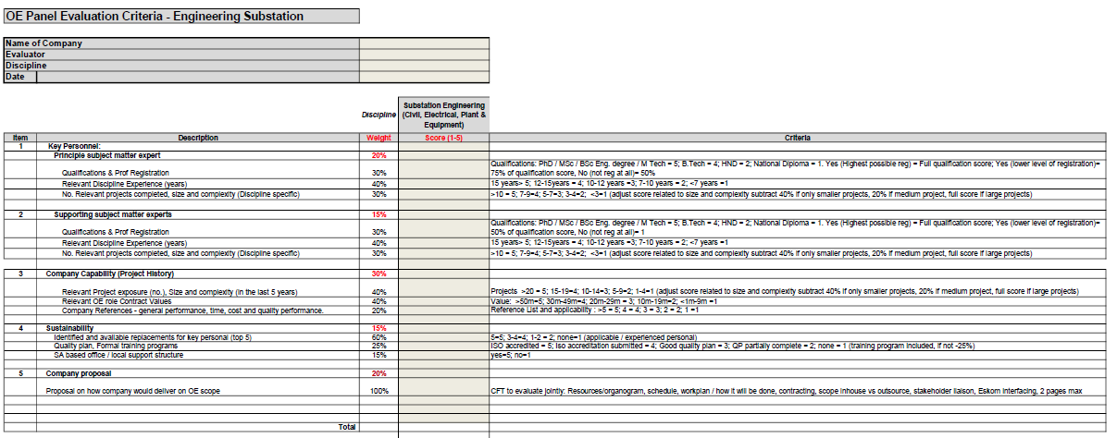
1.4 Tx. Eng. Evaluation Criteria_SS Eng.

Slide 8
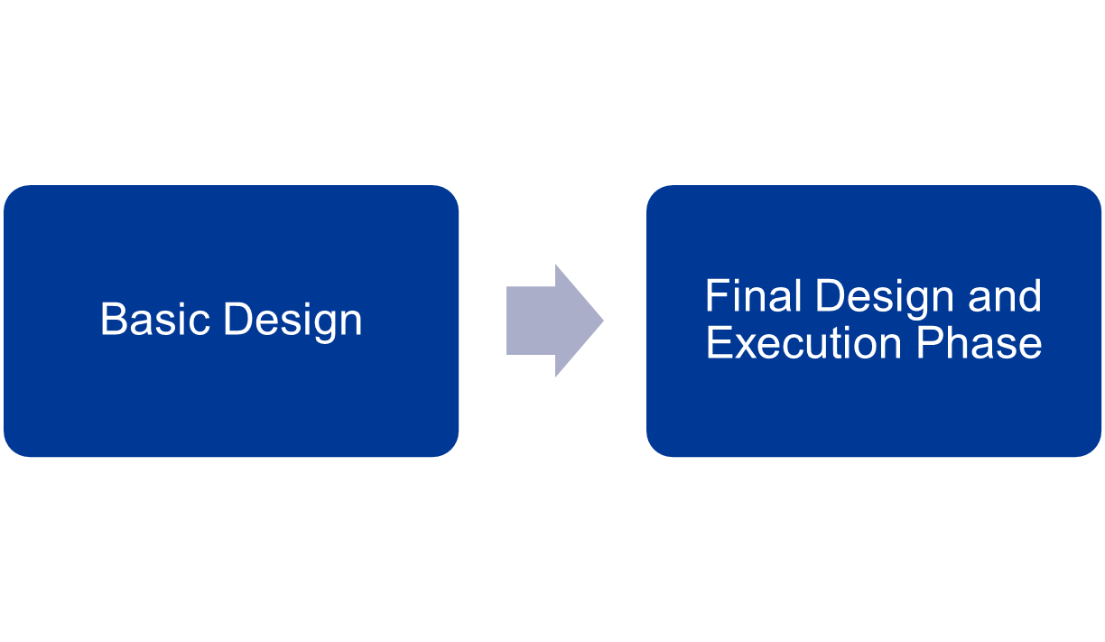
2. Powerline Engineering _Scope

Slide 9
2.1 Power Line Engineering Scope:
Basic Design
Route selection Activities
Profiles generated from DEM data
Geotechnical studies (desktop exercise)
Engineering survey activities
  Including and not limited to final route bend point pegging, data digitizing, option sketches, spatial information preparation, etc.
Lidar acquisition
Line communications (OPGW, ADSS/ADLash etc.) replacement activities and audits
Tower selection
  Power line tower designs – detailed designs and testing (manage testing by Eskom Tower Test Station)
Bypass design – profiling, earthing, tower analysis etc.
Review of templates and specifications used for EPC projects
Wayleave applications – technical analysis of the profiles and related electrical/mechanical studies submitted as part of wayleave applications

Slide 10
2.2 Power Line Engineering Scope:
Final Design and Execution Phase
Coordinate detailed design approvals (EPC designs) as per the specifications and detailed design report/presentation templates developed by Lines Engineering
Liaise with internal Transmission stakeholders for inputs into the scope for detailed design
Cross functional team squad checks
PDRA document preparation and presentation
Site clarifications with EPC contractor before EPC contract is awarded
Line walkdown with EMPr team
Construction support
  Link during specific hold points at construction stage (between EPC contractor and client).
As built documentation and TxSIS data for completed projects
Notes:
DEM = Digital Elevation Models

Slide 11
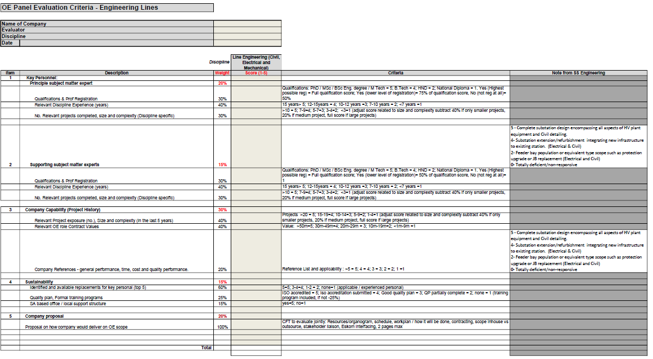
2.3 Tx. Eng. Evaluation Criteria_LES

Slide 12
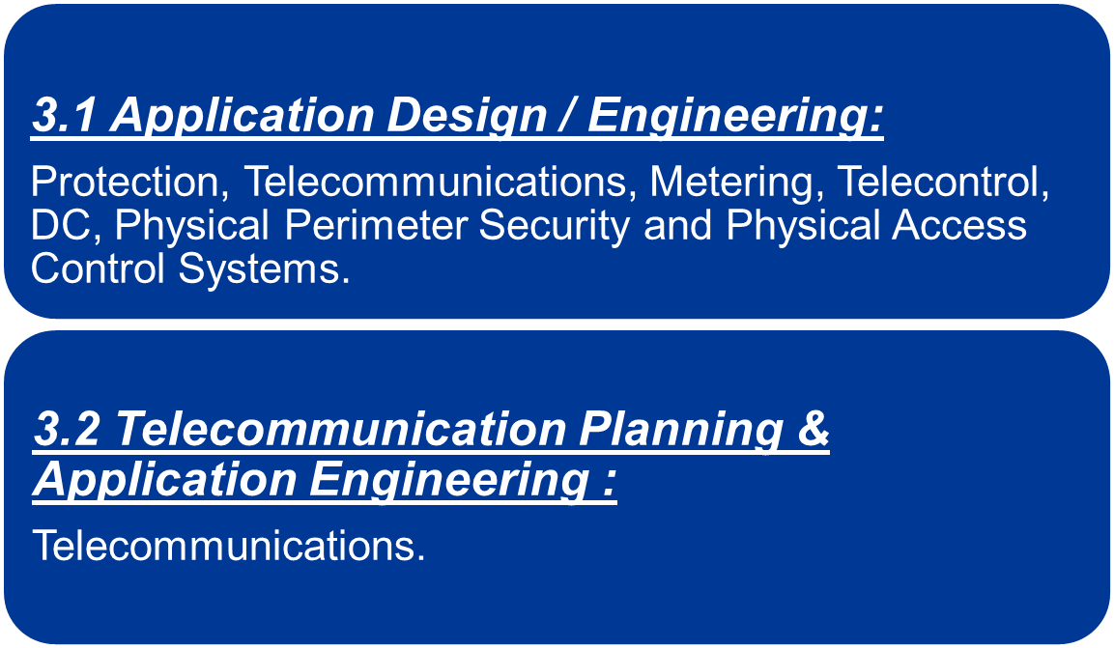
3. Secondary Plant Engineering and Technology Management_ Scope

Slide 13
3.1. Secondary Plant Application Engineering
Scope
Application design refers to the engineering activities associated with the design of power network infrastructure, utilising standard developed products which are typically available off Supply Contracts that Eskom has established with third party vendors.
Engineering processes and deliverables are to comply with statutory regulations and Eskom Transmission governance, philosophies, standards and accepted practices, and are to be delivered to Eskom in a format and on media to be specified with each task order. All designs are to be approved by a competent ECSA registered professional.
3.1 Application Design / Engineering
Design drawings (to-build and as-built),
Telecontrol datapoint definitions,
Substation / IED IEC 61850 CID, SCD, ICD database file design / definition / creation
Substation IP network design
Interlocking rule design / definition / creation
Protection design
DC system sizing and design
DC and AC board reticulation design, and
Control Room Layout in terms of panel placement, emergency evacuation requirements, lightning, access and overhead racking load calculations
Telecommunication specific Voice, Videoconference, IP router, Radio and Fibre Optic Network designs
CCTV, Volumetric Alarm, Perimeter Intrusion detection and Electric fence designs

Slide 14
3.2. Telecommunication Planning &
Application Engineering Scope
Engineering activities and design outputs include inter-alia:
Engineering processes and deliverables are to comply with statutory regulations and Eskom Transmission governance, philosophies, standards, and accepted practices, and are to be delivered to Eskom in a format and on media to be specified with each task order. All designs are to be approved by a competent ECSA registered professional.
3.2 Telecommunication planning & Application Engineering
Compile Basic Design for Operational Technology Voice, Video Conference, Radio and Fibre Optic, Multi-Service Access Platform. IP router, SDH, Optical transport Network, Operational Support System and Operational Technology Cybersecurity and Smart Grid Telecoms.
Compile Basic design for telecoms towers, tower foundations, earthing, roads, geo-tech, structural inspections and analysis, tower detailing and testing requirements.
Compile basic design for facilities which includes site civil works, equipment building. DC batteries, fire protection, fencing and gates, CCTV, tower lights, air-cons, alarm systems, plinth and containers where necessary.
Site visits for audits.
Provide technical requirements for land and rights negotiation and acquisition.
Provide input and support to engineering/ planning process tools and database design/ managements
Provide specialised studies.
Telecommunications network configuration and capacity analysis of integrated Transmission and Distribution networks.
Network Performance analysis for investment decision making.
Radio link propagation and optical link budget design (include site visits)
Owners engineer to have high- specification computers / laptops with Eskom approved engineering applications ( e.g. Pathloss, ICS Telecoms and PLS CAD etc.)
Owners engineer to provide own radio site survey tools (e.g. binoculars, GPS and 1/50000 maps, measuring tools, mirrors for line-of-sight checks. Etc.)
14

Slide 15
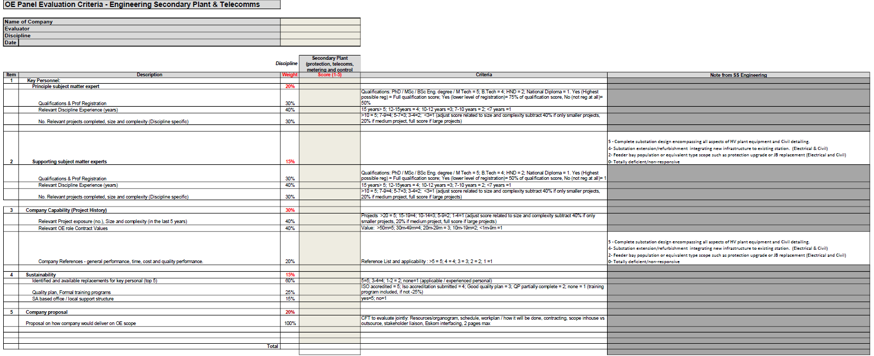
3.3 Tx. Eng. Evaluation Criteria_PTMC

Slide 16
4. Tx Design Draughting(MicroStation) _Scope
Create drawing master files
Check in/out drawings using Eskom approved configuration management systems
Print drawings as per requirements
Produce project design drawings (Electrical , Secondary plant and Civil)
Prepare hard copies of drawings for issue
All soft copies to be in Micro station V8i format
Update marked up drawings

