Slide 1
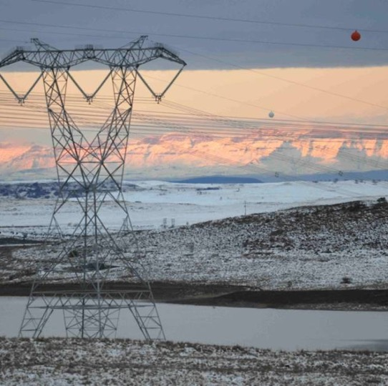
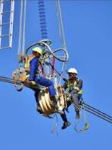
ACTIVITY SCHEDULE AND PRICE LIST –REAR AND FRONT PROJECTION SYSTEM
Presented by: Jeffrey Khangale
Date: 05 November 2024

Slide 2
ACTIVITY SCHEDULE STRUCTURE (ECC3)
  Phase 1: Detailed Design Specification (DDS)
  Phase 2: Delivery, Installation, Testing and Commissioning
  Phase 3: Site Acceptance Test (SAT)
  Phase 4: Commercial operation

Slide 3
PRICE LIST STRUCTURE (TSC3)
  Maintenance price list
  CPA formulae
  Spares
  Lifecycle cost 8 years to 15 years

Slide 4
ACTIVITY SCHEDULE AND PRICE LIST
  The Activity Schedule forms part of the Contract Documents and must be read and priced in conjunction with all the other documents comprising the Contract Documents, which include the Conditions of Tender, Conditions of Contract, Scope of work, Overview Document, and the Works information
  The Tenderer shall not under any circumstances whatsoever delete or amend any of the sums inserted in the “Amount” column of the Activity Schedule unless ordered or authorized in writing by the Employer before closure of tenders. Unauthorized changes made by the Tenderer to provisional items in the Activity Schedule, or to the provisional percentages and sums in the Summary of the Activity Schedule will lead to the disqualification of the Tenderer.

Slide 5
ACTIVITY SCHEDULE AND PRICE LIST
  The prices and rates to be inserted by the Tenderer in the Activity Schedule shall be full inclusive prices to be paid by the Employer for the work described under the several items, and shall include full compensation for all costs and expenses that may be required in and for the completion of all the work described in the Scope of work, Specification, Works information and Overview document as well as all overheads, profits, incidentals and cost of all general risks, liabilities and obligation set forth or implied in the documents on which the Tender is based.
  Each item shall be priced and extended to the “Total column” by the Tenderer, with the exception of the items for which only rates are required, or items which already Prime Cost or Provisional Sums affixed thereto.

Slide 6
ACTIVITY SCHEDULE AND PRICE LIST
  If the Tenderer omits to price any items in the Activity Schedule, then these items will be considered to have a nil rate or price.
  Arithmetic errors found in the Activity Schedule as a result of faulty multiplication or addition, will be corrected by the Employer at the tender evaluation stage

Slide 7
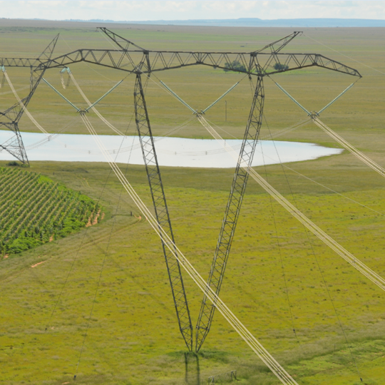
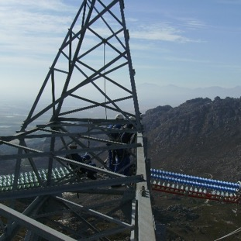
THANK YOU

