Slide 1
Request for Proposals for the Provision of Tractors and grass cutting slashers for Airports Company South Africa on an Ad hoc basis over a period of 60 months.
COR7143/2023

Slide 2
1
Welcome and Introductions
4
Tender Evaluation Criteria
2
Key dates and Instructions
Price and Preference
5
3
Background and Scope of Works
6
Questions
Notes:
s

Slide 3
1. WELCOME AND INTRODUCTIONS
ACSA’s TENDER PREPARATION & EVALUATION COMMITTEE (TPEC):
TPEC Chairperson: Alicia Sekoati
Technical Evaluator: Surajh Singh
Technical Evaluator: Marclen Stallenberg
Technical Evaluator: Siseko Tshangana
Technical Evaluator: Siphiwe Msimango
Technical Evaluator: Mzukisi Zazini
Alicia Sekoati is the only contact person for this tender process until its finalization.

Slide 4
2. KEY DATES AND INSTRUCTIONS
Key Dates:
Closing Date for Enquires: 28 July 2023
Closing Date for Submission: 4 August 2023 @ 12:00 pm
Tender Submission Instructions:
Bidders should submit their proposals via email to Alicia.Sekoati@airports.co.za only.
Please note that the email incoming message size limit is 35MB,
Please clearly label (by numbering) the emails in the subject line(E.g., COR7143/2023: XXX LTD email 1 of 7).
Ensure that all of your emails are sent/received before the deadline of 4 August 2023 @12:00PM.
Please don’t wait until the last minute to send your submissions.
ACSA will only evaluate the information sent/received before deadline. No excuses.
.
No bids will be accepted after closing time
Key Information:
Can those in attendance assist whoever will be compiling a response to this tender.

Slide 5
3. Background and scope of works
TRACTOR SPECIFICATIONS
1. Engine capacity | Minimum 88KW (bidders to quote for the closest to the minimum capacity stated- nothing less than 88KW)
2. Engine Torque | 2.1 Must have enough torque to pull slasher supplied as per specifications.
3. Fuel Type | 3.1 Diesel
4. Drive train & Transmission | 4.1 Min four speed with reverse gear, rear mechanical diff lock,4WD.
5. Steering | 5.1 Power steering
6. Clutch | 6.1 Manual gear selection 6.2 PTO for implements
7. Slasher specifications | 7.1 2/3 Rotor flex wings Slashers heavy duty 7.2 4 - 6 metre cutting width 7.3 50 mm minimum Cutting height 7.4 Solid tyres 7.5 12 - 16 x heavy duty cutting blades (3/4 per rotor) 7.6 Slip clutch protection 7.7 Heavy duty rotor gearboxes 7.8 Anti-scalp rotor protection dishes 7.9 Floating wings 7.10 Leaf-spring suspension 7.11 Parking jack
8. Cabin | 8.1 Enclosed cabin with retractable windows, adjustable driver’s seat & air-conditioned.
9. Working lights | 9.1 Standard working lights & LED (amber) star bar light mounted on top of enclosed cabin roof + rear working light and swivel flood light mounted on the roof.
10. Operators layout | 10.1 Programable Analog control panel, manual selection ergonomic controls for ease of operation.

Slide 6
3. Background and scope of works
11. Colour | 11.1 Standard as per manufacturer.
12. Signage & branding | 12.1 As per ACSA specifications supplied, numbering & company logo on both sides with reflective tape & numbering on roof. SEE APPENDIX B
13. Warranty | 13.1 Standard Manufacturer warranty (minimum of 12 months)
14. Accessories required | 13.1 Tow bar, 13.2 Fire extinguisher (2.5kg) with mounting bracket inside of cab.
15. Quantity required | 15.1 Rate based per tractor (estimated thirteen (13) tractors & thirteen (13) slashers for year one (1) 2023 order).
16. Airports for delivery | 16.1 Bram Fischer International Airport (two (2) tractors) 16.2 George Airport (three (3) tractors) 16.3 King Shaka International Airport (two (2) tractors) 16.4 King Phalo Airport (two (2) tractors) 16.5 Kimberly Airport (two (2) tractors) 16.6 OR Tambo International Airport (two (2) tractors) The above is estimated airport sites and number of units required for first order placement (2023). ACSA will confirm the specific delivery sites at contracting stage. Other possible sites after year one (1): 16.7 Cape Town International Airport 16.8 Upington Airport 16.9 Chief Dawid Stuurman International Airport

Slide 7
3. Background and scope of works
17. Mandatory requirements | 17.1 OEM letter of support/document confirming that maintenance support exists at all the various airport regions where the tractors will be delivered (as per above listed airports). The bidders are required to provide a detailed list of accredited dealers, workshops, or service providers in each of the town or cities where the airports are located, that will assist with aftermarket service (spares supply, warranty & maintenance).
18. Registration & licensing | 18.1 The supplier shall register & license the tractors on ACSA’s name at the specific registering authority per relevant region/s.
19. On road charges | 19.1 Delivery (to airport destination) and Handling (registration & licensing) charges to be included in price.
20. Onsite training | 20.1 Once-off introductory operator training for six (6) people per site.
21. Implements | 21.1 The tractor offering from the bidders must be adaptable to front load buckets, grass bailers, sprayers, slashers, rakes etc

Slide 8
3. Background and scope of works
Supply and fitment of any additional accessories as per specifications.
Supply of slashers as per specification.
Apply signage and branding as per ACSA’s specification (as provided).
The Bidder will be expected to process the homologation, registration and licensing of the tractors to be categorised as a specialised vehicles into Airports Company South Africa’s (ACSAs) name at the respective regions local traffic authorities.
Pre-delivery inspections and acceptance testing.
Delivery to the specified airports.
Additional Scope
The bidder must provide a standard manufacturer warranty (minimum of 12 months).
The bidder will be expected to provide basic training to operators and provide operator manuals.
All outsourced costs and accessories, signage and branding requirements must be included in the bid offer

Slide 9
3. Background and scope of works
The Bidder must provide these additional insurances:
Goods in Transit Insurance; against all risks of physical loss or damage while in transit by sea, air, road or rail from country or place of origin anywhere in the world to the site in the Republic of South Africa. The cost for Insurance shall be for the bidders own account.
Factory/dealer acceptance test
Each Tractor shall be subjected to an acceptance test program prior to shipment/delivery. The test shall be conducted in the presence of ACSA company representatives, unless otherwise advised in writing by the Company and shall be in accordance with the bidder’s quality control programme. The acceptance test shall be conducted for a period of one (1) day or as agreed between the parties.

Slide 10
4. TENDER EVALUATION CRITERIA
MANDATORY REQUIREMENTS
Sign and initial each page of the tender document
Complete the entire tender document in full
Accepted the Airports Company South Africa’s tender terms and conditions. (Section 5.5)
Completed the Bidder’s Disclosure (SBD4) (Section 5.2)
TECHNICAL REQUIREMENTS
The overall minimum required score for this tender is 70 points
Failure to achieve any of the minimum scores would result in disqualification for further consideration even if the overall minimum total score had been achieved.

Slide 11
4. TENDER EVALUATION CRITERIA
# | EVALUATION CRITERIA | Min | Max
1 | DELIVERY ON SITE FROM PURCHASE ORDER DATE: More than 8 months = 0 points More than 6 months to a maximum of 8 months = 30 points From 4 to 6 months- 40 points Less than 4 months = 50 points Bidders must include a detailed preliminary Scope of Programme indicating each stage from order date to delivery on site. Lead times for each stage to be included (e.g., manufacturing, shipment, delivery to site etc). Bidders that only provide a delivery date and not a detailed scope of programme will be penalised with 0 points. For illustrative purposes use 01 August 2023 as the purchase order date for an estimated thirteen (13) tractors and thirteen (13) grass cutting slashers for year one (1) of the supply period. | 30 | 50
Scope of Programme
Must demonstrate all of the following:
A breakdown of the entire process from the order date of 1 August 2023 to the final delivery date
Must be detailed with timelines for each stage of the process
Estimated dates of delivery at each site
If your scope of programme is not detailed you will be awarded 0 points
1.2 | CLIENT REFERENCE LETTERS Provide a signed/stamped client Reference letter with Client letterhead, with contactable references for each project listed in Annexure 10.

Slide 12
4. TENDER EVALUATION CRITERIA
2 | DECLARATION OF COMPLIANCE TO THE TECHNICAL SPECIFICATIONS FOR THE TRACTOR AND GRASS CUTTING SLASHERS (SEE APPENDIX C) Bidders are required to comply 100% on the specifications of the tractors and grass cutting slashers. Meets 100% compliance =30 points Non-compliance= 0 points | 30 | 30
REQUIREMENTS:
Complete Appendix C in full or you will receive 0 points
Mark each row with a ‘yes’ or ‘no’ to indicate whether the appropriate specification is met
Make a comment with further details in the ‘comment’ column
In order to meet this requirement and receive 30 points, you have to tick ‘yes’ and meet each of the specifications listed
See example below:
TRACTOR SPECIFICATIONS |  | PLEASE MARK THE APPROPRIATE COLUMN |  | COMMENT
 |  | YES | NO
1. Engine capacity | 1.1 Minimum 88KW (bidders to quote for the closest to the minimum capacity stated- nothing less than 88KW) | ✓ |  | Engine capacity is 100KW
2. Engine Torque | 2.1 Must have enough torque to pull slasher supplied as per specifications. | ✓ |  | 250 Nm

Slide 13
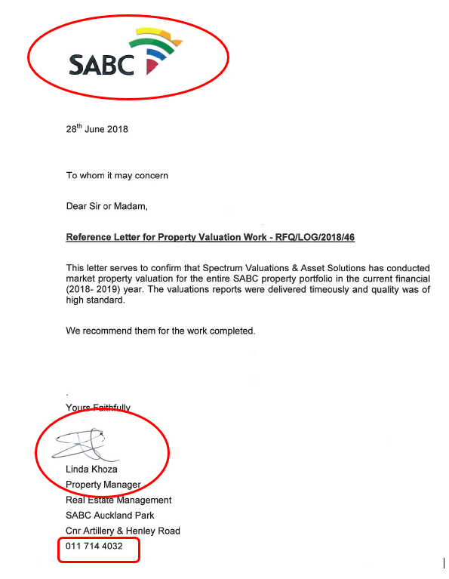
4. TENDER EVALUATION CRITERIA
3. | REFERENCES Provide three (3) relevant signed/stamped client Reference letters [with Client letterhead and contactable (email & contact number) references] from three (3) different companies/clients providing proof that you supplied and delivered tractors within the last 10 years (2013-2023). ACSA reserves the right to verify the reference letters a) Less than three (3) relevant reference letters = 0 Points b) Three (3) reference letters =10 Points c) More than three (3) references = 20 Points | 10 | 20
 | TOTAL | 70 | 100
Client letterhead
REQUIREMENT:
3 Reference letters from 3 different companies/clients
Reference received between 2013 and 2023
Call the references to ensure that they are indeed contactable
Client siganture
Client contact number and email

Slide 14
5. PRICE AND PREFERENCE
This stage of the evaluation process will be based on the PPPFA preference point system. Bidders will be ranked by applying the preferential point scoring 80/20 for bids
PRICE (80)
Complete Appendix A in full
Place R0.00 for items you will not charge ACSA for (don’t leave blanks)
The prices/rates provided are final and no further amounts will be awarded to the winning bidder
NOTES:
The prices shall be indicated in South African Rand (ZAR) where there is a foreign exchange component for imported goods, it is the bidder’s responsibility to include this cost in the total bid offer.
The prices shall exclude Value Added Tax (15%).
The prices shall include escalation, which shall be an annual increase that is market related.
The prices / rates shall be fixed for the 5-year supply period.
The prices/rates applicable shall be in accordance with the year of order placement.

Slide 15
5. PRICE AND PREFERENCE
ITEM NO. | DESCRIPTION | QUANTITY(EACH) | YEAR 1: 2023 | YEAR 2: 2024 | YEAR 3: 2025 | YEAR 4: 2026 | YEAR 5: 2027
1 | Unit Price for Tractor as per specification | 1 x Unit | R | R | R | R | R
2 | Grass cutting slasher as per specification | 1x Unit | R | R | R | R | R
3 | All accessories and signage costs as per specification | 1x tractor | R | R | R | R | R
4 | Registration & licensing costs(each)for Tractors | 1x tractor | R | R | R | R | R
5 | Delivery cost Bram Fischer International Airport | 1x tractor | R | R | R | R | R

Slide 16
5. PRICE AND PREFERENCE
6 | Delivery cost George Airport | 1x tractor | R | R | R | R | R
7 | Delivery cost King Shaka International Airport | 1x tractor | R | R | R | R | R
8 | Delivery cost King Phalo Airport | 1x tractor | R | R | R | R | R
9 | Delivery cost Kimberly Airport | 1x tractor | R | R | R | R | R
10 | Delivery cost O.R. Tambo International Airport | 1x tractor | R | R | R | R | R
11 | Delivery cost Cape Town International Airport | 1x tractor | R | R | R | R | R
12 | Delivery cost Upington Airport | 1x tractor | R | R | R | R | R
13 | Delivery cost Chief Dawid Stuurman International Airport | 1x tractor | R | R | R | R | R
14 | TOTAL PRICE (Excluding 15 % VAT) | Each | R | R | R | R | R
15 | 15 % Value Added Tax | Each | R | R | R | R | R
16 | TOTAL PRICE (Including 15 % VAT) | Each | R | R | R | R | R

Slide 17
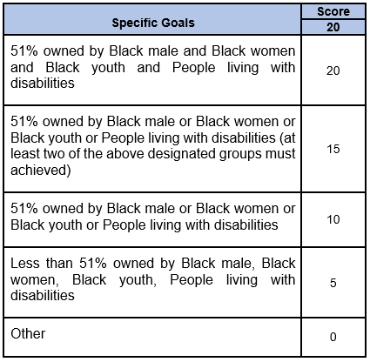
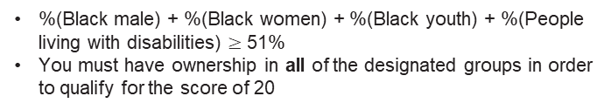
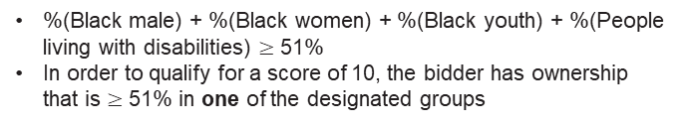
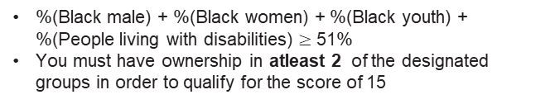
5. PRICE AND PREFERENCE
PREFERENCE (20)
ACSA will score specific goals out of 20 in accordance with the PPP Regulations 2022/2023.
%(Black male) + %(Black women) + %(Black youth) + %(People living with disabilities) $≥$ 51%
You must have ownership in all of the designated groups in order to qualify for the score of 20
%(Black male) + %(Black women) + %(Black youth) + %(People living with disabilities) $≥$ 51%
You must have ownership in atleast 2 of the designated groups in order to qualify for the score of 15
%(Black male) + %(Black women) + %(Black youth) + %(People living with disabilities) $≥$ 51%
In order to qualify for a score of 10, the bidder has ownership that is $≥$ 51% in one of the designated groups
%(Black male) + %(Black women) + %(Black youth) + %(People living with disabilities) < 51%
Any % ownership in groups other than those stated in this table

Slide 18

5. PRICE AND PREFERENCE
PREFERENCE
In order to determine your preference score, bidders are required to provide a BEE Certificate (issued by a Verification Agency accredited by SANAS) and Scorecard or BBBEE QSE/EME sworn Affidavit including scorecard
E.g.

Slide 19

5. PRICE AND PREFERENCE

Slide 20
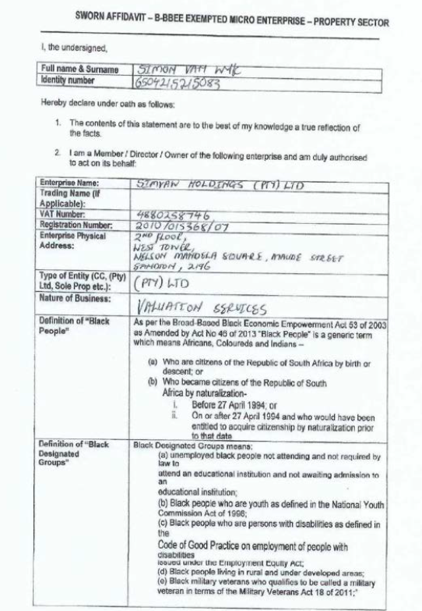
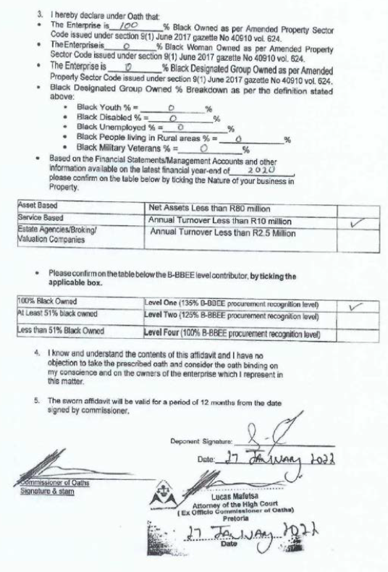
5. PRICE AND PREFERENCE

Slide 21
QUESTIONS

