Slide 1
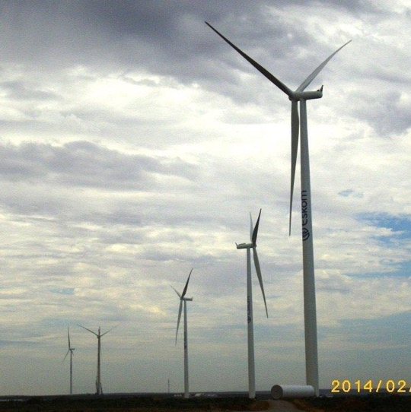
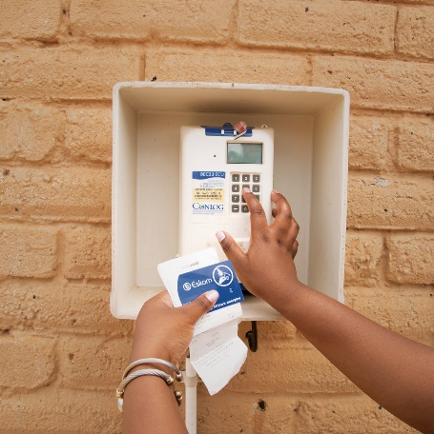
Site clarification for Renewable and Digital Training Centres
30 January 2024

Slide 2
Renewable and Digital Training Centre
Renewable energy training programme (course material, assessments, accreditation, training of Eskom trainers)
Establishment of a renewable energy training centre (infrastructure, available renewable technologies)
Aesthetics - offering a sleek, refined design, futuristic look, and ambiance at its academy of learning.
Digital learning tools: Virtual reality (Virtual tours of power plants) etc.

