Slide 1
TENDER CLARIFICATION PRESENTATION
EASTERN REGION

Slide 2
CONTRACT SANRAL N.011-040-2020/2F
CONSULTING ENGINEERING SERVICES FOR THE PERIODIC MAINTENANCE ON NATIONAL ROUTE N11, SECTION 4, FROM NCANDU RIVER (km 0.00) TO INGOGO STATION (km 21.3)
Tender documents are available from 18 November 2022 at no cost in electronic format downloadable from the SANRAL’s website by following the link: https://www.nra.co.za/sanral-tenders/status?region_id=national.
Tenderers must have access to Microsoft © Office 2013 and Acrobat Adobe © 9.0 or similar compatible software.

Slide 3
CONTRACT SANRAL N.011-040-2020/2F
NB: IN THE EVENT OF ANY INCONSISTENCIES IN THIS PRESENTATION AND TENDER DOCUMENT, THE TENDER DOCUMENT SHALL TAKE PRECEDENCE UNLESS CONFIRMED IN AN ADDENDUM

Slide 4
1. WELCOME & INTRODUCTION

Slide 5
2. IMPORTANT DATES

Slide 6
IMPORTANT DATES
SUBMISION OF FORM A1 CERTIFICATE CONFIRMING THAT THE TENDERER READ THE PRESENTATION BRIEFING OR ATTENDED THE NON- COMPULSORY CLARIFICATION MEETING | 25 November 2022
SUBMISSION OF QUERIES | 2 December 2022
TENDER CLOSING DATE | 9 December 2022

Slide 7
3. TENDERING PROCEDURES
T1.1: TENDER NOTICE AND INVITAION TO TENDER

Slide 8
PREQUALIFICATION REQUIREMENTS
PREQUALIFICATION REQUIREMENTS FOR THIS CONTRACT
Eligibility Criteria
Only tenderers with a B-BBEE contributor status level of 1, 2, 3 or 4, who meets the minimum requirements for the key persons; who are registered on the National Treasury Central Supplier Database at the tender closing date as stipulated in Clause C.2.1, are eligible to tender.
Joint Ventures (JV) will be allowed on condition that one JV partner is a Targeted Enterprise. The JV partner will, however, not contribute to sub-contract target for Targeted Enterprises.

Slide 9
T1.1 ENQUIRES
Queries relating to issues arising from these documents may be addressed to the following:
ALL ENQUIRIES
Contact Person | ProcurementER6@sanral.co.za

Slide 10
3. TENDERING PROCEDURES
T1.2: TENDER DATA

Slide 11
CONDITIONS OF TENDER
The conditions of tender are the standard conditions of tender as contained in Annexure C of the CIDB STANDARD FOR UNIFORMITY IN ENGINEERING AND CONSTRUCTION WORKS CONTRACTS as per Government Notice No. 423 published in Government Gazette No. 42622 of 08 AUGUST 2019 and as amended from time to time. (see https://www.cidb.org.za/wp-content/uploads/2021/07/Standard-for-Uniformity-August-2019.pdf).
The standard conditions of tender make several references to the tender data for details that apply specifically to this tender. The tender data shall have precedence in the interpretation of any ambiguity or inconsistency between the tender data and the standard conditions of tender.
Each item of data given below is cross-referenced to the clause marked “C” in the above-mentioned Standard Conditions of Tender.

Slide 12
TENDER DATA
The Standard Conditions is the standard conditions of tender as contained in Annexure C of the CIDB STANDARD FOR UNIFORMITY IN ENGINEERING AND CONSTRUCTION WORKS CONTRACTS and the Employer’s Special Conditions of Tender for Procurement make several references to the Tender Data for details that apply specifically to this tender. The Tender Data shall have precedence in the interpretation of any ambiguity or inconsistency between it and the standard/special conditions of tender.
Each item of data given below is cross-referenced to the clause marked “C” in the above mentioned Standard Conditions of Tender and Special Conditions of Tender to which it mainly applies

Slide 13
TENDER DATA
CLAUSE NUMBER | TENDER DATA
C1.1 | The Employer is The South African National Road Agency SOC Limited (SANRAL). The Employer’s domicilium citandi et executandi (permanent physical business address) is: 48 Tambotie Avenue VAL DE GRACE 0184 The Employer’s address for communication relating to this project is: SANRAL – Eastern Region 58 Van Eck Place Mkondeni Pietermaritzburg, 3201

Slide 14
TENDER DATA
CLAUSE NUMBER | TENDER DATA
C1.4 | The Employer’s Agent during the tender period is Email: ProcurementER6@sanral.co.za Tenderers to Note. This email address is NOT for submission of tender offers. Tenderers who submit via the above email address will be immediately disqualified.
C1.6 | Procurement Procedures A two-envelope system will be followed.

Slide 15
TENDER DATA
C2.1 | Only those tenderers who satisfy the following criteria are eligible to submit tenders: Meet the minimum requirements for the key persons as stated in the Scope of Works in Clause C.3.1.11: Personnel requirements; excluding 3.1.11(f), which is dealt with under Tender Data C.3.13(k). The Key Persons required for this project are: NB: Failure to meet the stipulated minimum eligibility requirements will render the tender non-responsive
Position | Minimum Qualification/Registration | Minimum Relevant Experience (years)
Project Leader Design Specialist: Pavement & Materials | Pr Eng¹ or Pr Tech Eng¹ | 10
1 Registered with Engineering Council of South Africa (ECSA) or any other international body recognised by ECSA, i.e. Washington Accord, Dublin Accord and Sydney Accord.
3 Relevant experience is the actual number of years, measured from the date of acquiring the base NQF qualification (either B.Eng / BSc.Eng / B.EngSci or BSc / B.Eng Tech (Hon) / PGDip (Engineering) / M.Eng for Pr.Eng or National Higher Diploma / Masters Diploma / BTech / B.Eng Tech / Dip Eng / Adv Dip Eng / AdvCert (Engineering Practice) plus Adv Dip Eng for Pr.Tech Eng and National Diploma / Dip Eng / Dip Eng Tech / AdvCert (Engineering Practice) / Higher Certificate (Eng) / Adv Cert (Engineering) / Adv Cert (Engineering Practice) for Pr.Techni Eng), worked in the field of the specified position. For the road safety audit team leader the field shall be road safety design and/or traffic and transportation engineering and/or geometric design.

Slide 16
TENDER DATA
C.2.1 | Only those tenderers who satisfy the following criteria are eligible to submit tenders: KEY PERSONS (CONT) If a tenderer, including key persons, a joint venture partner or a Targeted Enterprise, submits or participates in more than one tender for the same project (SANRAL N.011-040-2020/2F) , then all such tenders shall be disqualified (Tender Data C2.13.1) . When a proposed candidate for any position is not in the permanent employ of the tenderer but a contracted person, this must be indicated on form B2 and a signed letter of consent from the candidate must be submitted with the relevant B-forms. Where a proposed candidate for any position is a permanent staff member of the Tenderer - this must be indicated on form B2 and a signed letter of confirmation must be submitted with the relevant B forms. NB: Submit alternative candidates for positions identified, that could have possible conflict, by completing separate Returnable Schedules Forms B1 and B2 for the alternate. The Employer will not request alternative candidates after tender closure and will interpret the lack of any alternative candidate as an indication the tenderer accepts that it will be impossible to be awarded more projects than the limitations applicable to Key Persons. NB: Failure to meet the stipulated minimum eligibility requirements will render the tender non-responsive

Slide 17
TENDER DATA
CLAUSE NUMBER | TENDER DATA
C.2.1 (cont.) | (b) Registered on National Treasury Central Supplier Database. Tenderers, or in the event of a Joint Venture or a Targeted Enterprise, each member of the Joint Venture or Targeted Enterprise, shall be registered on the National Treasury Central Supplier Database at the closing date for tender submissions. If not registered as verified online at tender closing, the tender will be declared non-responsive. (c) Criteria for preferential procurement. Tenderers that have a B-BBEE contributor status level of 1, 2, 3 or 4. Tenderers shall submit a valid B-BBEE certificate or Sworn Affidavit (where applicable) in compliance with Tender Data C.3.11. as proof of eligibility. Failure to satisfy the eligibility criteria may result in a non-responsive tender.

Slide 18
TENDER DATA
C.2.6 | Acknowledging addenda Failure non-responsive in terms of condition of tender C.3.8. Failure to apply instructions contained in addenda may render a tenderer’s offer non-responsive in terms of condition of tender C.3.8.-responsive in terms of condition of tender C.3.8.
C.2.7 | Clarification briefing Non-Compulsory clarification meeting (Virtual) A tender clarification briefing presentation is available to be downloaded from the SANRAL website by the following link https://www.nra.co.za/sanral-tenders/status?region_id=national A non- compulsory clarification briefing meeting will be held via a virtual platform on 25 November 2022 at 11h00, where the project will be presented. A link to the clarification briefing meeting is: Click here to join the meeting A tenderer’s representative cannot represent more than one tenderer at the tender briefing meeting.
C.2.8 | Seeking clarification Request clarifications at least 7 working days before the closing date.
C.2.10 | Tenderers are required to state the rates and currencies in Rand. All rates and/or sums tendered shall not be negative.

Slide 19
TENDER DATA
C.2.12 | Alternative tender offers Alternative offers are generally not acceptable due to possible manipulation of the tender process and resulting complexity of the evaluation. Therefore, the submission of alternative tenders is strongly discouraged. The submission of alternative key persons will be declared non-responsive, even if submitted with an alternative financial offer. However, a tenderer wishing to submit an alternative offer shall first apply to the Em­ployer with full details of the principles of the alternative for confirmation that the Em­ployer’s standards and requirements are not compromised or reduced. Such con­firmation must have been provided by the Employer in writing at least 5 (five) working days before the date of tender closing, or as extended by an addendum sent to all tenderers. The application shall not be submitted later than 7 (seven) working days before the date of tender closing given in Tender Data Clause C.2.15. Acceptable alternative offers will only be considered from a tenderer with the highest number of evaluation points for the main offer.

Slide 20
TENDER DATA
CLAUSE NUMBER | TENDER DATA
C.2.13.1 | Submitting a tender offer - Participation in More Than One Tender If a tenderer, including key persons, a joint venture partner or a Targeted Enterprise, submits or participates in more than one tender for the same project (SANRAL N.011-040-2020/2F) , then all such tenders shall be disqualified.
C.2.13.3 | General Submission Requirements: The returnable documents shall be electronically completed in their entirety, submitted on the issued software format or fully compatible format, unless otherwise specified. Wherever it is a requirement that the tenderer has to provide hours to match the price tendered and failed to do so, such imbalance cannot be corrected and will be declared non-responsive. Submit the tender offer electronically on a flash drive. (In the relevant MS Word 2013 and MS Excel 2013 format as issued, and not in .pdf format, except where so specified.)

Slide 21
TENDER DATA
CLAUSE NUMBER | TENDER DATA
C.2.13.6 | A two-envelope procedure will apply as follows: A folder is provided marked “TECHNICAL PROPOSAL” a. Ensure that all returnable schedules listed in T2.1 List of Returnable Schedules for inclusion in the Technical Proposal and listed in the Technical Proposal folder are electronically completed (all A-Forms on the provided MS Word file and convert to pdf. As all B-Forms on the provided MS Excel file). Wherever it is a requirement to attach certificates or letters to the returnable schedules, these should be scanned in.pdf format. b. Upload the A-Forms (pdf.), B-Forms (excel and pdf) and certificates or letters (pdf.) on the flash drive. The completed flash drive should be marked with the tenderer’s company name, the project number and description and marked “TECHNICAL PROPOSAL”. b. Scan and insert a valid B-BBEE certificate. c. Scan and insert a copy of the completed Form C2.4: Key Persons for this Project. d. Electronically sign the declaration in the folder. e. Insert the electronically completed flash drive in an envelope marked “TECHNICAL PROPOSAL”.

Slide 22
TENDER DATA
CLAUSE NUMBER | TENDER DATA
C.2.13.6 | A folder is provided marked “FINANCIAL PROPOSAL” a. Ensure that all returnable schedules listed in T2.1 List of Returnable Schedules for inclusion in the Financial Proposal and listed in the Financial Proposal folder are electronically completed on a flash drive (Contract Data and Pricing Schedule). Wherever it is a requirement to attach letters or certificates to the returnable schedules, these should be scanned in, on the flash drive in .pdf format. The completed flash drive should be marked with the tenderer’s company name, the project number and description and marked “FINANCIAL PROPOSAL”. b. Electronically sign the declaration in the folder. c. Complete and electronically sign the Form of Offer and scan into the folder. A draft copy of this form is provided. d. Scan and insert a copy of the Summary of Pricing Schedule into the folder. e. Insert the electronically completed flash drive in an envelope marked “FINANCIAL PROPOSAL – DO NOT OPEN WITH TECHNICAL PROPOSAL”. f. Place and seal the signed and completed booklet with the electronically completed flash drive in an envelope marked “FINANCIAL PROPOSAL - DO NOT OPEN WITH TECHNICAL PROPOSAL”. 3. Each envelope shall state on the outside the Employer’s address, contract number and title as well as the Tenderer’s name, authorised representative’s name, postal address and contact telephone numbers.

Slide 23
TENDER DATA
CLAUSE NUMBER | TENDER DATA
C.2.13.6 | 4. Seal both envelopes in an outer envelope with the words “TENDER” clearly marked and bearing the Employer’s name, contract number and description as well as the Tenderer’s authorised representative’s name, postal address and contact details. SANRAL will not be held liable where the tenderer submit an electronic tender that cannot be accessed. The tenderer will be declared non-responsive if a tenderer submits: • One (1) envelope with 1 (one) document or 1 (one) flash drive (technical and financial); • Incorrectly labelled envelopes where the financial offer is labelled technical and the technical offer is labelled financial.

Slide 24
TENDER DATA
CLAUSE NUMBER | TENDER DATA
C.2.15 | The closing time for submission of tender offers is 11:00 on 9 December 2022.
C.2.16.1 | The tender offer validity period is: 180 days.

Slide 25
TENDER DATA
CLAUSE NUMBER | TENDER DATA
C.2.16.3 | Withdrawal of tender offers Where a tenderer, at any time after the opening of his tender offer but prior to entering into a contract based on his tender offer: (a) withdraws his tender; (b) gives notice of his inability to execute the contract in terms of his tender; or (c) fails to comply with a request made in terms of C.2.17, C.2.18 or C.3.9, such tenderer shall be barred from tendering on any of the Employer’s tenders for a period to be determined by the Employer, but not less than 6 (six) months from a date determined by the Employer. This sanction also applies to tenders under evaluation and not yet awarded. This sanction does not apply to tenders under evaluation where a request for extension for the validity period was not accepted by the tenderer. The Employer may fully or partly exempt a tenderer from the provisions of this conditions if he is of the opinion that the circumstances justify the exemption.

Slide 26
TENDER DATA
CLAUSE NUMBER | TENDER DATA
C.2.18 | Provide other material Any additional information requested under the clause must be provided within 5 (five) working days of date of request.
C.3.1.1 | The Employer shall respond to clarifications received up to 7 (seven) working days before tender closing date. The Employer shall respond to any clarifications from the tenderers emanating from the addenda until 3 working days before tender closing date.
C.3.2 | The employer shall issue addenda until 5 (five) working days before tender closing date.
C.3.4.1 | Tender Opening The time for opening of tender offers via live streaming are: Time: 11h00 on 9 December 20222 Location: Click here to join the meeting

Slide 27
TENDER DATA
CLAUSE NUMBER | TENDER DATA
C.3.7 | Grounds For Rejecting a tender offer in case of corrupt of fraudulent practices Prior to disqualification, the Employer shall inform the tenderer and give the tenderer an opportunity to make representations within 14 days as to why the tender submitted should not be disqualified and as to why the tenderer should not be restricted by the National Treasury from conducting any business with any organ of state for a period not exceeding 10 years. In the event of disqualification, the Employer may, at its sole discretion, claim damages from the tenderer and impose a specified period during which tender offers will not be accepted from the offending tenderer and, the Employer shall inform the National Treasury in writing.
C.3.11 | The minimum percentage of evaluation points for quality is not less than 70%.

Slide 28
TENDER DATA
CLAUSE NUMBER | TENDER DATA
C.3.9 | Arithmetical errors, omissions, discrepancies and imbalanced unit rates Check responsive tenders for discrepancies between amounts in words and amounts in figures. Where there is a discrepancy between the amounts in figures and the amount in words, the amount appearing in the summary to the Pricing Schedule shall govern. Check responsive tender offers for: (a) the gross misplacement of the decimal point in any unit rate; (b) omissions made in completing the Pricing Schedule or Bills of Quantities; or (c) arithmetic errors in: (i) line item totals resulting from the product of a unit rate and a quantity in Bills of Quantities or Schedules of Prices; or (ii) the summation of the prices; (d) imbalanced unit rates. Notify shortlisted tenderers of all errors, omissions or imbalanced rates that are identified in their tender offers.

Slide 29
TENDER DATA
CLAUSE NUMBER | TENDER DATA
3.9 Continued | Where the tenderer elects to confirm the errors, omissions or re-balancing of imbalanced rates the tender offer shall be corrected as follows: (a) if Bills of Quantities or Pricing Schedules apply and there is an error in the line item total resulting from the product of the unit rate and the quantity, the unit rate shall govern and the line item total shall be corrected. Where there is an obviously gross misplacement of the decimal point in the unit rate, the line item total as quoted and the unit rate shall be corrected. (b) Where there is an error in the total of the prices either as a result of other corrections required by this checking process or in the tenderer’s addition of prices, the total of the prices shall be corrected. (c) Where the unit rates are imbalanced, adjust such rates by increasing or decreasing them and selected others while retaining the total of the prices derived after any other corrections made under (a) and (b) above. Where there is an omission of a line item, no correction is possible and the offer will be declared non-responsive. Declare as non-responsive and reject any offer from a tenderer who elects not to accept the corrections proposed and subject the tenderer to the sanction under 4.16.2. The tenderer is required to submit balanced unit rates for Rate Only items in the Pricing Schedule. The rates submitted for these items will be taken into account in the evaluation of tenders.

Slide 30
TENDER DATA
CLAUSE | TENDER
C.3.11 | The procedure for the evaluation of responsive tenders is Method 3. If two or more tenderers score an equal total number of points and these tenders are also the highest ranked tenders, the tender with the highest preference points will be recommended for award. If functionality is part of the evaluation process and two or more tenderers score equal total points and equal preference points, the tenderer that scored the highest points for functionality will be recommended for award. If two or more tenderers score equal total points in all respects, the tenderer to be recommended for award will be decided by the drawing of lots.

Slide 31
TENDER DATA
CLAUSE | TENDER
C.3.11 (Cont.) | The value of W₁ is: 1. 90 where the financial value, inclusive of VAT, of the lowest responsive tender offer received has a value in excess of R50 000 000.00; or 2. 80 where the financial value, inclusive of VAT, of the lowest responsive tender offer has a value that equals or is less than R50 000 000.00. The value of A will be calculated utilising the following formula: A = (1 – (P – Pm) / Pm) Where: P is the comparative offer of the tender offer under consideration and Pm is the comparative offer of the most favorable comparative offer In the event that the calculated value is negative, the allocated score shall be 0 (zero). If the calculated value is negative, the allocated score shall be 0 (zero).

Slide 32
TENDER DATA
CLAUSE | TENDER
C.3.11 (cont) | Points awarded will be according to a tenderer’s B-BBEE status level of contributor and summarised in the table below:
B-BBEE Status Level of Contributor | Number of Points for Financial value up to and including R50,000,000 | Number of Points for Financial value above R50,000,000
1 | 20 | 10
2 | 18 | 9
3 | 14 | 6
4 | 12 | 5

Slide 33
TENDER DATA
CLAUSE | TENDER
C.3.11 (continued) | Eligibility for preference points will be determined as follows: Eligibility for preference points is subject to the following conditions: i) A tenderers’ scorecard shall be a B-BBEE Verification Certificate issued in accordance with: - the amended Construction Sector Codes published in Notice 931 of 2017 of Government Gazette No 41287 on 1 December 2017 by the Department of Trade and Industry. - In the event that the Measured Entity operates in more than one sector or a sub-sector (e.g. Contractor or BEP) the scorecard for the sector or sub-sector in which the majority of its core activities (measured in terms of annual revenue) are located will be acceptable, The tenderer must comply with the annual revenue thresholds for EME or QSE or Generic in accordance with the amended Construction Sector Codes published in Notice 931 of 2017 of Government Gazette No 41287 on 1 December 2017 by the Department of Trade and Industry.

Slide 34
TENDER DATA
C.3.11 (cont) | Eligibility for preference points will be determined as follows: Joint Ventures (JV) will be allowed on condition that one JV partner is a Targeted Enterprise. The JV partner will, however, not contribute to sub-contract target for Targeted Enterprises. ii) The scorecard shall be submitted as a certificate attached to Returnable Schedule Form D1; and iii) The certificate shall: (i) Be valid at the closing date; and (ii) Have been issued by a verification agency accredited by the South African National Accreditation System (SANAS); or (iii) Be in the form of a sworn affidavit (accompanied by financial statement or Management Account on the latest financial year) in the case of an Exempted Micro Enterprise (EME) with a total annual revenue of less than R1.8 million, if issued in accordance with the amended Construction Sector Codes published in Notice 931 of Government Gazette No 41287 on 1 December 2017 by the Department of Trade and Industry; and Have a date of issue less than 12 (twelve) months prior to the tender closing date (see Tender Data 4.15); and iv) Compliance with any other information requested to be attached to Returnable Schedule Form D1; and v) In the event of an un-incorporated Joint Venture (JV), a valid project specific consolidated B-BBEE Verification Certificate in the name of the JV shall be submitted,; and vi) If the tender documents indicate that the tenderer intends sub-contracting more than 25% of the value of the contract to any other person not qualifying for at least the status level that the tenderer qualifies for, 0(zero) points for preference will be awarded, unless the intended sub-contractor is an EME that has the capability to execute the sub-contract.

Slide 35
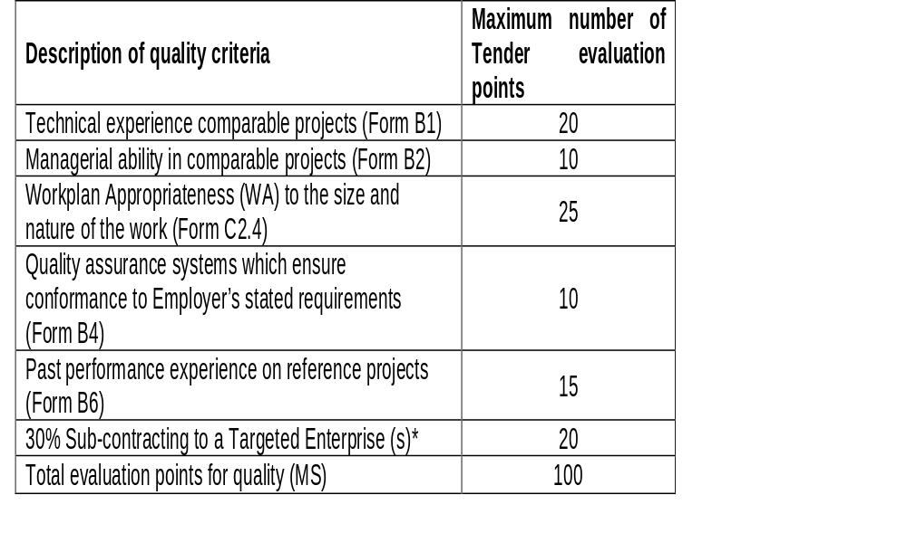
TENDER DATA
C.3.11 | Scoring quality The quality criteria and maximum score (including the relevant returnable schedule to calculate the score) in respect of each of the criteria are as follows: The minimum number of evaluation points for quality is not less than 70%. If a Tenderer scores less than 10 points for sub-contracting, they will be deemed non-responsive and will not be evaluated further.

Slide 36
TENDER DATA
C.3.11. | Scoring quality: Key Personnel Key persons shall be used to calculate the technical experience and managerial ability score. When a proposed candidate for any position is not in the permanent employ of the tenderer but a contracted person, this must be indicated on form B2 and a signed letter of consent from the candidate must be submitted with the relevant B-forms. Each proposed candidate shall complete the relevant B1 and B2 forms Design Specialists (DS) and Assistant Design Specialists (ADS) (if applicable) will be limited to participate in a maximum number of 6 (six) conventional contracts in the design phase with the Employer which will be complete after the Detailed Design report is accepted by the Employer.

Slide 37
TENDER DATA
C.3.13 | The conditions stated in clauses C.3.13(a) to (f) of the Conditions of Tender as well as the following additional clauses C.3.13(g) to (k) shall be applied as objective criteria in terms of section 2(1)(f) of the Preferential Procurement Policy Framework Act, 2000 (Act No. 5 of 2000) and as compelling and justifiable reasons not to award to the highest scoring tenderer: g) the tenderer or any of its directors is not listed on National Treasury’s Register of Tender Defaulters or Restricted Suppliers, or the Employer’s database, in terms of the Prevention and Combating of Corrupt Activities Act, 2004 (Act No 12 of 2004) as a tenderer or person prohibited from doing business with the public sector; h) the tenderer has not abused the Employer’s supply chain management system; and i) the tenderer has not failed to perform on any previous contract and has not been given a written notice to this effect. j) the tenderer is tax compliant. The recommended tenderer who becomes non-compliant, prior to award, shall be notified and must become compliant within 7 working days of the date of being notified. A recommended tenderer who remains non-compliant after the 7 working days of being notified, shall be declared non-responsive. k) the proposed Key Persons are not fully committed to the maximum number of projects in which they can participate, see Clause C3.1.11(f) in the Scope of Works

Slide 38
TENDER DATA
C.3.13 (cont) | In addition to the requirements in the Conditions of Tender, with regard to, where the associated risk is foreseen, in the event that a due diligence is performed as part of the tender evaluation, the due diligence report will be used to evaluate the tenderer’s ability to perform the contract as stated in sub-clause C.3.13 (b). The due diligence will evaluate the overall risk associated with the tender. The due diligence will take into consideration the following: • Assessment of financial statements to assess the financial position of the tenderer and its ability to obtain the necessary guarantees or insurances; • Integrity risk evaluation; • Operations, activities, locations and key customers; • Reference checks from previous clients; and • Risk rating (i.e. high risk, medium to high risk, medium risk or low risk) of the tenderer.

Slide 39
TENDER DATA
C.3.17 | Providing copies of the contracts The Employer will provide 1 (one) signed contract document to the Service Provider.
C.3.18 | Providing written reasons for actions taken All requests shall be in writing.
SPECIAL CONDITIONS OF TENDER CLAUSES:
SC3.19 | Jurisdiction Unless stated otherwise in the Tender Data, each tenderer and the Employer undertake to accept the jurisdiction of the law courts of the Republic of South Africa.

Slide 40
3. TENDERING PROCEDURES
PART T2: RETURNABLE SCHEDULES

Slide 41
PART T2: RETURNABLE SCHEDULES
Notes to tenderer:
1. Returnable schedules have been based on the CIDB Standard for Uniformity in Construction Procurement and incorporates National Treasury requirements within them. Returnable schedules are separated into the following categories:
i) Forms, certificates and schedules for completion by the tenderer for use in the quantitative and qualitative evaluation of the tender (Forms A, B, C and D).
ii) A list of other returnable documents for completion by the tenderer and which will subsequently be incorporated into the contract (Section C1).
2. Failure to fully complete the relevant returnable documents shall render such a tender offer to be declared non-responsive.
3. Tenderers shall note that their signatures appended to each returnable form represents a declaration that they vouch for the accuracy and correctness of the information provided, including the information provided by candidates proposed for the specified key positions.
4. Notwithstanding any check or audit conducted by or on behalf of the Employer, the information provided in the returnable documents is accepted in good faith and as justification for entering into a contract with a tenderer. If subsequently any information is found to be incorrect such discovery shall be taken as willful misrepresentation by that tenderer to induce the contract. In such event the Employer has the discretionary right under contract condition 8.4 to terminate the contract.

Slide 42
T.2.1 LIST OF RETURNABLE SCHEDULES
FORM NO | ELEC­TRONIC FORMAT | FORM DESCRIPTION | INITIAL if cOMPLETED
A1 | pdf | certificate of CONFIRMATION THAT THE TENDERER READ THE PRESENTATION | *1
A1.1 | PDf | CERTIFICATE OF INTENTION TO SUBMIT A TENDER | N/A
a2.1 | pdf | certificate of authority for signatory | *1
A2.2 | PDF | declaration of tenderer’s current status of any debt outstanding to sanral | N/A
A2.3 | PDF | CERTIFICATE OF SINGLE TENDER SUBMISSION | *1 & *2
A2.4 | PDF | CERTIFICATE OF FRONTING PRACTICES | *1 & *2
A2.5 | PDF | DECLARATION – MANAGEMENT OF PROMINENT INFLUENTIAL PERSONS | *1 & *2
A2.6 | PDF | CERTIFICATE OF PERMISSION TO CONDUCT DUE DILIGENCE INVESTIGATION | N/A
A2.7 | PDF | DECLARATION OF independent TECHNOLOGY-BASED INTELLECTUAL SERVICE PROVIDER | *1 & *2
a3.1/ SBD4 | pdf | BIDDER’S DISCLOSURE | *1 & *2
A3.2/ SBD9 | PDF | CERTIFICATE OF INDEPENDENT TENDER – REPEALED | N/A
A3.3/ SBD8 | PDF | DECLARATION OF TENDERER’S PAST SUPPLY CHAIN MANAGEMENT PRACTICES - REPEALED | N/A
A3.4 | PDF | registration on national treAsury central supplier database | *1 & *2
a4 | pdf | SCHEDULE OF DEVIATIONS OR QUALIFICATIONS BY TENDERER | *1 & *2
a5 | pdf | SCHEDULE OF ADDENDA TO TENDER DOCUMENTS | *1
A6/ SBD2 | pdf | CERTIFICATES OF TAX COMPLIANCE | *1
A7 | pdf | CERTIFICATE OF INSURANCE COVER | *1
A8 | pdf | TENDERER’S REGISTERED FINANCIAL SERVICE PROVIDER LETTER AND BANK DETAILS | *1
A9 | pdf | DECLARATION OF TENDERER’S LITIGATION HISTORY | *1
A10 | pdf | SCHEDULE OF CURRENT COMMITMENTS | *1
A11 | pdf | POSSIBLE COMMITMENTS OF KEY PERSON | *1
a12 | pdf | CERTIFICATE OF COMPLIANCE WITH OCCUPATIONAL HEALTH AND SAFETY ACT, 1993 AND CONSTRUCTION REGULATIONS, 2014 AS WELL AS COID ACT, 1993 | *1
A13/ SBD1 | pdf | INVITATION TO BID AND TERMS AND CONDITIONS FOR BIDDING | *1 & *2
B1.1 | MS EXCEL | KEY PERSON’S TECHNICAL/MANAGERIAL RECORD | *1
b1.2 | ms excel | alternate key person’s technical/managerial record | *1
B2.1 | MS EXCEL | KEY PERSON’S QUALIFICATION AND REGISTRATION RECORD | *1
b2.2 | ms excel | alternate key person’s qualification and registration record | *1
B3 | MS EXCEL | TENDERER’S PROJECT STRUCTURE | *1
B4 | PDF | CERTIFICATE OF QUALITY SYSTEMS | *1
B5 | pdf | PRELIMINARY PROGRAMME (INCLUDING UNDERSTANDING AND APPROACH) | *1
B6 | PDF | PAST PERFORMANCE PROJECT REPORTS | *1
B7 | pdf | TARGETED ENTERPRISE/SUB-CONTRACTOR DETAILS AND DECLARATION | *1 & *2
b8 | pdf | joint venture agreement | *1&*2
c2.4 | pdf | KEY PERSONS FOR THIS PROJECT AND SUMMARY OF NORMALISED HOURS TENDERED | *1
d1 | PDF | tenderer’s B-Bbee VERIFICATION CERTIFICATE | *1 & *2
c1.1.1/SBD7 | pdf | FORM OF OFFER | *2
C1.2.3 | pdf | CONTRACT DATA – INFORMATION PROVIDED BY THE TENDERER | *2
C2.2/ SBD3 | MS EXCEL | PRICING SCHEDULE | *1 & *2
c2.3 | MS EXCEL | SUMMARY OF PRICING SCHEDULE | *1 & *2
C2.4 | MS EXCEL | KEY PERSONS FOR THIS PROJECT AND SUMMARY OF NORMALISED HOURS TENDERED | *1 & *2

Slide 43
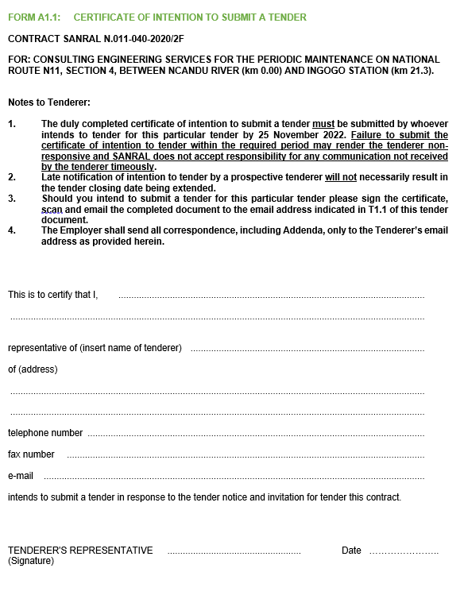
RETURNABLE SCHEDULE
FORM A1
CERTIFICATE OF ATTENDANCE AT CLARIFICATION MEETING
NB: TO BE COMPLETED AND SUBMITTED WITH THE TENDER

Slide 44
FORM A2.1: CERTIFICATE OF AUTHORITY FOR SIGNATORY
The signatory for the tenderer
the board of directors/partners resolution.
shall confirm his/her authority
tendering company’s letterhead
Duly signed and dated
In the event of a joint venture, a certificate is required from each member of the JV clearly setting out:
authority for signatory,
undertaking to formally enter into a joint venture contract should an award be made to the joint venture,
name of designated lead member of the intended joint venture, as required by tender condition 4.13.1.
3. The resolution in form A2.1 is given as an example of an acceptable format for authorisation, but submission of this page with the example completed shall not be accepted as authorisation of the tenderer’s signatory.

Slide 45
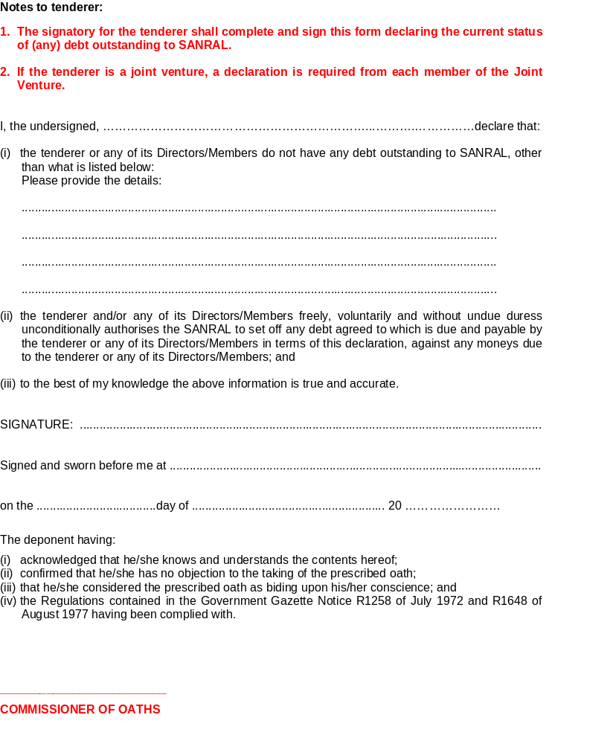
FORM A2.2: DECLARATION OF TENDERER’S CURRENT STATUS OF ANY DEBT
OUTSTANDING TO SANRAL

Slide 46
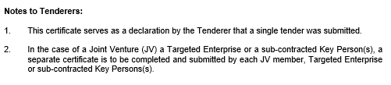
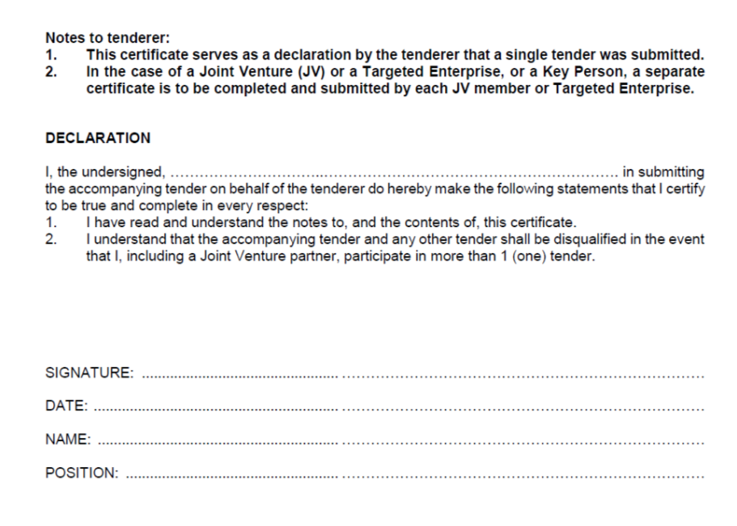
FORM A2.3: CERTIFICATE OF SINGLE TENDER SUBMISSION

Slide 47
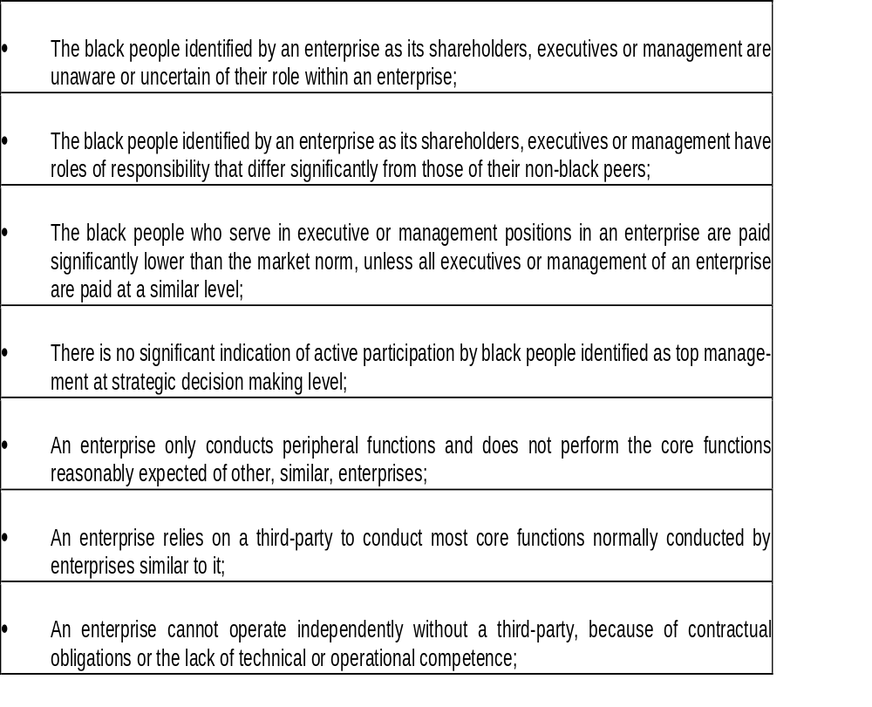
FORM A2.4: CERTIFICATE OF FRONTING PRACTICES

Slide 48
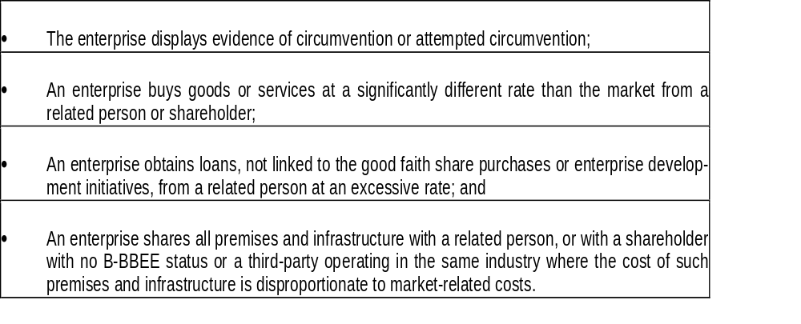


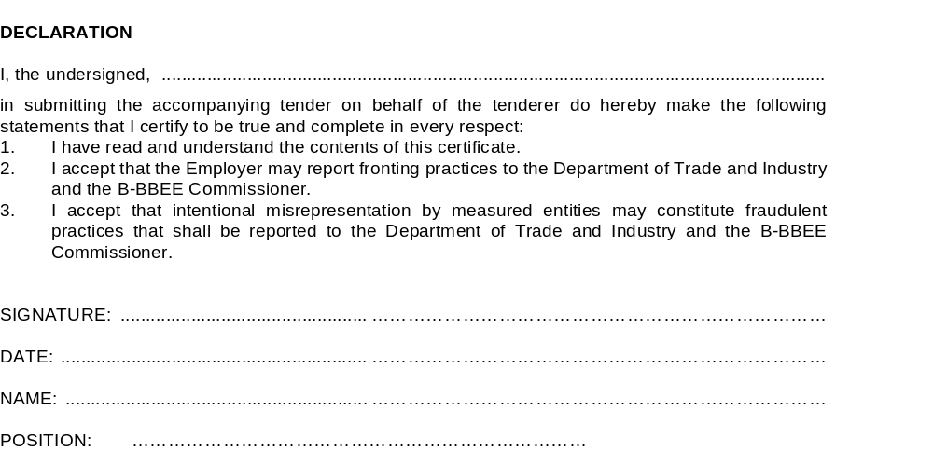

Slide 49
ALL DECLARATIONS TO BE FULLY COMPLETED AND SIGNED
FORM A2.5
FORM A2.7
FORM A3.1
FORM A3.2
FORM A3.3

Slide 50
RETURNABLE SCHEDULE A3.4 – REGISTRATION ON NATIONAL TREASURY CENTRAL SUPPLIER DATABASE
The tenderer shall provide a printed copy of the Active Supplier Listing on the National Treasury Central Supplier Database. (www.treasury.gov.za). In the case of a joint venture (JV), the tenderer shall provide scanned copies of the Active Supplier Listing on the National Treasury Central Supplier Database for each member of the JV. Tenderers who are not registered on the Central Supplier Database at the closing date for tender submissions will be declared non-responsive and will not be considered.
Name of Service Provider: …………………….…………………………………………………………..
Central Supplier Database Supplier Number: …………………………………………………….
Supplier Commodity: …………………………………………………………………………………………
Delivery Location: ………………………………………………………………………………………………

Slide 51
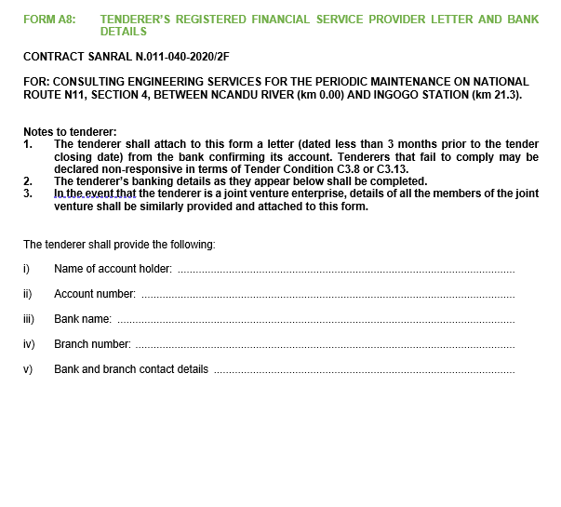
FORM A8: TENDERER’S REGISTERED FINANCIAL SERVICE PROVIDER LETTER AND BANK DETAILS

Slide 52
RETURNABLE SCHEDULE FORM A11: POSSIBLE COMMITMENTS OF KEY PERSON
Key Person | Project Phase | Limit of conventional contracts
Project Leader Design Specialist: Pavement & Materials | Design | (six) 6
The Tenderer may propose the same candidate for more than 1 (one) position simultaneously. If this is proposed and the evidence of the candidates’ suitability is different for each position in the team, separate Returnable Schedules for each position must be completed.
1. Key Persons: The Project Leader (PL) and the Assistant Project Leader (APL) (if applicable) will be limited to participate in a maximum number of 6 (six) conventional contracts in active design phase which will be complete after the award of the Works Contract tender. Design Specialists (DS) and Assistant Design Specialists (ADS) (if applicable) will be limited to participate in a maximum number of 6 (six) conventional contracts in the design phase with the Employer which will be complete after the Detailed Design report is accepted by the Employer.
2. The purpose of this form is for the tenderer to identify areas of conflict with respect to Key Person proposed for the project. Failure to identify where areas of conflict occur, or may occur, and which are subsequently discovered by the Employer shall render such offer as non-responsive, rejected and the tenderer automatically barred from tendering on SANRAL projects for a period of at least 3 (three) months from the date of tender closure.
3. The tenderer shall list below all projects/tenders for which the proposed Key Persons have been proposed, and for which results of an award are unknown at the date of tender closure of this project.
4. The start date in column 4 of the table below is that date indicated in the tender documents as being the intended start of the duties of the key personnel (i.e. expected start of design or supervisory duties).
5. Tenderers must submit an alternative candidate for those positions identified as being possible areas of conflict by completing separate Returnable Schedules Forms B1 and B2 for the alternate. The Employer will not request alternative candidates after tender closure and will interpret the lack of any alternative candidate as an indication the tenderer accepts that it will be impossible to be awarded more projects than the limitations applicable to Key Persons. The Employer reserves the right to select according to its best interest and not the tenderers.

Slide 53

FORM B2: EXPLANATION OF CONSULTANT TENDER EVALUATION SCORING FOR CONVENTIONAL PROJECTS
Tenderers must meet a minimum of 70% Quality scores
If a Tenderer scores less than 10 points for sub-contracting, they will be deemed non-responsive and will not be evaluated further.

Slide 54

CONTRACT SANRAL N.011-040-2020/2F
CONSULTING ENGINEERING SERVICES FOR THE PERIODIC MAINTENANCE ON NATIONAL ROUTE N11, SECTION 4, FROM NCANDU RIVER (km 0.00) TO INGOGO STATION (km 16.14)

Slide 55
SUMMARY OF PROJECT
The project is located on National Route N11, Section 4 – starting from km 0.00 at the Ncandu river bridge, up to km 21.3 near the iNgogo station. It covers a total distance of 21.3 km.
The route is a single carriageway consisting of 1-lane per direction. There are also climbing lanes
It is in the province of KwaZulu Natal in the Newcastle Local Municipality – the main centre being Newcastle, which is within the Amajuba District Municipality.
The Assessment and detailed inspection undertaken revealed the road surface will require periodic maintenance in the for of a re-surfacing.

Slide 56
SUMMARY OF PROJECT CONT.
The Services required of the Service Provider are divided into the following distinct stages:
Project Assessment.
Investigations for Design Development.
Design Development which shall include the following phases:
  Detailed design
Tender Documentation.
Clarification Meeting, Tender Period and Tender Evaluation.
Administration and Monitoring of the Works Contract.
Additional duties, Special Services and Specialist Advice.
Quality Control: Works Contract.
Close Out

Slide 57
PART C1: AGREEMENTS AND
CONTRACT DATA

Slide 58
C1.2.2 CONTRACT DATA: INFORMATION PROVIDED BY THE EMPLOYER
CONTRACT SANRAL N.011-040-2020/2F
Clause | Contract Data
3.4 | The address for receipt of communications is: TO BE CONFIRMED FOLLOWING AWARD
3.5 | The project is for Consulting Engineering Services for consulting engineering services for the Periodic Maintenance on National Route N11, Section 4, from Ncandu River (N11/4-km 0.00) to iNgogo Station (N11/1-km 21.3). The location for the performance of the Project is in the province of KwaZulu-Natal and in the Newcastle Local Municipality Municipality.
5.1.7 | Local Targeted Enterprises from the Kwazulu-Natal Province must participate in a minimum of 1/3 (one third) of the tendered percentage of the Contract Price (excluding provisional and prime cost sums and the respective mark-up, but including provision for site supervision staff and the respective mark-up.

Slide 59
C1.2.2 CONTRACT DATA: INFORMATION PROVIDED BY THE EMPLOYER
CONTRACT SANRAL N.011-040-2020/2F
Clause | Contract Data
5.4 | The Service Provider is required to provide the Service with all reasonable care, diligence and skill in accordance with generally accepted professional techniques and standards. The Service Provider is required to provide the following insurances 1. Insurance against Professional indemnity Cover is: R 9 million without a limit on the number of claims (The limit of liability is only provided to cover the Employer’s damages and does not allow for the Service Provider’s costs for defending any claim.) Period of cover: Structures – 25 years: all other instances – 10 years 2. Insurance against general public liability Cover is: R 10 million Period of cover: Structures – 25 years: all other instances – 10 years 3. Third Party Liability Cover is: R 9 million Target on Period of cover: Duration of contract only.

Slide 60
C1.2.2 CONTRACT DATA: INFORMATION PROVIDED BY THE EMPLOYER
CONTRACT SANRAL N.011-040-2020/2F
Clause | Contract Data
5.5 | The Service Provider is required to obtain the Employer’s prior approval in writing before taking any of the following actions: 1. Appointing Key Personnel not listed by name in the Contract Data. 2. Appointing sub-contractors for the performance of any part of the Service. 3. Expending any Prime Cost and/or Provisional Sum in the Contract or Works Contract. 4. Authorising any work under a Variation (Works Authorisation) for the Works Contract. 5. Authorising any work outside the contract limits. 6. Over-expenditure on the Works Contract. 7. Changing the scope of work for the Works Contract. 8. Acceptance of sub-standard work and/or reduced payments under the Works Contract. 9. All requirements in the relevant documents listed in Clause C3.1.6. 10. Making statements to the media regarding the project.

Slide 61
C1.2.2 CONTRACT DATA: INFORMATION PROVIDED BY THE EMPLOYER
CONTRACT SANRAL N.011-040-2020/2F
Clause | Contract Data
11.2 | The Service Provider shall not sub-contract more than 25% of the tendered contract value (including value of work allocated to Targeted Enterprise(s) but excluding any services specified in the Scope of Works to be procured under a Provisional Sum through the Employer’s Supply Chain Procurement process) to any other enterprise that does not have an equal or higher B-BBEE status level, unless the intended sub-contractor(s) is an Exempted Micro Enterprise that has the capability and ability to execute the sub-contract. The Targeted Enterprise(s) shall not be allowed to sub-contract any work that forms part of the tendered participation percentage without the Employer’s approval. All Targeted Enterprise(s)/ subcontractor(s) shall be registered on the National Treasury’s Central Supplier Database (CSD) The Service Provider shall disclose all subcontracting arrangements. If the Service Provider fails to disclose, he shall be given 14 days to make representation as to why: the contract shall not be terminated; the Service Provider shall not be penalised up to 10% of the value of the contract.

Slide 62
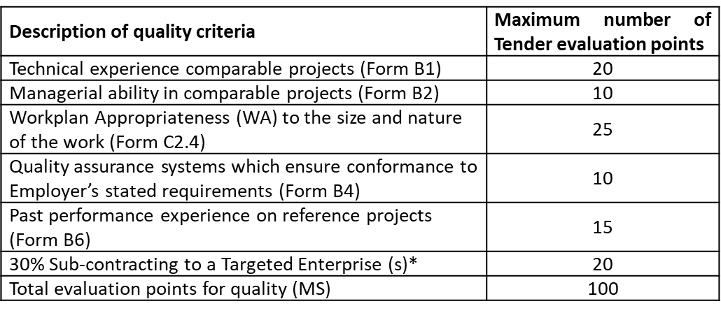
TENDER DATA - CONTRACT SANRAL N.011-040-2020/2F
CLAUSE | TENDER
C.3.11 | The quality criteria and maximum score (including the relevant returnable schedule to calculate the score) in respect of each of the criteria are as follows: The minimum number of evaluation points for quality is not less than 70.

Slide 63
TENDER DATA - CONTRACT SANRAL N.011-040-2020/2F
C.3.11 (continued) | Key Persons As part of the quality criteria as specified above, key persons shall be used to calculate the technical experience and managerial ability score. For this purpose the tenderer may pro­pose the same candidate for more than 1 (one) position simultaneously. If this is proposed and the evidence of the candidates’ suitability is different for each position in the team then separate Returnable Schedules for each position must be completed. Each proposed candidate shall complete the relevant B1 and B2 forms included in the Returnable Schedules. The Project Leader (PL) and the Assistant Project Leader (APL) (if applicable) will be limited to participate in a maximum number of 6 (six) conventional contracts in active design phase which will be complete after the award of the Works Contract tender. Design Specialists (DS) and Assistant Design Specialists (ADS) (if applicable) will be limited to participate in a maximum number of 6 (six) conventional contracts in the design phase with the Employer which will be complete after the Detailed Design report is accepted by the Employer. Tenderers must submit an alternative candidate for those positions identified as being possible areas of conflict by completing separate Returnable Schedules Form B1 and B2 for the alternate. The Employer will not request alternative candidates after tender closure and will interpret the lack of any alternative candidate as an indication the tenderer accepts that it will be impossible to be awarded more projects than the limitations applicable to Key Persons. The Employer reserves the right to select according to its best interest and not the tenderers. When a proposed candidate for any position is not in the permanent employ of the tenderer but a contracted person, this must be indicated on form B2 and a signed letter of consent from the candidate must be submitted with the relevant B-forms. When a proposed candidate for any position is a permanent staff member of the tenderer, this must be indicated on Form B2 and a signed letter of confirmation must be submitted with the relevant B-forms.

Slide 64
TENDER DATA - CONTRACT SANRAL N.011-040-2020/2F
C.3.11 (continued) | Key Persons The following key persons shall form part of the quality criteria: Project Leader Design Specialist: Pavement & Materials Other required resources (Design Specialist(s)) Additional required resources (Design Specialist(s)) other than Key Persons for this project is as follows: Design Specialist: Geotechnical Engineer

Slide 65
PROJECT INFORMATION, SCOPE OF WORKS AND SITE INFORMATION

Slide 66
C3 SCOPE OF WORKS – CONTRACT SANRAL N.011-040-2020/2F
C3.1.2 Location of the project
The proposed project is located on National Route N11, Section 4, from km 0.00 to km 21.3

Slide 67
C3 SCOPE OF WORKS – CONTRACT SANRAL N.011-040-2020/2F
C3.1.3 Description of the Project
The envisaged scope of the works have been established through the SANRAL Asset Management System (AMS) verified by regional panel inspections that have either formed part of the Employer’s normal business practices or have been the subject of previous separate assignments by the same or another Service Provider.
Periodic Maintenance: The Employer’s AMS currently indicates that the periodic maintenance will most probably take the form of appropriate localised repair and pre-treatment of the existing surface followed by the construction of an appropriate surface seal and/or asphalt overlay. There will be a need to assess the edge failures and drop-off which the service provider will need to formulate a proposal for a solution, furthermore, service provider will be required to assess the road centre line / camber for consideration of a solution where defects are noted.
The Services required of the Service Provider are divided into the following distinct stages:
Project Assessment.
Investigations for Design Development.
Design Development which shall include the following phases:
  Detailed design
Tender Documentation.
Clarification Meeting, Tender Period and Tender Evaluation.
Administration and Monitoring of the Works Contract.
Additional duties, Special Services and Specialist Advice.
Quality Control: Works Contract.
Close Out.

Slide 68
C3 SCOPE OF WORKS – CONTRACT SANRAL N.011-040-2020/2F
C3.1.4 Determination of Remuneration
Table C3.1.4(b): Percentage points for phases/stages: Road Works, Structures, Building and Other
Type of Service | Concept Design (CD) | Preliminary Design (PD) | Detailed Design (DD) | Administration & Monitoring of works contract (AMW) | Close out (CO) | Total
Full service | 5% | 21% | 42% | 27% | 5% | 100%
CD | 100% | 0% | 0% | 0% | 0% | 100%
CD & PD | 20% | 80% | 0% | 0% | 0% | 100%
CD ,PD& DD | 8% | 31% | 61% | 0% | 0% | 100%
PD | 0% | 100% | 0% | 0% | 0% | 100%
PD & DD | 0% | 33% | 67% | 0% | 0% | 100%
DD, AMW, CO | 0% | 0% | 63% | 31% | 6% | 100%
PD, DD, AMW, CO | 0% | 22% | 44% | 28% | 6% | 100%
AMW & CO | 0% | 0% | 0% | 83% | 17% | 100 %

Slide 69
C3 SCOPE OF WORKS – CONTRACT SANRAL N.011-040-2020/2F
C3.1.5 Employer’s Cost Estimate
For the purposes of this project, the current budget for the Works is based on embankment reinstatement and strengthening including pavement layer reconstruction along the specified section length.
The estimated costs of the different construction work types with a construction start date of February 2024 are provided below:
Road works R 150 million
(EST) Total project value (excluding contingencies,
CPA during the construction period and VAT) R 150 million

Slide 70
C3 SCOPE OF WORKS – CONTRACT SANRAL N.011-040-2020/2F
C3.1.7 Stakeholder and Community Liaison
(b) Existing contracts
The Employer currently has a routine road maintenance (RRM) contract in progress along the route. The Service Provider shall not visit the site for purposes of undertaking any investigation without first informing the Route Manager of the visit and what type of investigation is intended. The RRM contractor needs to be able to plan his accommodation of traffic duties and no inspection or investigation can take place without acquiring assistance from the RRM for safe conduct through the site or protection when undertaking intrusive or out-of-vehicle surveys. The Service Provider shall timeously liaise with the Employer and his appointed Route Manager in order to program the assistance required. The contact details of the parties involved in the RRM contract are as follows:
Route Manager: Asanda Koti [Zimile Consulting Engineers (Pty) Ltd]
Tel: Cell: 073 283 8809
Contractor: Dominic Adams [Rail Refurb (Pty) Ltd]
Tel: Cell: 083 393 1264

Slide 71
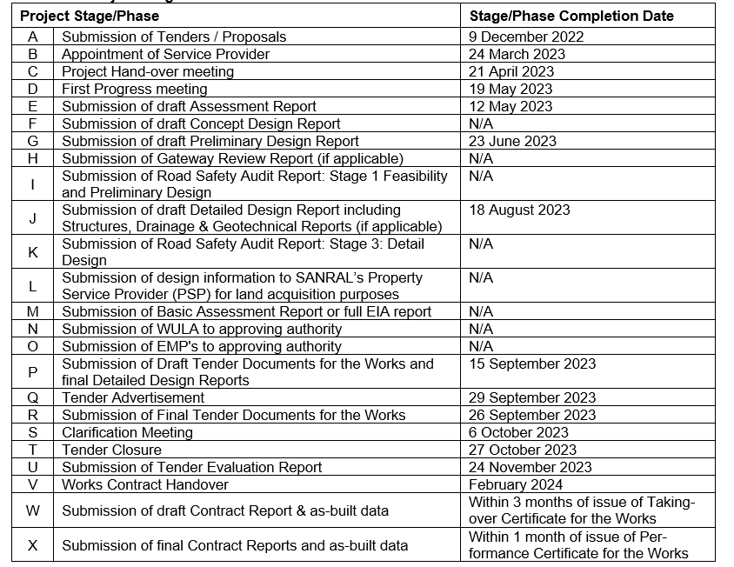
C3.1.9 Project Programme

Slide 72
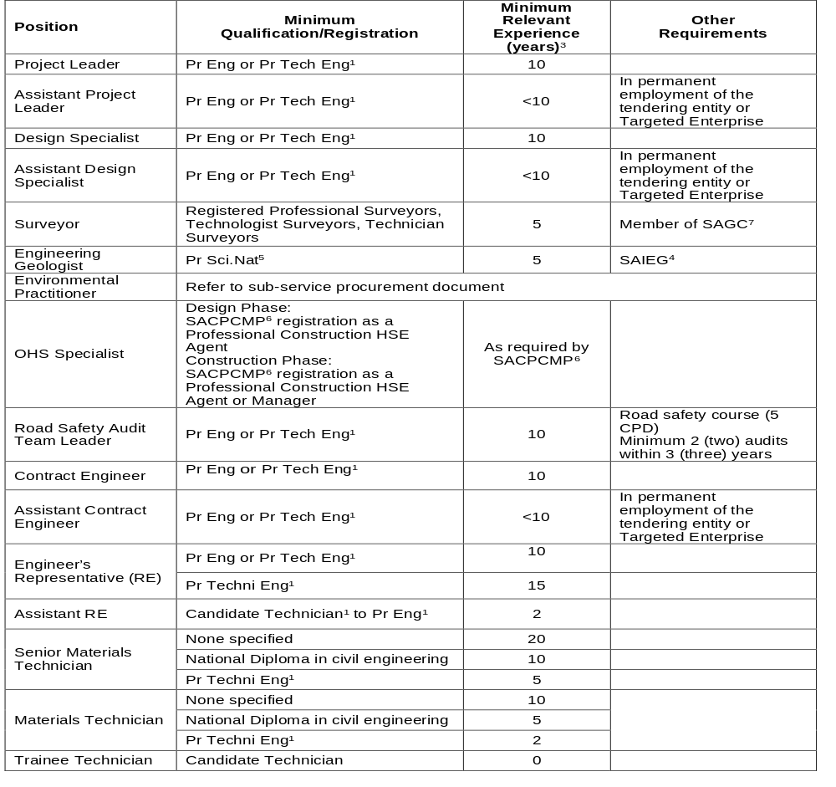
C3.1.11 Personnel Requirements – Minimum Requirements

Slide 73
C3 SCOPE OF WORKS – CONTRACT SANRAL N.011-040-2020/2F
C3.1.19 Participation of targeted enterprise(s) The Employer may stipulate the involvement of Targeted Enterprise(s) in the project design and construction as a mechanism to broaden the economic share of the national spend on engineering services and as a means to hasten and improve the transfer of technical skills. The Service Provider’s Targeted Enterprise(s) become a contractual commitment upon award. The Targeted Enterprise(s) shall be involved throughout the project stages and the percentage tendered in the Contract Data shall be applicable to actual work split (excluding all provisional and prime cost sums but including site staff salaries) amongst the following stages: Project Assessment stage Investigation for Design Development Design Development stage Tender Documentation Clarification Meeting, Tender Period & Tender Evaluation Administration and Monitoring of the Works Additional duties, special services and specialist advice Quality control Close out The use of Targeted Enterprise personnel as site staff during the administration and monitoring of the Works phase is included as part of the percentage tendered in the Contract Data.

Slide 74
C3 SCOPE OF WORKS –CONTRACT SANRAL N.011-040-2020/2F
C3.7 ADMINISTRATION AND MONITORING OF THE WORKS CONTRACT C3.7.2 Administration and Monitoring a) Fulfilling the functions of the Contract Engineer (CE) Three (3) months prior to the commencement of the Works Contract, the Service Provider shall submit for consideration and approval to the Employer a detailed proposal in the Employer’s prescribed format which shall include a CV of appropriate experience and qualifications for the proposed Contract Engineer. In addition, the Service Provider shall also complete Returnable Schedule Forms B1 and B2 for the proposed Contract Engineer. Amongst other criteria to be used, shall be the individual threshold of 70% and the limitation to participate in a maximum number of 6 (six) conventional contracts in active construction phase with the Employer which will be completed after the Taking-Over Certificate is issued to the Contractor.

Slide 75
C3 SCOPE OF WORKS –CONTRACT SANRAL N.011-040-2020/2F
C3.7 ADMINISTRATION AND MONITORING OF THE WORKS CONTRACT C3.7.3 Establishment of supervisory personnel on site a) Supervisory team Provision has been made in the Pricing Schedule for the envisaged staffing requirement. The establishment of such staff, however, shall be subject to the approval of the Employer. For the envisaged scope of the Works, the supervisory team will consist of at least the following: Resident Engineer Assistant Resident Engineer/s Senior Materials Technician Trainee Technician Surveyor - full time (if needed)Surveyor team (part time) (if needed) Trainee (student) Project Liaison Officer Administrative Assistants (data capture) Mentors/Coaches for Targeted Enterprises (sub-contractors) The minimum requirements for qualification and experience of the supervisory team are specified in Clause C3.1.11.

Slide 76
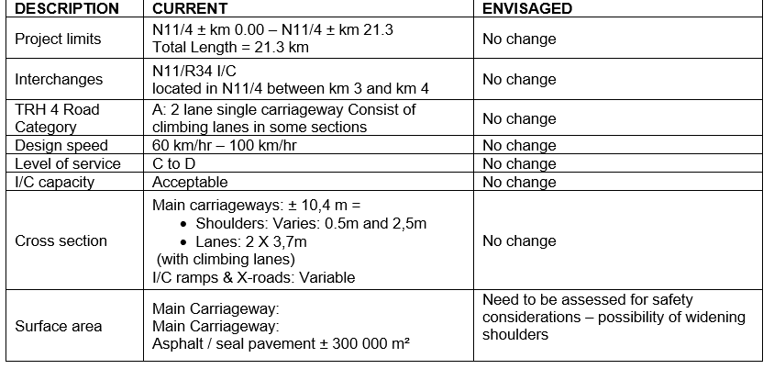
C4 SITE INFORMATION – CONTRACT SANRAL N.011-010-2024/F
C.4.2 GEOMETRIC INFORMATION
TABLE 4.2

Slide 77
C4 SITE INFORMATION – CONTRACT SANRAL N.011-040-2020/2F
C.4.5 GEOTECHNICAL
There are no known geotechnical problem areas identified on this section of the route. The service provider will be required to assess the existing cutting and embankments for any of the Works that might be needed
C.4.6 MATERIAL SOURCES
Material sources for natural/crushed gravel for earthworks, layer works, asphalt and concrete layers will have to be identified and proved. Dependent on the quantities of each, it may be cost effective to source some, or all, materials from commercial sources.
C.4.9 DRAINAGE
Drainage forms an integral part of the rehabilitation and upgrade design. Initial assessments indicate that the existing side drains have sufficient capacity. It is assumed that the existing sub surface drains are not fully functional in areas and will thus require assessment and possible replacement. There are a number of pipe culverts present along the route which needs to be assessed for condition.

Slide 78
C4 SITE INFORMATION – CONTRACT SANRAL N.011-040-2020/2F
C.4.12 SUB-SERVICE PROVIDERS
The following sub-service will be required on this project:
Environmental Impact Assessment Practitioner
External OHS auditor
Site laboratory

Slide 79
THANK YOU
Queries relating to issues arising from these documents may be addressed to:
ProcurementER6@sanral.co.za

