Slide 1

THE MAINTENANCE OF BUILDING AND MARINE DEPOT IN THE PORT OF DURBAN FOR A PERIOD OF SIX (6) MONTHS
TENDER CLARIFICATION MEETING
08 SEPTEMBER 2026
10H00
Notes:
Growth and Reinvent

Slide 2
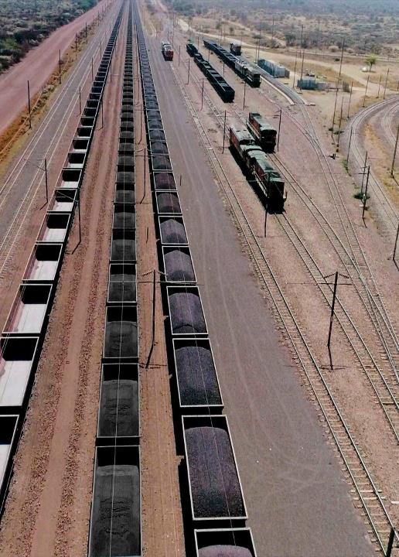
Contents
Agenda
01 | Welcome
02 | Introduction and Agenda
03 | Safety Briefing and Evacuation Procedure
04 | Project Overview
05 | Commercial Presentation
06 | Enterprise Supplier Development
07 | Technical Presentation
08 | Question and Answer
2

Slide 3
Project Background- Mpendulo

Slide 4
PROJECT BACKGROUND
The works that the Contractor is to perform involve the interior and exterior renovations at Building and Marine depot. The primary purpose of this document is to outline the scope of services and deliverables that Transnet National Ports Authority (TNPA) will require of a Principal Contractor with necessary experience and expertise to conduct repairs and renovations in with no disruption to operations.

Slide 5
Commercial- Hlengiwe

Slide 6
COMMERCIAL REQUIREMENTS
PLEASE GO TO NATIONAL TREASURY eTENDER PUBLICATION PORTAL AT www.etenders.gov.za and the Transnet website at https://transnetetenders.azurewebsites.net TO DOWNLOAD ALL PDF’S
CLARIFICATION REGISTERS
ADDENDUMS

Slide 7
TENDERING PROCEDURES
All communications whether general, commercial or technical to go via the Procurement
Department, HLENGIWE DLAMINI in writing.
Email – TNPAtenderenquiriesdbn@transnet.net
All communication will be sent via a clarification register and will be e-mailed to all attendees of this clarification meeting and posted on the Transnet Portal and NT.
Please complete the attendance register and ensure that the contact details are correctly recorded (as these contact details will be used to issue all clarifications and addendums).
Last day for Clarification – Five working days before the closing date (15 September 2026, 16:00).
Electronic Tenders Documents must be legible.

Slide 8
TENDERING PROCEDURES (Continued)
TENDERING PROCEDURES
Tender closing date: 22 September 2026 at 14h00 via the electronic tender submission system, the e-Tender Submission Portal
“HOW TO” GUIDE FOR BIDDERS IS INCLUDED IN THE TENDER (ALLOW TIME)
NO EXTENSIONS TO THIS DATE WILL BE ENTERTAINED
NO LATE TENDERS WILL BE CONSIDERED

Slide 9
TENDERING PROCEDURES (Eligibility Criteria)
Stage One – Administrative and Substantive Responsiveness
Whether the Bid has been lodged on time
Whether all Returnable Documents and/or schedules [where applicable] were completed and returned by the closing date and time
Verify the validity of all returnable documents
Verify if the Bid document has been duly signed by the authorised respondent
Whether any general and legislation qualification criteria set by Transnet, have been met
Whether the Bid contains a priced schedule and Form of offer and acceptance. Respondents are required to complete the BOQ in full, failure to complete may result in disqualification.
Whether the Bid materially complies with the scope and/or specification given
Stage One 2B Eligibility with regards to attendance at the clarification meeting:
Ensure your Clarification Meeting Returnable is signed today and returned with your tender.

Slide 10
TENDERING PROCEDURES (Eligibility Criteria)
Stage Two – CIDB Registration 6CE or 6GB or higher class of construction work
Account to be “Active”
Stage Three – Technical Pre-Qualification criteria:
Tenderer to submit certificates of the key personnel as per the role descriptions in the organizational chart for Construction work.
The Service provider undertaking asbestos work shall be registered with Department of Employment & Labour as a registered asbestos contractor (RAC) and certified to transport asbestos waste to the licensed landfill site
Tenderer to submit a valid proof of registration in terms of Section 18(1) (c) of the Project and Construction Management professions Act, Act 48 of 2000, with South African Council for the Project and Construction Management Professions (SACPCMP) for the Safety officer to be appointed to the project

Slide 11
TENDERING PROCEDURES (Eligibility Criteria Continued)
The tenderer is required to submit all documents as stated in C.2.23 of the tender data and the
tender offer will only be accepted if the tenderer complies with C3.13 of the tender data such as:
A valid Tax Clearance Certificate issued by the South African Revenue Services. Tenderers also to provide Transnet with a TCS PIN to verify Tenderers compliance status.
A valid B-BBEE Certificate from a Verification Agency accredited by the South African Accreditation System [SANAS], CIPC B-BBEE Certificate or a Sworn Affidavit confirming annual turnover and level of black ownership in case of all EMEs and QSEs with 51% black ownership or more together with the tender;
A valid CIDB certificate in the correct designated grading;
Proof of registration on the Central Supplier Database
Letter of Good Standing with the Workmen’s compensation fund by the tendering entity or separate Letters of Good Standing from all members of a newly constituted JV.

Slide 12
CONTRACT DATA
NEC 3 ECC
Main Option B – Priced contract with BOQ
Secondary Clauses
  X2: Changes in the law
  X7: Delay damages @ R5 300.00 per day
  X13: Performance Bond @ 5% of the total of the prices
  X16: Retention @ 7% on all payments certified
  X18: Limitation of liability
  Z: Additional conditions of contract

Slide 13
Enterprise & Supplier Development- (Specific Goals)

Slide 14
TRANSNET PREFERENTIAL PROCUREMENT POLICY SPECIFIC GOALS
The following preference points must be awarded to a bidder who provides the relevant required evidence for claiming points:
The following specific goals will apply for this transaction:
Specific Goals | Number of points (80/20 system) | Number of points (90/10 system)
B-BBEE Status Level of Contributor 1 or 2 | 05 | 03
EME or QSE 51% Black Owned | 15 | 07
Non-Compliant and/or B-BBEE Level 3-8 contributors | 00 | 00

Slide 15
EVIDENCE REQUIRED FOR CLAIMING SPECIFIC GOALS
In terms of Transnet Preferential Procurement Policy (TPPP) and Procurement Manuals, preference points must be awarded to a bidder for providing evidence in accordance with the table below:
Specific Goals | Acceptable Evidence
B-BBEE Status Level of Contributor (1 or 2) | B-BBEE Certificate / Sworn - Affidavit / CIPC B-BBEE Certificate (in case of JV, a consolidated scorecard will be accepted) as per DTIC guidelines
EME or QSE 51% Black Owned | Audited Annual Financial Statements B-BBEE Certificate / Sworn - Affidavit / CIPC B-BBEE Certificate (in case of JV, a consolidated scorecard will be accepted) as per DTIC guidelines
Note: Tenderers who fail to submit acceptable evidence for specific goals applicable in will be allocated zero (0) preference points.

Slide 16
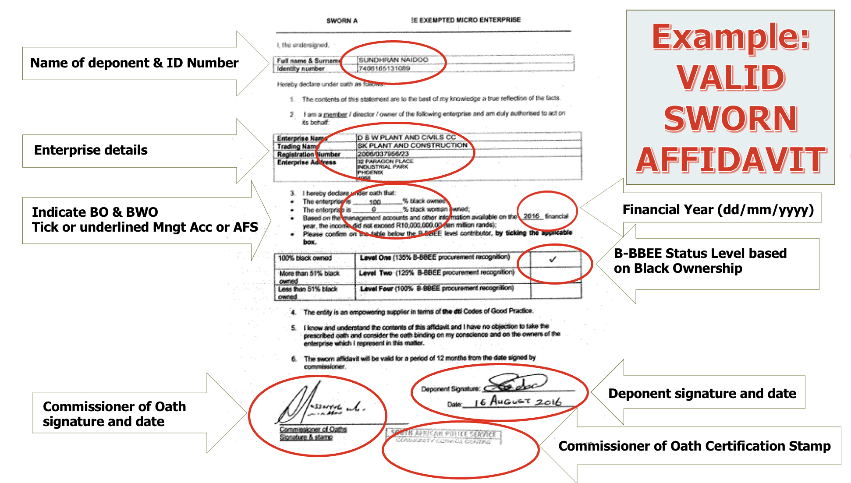
VALID B-BBEE SWORN AFFIDAVIT

Slide 17
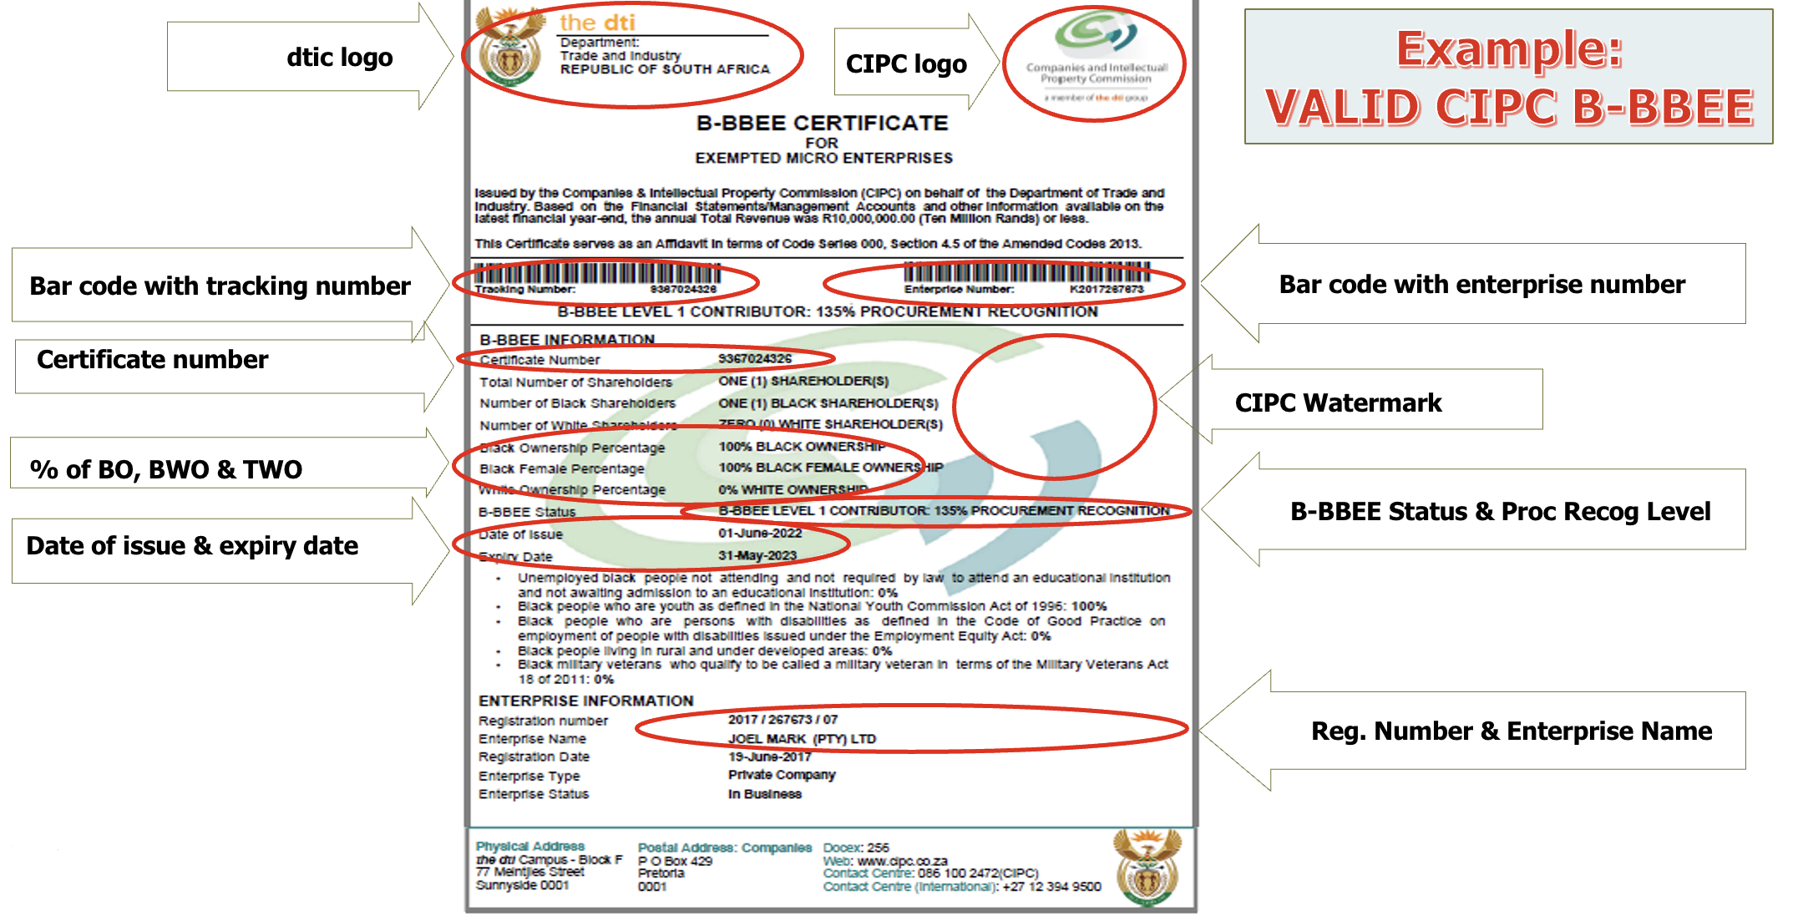
VALID CIPC B-BBEE CERTIFICATE

Slide 18
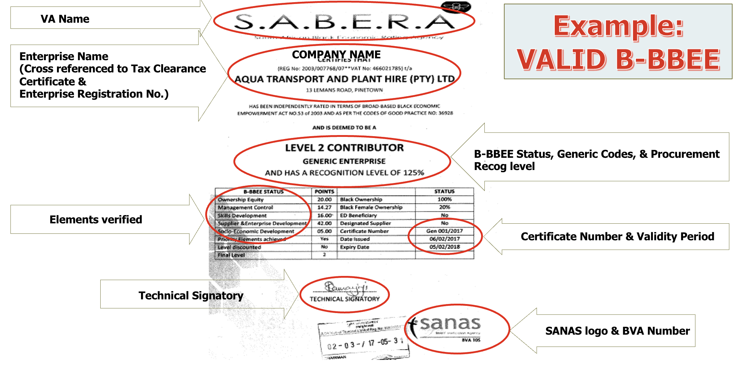
VALID B-BBEE CERTIFICATE

Slide 19
Technical Presentation – Mpendulo

Slide 20
SCOPE OF WORK
The scope includes but not limited to the following:
1. Preliminary & General, safety and Labour
SHERQ Obligations including Compilation of SHE File
Establishment of Equipment and Facilities on the Site
Supervision for duration of Construction
Appointment of SACPCMP registered Safety officer to be on site for the duration of the project.
Waste collection and Disposal
Site de-establishment
2. Replacement of roof sheets, cladding and accessories (Asbestos and IBR)
3. Wall painting (interior and exterior)
4. Replacement of wall tiles

Slide 21
5. Repair to wall cracks and concrete spalling and plaster restoration
6. Replacement of doors, windows, frames, handles, hinges
7. Replacement of kitchen cupboards
8. Replacement and installation of sanitary ware and accessories
9. Epoxy flooring on the sheds
10. Demolition and rebuilding of damaged brick wall
11. Replacement of damaged and severe corroded steel members
12. Blasting and painting of steel members
13. Roof painting with rubberized paint
14. Yard paving
15. Hire of temporary park homes
SCOPE OF WORK-continued

Slide 22
TECHNICAL SPECIFICATION
ROOF ACCESSORIES
Damaged Zinc/ aluminium roof sheets shall be removed and replaced with new.
Asbestos sheets should be removed and disposed of at an approved dump site.
Broken and corroded gutters and rainwater downpipes shall be removed, disposed off-site and new gutters and downpipes shall be installed to match existing sizes on site, not unless stated otherwise.
All blocked gutters and rainwater downpipes shall be cleaned of debris and vegetation and blockages removed.

Slide 23
TECHNICAL SPECIFICATION -continued
PAVING
The existing tar and concrete surface on site should be cut to a depth up to 60mm and be discarded off site.
Cut existing subbase material and stockpile on site for later use
Rip and recompact in-situ material to 100% MOD. AASHTO.
Supply and install drainage system as proposed in drawing TNPA-C102
Import and lay G2 compacted to 95% MOD. AASHTO to a fall to the valley or drainage as shown on the drawing.
Supply and apply vegetation poisoning on the subbase.

Slide 24
TECHNICAL SPECIFICATION -continued
PAVING Continued:
Supply and lay 25mm river sand (Leveling layer) with a fall to existing storm water drain, stabilize and compact.
Supply and Lay 65mm brick paver on pattern as shown in drawing TNPA – A101-Rev-C.
Figure 8A concrete kerbs should be used at the edges.
Sweep sand into the gaps and make good finishing

Slide 25
TECHNICAL SPECIFICATION -Continued
PAINTING
All previously painted areas must be washed down to remove dirt and other contaminants and allow drying completely before any paint applied. Blistered or peeling of paint shall be completely removed.
Surfaces to be painted must be dry and free of dirt, grease, and peeling, flaking paint before painting commences.
Surfaces not being painted must be covered against spotting and spillage by masking tape, spot sheet.
All paint used shall be SABS approved and Painting shall be done in accordance with the requirements of SANS 10305.
Paint to be used should have a minimum of 8 years durability warranty.
The Contractor shall provide a sample of the new paint for approval by the Project Manager prior to procuring and bringing on site.

Slide 26
TECHNICAL SPECIFICATION-Continued
Paint product information:
Substrate | Specification
Exterior walls, ledges, parapets, boundry walls, interior walls and dry walls | One coat of trade alkali resistant primer (patching) Two coats of trade 100 low sheen
Galvanised sheeting, Chromodek roof | One coat of primer for galvanized iron Two coats of Rubberized paint
Exterior wooden doors, door frames and balustrades | Three coats of int/ext timber varnish
Ceilings | One coat of trade alkali resistant primer (patching) Two coats of trade 65 matt pva
Wooden windows, window frames, doors, door frames, fascia boards, beams and louvers | One coat of primer for wood (patching) One coat of trade universal undercoat (patching) Two coats of gloss enamel
Bituminous torch on | Two coats of trade bituminous aluminium paint
Mild steel posts, balustrades and handrails | One coat of primer for steel (patching) One coat of universal undercoat (patching) Two coats of gloss enamel
Interior wooden doors | One coat of primer for wood (patching) One coat of trade universal undercoat (patching) Two coats of trade 100 low sheen
Powder coated barge boards | One coat of supergrip all-surface primer (patching) Two coats of roofguard pure acrylic roof coating
Interior wooden doors | Three coats of woodgard interior double life timber varnish (matt)

Slide 27
TECHNICAL SPECIFICATION-Continued
BLASTING, DERUSTING AND PAINTING OF STEEL MEMBERS
For minor corrosion – Remove any loose rust, scale, or old paint using wire brush, sand paper or power tool.
If the corrosion is severe - Blast clean to BS 7079 or EN ISO Sa 3 to help remove the stubborn rust
Clean the surface thoroughly to remove any dirt, grease or other contamination.
Apply the rust converter or phosphoric acid-based solution to the cleaned surface and allow to dry according to manufacturer's instructions.
Shop – 1st coat item 159 aluminium epoxy sealer – applied at 12 to 20 sq.m/litre
Shop – 2nd coat item 111 Zinc Phosphate HB QD Epoxy blast primer – mdft 100 microns
Shop – 3rd coat item 1132 MIO HB QD Epoxy undercoat/finish – mdft 125 microns
Shop/site – 4th coat item 169, semi-gloss, acrylic polyurethane (2 pack) finish – mdft 50 microns.

Slide 28
SCOPE OF WORK-Continued
BLASTING, DERUSTING AND PAINTING OF STEEL MEMBERS Continued:
  • Stripe coat – 3rd coat on 2nd coat by brush at 75 microns mdft
  • Minimum system total dry film thickness -425 microns including metal spray minimum total dry film thickness of paint system – 300 microns
  • Aesthetic topcoat – item 169, semi-gloss, acrylic polyurethane (2 pack) finish 50 microns
  • HSFG Joints – contact faces aluminium metal spray on fasteners – aluminium metal spray after joint is made.
  • The final coat must be SANS 1091 G 22 DOVE grey or D 30 French grey (mill green/ Grey green).

Slide 29
SCOPE OF WORK-Continued
PARK HOMES
The nominated contractor should provide the 6m x 3m temporary park homes for ablutions as per specification.
The contractor shall provide all necessary material for connection to water supply, electric supply and waste line/ sewer.
Services will be connected to the nearest existing Transnet services

Slide 30
TECHNICAL SPECIFICATION-Continued
CRACKS
Open up the cracks to a minimum width of 10mm and 10mm deep on either side of the wall where crack is mirrored. Ensuring that any precious crack repair materials are completely removed down to a sound, dry and clean substrate.
Using epoxy repair mortar, fill the opened crack and smooth over with a trowel on the exterior face.
Cracks less than 3mm wide shall be reamed out and sealed with structural non-shrink repair mortar.

Slide 31
TECHNICAL SPECIFICATION-Continued
WASTE COLLECTION AND DISPOSAL:
All rubble and Debris must be cleared from site and site to be left clean.
The collection and disposal of all the rubble/ waste on site should only be done by contractor or subcontractor with waste disposal license issued by Transnet National Ports Authority, Port of Durban.
TNPA will provide the metal skip for all scrap metal that will be generated from the renovations.

Slide 32
TECHNICAL SPECIFICATION-Continued
SAFE EQUIPMENT FOR WORKING AT HEIGHT:
Supply safe and suitable working at height equipment for every height work.
A contractor must appoint a competent person in writing who must ensure all height equipment’s operations are carried under his or her supervision and that all erectors, team leaders and inspectors are competent to carry out work.

Slide 33
`
NB: The contractor shall allow in his prices for the following:
Renovations work will also take place within an operational office environment; no additional payment will be made for work done in confined areas. The prospective tenderers shall exercise due diligence during the execution of the project to minimize risk of damaging existing equipment/infrastructure and also ensure minimal disruption to office staff.
The Contractor will be responsible for any costs associated with damages to existing infrastructure located on the buildings; the Contractor shall therefore make provision in his prices for the risk of damage to existing equipment/infrastructure.

Slide 34
Thank you

