Slide 1

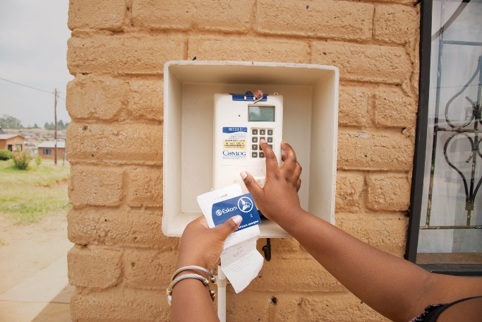
Enquiry No. E2994GXPOU:
Supply and Delivery of Pumps at Peaking Operating Unit (All Stations)
Clarification Meeting
17 June 2026

Slide 2
Agenda
Welcome and Introductions
Safety Moment
Tender Overview
Basic Compliance & Submission Requirements
Technical Evaluation Overview
Pricing & Commercial Requirements
Contractual Requirements (SDL&I, Safety & Quality)
NEC Contract Overview
Clarification Process
Questions and Answers

Slide 3
Tender Overview
Scope:
Supply and delivery of pumps on an “as and when required” basis
Contract Term:
5 Years
Sites:
All Peaking Power Stations
Closing Date:
16 July 2026 at 10:00 (SAST)
Submission Method:
Electronic via Eskom eTendering Portal
Tender Validity Period:
150 days from closing date of tender

Slide 4
Basic Compliance & Clarification Period
Tenderers must:
  Meet eligibility criteria
  Submit a complete tender (technical, commercial, financial)
  Submit all mandatory returnables including:
    Completed NEC contract and pricing schedule
    Excel price list
    CPA for local goods / CPA(IG) for imported goods, where applicable
    Local content declarations (SBD 6.2 and Annexures G1–G4)
  Ensure all documents are submitted in the correct format via eTendering
    All tender documents must be submitted in PDF; the price list must be submitted Excel and PDF’d and Signed will be appreciated.
    No hard copy or zipped submissions will be accepted.
    Upload limit: 500MB per document and 4GB in total.
  Clarification Period:
  Queries must be submitted in writing to the Buyer
  Queries must be submitted 5 working days before the tender closing date
  Responses will be consolidated and issued via clarification/addendum
  No queries will be accepted after the deadline

Slide 5
Technical Evaluation Overview
Minimum Functionality Threshold : 70%
Refer to ITT (pages 9–11)
Technical Area | Requirement Description | Weighting
Experience | Tenderer must submit project references with the requirements as listed. | 60%
Experience | Tenderer submits the company establishment date | 40%
Technical Compliance | Tenderer to submit datasheets with the minimum Requirements as described. Scores will be assigned based on the percentage of datasheets that are deemed to be technically acceptable for the pumps they are to be replacing. NB: Datasheets must be linked to specific pumps listed in the works to be considered for this returnable. A referenceable index must be provided as part of the tender. | 100%
Delivery Capability | Tenderer to provide evidence of delivery of Pumps with requirements as described. | 100%

Slide 6
Pricing Requirements
Pricing must be submitted in:
Completed NEC pricing schedule (PDF)
Excel price list
Prices must include:
Delivery to site (DAP)
All applicable costs
Pricing structure:
Fixed for the first 12 months
Adjustments applicable thereafter in terms of the contract

Slide 7
NEC Contract Overview & Key Provisions
NEC3 Supply Contract applies
Contract duration: 5 years
Supply on an “as and when required” basis
Each purchase order forms part of the contract
Key NEC Provisions
Delivery: Supplier responsible for DAP delivery to various peaking power stations
Standards: Goods must be manufactured, handled, packaged and transported in accordance with applicable safety, environmental and quality standards
Documents: Delivery must include packing lists, invoice copy, delivery note, and test results / maintenance manuals, as applicable
Performance: On-time delivery is important; deliveries must align to the relevant purchase order

Slide 8
Contractual Requirements
The following requirements apply as stipulated in the ITT:
SDL&I Requirements:
  Supplier obligations relating to supplier development and localisation
Safety Requirements:
  Compliance with Eskom safety standards and applicable legislation
Quality Requirements
  Compliance with Eskom quality standards and technical specifications
General Compliance
  Adherence to all ITT and contractual obligations
  Mandatory requirement: CSD registration
  Note: Contractual requirements are not evaluation criteria and will be assessed after evaluation and ranking, prior to contract award.

Slide 9
QUESTIONS?

