Slide 1


THE PROVISION OF PROFESSIONAL ASSURANCE SERVICES FOR NTCSA ON AN AS AND WHEN REQUIRED BASIS FOR A PERIOD OF FIVE (5) YEARS.
Presented by: Proscoviour Ratsethana
Date: 22.09.2026

Slide 2
Contents
Welcome and Introduction
Safety and Evacuation Procedure
Declaration of Interest
Commercial Requirements
Scope of work and Functionality
SDL and I Requirements
SHEQ Requirements

Slide 3
Commercial process
The first stage is an open tender process where suppliers are
qualified in terms of their technical offer and ability to render the
services as required for the panel.
The second stage is a secondary procurement process under
which Requests for Quotations will be issued to panel members on
a transparent and auditable basis.
Responses will be evaluated using the 80/20 preference point
system for Price and Specific Goals. Where justified by the nature
or complexity of a Task Order, functionality/technical criteria may
also be applied as a qualifying evaluation stage before the 80/20
evaluation process. The Task Order will be awarded to the highest scoring
tenderer in terms of the outcome of the Price and Specific
Goals ranking process.
4

Slide 4
Commercial process
      Prices will be scored out of 80 points
      20 points for B-BBEE
  Single point of contact is Proscoviour Ratsethana
  (E-mail: mashamLa@ntcsa.co.za)
  Tel: 011 800 5699
  In terms of Eskom's Policy and Procedure, all questions and queries received will be answered in writing to all the bidders.
  Closing date is 05 October 2026 at 10H00 South African Standard Time.
  Late tenders will not be accepted.
4

Slide 5
Commercial process
Tender submission
Electronic Tender Submissions
-The tenderer must upload the tender via NTCSA Tender bulletin site on the NTCSA E- tendering page. The documents need to be uploaded under the folder Technical, Commercial, Financial, and other.
-All documents need to be submitted in a PDF format.
4

Slide 6
Commercial process
Tender submission
-No Zip/condense files can be uploaded
-No hard copy will be accepted
-If for some reason you resubmit your tender, then the latest version of the tender submitted will only be accepted and all previous submission/s will be null and void.
-Please ensure that the submission status is indicated as complete.
4

Slide 7
Commercial process
Tender submission
Supplier Help Manual guide is uploaded with the tender-on-tender portals. And video can be found on NTCSA E-Tendering page
4

Slide 8

Questions

Slide 9
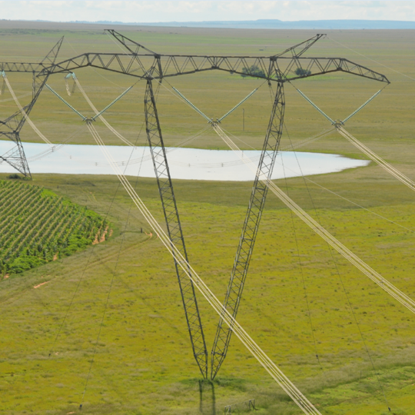
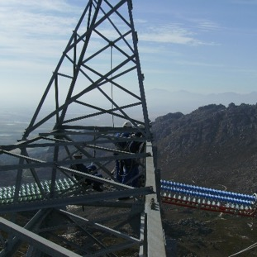
Conclusion

