Slide 1
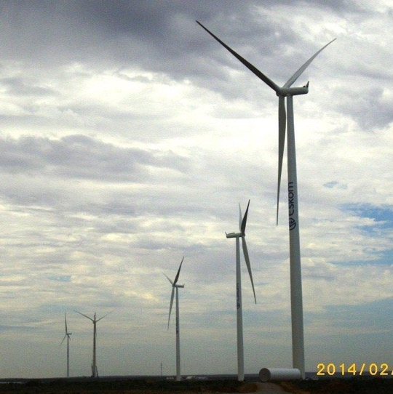
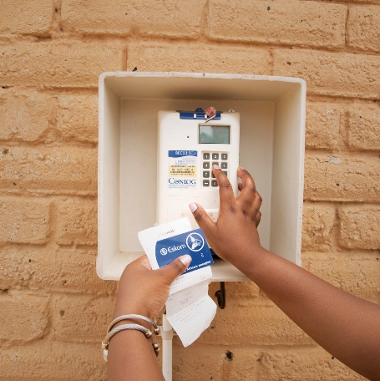
Vryburg Roof Replacement
ERE Engineering

Slide 2
High Level Scope
3.3.1 Employer’s design – As per the WI/Tech Spec
Assessment of the entire Roof assembly, which is inclusive of rainwater goods and associated infrastructure, to ensure compliance with SANS
Replacement of southern end roof system as well as any defect to a SANS approved roofing system with future PV support and Assessment of the entire Roof System to ensure compliance with SANS
Replacement of the services impacted by the roof replacement and provide an appropriate CoC
Provide the documentation required for the occupancy certificate for the building

Slide 3
Architectural Scope
Application and complying to the National Building Regulations is the key underpinning of the project and to ensure occupancy certificate is issued by the respective Local Authority with all the prerequisite procedures and outputs, The following are key extracts and summary to comply with;
Condition Assessment & Approvals
Appoint a competent professional to assess defects, develop repair solutions, and obtain required Local Authority approvals.
Roof Replacement & Compliance
Replace defective roof elements and rainwater goods with a SANS-compliant system suitable for future PV installation – Submission of design to Local Authority
SANS 10400-XA Compliance
Ensure the roof and associated systems meet all energy efficiency requirements.
Detailed Design Documentation
Provide coordinated drawings, specifications, layouts, and material schedules for all proposed works.
Quality Materials
Utilize approved, durable, energy-efficient materials supported by samples and technical data sheets.
Building Integration
Ensure all proposed works are compatible with and do not negatively impact the existing building fabric.
Service Coordination
Conceal all cabling and conduits where possible and provide comprehensive cable management solutions.
Protection & Making Good
Protect existing building elements during construction and provide all necessary repairs, touch-ups, and reinstatement works.
Quality Control & Record Keeping
Maintain photographic records, adhere to hold points, manage snags continuously, and obtain approvals for any unforeseen conditions.
Occupancy Certificate Issued by Local Authority
Provide as-built documentation, Design proposed, Submission to Local Authority, compliance certificates, and all information required to receive building occupancy certification.

Slide 4
Architectural Evaluation
Tender Criteria:
Provide a copy of the CV and Qualifications of the registered Architectural Professional,
  That will show;
    5 years' experience,
    Showing similar scope of work post professional registration.
  This professional will be responsible for Design & updating drawings, submission to local authority obtaining approval and obtaining occupancy certificate from local authority
High-level method statement for the entire architectural works clearly demonstrating compliance and understanding with the full scope of works as listed in the technical specification)
Tenderer provides evidence of completing a minimum of 3 projects (as per the architectural scopes of work) in the last 5 years. Reference letters to include contact numbers of client, description of involvement in the project and the cost of the project as a minimum.

Slide 5
Structural Scope & Evaluation
Section 3.3.2.2
The Contractor assesses the roof trusses and replaces all damaged trusses at the southern end of the building.
The Contractor ensures all works are approved by a Professional Engineer/Technologist.
Tender Criteria:
Provide a copy of the CV and qualifications of a Civil Professional Engineer/Technologist that will be responsible for the Civil works. The Professional Engineer/Technologist must have a minimum 5 years’ experience post Professional Registration. This Engineer/Technologist is responsible for the Assessments, Design, and on-site supervision for the entire project.
High-level method statement for the entire civil works clearly demonstrating compliance and understanding with the full scope of works as listed in the technical specification)
Tenderer provides evidence of completing a minimum of 3 projects (as per the civil scopes of work) in the last 5 years. Reference letters to include contact numbers of client, description of involvement in the project and the cost of the project as a minimum.

Slide 6
Electrical Scope
Lighting:
The contractor conducts an Illumination survey illumination survey according to SANS 10114 part 1 and 2 - Interior lighting - Artificial lighting of interiors and Emergency lighting. The minimum Illuminance levels measured in each respective area shall be presented in a tabulated format and submit it to the employer.
Upgrade lighting (based on the results of the survey):
Include:
o Energy-efficient LED fittings.
o Testing and commissioning.

Slide 7
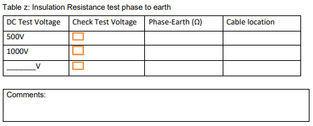
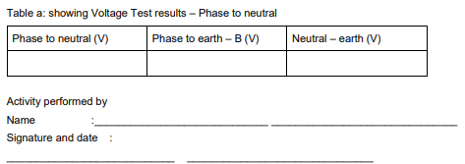
Electrical Scope Cont..
Electrical cables:
Tests:
Carryout insulation resistance and continuity tests on all building’s associated power cables.
Conductor resistance/continuity test shall be performed.
Tests shall be in accordance with SANS 10142-1, 97, 1507, 1574, 1339, 10198-13 and other relevant standards.

Slide 8
Electrical Scope Cont..
Electrical Cable Sizes:
The Contractor ascertains the cabling in the property complies to the following requirements:
The minimum size of copper wire for the lighting circuits shall be 2.5 mm².
The minimum size of copper wire for the socket outlet circuits shall be 4.0 mm².
Conduit, saddles and power trunking:
The Contractor shall install standard compliant conduits, power trunking and saddles to contain the power cables. Conduit in roof spaces shall be installed parallel or at right angles to the roof members and shall be secured at intervals not exceeding 1,5m by means of saddles screwed to the roof timbers. All conduits shall be manufactured of mild steel with a minimum thickness of 1,2mm for plain end conduit and 1,6mm in respect of screwed conduit and galvanised.
Earthing:
The Contractor shall ensure that the electrical system is properly earthed, and conductive metallic parts bonded to SANS 10142-1.
Certificate of compliance Upon completion of the Works:
Full verification testing shall be carried out on the installation(s) and the Employer’s representatives shall be invited to witness at the testing phase.
Tests shall be performed and recorded on the respective recording sheets.
A certificate of compliance shall then be tendered to the Employer prior or during commissioning for review and submitted for acceptance as part of the handover packages at the completion of the Works.

Slide 9
Electrical Evaluation
Tender Criteria:
Mandatory:
Proof of Registration as Electrical Contractor with the Department of Labour by the Principal contractor OR Joint Venture (JV) OR Sub-contractor.
Qualitative:
Resumé of candidate with Electrical trade test, and Wiremen’s licence. A minimum 3 years of related experience.
Provides evidence of completing at least 2 projects related to small power and lighting (as per the scopes of work) in the last 5 years.

Slide 10
Fire Scope
Supply and Install Fire Exit Door
Signage where needed

Slide 11
Evacuation systems
Building category is G1,i.e, Office building
The following will be installed for evacuation purposes:
A manual call points on exits and escape routes shall be provided consisting of manual call points,
Electronic sounders/sounder-beacons,
Conventional fire alarm control panel with standby batteries,
Supervised detection and alarm circuits.
The system shall be designed, installed, tested and commissioned in accordance with applicable fire detection and alarm standards.

Slide 12
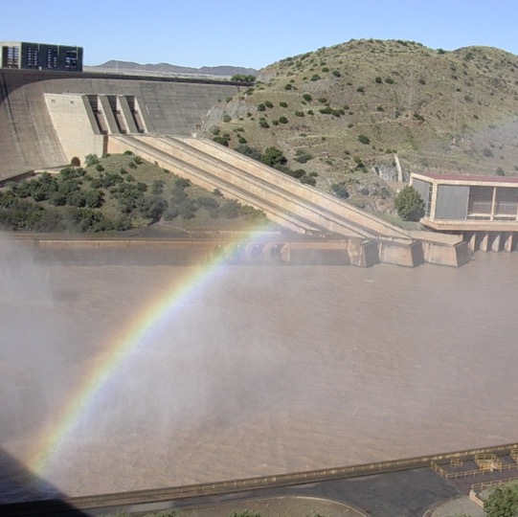

Conclusion

