Slide 1






Integrated Physical Security System in the Transmission Grid and Eskom Telecoms
Presenter: Martin Sabelo
Date: 25 March 2024

Slide 2

We have a mandate to contribute positively to the development of the country
Our mandate is to achieve maximum and sustainable local development impact through leveraging Eskom’s procurement spend in a manner that allows flexibility within the business in order to accommodate government local development initiatives and policies

Slide 3
Supplier Development & Localization (SD&L) measures impact along these key performance areas
Key performance area
Definition
  Skills development
  Increasing the skill base (number and skill level) of South African workers in areas relevant to the energy sector and where there is a national scarcity of skills
  Local content
  Utilisation of Eskom and suppliers’ spend to develop South African based suppliers relevant to the energy sector (focusing primarily on BBB-EE and Black Owned suppliers)
  Industrialisation
  Utilisation of Eskom and suppliers’ spend to foster the establishment of new competitive industries in the energy sector
Job creation and Employment
  Creation of new jobs by suppliers as a direct result of Eskom business
  Supplier development
  Providing a platform to develop emerging suppliers, and further opportunities for national and international suppliers
3

Slide 4
SDL&I Evaluation
BBBEE 90/10 Point Scoring will apply
A valid BBBEE certificate issued by a SANAS accredited agency(SANAS Logo on the certificate)
Valid Affidavits on DTI template (EME/QSE acceptable)
Joint Ventures must submit a consolidated BBBEE certificate
Local content: Objective Criteria
National Industrial Participation Programme - NIPP
Subcontracting: Objective Criteria
Skills Development: Objective Criteria
Notes:
:

Slide 5
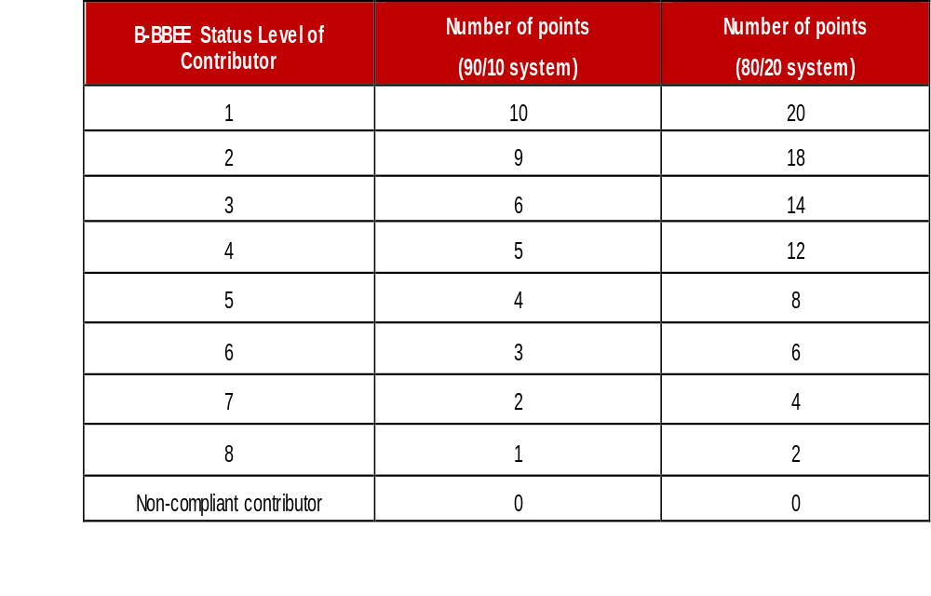
Preference Points B-BBEE

Slide 6
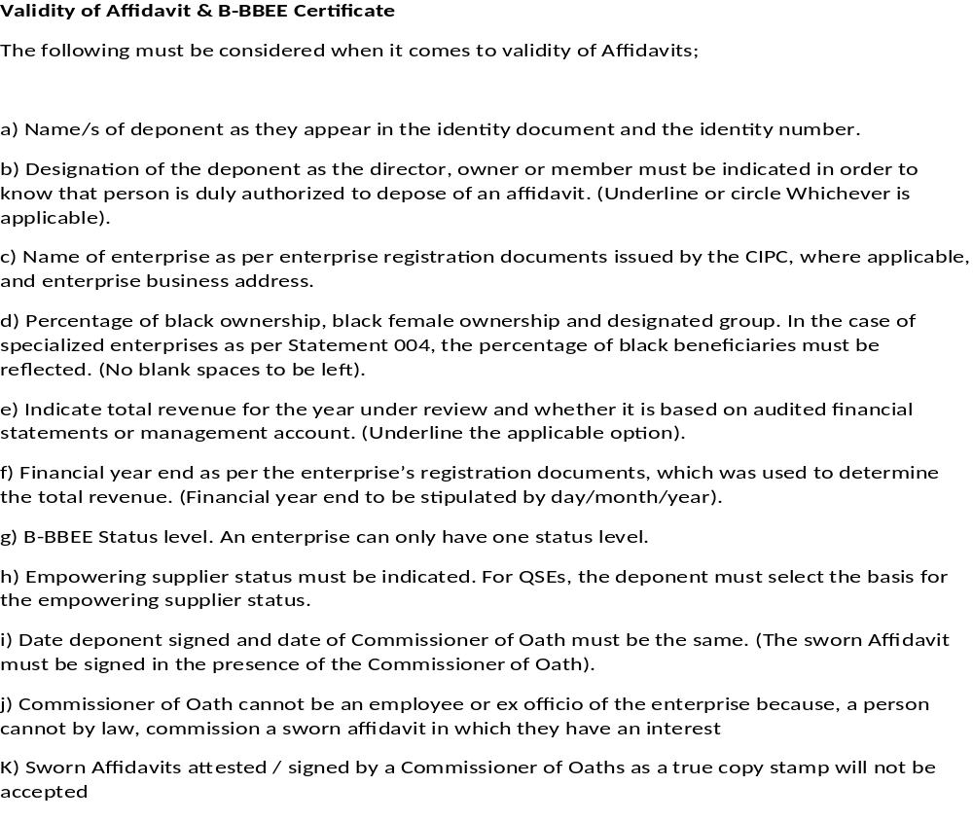

Validity of Affidavit

Slide 7
Designated Sectors By DTIc - Objective Criteria
Steel Material 100%
Electrical and Telecoms Cables 90%
Note: Suppliers must submit completed and dully signed Annexure C,D,E and SBD6.2
Exemption not to comply with local content requirements can be obtained from DTIC – Annexure D applicable once exemption granted.
.

Slide 8
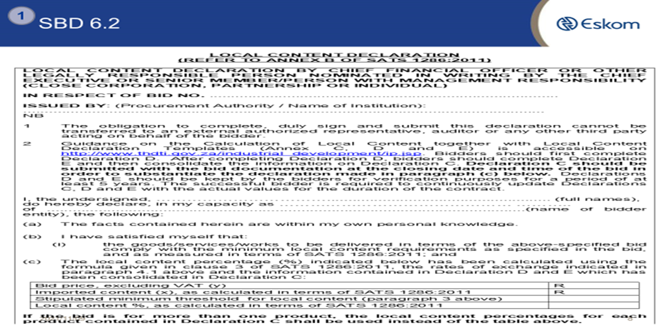
Designated Sector - DTIc
Note: As a tender returnable suppliers must submit Local Content Declaration Annexure C and SBD 6.2.
.
Industry | Threshold
Wire Products | 100%

Slide 9
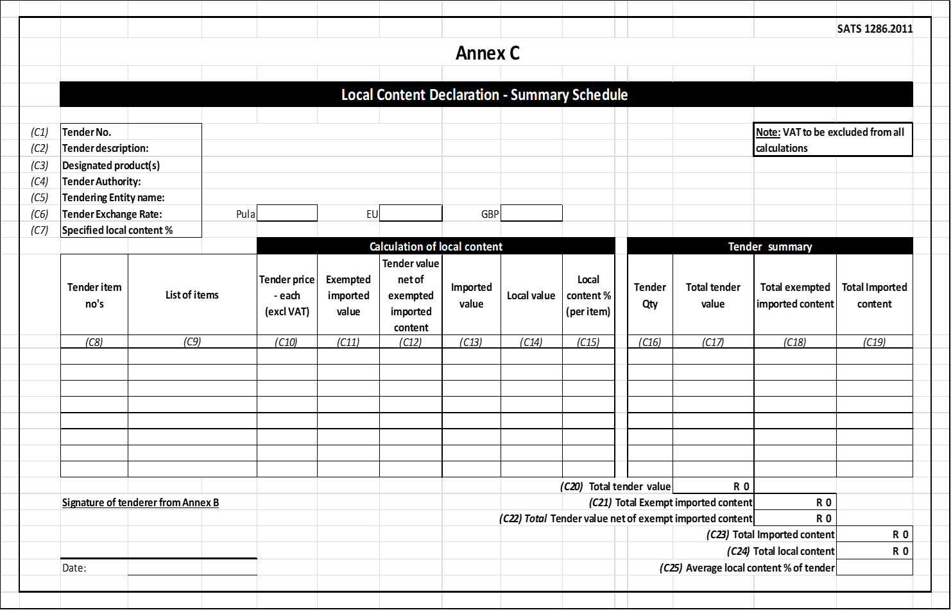
Annexure C
.

Slide 10
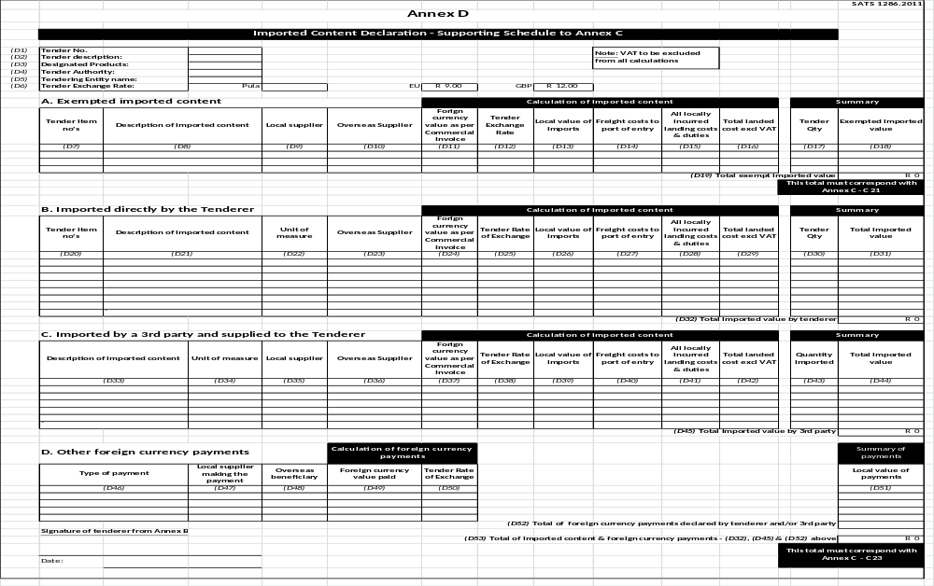
Annexure D
3

Slide 11
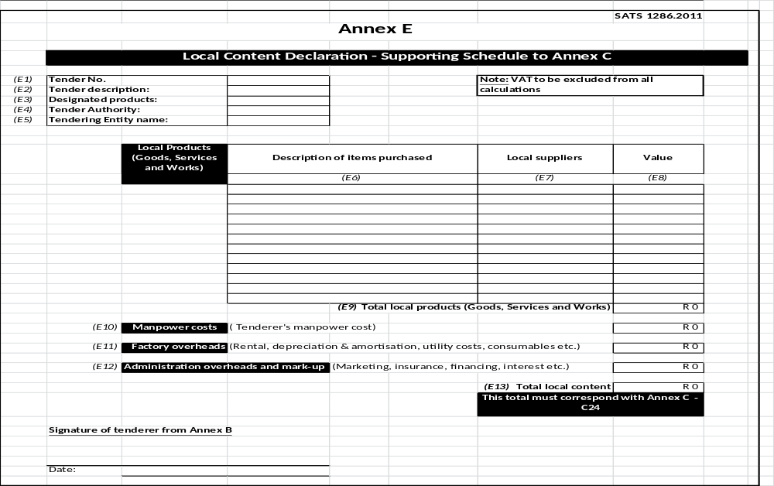
Annexure E
4

Slide 12
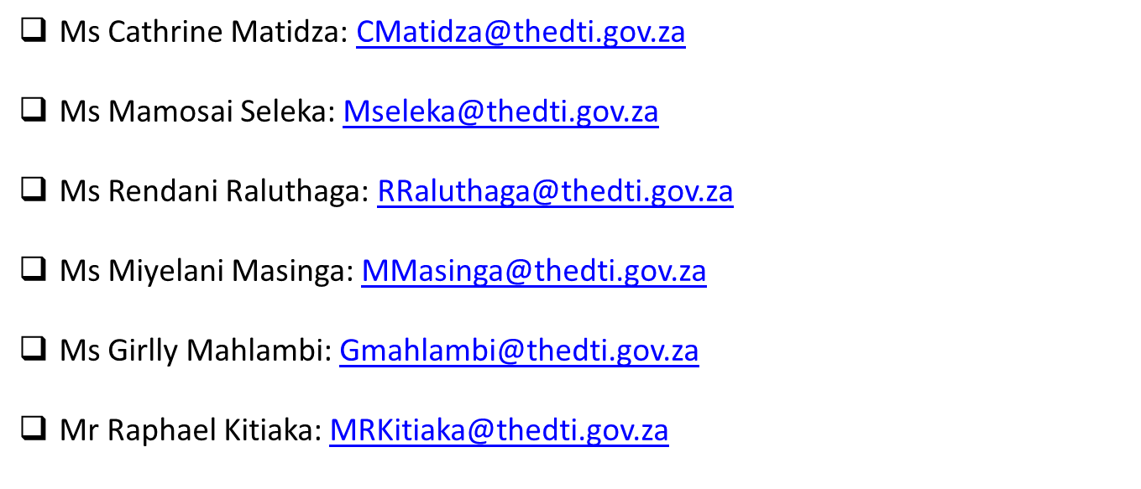
DTiC - Local Content Enquiries: Bidding Documents, Calculations & Annexures
.

Slide 13
Letter of Undertaking - National Industrial Participation Programme (NIPP)
NIPP: In line with DTI requirements on imported content that is above $5million, the National Industrial Participation Program has to be applied in order to stimulate local manufacturing capability and job creation. Manufactures have to commit on minimum thirty percent local participation program through formalized DTI NIPP obligations agreements. Therefore, in line with NIPP requirements, once the contract is awarded, the international company has to complete SBD 5 form as an undertaking to DTI.
Note: In an event the contract placed does not have an imported content that exceeds $5million, this requirement falls off.
As a tender returnable suppliers will be required to complete SBD 5 Form that must be ``signed and returned to Eskom on the date of the tender closing.

Slide 14
DTiC - NIPP Contact details
Mr Abiel Mohlahlo Amohlahlo@thedtic.gov.za
Ms Yvonne Nematswerani Ynematswerani@thedtic.gov.za

Slide 15
Subcontracting : Objective Criteria
30% subcontracting to EME/QSE’s that are level 1 to 2.
(b) an EME or QSE which is at least 51% owned by black people;
(c) an EME or QSE which is at least 51% owned by black people who are youth;
(d) an EME or QSE which is at least 51% owned by black people who are women;
(e) an EME or QSE which is at least 51% owned by black people with disabilities;
(f) an EME or QSE which is 51% owned by black people living in rural or underdeveloped areas or townships;\
(g) a cooperative which is at least 51% owned by black people;
(h) an EME or QSE which is at least 51% owned by black people who are military veterans

Slide 16
Skills Development and Local Employment
Skills development is not an evaluation criteria but a contract requirement which will be finalized at a contract stage with a successful tenderers
Tenderers cannot charge Eskom on Skills development
Contractors/Suppliers are encouraged/expected to employ locals to avoid disruptions on site and also to ensure that there is benefit for local communities.

Slide 17
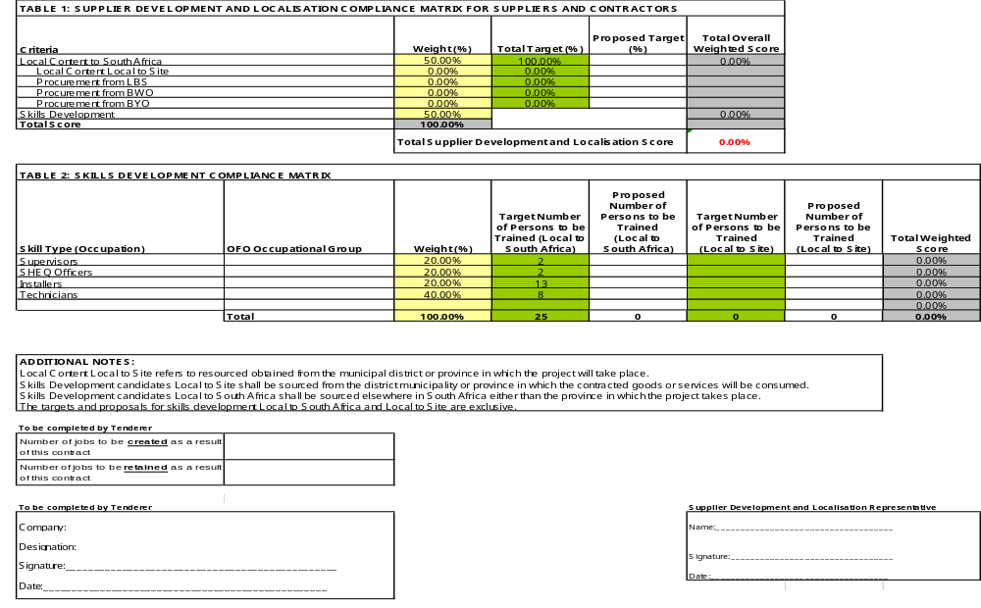
SDL&I Contractual requirements – Objective Criteria
(Not a weighted Criteria)

Slide 18
Monitoring ation (Not a weighted Criteria)
Implementation schedule to be submitted within a month of contract signing.
Quarterly or monthly reports on progress of implementation of SD&L to be submitted to the PM.
SDL&I penalty (2.5% retention)

Slide 19

Thank You
Notes:
19

