Slide 1




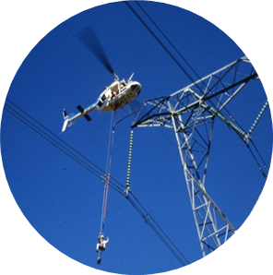

Supply and Delivery of Various Consumables - KZN115
Technical Clarification
Folder 2 - Technical
Date: 25 January 2024

Slide 2
Scope
The scope is the supply and delivery of consumables to various sites across the cluster on an as and when required basis
It is for supply of non-durable household goods e.g. Milk, teabags, sugar, insecticide etc
Suppliers will be appointed as part of a panel of contractors to execute the scope
The form of contract used will be NEC3 Supply Short Contract
Note : Delay damages specified is R500 a day

Slide 3
Technical Criteria Methodology
Technical Criteria is structured to assess tenderer’s experience and ability to execute the scope.
The technical evaluation will be made up of 2 parts. Part A is a mandatory section. Part B is a supplementary section, which will also consist of an on-site evaluation to verify information in Part B.
100% must be achieved in Part A and a minimum threshold of 75% must be achieved in Part B for the tenderer to be deemed as successful in the technical evaluation.
Tenderers must pass part A to be further evaluated in Part B. If the threshold is not achieved in any part of the evaluation the tenderer will be deemed unsuccessful for the technical evaluation.
A Technical Tender Returnable template is provided in Folder 2 – Technical for the ease of the Tenderers to submit all technical returnable.
The Technical Tender Returnable template includes the Technical Evaluation Criteria for your reference

Slide 4
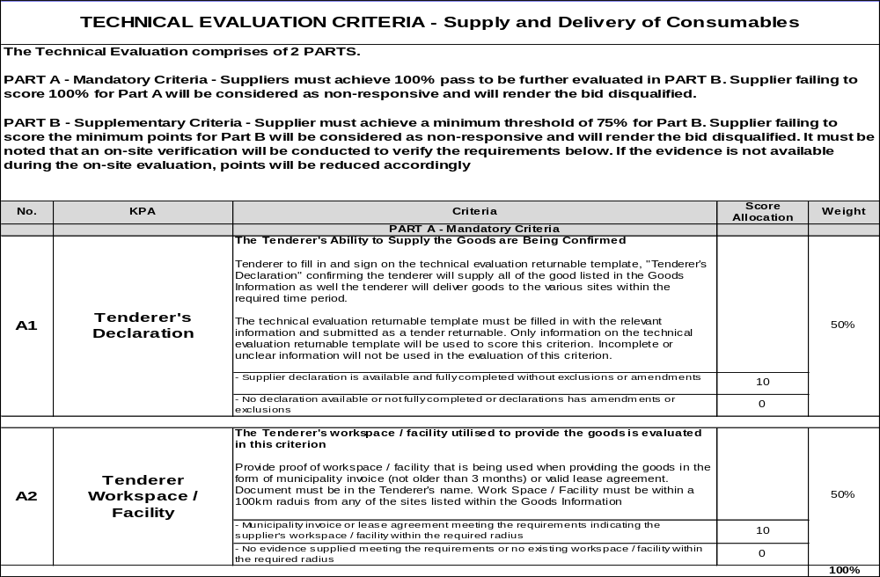
Technical Evaluation Criteria

Slide 5
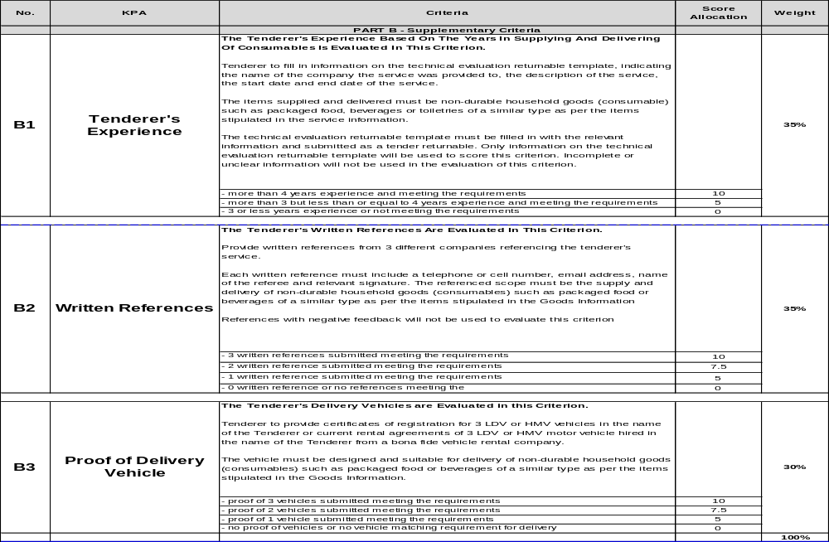
Technical Evaluation Criteria

Slide 6

End

