Slide 1
TENDER BRIEFING SESSION:
TNPA/2022/04/0250/RFP
PROJECT NAME:
CONSTRUCTION OF TWO 80 TON REINFORCED CONCRETE BOLLARDS FOR THE PORT OF EAST LONDON
Date: 2022/05/03

Slide 2
CONTENT / MEETING AGENDA
1 | Welcoming and Introductions | N Molokomme
2 | Part T1: Tendering Procedures | N Molokomme
3 | Part T2: Returnable documents | All
4 | Part C1: Agreements and Contract Data | L Tetani
5 | Part C2: Pricing Data | L Sidlayi / L Tetani
6 | Part C3: Scope of Works | L Sidlayi / K Veerasamy
7 | Part C4: Site Information | L Sidlayi / K Veerasamy
9 | Questions and Answers | All
10 | Closing and Site Visit | N Molokomme

Slide 3
PART T1: TENDERING PROCEDURES
  RFP information:
    RFP Number: TNPA/2022/04/0250/RFP
    Issue Date: 14 April 2022
    Compulsory Briefing: 03 May 2022 @ 10h00
    Closing Date: 17 May 2022 @ 12h00
    Tender Validity Period: 12 week from closing date
  Tender submissions:
    Submit bids on Transnet’s e-Tenders Submission Portal on www.transnet.net (refer Section 2 of T1.1 on page 4 of 99)
    CIDB grading 3CE
    No late tenders will be accepted.
  SCM contact person: (details are available on the tender document)
    Ms Lungelwa Mxokozeli (Procurement Manager)
    email: Lungelwa.Mxokozeli@transnet.net
    Tell: 043 700 2247

Slide 4
ELIGIBILITY CRITERIA
Only those tenderers who satisfy the following eligibility criteria are eligible to submit tenders:
Stage one as per CIDB: Eligibility Criteria Schedule: Certificate of attendance at Compulsory Tender Clarification Meeting | Certificate of attendance at Compulsory Tender Clarification Meeting: An authorised representative of the tendering entity or a representative of a tendering entity that intends to form a Joint Venture (JV) must attend the compulsory clarification meeting in terms C2.7
Stage two as per CIDB: Eligibility Criteria Schedule - CIDB Registration | Only those tenderers who are registered with the CIDB, or are capable of being so prior to the evaluation of submissions, in a contractor grading designation equal to or higher than a contractor grading designation determined in accordance with the sum tendered or a value determined in accordance with Regulation 25 (1B) or 25(7A) of the Construction Industry Development Regulations, designation of 3 CE or higher class of construction works, are eligible to have their tenders evaluated

Slide 5
TENDERER IS REQUIRED TO SUBMIT WITH THE TENDER
The tenderer is required to submit with his tender:
A valid Tax Clearance Certificate issued by the South African Revenue Services. Tenderers also to provide Transnet with a TCS PIN to verify Tenderers compliance status.
A valid B-BBEE Certificate from a Verification Agency accredited by the South African Accreditation System [SANAS], or a sworn affidavit confirming annual turnover and level of black ownership in case of all EMEs with 51% black ownership or more together with the tender;
A valid CIDB certificate in the correct designated grading;
Proof of registration on the Central Supplier Database;
Letter of Good Standing with the Workmen’s compensation fund by the tendering entity or separate Letters of Good Standing from all members of a newly constituted JV.
Note: Refer to the next slide for: Part 2 - list of returnable documents

Slide 6
PART T2: RETURNABLE DOCUMENTS
T2.1 List of Returnable Schedule / Document(s)
Pre-Qualification and eligibility:
T2.2-01 Eligibility Criteria Schedule: Certificate of attendance at Compulsory Tender Clarification Meeting
Functionality / Technical evaluation:
T2.2-03 to T2.2-09 (details covered in the next slide)
General:
T2.2-10 Authority to submit
T2.2-02 CIDB Grading Designation
T2.2-11 Record of addenda to tender documents
T2.2-12 Letter of Good Standing
Agreement and commitment by Tenderer:
T2.2-13 CIDB SFU ANNEX G Compulsory Enterprise Question
T2.2-14 Non-Disclosure Agreement
T2.2-15 RFP Declaration Form
T2.2-16 RFP – Breach of Law
T2.2-17 Certificate of Acquaintance with Tender Document
T2.2-18 Service Provider Integrity Pact
T2.2-19 Supplier Code of Conduct
T2.2-20 Agreement in terms of Protection of Personal Information (POPIA)
Financial/Insurance:
T2.2-21 Three (3) years audited financial statements
T2.2-22 Insurance provided by the Contractor

Slide 7
PART T2: RETURNABLE DOCUMENTS
T2.2 Returnable Schedule – Functionality / Technical Evaluation
Minimum threshold on functionality / technical is 70 points
Functionality Criteria |  | Max Score
T2.2-03 | Programme | 10
T2.2-04 | Project Organogram, Management, & CVs of Key Persons | 30
T2.2-06 | Quality Management | 10
T2.2-07 | Health and Safety Management | 5
T2.2-08 | Environmental Management | 5
T2.2-09 | Previous Experience | 30
T2.2-10 | Method Statement | 10
 | Maximum score for functionality | 100

Slide 8
80/20 – PREFERENCE POINT SYSTEM
Only tenders that achieve the minimum qualifying score for functionality will be evaluated further in accordance with the 80/20 preference points systems as described in Preferential Procurement Regulations 6 and 7
The maximum points for this bid are allocated as follows:
DESCRIPTION | POINTS
PRICE | 80
B-BBEE STATUS LEVEL OF CONTRIBUTION | 20
TOTAL POINTS FOR PRICE AND B-BBEE MUST NOT EXCEED | 100

Slide 9
PART C1: AGREEMENTS AND CONTRACT DATA
  C1.1 Form of Offer and Acceptance
  C1.2 Contract Data
  C1.3 Form of Guarantee

Slide 10
PART C1: AGREEMENTS AND CONTRACT DATA
C1.2 Contract Data
Contract Type: NEC3 Engineering and Construction Contract (ECC)
Core Clauses: 1 - 9
Main Option Clause: B - Priced contract with bill of quantities
Dispute resolution: Option W1 - Dispute resolution procedure
Secondary option clauses: X2 Changes in law
X4 Parent company guarantee
X7 Delay damages
X13 Performance guarantees
X16 Retention
X18 Limitation of liability
Z: Additional condition of the contract

Slide 11
PART C2: PRICING DATA
  Refer to attached Bill of Quantities

Slide 12
PART C3: SCOPE OF WORKS
  Excavating for 3m x 3m foundations
  Drilling, installing, and testing of threaded tie bars
  Reinforced concrete casting
  Installing 80 ton tee type bollards (issued by Employer)
  Backfilling of existing trenches

Slide 13
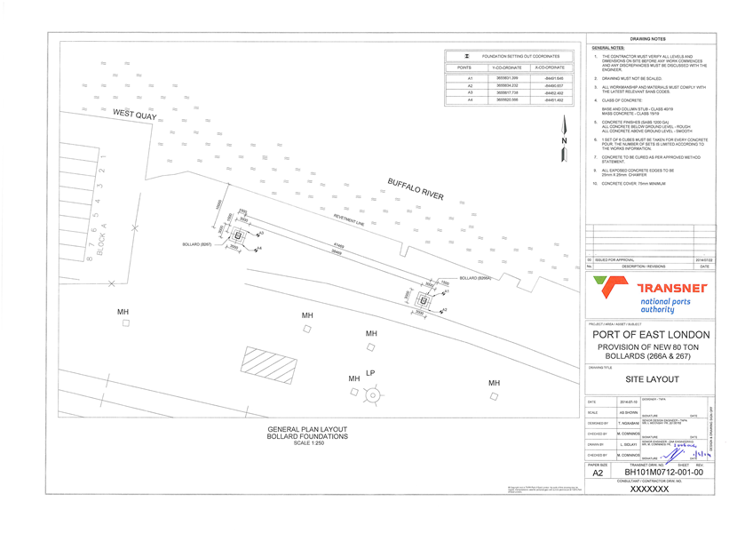
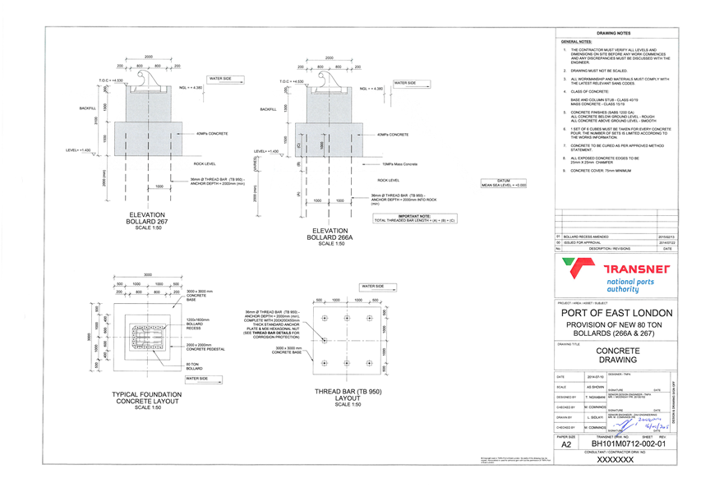
PART C3: SCOPE OF WORKS
  Drawings issued for tender purposes

Slide 14
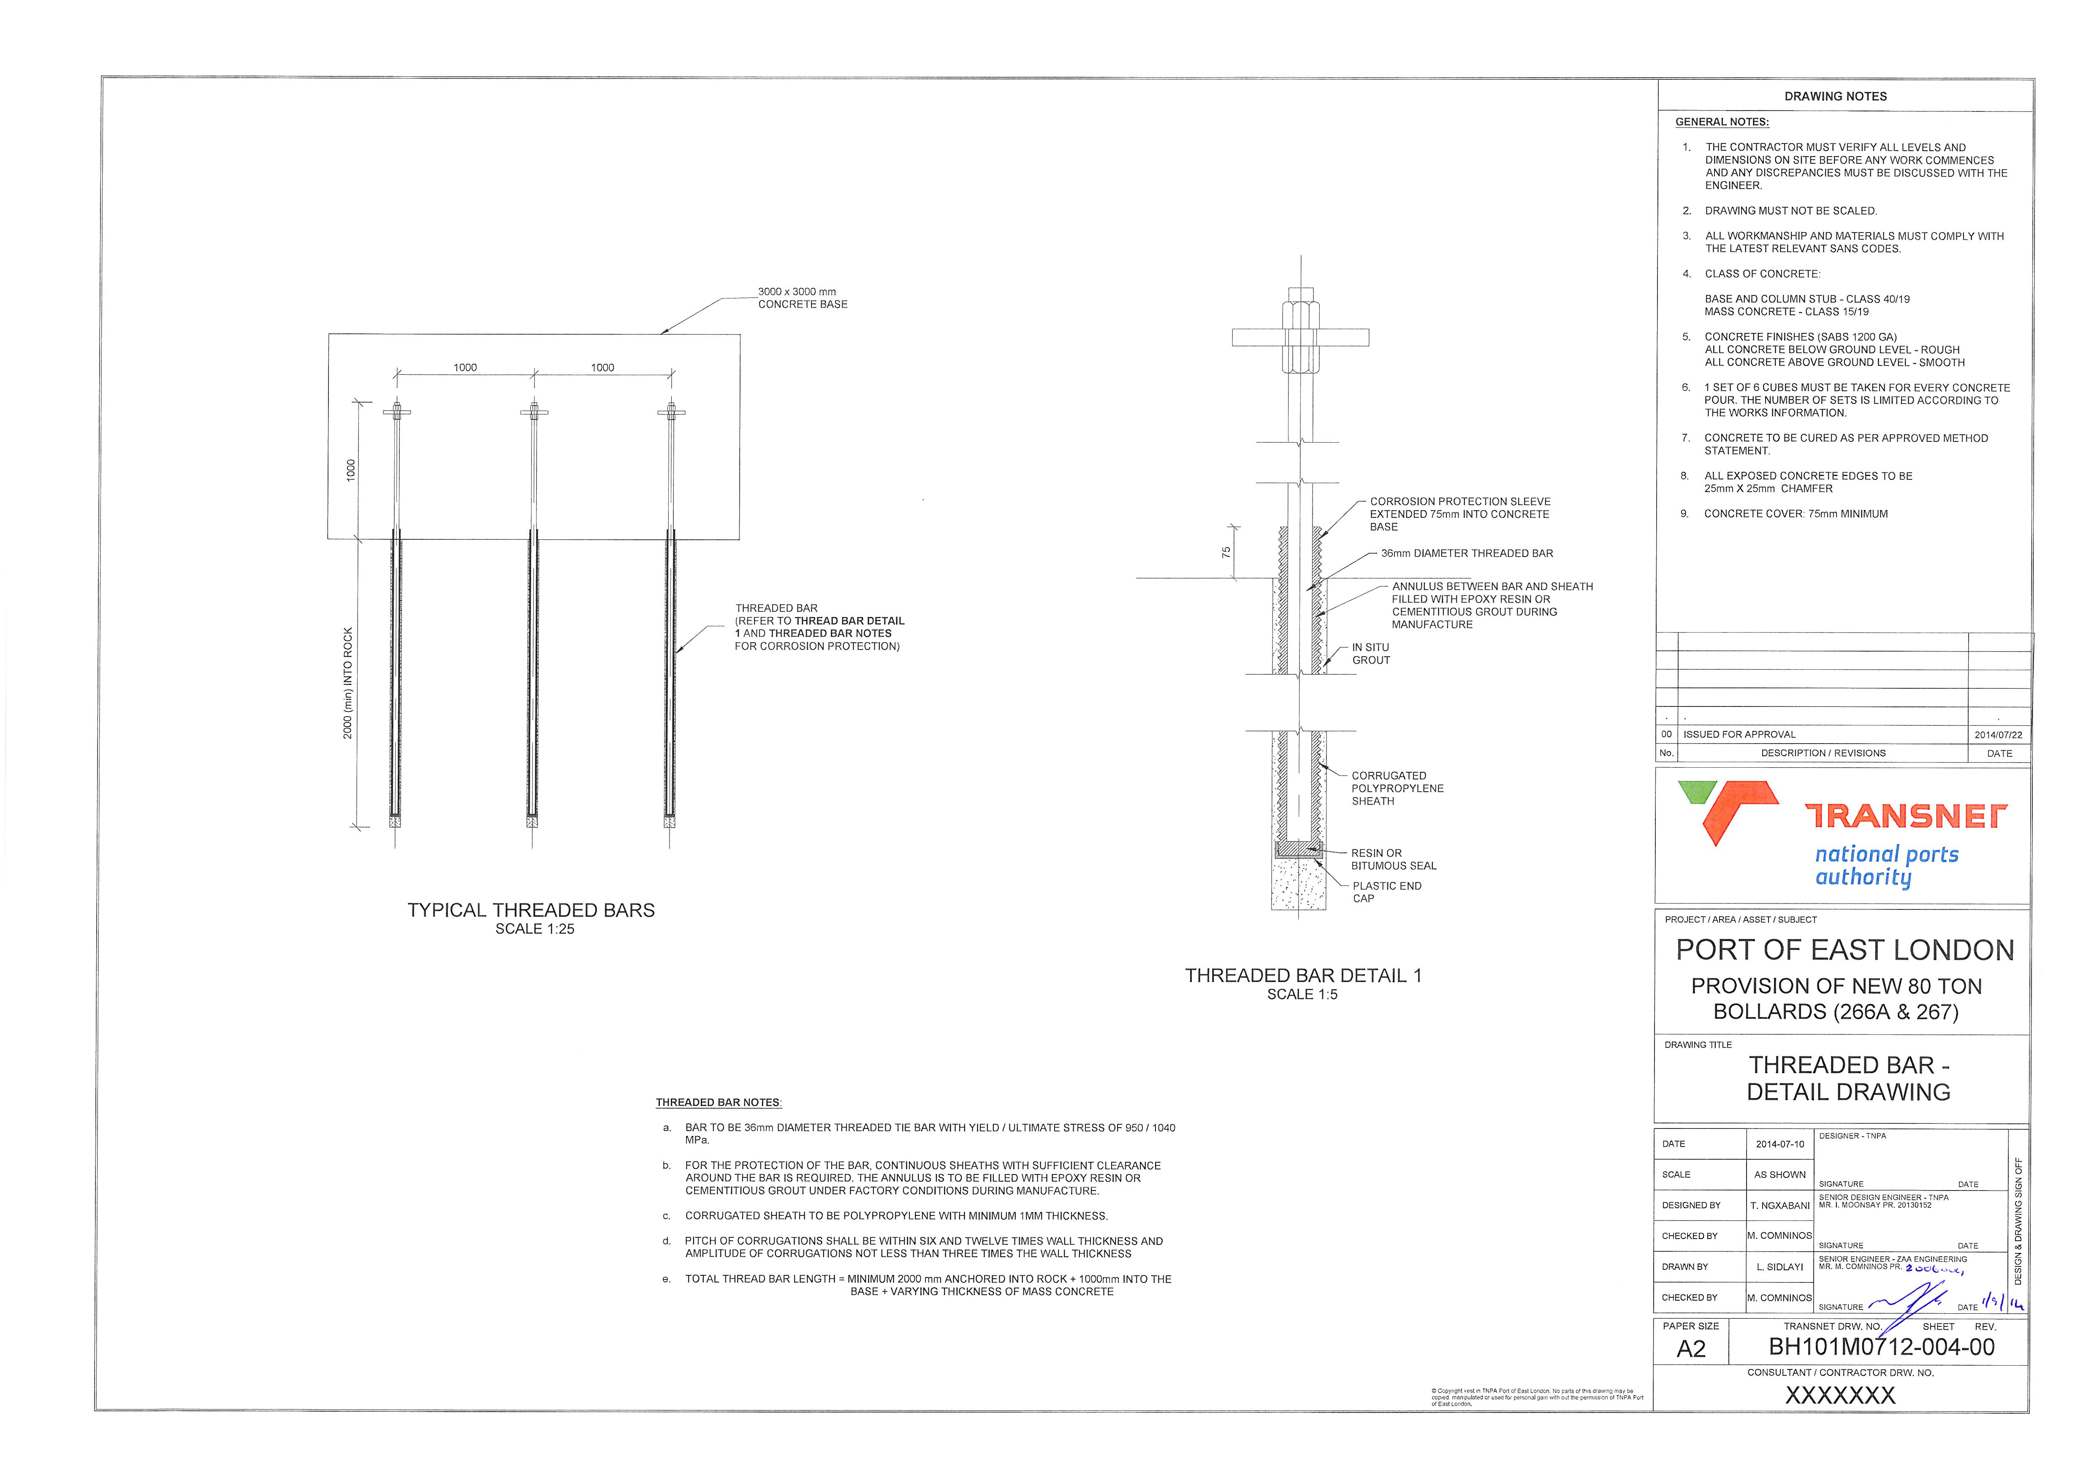
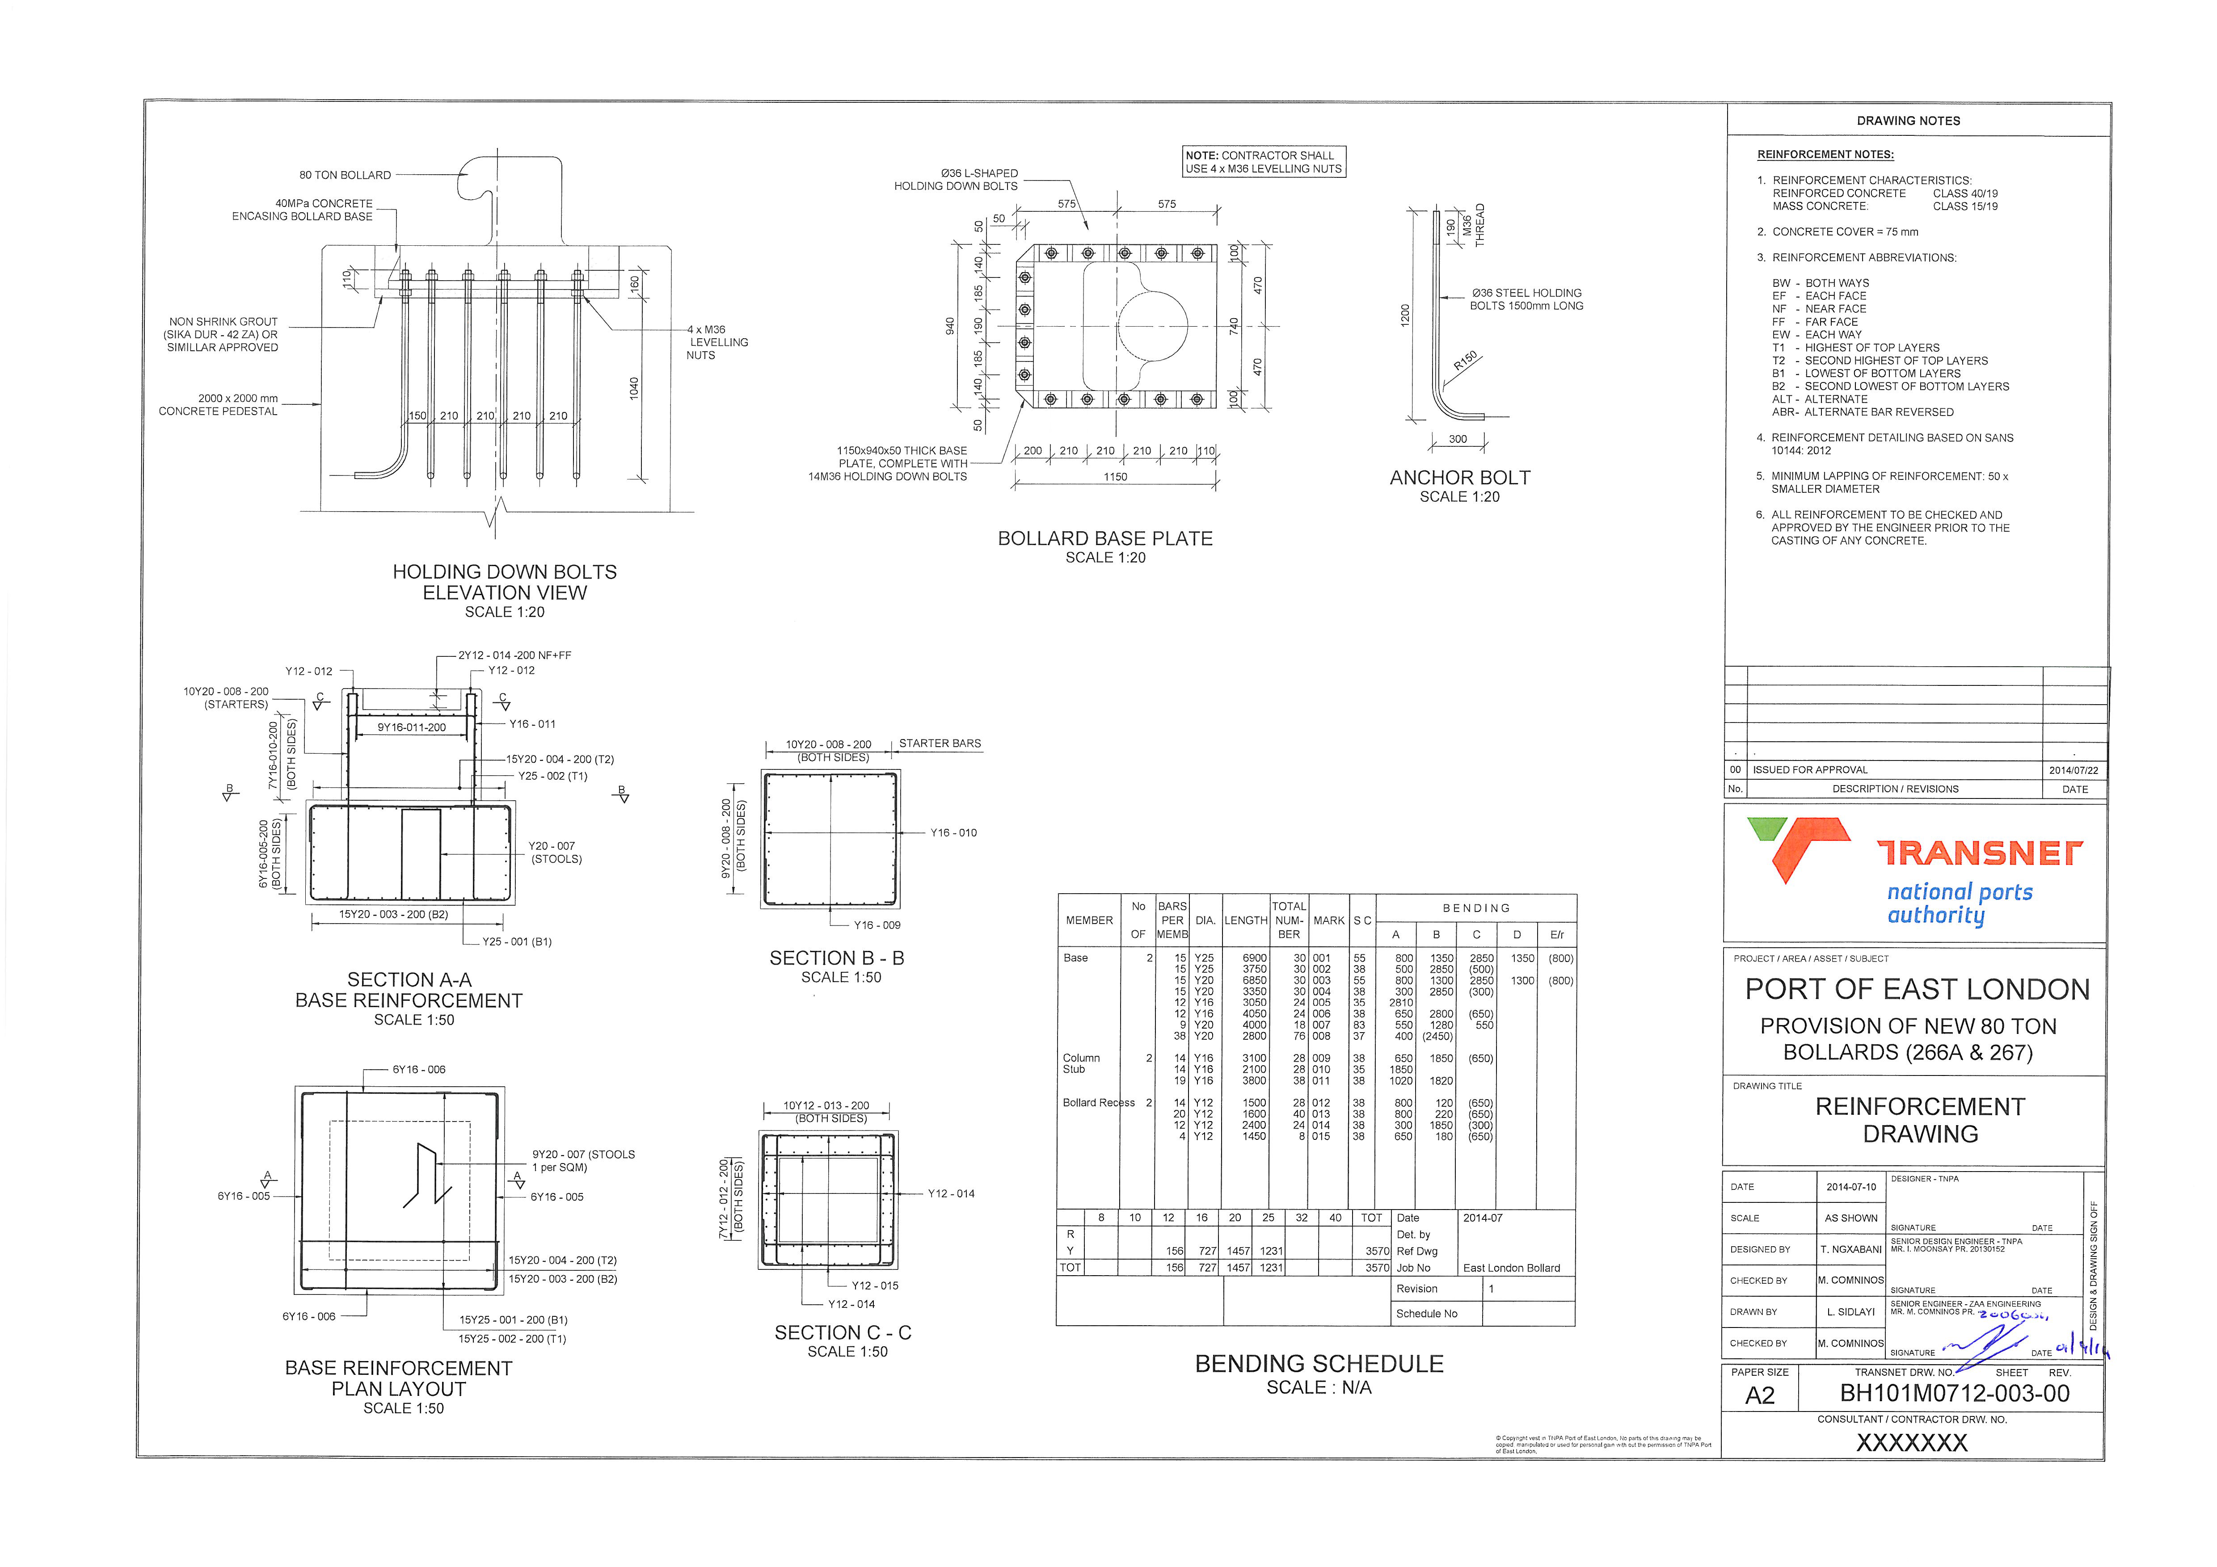
PART C3: SCOPE OF WORKS
C3.1 Work Information
  Drawing issued for tender purposes

Slide 15
PART C4: SITE INFORMATION
<insert site pics>

Slide 16
THANK YOU
Contact details
TNPA Port of East London
Ganteaume Crescent
Quigney
East London
5201

