Slide 1

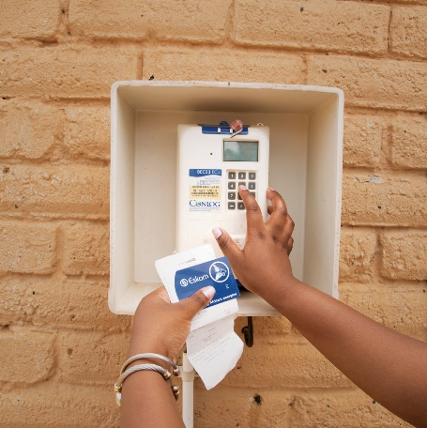
E2837DXNCOU - Tender clarification meeting: Provision of major and minor reticulation
Technical
2026-08-28

Slide 2
Technical Clarification
Technical Requirements and Evaluation Process (Clause 3)
  The evaluation process consists of three distinct phases that follows a chronological order
    Mandatory Requirements: Evaluated on a pass or fail basis – Only submissions that pass this stage will then be considered in the next stage of evaluation
    Functional Requirements: Evaluated based on the quality and quantity of supporting evidence, resulting in a percentage score. All functional criteria will be scored against minimum threshold. To be considered technically compliant, tenderers must achieve a minimum weighted final score (threshold) of 70%. Eskom reserves the right to lower the threshold to 60% if there are inadequate number of submissions that pass the functional requirements as stated in the strategy.
    Contractual Obligation Requirements: This stage will include non-scoring/informational criteria to be assessed at contract award stage. It outlines the final technical requirements, including all necessary authorizations and compliance with applicable technical standards and criteria.

Slide 3
Technical Clarification – Table 1 Preliminary Checklist (Mandatory)
Nr. | Submission Returnable | Required Qualification Evidence | Evaluation
1. | Electrical Contractor Registration Certificate | Department of Labour Certificate Certified Valid Department of Labour Certificate (Letter of Registration) in your Company Name / Trading as name or Company Owner | Submitted: Pass Not Submitted: Fail
2. | Skills Resources Schedule | Annexure B – Skills Resources Schedule Completed in full. Signed and dated by Owner/Company Representative | Submitted: Pass Not Submitted: Fail
3. | Vehicle Schedule | Annexure C – Vehicles Schedule Completed in full. Signed and dated by Owner/Company Representative | Submitted: Pass Not Submitted: Fail
4. | Tools & Equipment Schedule | Annexure D – Tools & Equipment Schedule Completed in full Signed and dated by Owner/Company Representative | Submitted: Pass Not Submitted: Fail
5. | Nearest Base of Operation | Annexure A – Base of Operation Completed in full. Signed and dated by Owner. AND At least one of the following: Lease Agreement With corresponding address as stipulated in Annexure A OR Title deed or bond statement OR Letter from Property Owner or Primary Lease holder OR A letter from Property Owner or property manager confirming intent to rent property upon successful contracting | Submitted: Pass Not Submitted: Fail
Preliminary Evaluation Outcome |  |  | Fails > 0: Unsuccessful Pass = 5: Continue

Slide 4
Technical Clarification – Table 2 Mandatory and Functional (Skills Resources)
The completed list of resources and skills as per Annexure B – Skills Resources Schedule, will be evaluated and scored as per Table 2.
Each skill resource must be covered by at least one person, with Cable Technician and Rock Drill Operator as exceptions
Where a person holds multiple qualifications, that person can be listed under more than one resource skill (i.e. MV and LV Lineman may be 1 individual)
For every person named on Annexure B, completion of Annexure B1 (Affidavit) together with Annexure B2 (POPIA Consent form) is required
A certified, valid ID copy has to accompany each of Annexures B1 and B2 (1 copy of ID, B1 and B2 annexures per person listed in the schedule)
Where a temporary ID is provided, it should still be valid
Skills resources contribute 60% towards the final score

Slide 5
Technical Clarification – Table 3 Mandatory and Functional (Vehicles)
The completed list of vehicles as per Annexure C – Vehicles Schedule, will be evaluated and scored as per Table 3.
Minimum of one vehicle per category is required
If owned, submit the certified and valid copy of full licence document showing company/owner’s information
If hired, submit a proof of hiring contract or pre-approved letter from the hiring company
Vehicle resources contribute 20% towards the final score

Slide 6
Technical Clarification – Table 4 Mandatory and Functional (Tools, Equipment and Machinery)
The completed list of tools, machinery and equipment as per Annexure D – Tools & Equipment Schedule, will be evaluated and scored as per Table 4.
Note the minimum requirements, which are set out in Table 4
For GPS, Camera and certain testing instruments, a copy of the user manual/section indicating accuracy must be submitted
Where equipment is hired, proof of the hiring contract or a pre-approved letter from the hiring company is required
A weighting of 20% of the final score is assigned to Tools, Equipment and Machinery

Slide 7
Technical Clarification – Common Submission Mistakes
Incomplete and unsigned documents i.e., Annexures A, B, C, and D
Although multiple names appear in the annexures, evidence was provided for only one person
No copies of ID for Skill resources
Annexure A: Base of Operation submitted without supporting evidence such as lease agreement or letter of intent to rent
The nearest base of operation need not be in the Northern Cape; we are looking to establish that the business has the required facilities to perform work
Where a business runs from a residential property, a letter from the owner confirming that business activity is permitted at the premises must be supplied (municipal bylaws)
Neither a certified SPU Maintenance and Commissioning course certificate nor a signed, dated letter of intent to obtain that certificate within 3 months after tender award is provided (Meter Worker)
Installation electricians are put forward although their names do not appear on the Letter of registration as Electrical contractor
Only full-time staff of the tendering company may serve as installation electricians, and their names must appear in annexure B
User manuals not submitted for some of the tools or testing instruments
Failure to provide a GPS user manual whose stated accuracy falls beyond the specified range (i.e. 5-10m accuracy)

Slide 8
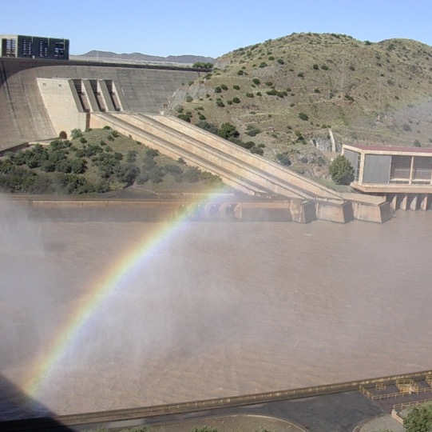

End

