Slide 1






Clarifications: The manufacture, supply and delivery of Fibre Optic Line Hardware for Eskom on an “as and when” required basis for a five (5) period. MWP2330TX
SDL&I Evaluations
19 January 2024
Zwelethu Xundu

Slide 2

We have a mandate to contribute positively to the development of the country
Our mandate is to achieve maximum and sustainable local development impact through leveraging Eskom’s procurement spend in a manner that allows flexibility within the business in order to accommodate government local development initiatives and policies

Slide 3
Supplier Development & Localization (SD&L) measures impact along these key performance areas
Key performance area
Definition
  Skills development
  Increasing the skill base (number and skill level) of South African workers in areas relevant to the energy sector and where there is a national scarcity of skills
  Local content
  Utilisation of Eskom and suppliers’ spend to develop South African based suppliers relevant to the energy sector (focusing primarily on BBB-EE and Black Owned suppliers)
  Industrialisation
  Utilisation of Eskom and suppliers’ spend to foster the establishment of new competitive industries in the energy sector
Job creation and Employment
  Creation of new jobs by suppliers as a direct result of Eskom business
  Supplier development
  Providing a platform to develop emerging suppliers, and further opportunities for national and international suppliers
3

Slide 4
Designated sectors - DTIc
NOTE: SBD 6.2 Declaration Form and Annex C (Local Content Declaration-Summary Schedule) are therefore mandatory for contract award.
.
Sector | Threshold
Fibre Optic Line Hardware | 100%

Slide 5
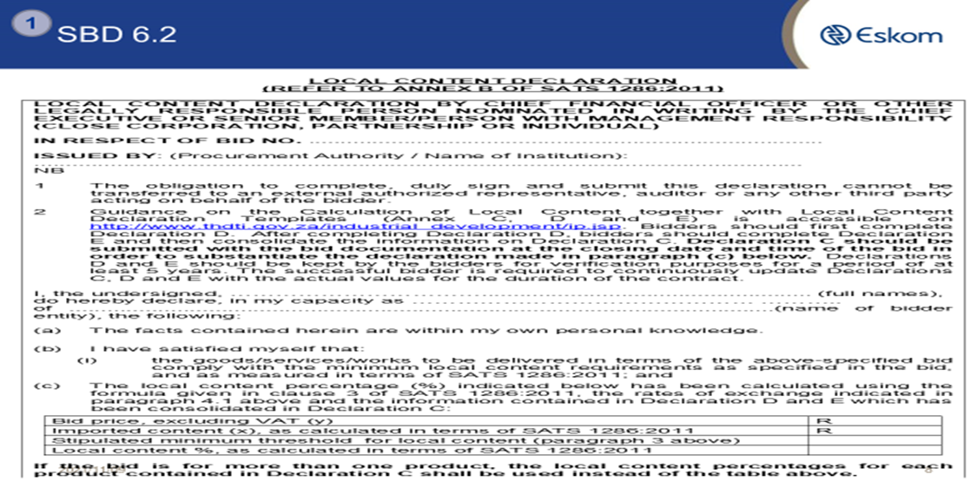
Designated Sector - DTIc
Note: As a tender returnable suppliers must submit Local Content Declaration Annexure C and SBD 6.2.
.
Industry | Threshold
Wire Products | 100%

Slide 6
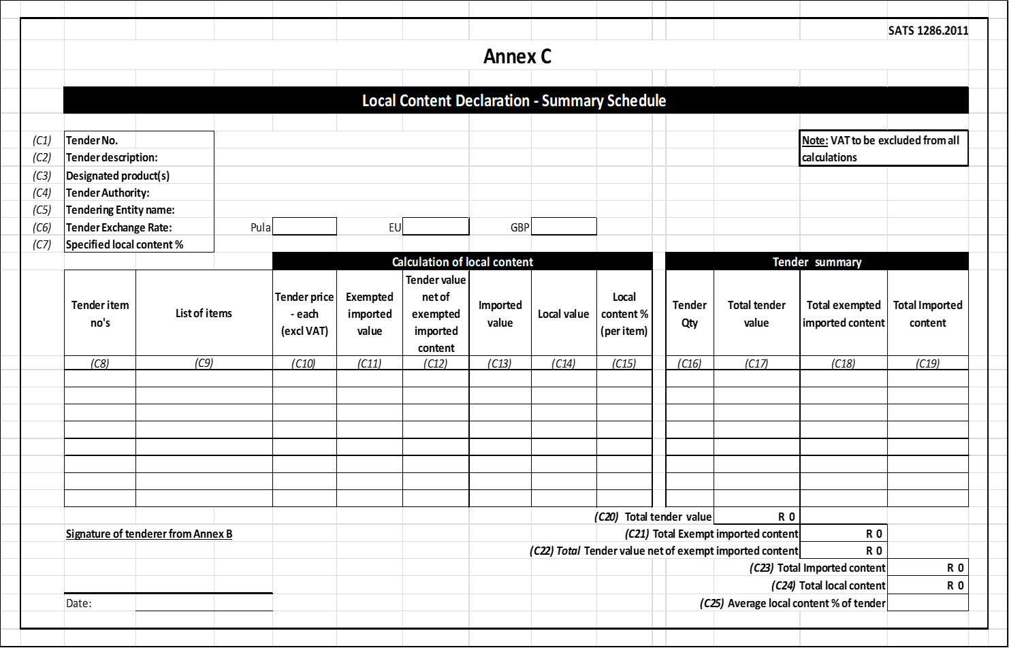
Annexure C
.

Slide 7
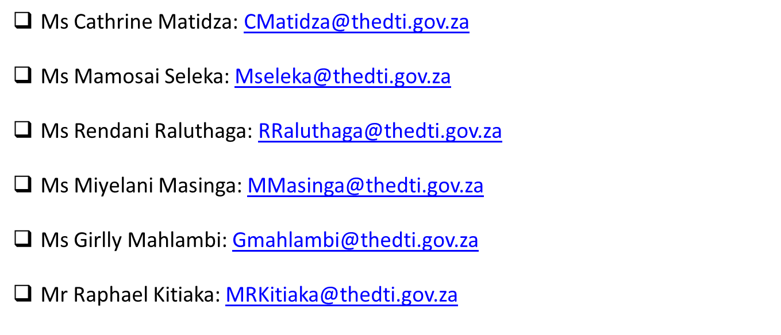
Local Content Enquiries: Bidding Documents, Calculations & Annexures
.

Slide 8
Evaluation criteria
The 90:10 OR 80:20 rule will apply in this project:
B-BBEE = 10 /20
Price = 90 /80
.

Slide 9
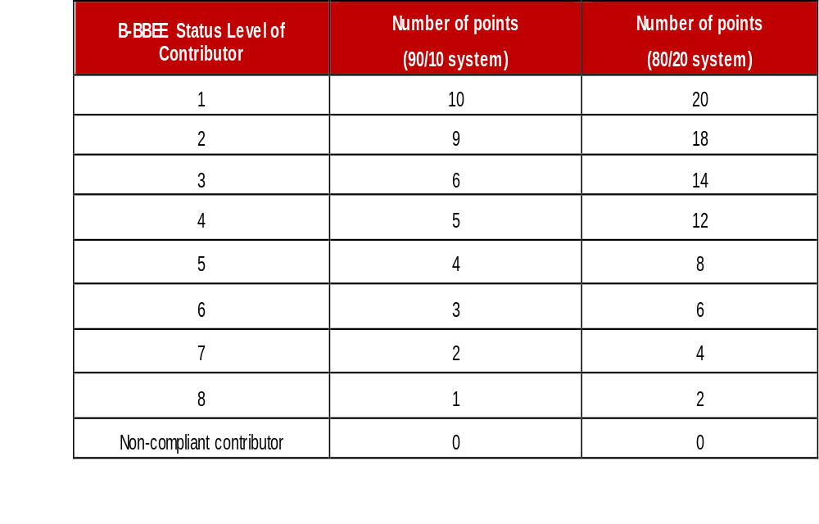
Preference Points B-BBEE

Slide 10

B-BBEE requirements
The certificate must be valid.
Verification Agency must be SANAS accredited.
There should be a logo of SANAS on the certificate.
QSEs and EMEs – Sworn affidavit is acceptable

Slide 11
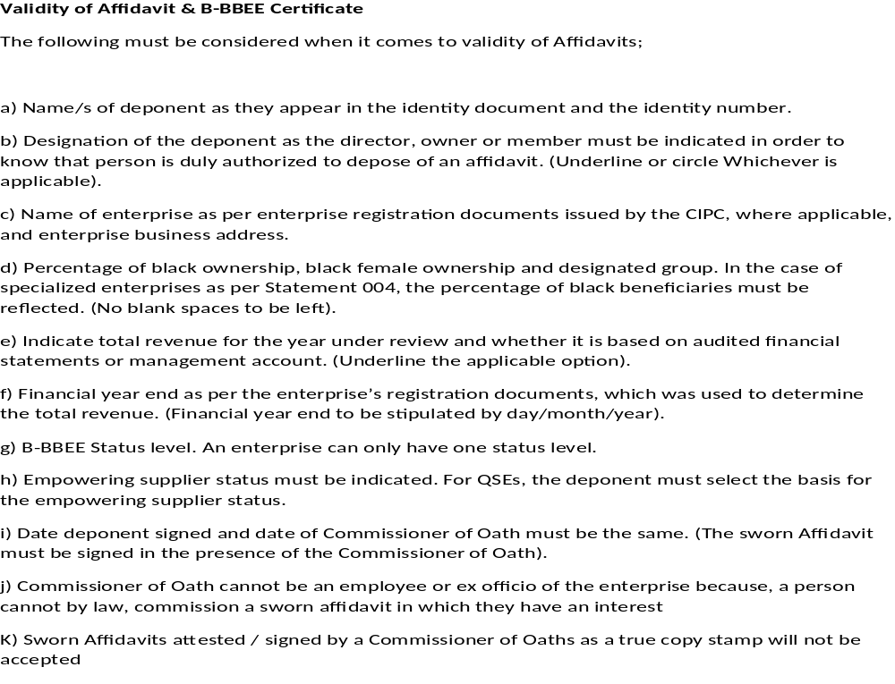
Validity of Affidavit

Slide 12
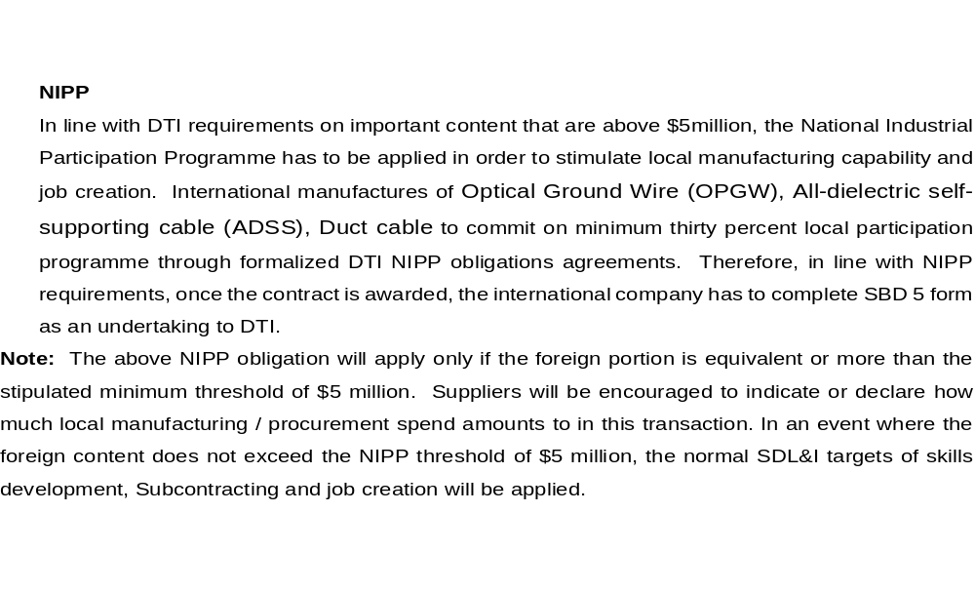
SDL&I Objectives in Line with RDP Goal
(Not a weighted Criteria)

Slide 13
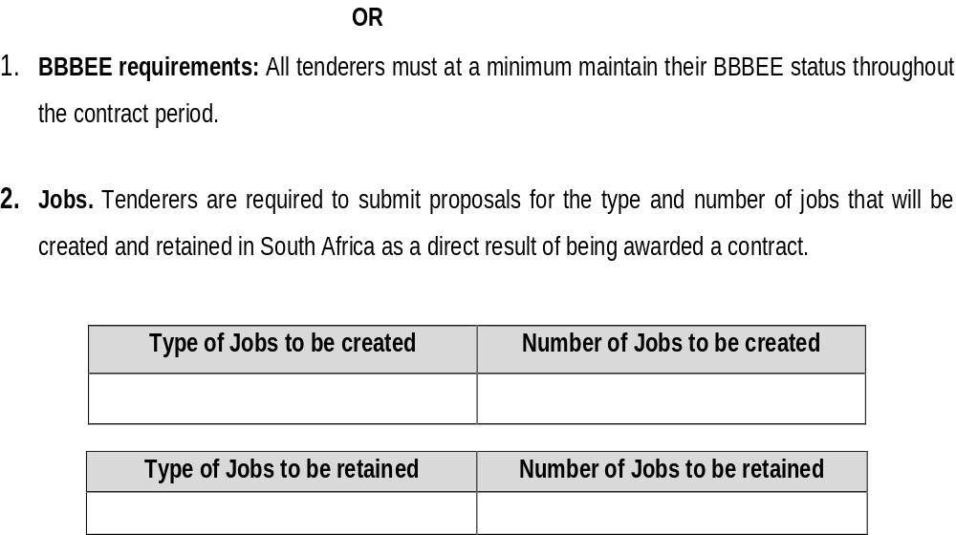
SDL&I Objectives in Line with RDP Goals
(Not a weighted Criteria)

Slide 14
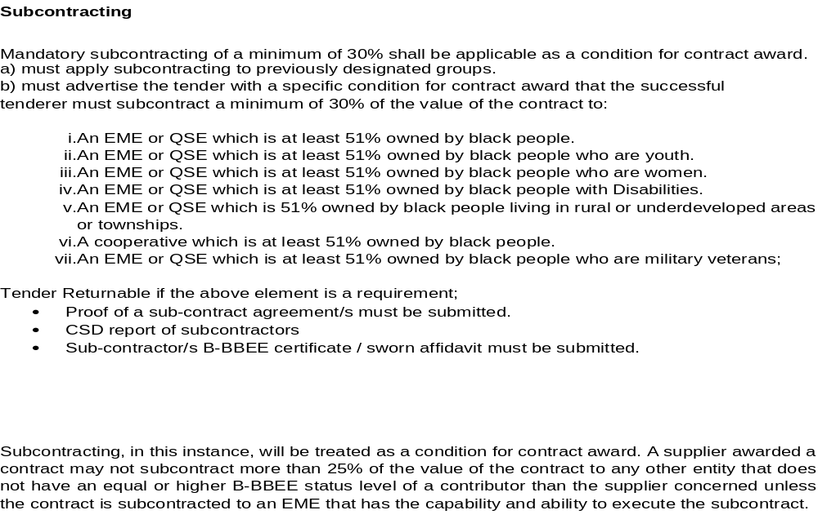
SDL&I Objectives in Line with RDP Goals
(Not a weighted Criteria)

Slide 15
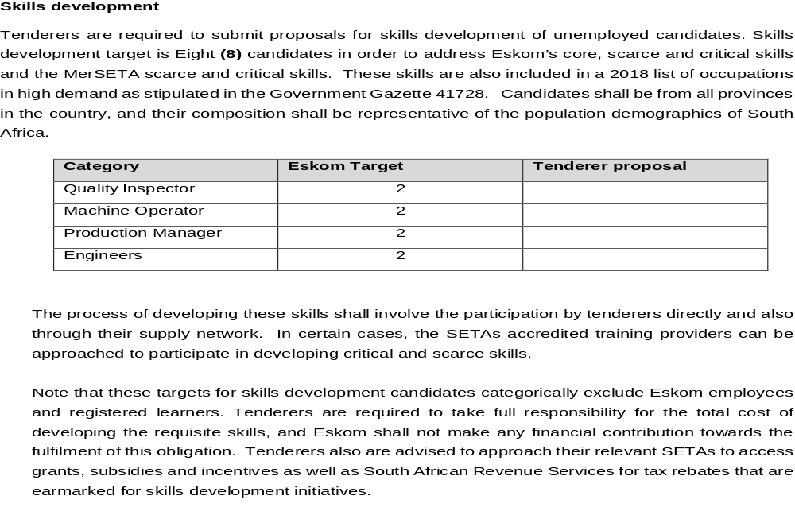
SDL&I Objectives in Line with RDP Goals
(Not a weighted Criteria)

Slide 16
Monitoring ation (Not a weighted Criteria)
Implementation schedule to be submitted within a month of contract signing.
Quarterly or monthly reports on progress of implementation of SD&L to be submitted to the PM.
SDL&I penalty (2.5% retention / Performance Bond)

Slide 17

Thank You
Notes:
17

