Slide 1
THE SOUTH AFRICAN NATIONAL ROADS AGENCY SOC LTD
CONTRACT No. SANRAL N.001-190-2017/2
FOR THE ASPHALT OVERLAY RESURFACING ON NATIONAL ROUTE N1 SECTION 19 FROM VAAL RIVER (KM 0.0) TO KLEIN RIETSPRUIT (KM 10.1)
CLARIFICATION MEETING PRESENTATION

Slide 2
AGENDA
WELCOME
INTRODUCTION
TENDERING PROCEDURES
RETURNABLE SCHEDULES
CONTRACT DATA
PROJECT INFORMATION
PROJECT SPECIFICATIONS
CLOSURE

Slide 3
1. WELCOME
Contract: N.001-190-2017/2
FOR THE ASPHALT OVERLAY RESURFACING ON NATIONAL ROUTE N1 SECTION 19 FROM VAAL RIVER (KM 0.0) TO KLEIN RIETSPRUIT (KM 10.1)
Tender documents are available at no cost in electronic format downloadable from SANRAL website
https://www.nra.co.za/service-provider-zone/tenders/open-tenders/
Tenderers must have access to Microsoft Office © 2013 and Acrobat Adobe © 9.0, or similar compatible software.
All Queries related to this tender is to be addressed only to the SANRAL Procurement Officer:
Mr Andile Gogotya
E-Mail: gogotyaa@nra.co.za

Slide 4
2. INTRODUCTION
PROJECT | N.001-190-2017/2
CLIENT | SANRAL
PROCUREMENT OFFICER | MR ANDILE GOGOTYA
DESIGN CONSULTANT | BVi CONSULTING ENGINEERS WESTERN CAPE (PTY) LTD
PROJECT LEADER | ANDRE VAN PLETZEN
CONTRACT ENGINEER | ANDRE VAN PLETZEN

Slide 5
2. INTRODUCTION
IMPORTANT TENDER DATES
SUBMISSION OF FORM A1.1 NB:Failure to submit this certificate would result in the tenderer not receiving addenda or additional issued information and may result in the tender being non-responsive. | 22 OCTOBER 2021
SUBMISSION OF QUERIES | 5 NOVEMBER 2021
TENDER CLOSING DATE | 12 NOVEMBER 2021

Slide 6
3. TENDERING PROCEDURE
PLEASE NOTE:
THE SIGNATURE ON THE DULY COMPLETED AND SIGNED FORM A1 SHALL BE CONSIDERED PROOF THAT THE TENDERER READ/VIEWED THE WHOLE CLARIFICATION BRIEFING PRESENTATION AND CLEARLY UNDERSTOOD ALL DIRECTIVES AND CLARIFICATIONS GIVEN IN THE PRESENTATION
ANY INCONSISTENCY BETWEEN THE PRESENTATION AND TENDER DOCUMENT, THE TENDER DOCUMENT SHALL PREVAIL UNLESS COMMUNICATED IN THE ADDENDUM

Slide 7
PART T1: TENDERING PROCEDURES
BOOK 1 of VOLUME 3

Slide 8
3. TENDERING PROCEDURES
T1.2 TENDER DATA
Form A1.1 Certificate of Intention to Submit a Tender must be submitted, via email by close of business on 22 October 2021. Failure to submit this certificate will result in the tenderer not receiving addenda or additional issued information and may result in the tenderer being non-responsive.
C.2.1 Eligibility criteria
(a) CIDB registration (Form A12)
Tenderers should have a CIDB contractor grading designation of 8CE.
Only those tenderers who are registered with the CIDB or are capable of being so prior to the evaluation of submissions, in a contractor grading designation equal to or higher than a contractor grading designation determined in accordance with the sum tendered, or a value determined in accordance with Regulation 25 (1B) or 25(7A) of the Construction Industry Development Regulations, for a 9 CE class of construction work, are eligible to have their tenders evaluated.

Slide 9
3. TENDERING PROCEDURES
T1.2 TENDER DATA
(a) CIDB registration (Form A12)
Joint ventures are eligible to submit tenders provided that:
1. every member of the joint venture is registered with the CIDB;
2. the lead partner has a contractor grading designation in the 8 CE class of construction work; or not lower than one level below the required grading designation in the class of works construction works under considerations and possess the required recognition status.
3. the combined contractor grading designation calculated in accordance with the Construction Industry Development Regulations is equal to or higher than a contractor grading designation determined in accordance with the sum tendered for a 9 CE class of construction work or a value determined in accordance with Regulation 25 (1B) or 25(7A) of the Construction Industry Development Regulations.
Tenderers whose CIDB registration expires within the tender validity period, need to demonstrate that there is a reasonable chance of being registered in the appropriate grading designation during the tender evaluation period, by submitting a copy of their timely application for CIDB registration, with their tender submission.

Slide 10
3. TENDERING PROCEDURES
T1.2 TENDER DATA
(a) CIDB registration (Form A12) continuous
Tenderers registered as potentially emerging enterprises but with a CIDB contractor grading designation lower than a contractor grading designation determined in accordance with the sum tendered, or a value determined in accordance with Regulation 25(7A) of the Construction Industry Development Regulations, are not eligible to have their tenders evaluated.
This contract is not classified in terms of CIDB Regulation 25(1B), and the value of the contract may, for the purpose of CIDB Regulation 25(1), not be taken at its annual value.
The tender will be declared non-responsive if:
- The Tenderer is not registered on CIDB within the required contractor grading and category prior to evaluation of submission, or
- the Tenderer is suspended, or
- the Tenderer has not declared interest of application to upgrade the grading.

Slide 11
3. TENDERING PROCEDURES
T1.2 TENDER DATA
(b) Local production and content (Forms A3.5 and A3.6) continuous
(i) Steel
  Only locally produced or locally manufactured steel products and components for construction with a minimum threshold for local content and production as stipulated in the Tender Document
(ii) Yellow Metal Equipment
  Only locally produced or locally manufactured Yellow metal equipment for construction with a minimum threshold (based on the cost of the locally produced portion of the equipment relative to the cost of the equipment) for local content and production as stipulated below will be considered. This only applies for equipment acquired to be utilised on this project.

Slide 12
3. TENDERING PROCEDURES
T1.2 TENDER DATA
(b) Local production and content (Forms A3.5 and A3.6)
(iv) Textiles, Clothing, Leather and Footwear
  Only locally produced or locally manufactured Textiles, Clothing, Leather and Footwear from local raw material or input, with a minimum threshold for local production and content of 100% will be considered.
If the minimum threshold/s % local content is below the stipulated minimum threshold for local production and content, or if either of the Forms is omitted, the tender will be declared non-responsive.

Slide 13
3. TENDERING PROCEDURES
T1.2 TENDER DATA
(c) National Treasury Central Supplier Database (Form A3.4)
Tenderers, or in the event of a joint venture, each member of the joint venture, must be registered on the National Treasury Central Supplier Database at the closing date for tender submissions. If not registered as verified online at tender closing; the tender will be declared non-responsive.
(d) Pre-qualification criteria for preferential procurement (Form C1.1)
Only tenders with a B-BBEE contributor status level of 1, 2, 3 or 4, are eligible to tender.
The tenderer shall submit a valid B-BBEE certificate in compliance with the requirements of Tender Data C.3.11.8 subclause 1 to 5, as proof of eligibility.
The tender will be declared non-responsive:
    (a) If the B-BBEE Certificate is not submitted or submitted B-BBEE certificate is not valid; or
    (b) If the B-BBEE Certificate is not submitted, and the tenderer has claimed a status point level; or

Slide 14
3. TENDERING PROCEDURES
T1.2 TENDER DATA
(d) Pre-qualification criteria for preferential procurement (Form C1.1) continuous
    (c) If tenderer failed to submit a valid B-BBEE Certificate but claimed status level points; or
    (d) If the tenderer submits a B-BBEE Certificate that is expired - but did claim preference points; or
    (e) If the tenderer submits a B-BBEE Certificate that does not comply with requirements; or
    (f) If the tenderer submits the Scorecard assessment report only; or
    (g) If, in a case of a Joint Venture, the tenderer submits an unincorporated consolidated Joint Venture B-BBEE Certificate which is not project specific; or
    (h) If, in a case of a Joint Venture, the tenderer submits an unincorporated consolidated Joint Venture B-BBEE Certificate which does not have a contract description and / or a tender number; or
    (i) If a tenderer only submits one B-BBEE certificate in one tender submission, where multiple tenders were issued by SANRAL; or
    (j) If the BBBEE certificate or Sworn Affidavit is not submitted or not valid; or

Slide 15
3. TENDERING PROCEDURES
T1.2 TENDER DATA
(d) Pre-qualification criteria for preferential procurement (Form C1.1) continuous
    (h) for a Sworn Affidavit; if
    (i) EME (not start-up) submits a Sworn Affidavit with total revenue above R3 million (contractors) instead of a B-BBEE Certificate.
    or
    (ii) QSE submits Sworn Affidavit (consultants and contractors) instead of a B-BBEE Certificate
    Failure to satisfy all the eligibility criteria will result in a non-eligible tender.

Slide 16
3. TENDERING PROCEDURES
T1.2 TENDER DATA
C.2 Acknowledge addenda
Failure to apply instructions contained in addenda issued by the Employer will render a Tenderer’s offer non-responsive in terms of Condition of Tender C.3.8.
C2.12 Alternative tender offers
C2.12.1 A tenderer wishing to submit an alternative offer (excluding alternative offers of different contract duration, retention guarantees, discounted offers or different compliant material sources) shall first apply to the Employer for confirmation that the Employer’s standards and requirements envisaged in the design are not compromised or reduced. Such confirmation must have been provided by the Employer in writing at least 5 (five) working days before the date of tender closing, or as extended by an addendum sent to all tenderers. The application shall not be submitted later than 7 (seven) working days before the date of tender closing given in Tender Data clause C.2.15, or as extended by an addendum sent to all tenderers.

Slide 17
3. TENDERING PROCEDURES
T1.2 TENDER DATA
C.2.13 Submitting a tender offer
C.2.13.2 The tenderer is required to submit all certificates as listed in the Schedule of Tender Compliance (Form F1) as scanned copies, in .pdf format (saved on a flash drive) and printed and bound hard copy.
C.2.13.3 Only the following needs to be submitted:
(a) Main Tender Offer
    The following information to be submitted in printed and bound hard copy and electronically on flash drive and marked Main Tender Offer followed by the “Tenderer name”, in the following order:
      Form of Offer (signed and scanned as .pdf and hard copy)
      All returnable schedules and attachments and certificates (signed and scanned as .pdf and hard copy)
      Completed pricing schedule (scanned copy in .pdf and copy in Excel and hard copy)

Slide 18
3. TENDERING PROCEDURES
T1.2 TENDER DATA
C.2.13.3 Only the following needs to be submitted:
(b) For alternative offers the tenderer shall submit the following additional documentation, in printed and bound hard copy and electronically on separate flash drive marked Alternative followed by the “Tenderer name”:
          - Form of Offer (signed and scanned as .pdf and state “Alternative Form of Offer” and hard copy)
          - All returnable schedules and attachments and certificates applicable to the alternative offer (signed and scanned as .pdf and hard copy)
          - Alternative Pricing Schedule (scanned copy in .pdf and copy in Excel and hard copy)
          - Other relevant information.

Slide 19
3. TENDERING PROCEDURES
T1.2 TENDER DATA
C2.13.5 The Employer’s address for delivery of tender offers and identification details to be shown on each tender offer package are:
Location of tender box: Northern Region (Security Gate)
Physical address: 38 Ida Street, Menlopark, Pretoria
Identification details: Place the completed printed and bound hard copy and flash drive in a package marked with the tenderer’s company name, the project number and description:
TENDER: SANRAL N.001-190-2017/2
FOR THE ASPHALT OVERLAY RESURFACING ON NATIONAL ROUTE N1 SECTION 19 FROM VAAL RIVER (KM 0.0) TO KLEIN RIETSPRUIT (KM 10.1)
It is in the tenderer’s interest to ensure that the delivery of the tender offer is recorded in the Employer’s tenders received register and deposited in the tender box.

Slide 20
3. TENDERING PROCEDURES
T1.2 TENDER DATA
C.2.15 The closing time for submission of tender offers is 11h00 on Friday 12 November 2021
C.2.16.1 The tender offer validity period is 24 weeks.
C.2.16.3 Where a tenderer, at any time after the opening of his tender offer but prior to entering into a contract based on his tender offer:
  withdraws his tender;
  gives notice of his inability to execute the contract in terms of his tender; or
  fails to comply with a request made in terms of C.2.17, C.2.18 or C.3.9,
  such tenderer shall be barred from tendering on any of the Employer’s tenders for a period to be determined by the Employer, but not less than six (6) months from a date determined by the Employer. This sanction also applies to tenders under evaluation and not yet awarded…

Slide 21
3. TENDERING PROCEDURES
T1.2 TENDER DATA
C.3.9 Arithmetical errors, omissions, discrepancies and imbalanced unit rates
Check responsive tenders for discrepancies between amounts in words and amounts in figures. Where there is a discrepancy between the amounts in figures and the amount in words, the amount appearing in the summary to the Pricing Schedule shall govern.
Check responsive tender offers for:
the gross misplacement of the decimal point in any unit rate;
omissions made in completing the pricing schedule or bills of quantities; or
arithmetic errors in:
i) line item totals resulting from the product of a unit rate and a quantity in bills of quantities or schedules of prices; or
ii) the summation of the prices.
d) imbalanced unit rates.

Slide 22
3. TENDERING PROCEDURES
T1.2 TENDER DATA
C.3.11 The procedure for the evaluation of responsive tenders is Method 3.
The value of W1 is 90
Points awarded will be according to a tenderer’s B-BBEE status level of contributor and summarised in the table below:
B-BBEE Status Level of contributor | Number of Points for financial value above R50 000 000
1 | 10
2 | 9
3 | 6
4 | 5

Slide 23
3. TENDERING PROCEDURES
T1.2 TENDER DATA
Eligibility for B-BEE points is subject to the following conditions:
1. A tenderer’s scorecard shall be a B-BBEE Certificate issued in accordance with:
- the amended Construction Sector Codes published in Notice 931 of 2017 of Government Gazette No. 41287 on 1 December 2017 by the Department of Trade and Industry; or
- in the event that the Measured Entity operates in more than one sector or a sub-sector, the scorecard for the sector or sub-sector in which the majority of its core activities (measured in terms of annual revenue) are located will be acceptable. The tenderer must comply with the annual revenue thresholds for EME or QSE or Generic in accordance with the amended Construction Sector Codes; and
2. The scorecard shall be submitted as a certificate attached to Returnable Schedule Form C1; and
3. The certificate shall:
- be valid at the tender closing date; and
- have been issued by a verification agency accredited by the South African National Accreditation System (SANAS); or

Slide 24
3. TENDERING PROCEDURES
T1.2 TENDER DATA
Eligibility for B-BEE points is subject to the following conditions:
- be in the form of a sworn affidavit or a certificate issued by the Companies and Intellectual Property Commission in the case of an Exempted Micro Enterprise (EME) with a total annual revenue of less than R3 million if issued in accordance with the amended Construction Sector Codes published in Notice 931 of 2017 of Government Gazette No. 41287 on 1 December 2017 by the Department of Trade and Industry; and
- have a date of issue less than 12 (twelve) months prior to the original advertised tender closing date (see Tender Data C.2.15); and….
4. Compliance with any other information requested to be attached to Returnable Schedule Form C1; and
5. In the event of a Joint Venture (JV), a project-specific consolidated (SANRAL project number indicated) valid B-BBEE verification certificate in the name of the JV, issued by a verification agency accredited by the South African National Accreditation System (SANAS) shall be submitted; and…

Slide 25
3. TENDERING PROCEDURES
T1.2 TENDER DATA
C.3.13 Acceptance of a tender offer
The conditions stated in clauses C.2.13(a) to (f) of the Conditions of Tender as well as the following additional clauses C.3.13(g) to (k) shall be applied as objective criteria in terms of section 2(1)(f) of the Preferential Procurement Policy Framework Act, 2000 and as compelling and justifiable reasons in terms of Conditions of Tender clause 5.11:
the tenderer or any of its directors is not listed on the Register of Tender Defaulters in terms of the Prevention and Combating of Corrupt Activities Act of 2004 as a person prohibited from doing business with the public sector;
the tenderer has not abused the Employer’s supply chain management system;
the tenderer has not failed to perform on any previous contract and has not been given a written notice to this effect; and

Slide 26
3. TENDERING PROCEDURES
T1.2 TENDER DATA
C.3.13 Acceptance of a tender offer
(j) the tenderer is tax compliant. The recommended tenderer who becomes non-compliant, prior to award, shall be notified and must become compliant within 7 working days of the date of being notified. A recommended tenderer who remains non-compliant after the 7 working days of being notified, shall be declared non-responsive.
    (k) the tenderer is registered and in good standing with the compensation fund or with a licensed compensation insurer. The licensed compensation insurer shall be approved by Department of Labour in terms of Section 80 of the Compensation for Injury and Disease Act, 1993 (Act No. 130 of 1993).
In addition to the requirements under paragraph (b) of the Conditions of Tender, in the event that a due diligence is performed as part of the tender evaluation, the due diligence report will be used to evaluate the tenderer’s ability to perform the contract as stated in paragraph (b). The due diligence will evaluate the overall risk associated with the tender.

Slide 27
3. TENDERING PROCEDURES
T1.2 TENDER DATA
The due diligence will take into consideration the following:
- Assessment of financial statements to assess the financial position of the tenderer and its ability to obtain the necessary guarantees or insurances,
- Evaluation of managerial and technical ability & available resources in relation to the proposed tender,
- Integrity Risk Evaluation,
- Operations, Activities, Locations and Key Customers,
- Reference checks from previous clients, and
- Risk rating (i.e. High Risk, Medium to High risk etc. ) of the tenderer
- Past Contracts comprising the following quantities of work completed satisfactorily and certified by the Engineer to demonstrate capacity and capability in relation to the proposed tender:
COTO Ch. | DESCRIPTION | QUANTITY COMPLETED
9 | Asphalt Layers | 10 000 Tons

Slide 28
4. RETURNABLE SCHEDULES
LIST OF RETURNABLE SCHEDULES
Document Checklist : Page T-90 Please complete all documents as required, use the checklist!!!!
Returnable Schedules required for Tender Evaluation Purposes:
A1 - CERTIFICATE CONFIRMING THAT THE TENDERER READ THE PRESENTATION AND VIEWED THE PRE-RECORDED VIDEO BRIEFING
A1.1 - CERTIFICATE OF INTENTION TO SUBMIT A TENDER
A2.1 - certificate of authority for signatory
a2.2 - DECLARATION OF TENDERER’S CURRENT STATUS OF ANY DEBT OUTSTANDING TO SANRAL
A2.3 - CERTIFICATE OF SINGLE TENDER SUBMISSION
A2.4 - CERTIFICATE OF FRONTING PRACTICES
A2.5 - declaration OF DOMESTIC PROMINENT INFLUENTIAL PERSONS, FOREIGN PROMINENT PUBLIC OFFICIALS OR FOREIGN INFLUENTIAL NATIONALS (DPIPs, FPPOs & FINs)

Slide 29
4. RETURNABLE SCHEDULES
LIST OF RETURNABLE SCHEDULES
A2.6 - CERTIFICATE OF PERMISSION TO CONDUCT DUE DILIGENCE INVESTIGATION
A3.1 - (SBD4) COMPULSORY DECLARATION
A3.2 - (SBD9) CERTIFICATE OF INDEPENDENT TENDER
A3.3 - (SBD8) DECLARATION OF TENDERER’S PAST SUPPLY CHAIN MANAGEMENT PRACTICES (INCORPORATING SBD8)
A3.4 - REGISTRATION ON NATIONAL TREASURY CENTRAL SUPPLIER DATABASE
A3.5 - (SBD6.2) DECLARATION CERTIFICATE FOR LOCAL PRODUCTION AND CONTENT FOR DESIGNATED SECTORS
A3.6 - LOCAL CONTENT DECLARATION: SUMMARY SCHEDULE
A4 - schedule of Deviations OR QUALIFICATIONS by Tenderer
A5 - schedule of addenda to tender documents
A6 - (SBD2) certificate of tax COMPLIANCE
A7 - certificate of insurance cover
A8 - Tenderer’s REGISTERED FINANCIAL SERVICE PROVIDER LETTER AND bank details

Slide 30
4. RETURNABLE SCHEDULES
T.2.1 LIST OF RETURNABLE SCHEDULES
A9.1 - SCHEDULE OF TENDER’S LITIGATION HISTORY
A9.2 - environmental, social, health, and safety performance declaration
A10 - schedule of current commitments
A11 - certificate of compliance with occupational health and safety act, 1993 (ACT nO. 130 OF 1993)
A12 - certificate of registration with cidb
A13 - (SBD1) INVITATION TO BID AND TERMS AND CONDITIONS FOR BIDDING
B1 - CONTRACTOR’S ESTABLISHMENT ON SITE
B2 - SCHEDULE OF SPECIAL MATERIALS
C1.1 - TENDERER’S b-bbee VERIFICATION CERTIFICATE
C1.2 - (SBD6.1) PREFERENCE POINTS CLAIM FORM IN TERMS OF THE PREFERENTIAL PROCUREMENT REGULATIONS 2017
D1 - SCHEDULE OF TENDERER’S PLANT AND EQUIPMENT
D2 - TENDERER’S METHOD STATEMENT
D3 - TENDERER’S ORGANISATION AND STAFFING

Slide 31
4. RETURNABLE SCHEDULES
LIST OF RETURNABLE SCHEDULES
D4.1 - TENDERER’S KEY PERSONNEL EXPERIENCE (contracts director)
D4.2 - TENDERER’S KEY PERSONNEL EXPERIENCE (contracts manager)
D4.3 - TENDERER’S KEY PERSONNEL EXPERIENCE (construction manager (Contractor’s Representative))
D5.1 - TENDERER’S EXPERIENCE based on completed projects
D5.2 - TENDERER’S EXPERIENCE based on projects IN PROGRESS
D6 - TENDERER’S INDICATIVE PROGRAMME
D7 - SCHEDULE OF ESTIMATED MONTHLY EXPENDITURE
D8 - SCHEDULE OF SUBCONTRACTORS
D9 - CORPORATE SOCIAL INVESTMENT
F1 - SCHEDULE OF TENDER COMPLIANCE
C1.1.1 - (SBD7) FORM OF OFFER
C1.2.3 - CONTRACT DATA – INFORMATION PROVIDED BY THE TENDERER
C2.2 - (SBD3) PRICING SCHEDULE

Slide 32
4. RETURNABLE SCHEDULES
LIST OF RETURNABLE SCHEDULES
C.2.3 - SUMMARY OF PRICING SCHEDULE (including breakdown of rates)

Slide 33
PART C1: AGREEMENTS AND CONTRACT DATA
BOOK 2 of VOLUME 3

Slide 34
5. CONTRACT DATA
PART C1.1: AGREEMENTS For information purposes PART C1.2: CONTRACT DATA PART A: FIDIC AMENDMENTS Refer to table for the ERRATA to the First Edition, 1999

Slide 35
5. CONTRACT DATA
PART C1.2: CONTRACT DATA PART B: PARTICULAR CONDITIONS OF CONTRACT Very Important to note. PART C1.2.2 - APPENDIX TO TENDER: CONTRACT DATA - INFORMATION PROVIDED BY THE EMPLOYER We wish to highlight the following information:

Slide 36
5. CONTRACT DATA
Item | Cl No | Data
Employer | 1.1.2.2 | means the South African National Roads Agency SOC Limited instituted in terms of the South African National Roads Agency Limited and National Roads Act (Act No. 7 of 1998) or a person delegated by the South African National Roads Agency SOC Limited to act on its behalf. The Employer’s address is: The South African National Roads Agency SOC Limited 48 Tambotie Avenue Val De Grace Pretoria, 0184

Slide 37
5. CONTRACT DATA
Item | Cl No | Data
Engineer | 1.1.2.4 | means BVi Consulting Engineers Western Cape (Pty) Ltd The engineer’s address to be used for this contract is: Physical address: TBA Postal address: TBA Email: TBA

Slide 38
5. CONTRACT DATA
Item | Cl No | Data
Time for completion of works | 1.1.3.3. | 12 months maximum (including the contractor’s holidays in December and January), of which 3 months maximum will be the Mobilisation Period
Defects for notification period | 1.1.3.7 | 12 calendar months
Mobilisation Period | A1.1.3.10 | 3 months maximum commencing on the Commencement Date.
Laws | 1.4 | The law governing this contract is South African law

Slide 39
5. CONTRACT DATA
Item | Cl No | Data
Amount of performance security | 4.2 | One Performance Security totalling 10% of the Accepted Contract Amount (excluding VAT)
Contractor’s Representative | 4.3 | The Construction Manager shall be employed full time on the Works, the single point accountability and responsible for the management of the construction works and shall be registered with SACPCMP as PrCM or ECSA as PrEng or PrTechEng.
Subcontractors and suppliers | A4.4 | The percentage of the contract value that may be sublet shall not exceed 50% if the Targeted Enterprises subletting target is equal to or less than 30%.......

Slide 40
5. CONTRACT DATA
Item | Cl No | Data
Rates of Wages and Conditions of Labour | A6.2 | The Contractor and his Subcontractors shall be registered with the Bargaining Council for the Civil Engineering Industry (Government Notice R.490 – Part III contained in Government Gazette No. 37750) and rates for wages and conditions of labour agreed by the Bargaining Council for the Civil Engineering Industry shall apply to the Contractor and all his Subcontractors except where a specific industry publishes its own wage rates and conditions of labour

Slide 41
5. CONTRACT DATA
Item | Cl No | Data
Special non working hours/days | A6.5 | (a) All designated public holidays (including all foreseeable statutory declared election days) (b) The annual shut-down period between December and January (c) Day before Easter Weekend (d) Day of State school term closure and day prior to State school term start Other non-working days and restricted working hours (f) Sundays (g) Between sunset and sunrise.

Slide 42
5. CONTRACT DATA
Item | Cl No | Data
Contractor’s Personnel | A6.9 | The Contractor shall provide the key personnel (as indicated in form C1.2.3 - Appendix to Tender: Contract Data – Information Provided by the Tenderer).
Commencement Date | A8.1 | As per the Form of Acceptance
Period in which works must commence | A8.1 | Not prior to the date of Access to Site and not later than 3 Months after the Commencement Date

Slide 43
5. CONTRACT DATA
Item | Cl No | Data
Restricted working conditions | A8.3(m) | Accommodation of traffic restrictions as per Chapter 1.5 in COTO and Book 3 of Contract Documentation.
Extension of time for completion | A8.4 | Exceptional adverse climatic condition shall be considered where the return period of the climatic condition exceeds a return period of 1:5.
Delay damages | A8.7(a) | Delay Damages – R 50 000/day

Slide 44
5. CONTRACT DATA
Item | Cl No | Data
Other Non-compliance Charges | A8.7(b) | Other Non-compliance charges: Lane occupation levy (Occupation beyond completion dates and times, as well as for remedial work after completion of the Works) – R 10 000.00/day – The principle of penalties being imposed for late occupation of lanes is as specified in Part C3 clause A1.5.3.4 Accommodation of traffic non-compliance as specified in Part C3 clause A1.5.3.7. (i) Fixed penalty – R20 000.00/ occurrence (ii) Time related penalty – R2000.00/hour

Slide 45
5. CONTRACT DATA
Item | Cl No | Data
 | A8.7(b) | (iii) Overloading – 2 x Unit Rate of material hauled x overload factor x distance hauled as specified in Part C3 clause A1.7.7. The overload factor is the difference between the Actual loaded vehicle mass and the Gross vehicle mass Contract Participation Targets – Calculated as per D1003.05 Contract Skills Development Goal – Calculated as per D1010.05 Subcontracting without disclosure or non-compliance to Subcontract agreement requirements – up to 10% of the Contract Price

Slide 46
5. CONTRACT DATA
Item | Cl No | Data
 | A8.7(b) | Layer irregularities (i) Asphalt – quantity/ 100m x unit rate x payment adjustment factor (ii) Base–quantity/100m x unit rate x payment adjustment factor

Slide 47
5. CONTRACT DATA
Item | Cl No | Data
Evaluation | A12.3 | The term “fixed rate item” shall apply to all items of work listed in the Pricing Schedule (Including agreed items of work listed in variation orders).
Daywork allowances | A13.6 | Not required (Dayworks provided for in the pricing schedule)
Special materials | A13.8 | Bitumen binder extracted from petroleum based products and used on site. Including that used in asphalt, irrespective of whether it is produced and/or placed by the contractor or an approved sub-contractor.

Slide 48
5. CONTRACT DATA
Item | Cl No | Data
Base date | A13.8 | Base date for this contract is 28 days prior to the closing date of tender
Retention money: - Percentage | 14.3(c) | 10% of value of completed work
- Limit | 14.3 (c) | 5% of the Accepted Contract Amount (Including VAT)
Guarantee | A14.3 (c) | This will be considered provided that the tenderer submits his proposal as an alternative tender and provided that a discount equal to or more than R 1 050 000.00 is offered.
Minimum amount of interim payment certificate | 14.6 | R2 000 000.00 excluding payments during the Mobilisation Period

Slide 49
5. CONTRACT DATA
Item | Cl No | Data
Time period for submission of evidence of insurance and copies of insurance | 18.1 | As stated in the Form of Acceptance
Minimum Insurance cover for Injury to persons and Damage to Property | 18.3 | R20,000,000.00 for each and every claim.
Appointment of DAB | A 20.2 | The DAB shall comprise of 1 Member and its appointment to be not later than 60 days after the Commencement Date.
Appointment (if not agreed) to be made by | A 20.3 | The President of SAICE or a person appointed by the SAICE President

Slide 50
BOOK 3 of VOLUME 3
PART C2 – PRICING DATA
PART C3 –SCOPE OF WORK
PART C4- PROJECT INFORMATION

Slide 51
BOOK 3 of VOLUME 3
PART C4.1 – DESCRIPTION OF THE WORKS

Slide 52
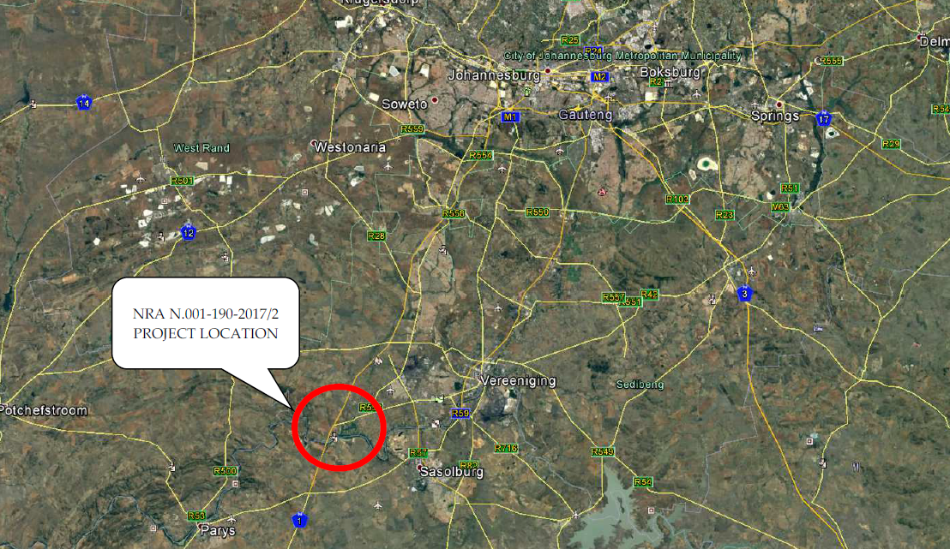
6. PROJECT INFORMATION

Slide 53
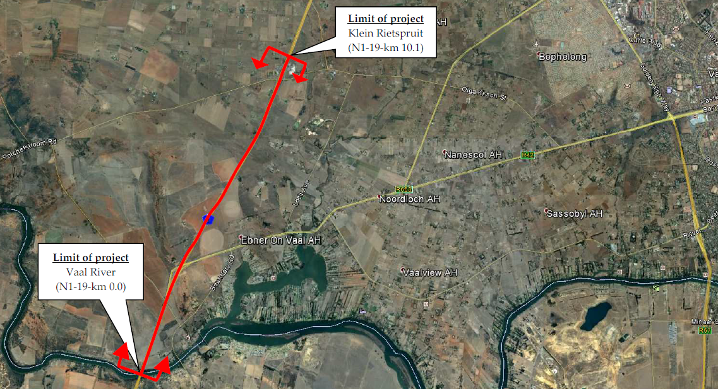
6. PROJECT INFORMATION

Slide 54
6. PROJECT INFORMATION
C4.1.1.1 Contract location and limits
The contract is situated on National Route 1 Section 19 and extends from the southern side of the Vaal River (N1-19, km 0.0) to Klein Rietspruit (N1-19, km 10.1). It is situated in the Gauteng Province within the Sedibeng District Municipality and falls within the jurisdiction of South African National Roads Agency’s Northern Region.
Located within the project limits are the following:
  2 Interchanges and,
  5 Bridges.
A summary of the bridges and interchanges within the project limits is shown in the table below.

Slide 55
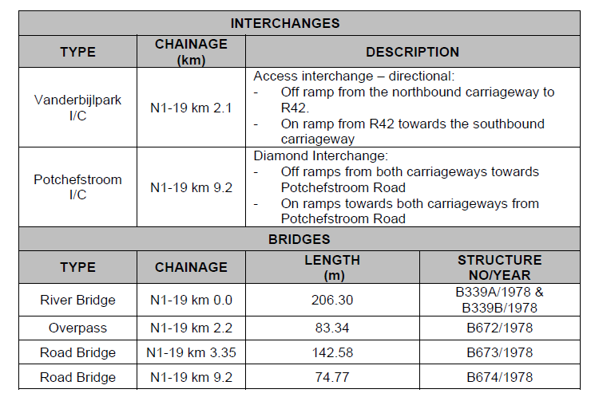
6. PROJECT INFORMATION

Slide 56
6. PROJECT INFORMATION
C4.1.1.2 Existing cross section
The section of the N1 forming part of this project consists of a dual carriageway road with two lanes per direction while the interchange ramps consist of a single lane. The widths of the main carriageway and interchange ramps are summarised in the table overleaf.
Section | Number of lanes | Lane (m) | Slow shoulder (m) | Fast lane shoulder (m) | Total width (m)
Main Carriageway | 2 | 3.7 | 3.0 – 3.5 | 0.5 – 1.0 | 12.6
Interchanges Ramps | 1 | 4.0 | 2.0 | 2.0 | 8.0

Slide 57
6. PROJECT INFORMATION
C4.1.1.3 Extent of works
The extent of the work to be carried out includes an asphalt mill and replace operation along both carriageways as well as on the interchanges and cross roads within the project limits. The total surfaced area of the project is approximately 320 000 m².
C4.1.1.4 Scope of works
The work to be done on the project will consists of the following:

Slide 58
6. PROJECT INFORMATION
C4.1.1.4.1 Milling out existing surfacing:
The existing asphalt surfacing will be milled out to an average depth of 40 mm. Some of the milled asphalt will be spoiled to a registered and legally operating spoil area and the other milled asphalt will be hauled to a stockpile for later use in the new asphalt. The asphalt stockpile area may be set up:
At the asphalt plant that will supply the asphalt to the project; or
In the open areas as indicated in Appendix 7.1.

Slide 59
6. PROJECT INFORMATION
C4.1.1.4.2 Localised base patches:
Localised base repairs will only be done on areas that are showing clear signs of pavement distress such as rutting, crocodile cracks and pumping of fines. Sections of the road that were identified as requiring base repairs are shown on drawing series 32922.00-118.
The base patching will be done by milling out the demarcated area to the specified depth and will extend through the existing BTB base layer and may include milling of the granular subbase layer. The backfill of the patches will consist of continuously graded (stone skeletal) BTB base patches using 50/70 penetration grade bitumen. The minimum base patch thickness allowed is 60 mm. No additional payment will be made for patches done in more than one layer.

Slide 60
6. PROJECT INFORMATION
C4.1.1.4.3 Crack seal:
Long continuous cracks, in excess of 3,0 mm in width, and isolated surface cracks visible after milling will be sealed using C-R1. The identified cracks are to be blown out with hot compressed air prior to being sealed.
C4.1.1.4.4 New asphalt surfacing:
A new 45 mm asphalt surfacing (sand skeletal) with 14 mm rolled-in chips will be constructed using an A‑E2 binder with minimum 40% reclaimed asphalt.

Slide 61
6. PROJECT INFORMATION
C4.1.2 PAVEMENT DESIGN FOR ALL PARTS OF THE VARIOUS ROADS
C4.1.2.1 Existing pavement information
The results of the test pit investigation are included in Appendix 2 for reference purposes.
C4.1.2.2 Base Layer
The base layer along both carriageways as well as the interchanges consists of a coarse light grey, imported sandy gravely crusher run. The layer can be described as dense and intact (no cracks). Following the TRH14 guidelines, the base layer material ranges from G1- to G7-quality.

Slide 62
6. PROJECT INFORMATION
C4.1.2.3 Subbase Layer
For both carriageways, the type of subbase layers varies along the length of the carriageway, between cemented and non-cemented. The cemented and non‑cemented subbase are mainly found on the slow and fast lane, respectively. The cemented subbase is typically of C4-quality, with the parent material being an imported sandy gravel.
The non-cemented subbase consists of a coarse imported sandy gravel. Following the TRH14 guidelines, this material ranges from G5- to G7-quality.

Slide 63
6. PROJECT INFORMATION
C4.1.2.4 Selected Layer
Along both carriageways the selected layers are made up of one or a combination of the following:
  Uniform imported silty sandy gravel;
  Uniform imported clayey sandy gravel;
  Uniform imported sandy gravel.
According to the TRH14 guidelines, the selected subgrade material ranges from G5- to G8-quality.

Slide 64
6. PROJECT INFORMATION
C4.1.2.5 Riding Quality
Roughness measurements were conducted in April 2021 along the slow lane of both carriageways. These measurements are included under Appendix 3. Provision has been made to conduct roughness measurements upon the Contractor’s establishment. These measurements will be done along the lanes and shoulders wider than 2.0 m of both carriageways, as well as the on-of ramps and overhead bridges as determined on site.
C4.1.3 STRUCTURAL WORKS
No structural work will be done under this contract. The work will be done under an adjacent contract and the Contractor is made aware that the structural work repairs might be done at concurrent with this contract.

Slide 65
6. PROJECT INFORMATION
C4.1.4 MAINTENANCE WORKS
There is currently a Routine Road Maintenance (RRM) Contract in place along the route. The contact details of the parties involved in the RRM contract are as follows.
Route Manager:
Brighton Chippenyama (Ndodana and Oarona JV)
Telephone: (011) 789 6984
Cell: 071 923 6155
Email: brighton@ndodana.co.za
Contractor:
Zama Kokela (VEA Roads)
Cell: 082 799 6560
Email: zama.kokela@vearoad1.co.za
The RRM contractor remains responsible for the areas within the road reserve but excluding the surfaced road areas.

Slide 66
6. PROJECT INFORMATION
C4.2 DRAWINGS
Refer Volume 4 for drawings.
C4.3 CAMP ESTABLISHMENT, POWER SUPPLY AND OTHER SERVICES
        The contractor is to make his own arrangements concerning the supply of electrical power and all other services.

Slide 67
6. PROJECT INFORMATION
C4.4 CONSTRUCTION IN CONFINED AREAS
    It is deemed that the rates tendered in the Pricing Schedule include full compensation for all special equipment and construction methods and for all difficulties encountered when working in confined areas and narrow widths, and at or around obstructions. No extra payment will be made nor will any claim for additional payment be considered in such cases.
    C4.5 MANAGEMENT OF THE ENVIRONMENT
    The contractor will be responsible for construction according to an environmental management plan in terms of Section C1000 Scope of Works.
    C4.6 TRAFFIC
The latest traffic count (2015) for Station 2040 indicates that:
Between Monday to Thursday, the traffic flow trends are constant. From 06:00 to 12:00, the traffic flow varies between 400 – 450 vehicles per hour, increasing to a peak traffic flow of between 500 – 600 vehicles per hour at 16:00.
The peak flow in a week is usually on Fridays. On Fridays, from 06:00 to 12:00, the traffic flow varies between 450 – 600 vehicles per hour, increasing to a peak traffic flow of 850 vehicles per hour at 16:00.

Slide 68
6. PROJECT INFORMATION
C4.7 SMALL CONTRACTOR DEVELOPMENT, TRAINING AND COMMUNITY LIAISON
Section D of the Scope of Works covers the contractor’s requirements in detail, as well as defining the targets that comprise the Contract Participation Goal (CPG)
C4.8 CLIMATE
Note information provided.
C4.9 REQUIREMENTS OF THE OCCUPATIONAL HEALTH AND SAFETY ACT AND REGULATIONS 2014
Note information provided.
C4.10 SAFETY PROCEDURES
Note information provided.

Slide 69
6. PROJECT INFORMATION
C4.11 OTHER INFORMATION
The table below shows a list of asphalt plants within the vicinity of the project that can be used for the project.
Water required for construction should be procured from the Emfuleni Local Municipality.
NAME | LOCATION | CONTACT
Much Asphalt | IQ 323 Farm Old Vereeniging Road Eikenhof | 087 997 1108
National Asphalt | Plot 10, Plein Rietspruit, Vanderbijlpark | 060 965 1393

Slide 70
7. PROJECT SPECIFICATIONS
PART C2– PRICING SCHEDULE

Slide 71
7. PROJECT SPECIFICATIONS
PART C2– PRICING SCHEDULE
All items are equally important so no specific items will be highlighted
Strong recommendation that contractor re evaluate all payment items from start as there is slight yet significant differences between new COTO and COLTO.
All items should be priced
All rates should be balanced

Slide 72
7. PROJECT SPECIFICATIONS
SECTION A1 – STANDARD AMENDMENTS ISSUED BY COTO
As at 26 May 2021 no amendments have been issued by COTO.

Slide 73
7. PROJECT SPECIFICATIONS
SECTION A2 – PROJECT SPECIFICATION AMENDMENTS TO THE COTO STANDARD SPECIFICATIONS
Less than normal amendments and most changes have been incorporated into the Specification Data.
Minor changes included with a few abstracts in the next slides.

Slide 74
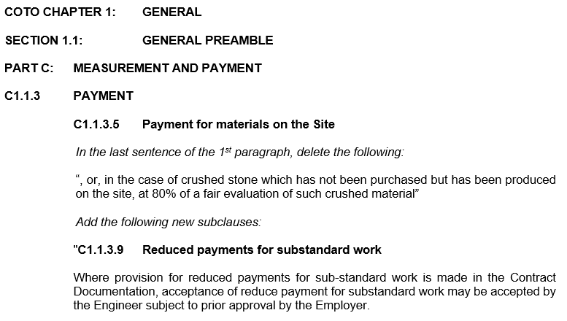
7. PROJECT SPECIFICATIONS
SECTION A2 – PROJECT SPECIFICATION AMENDMENTS TO THE COTO STANDARD SPECIFICATIONS

Slide 75
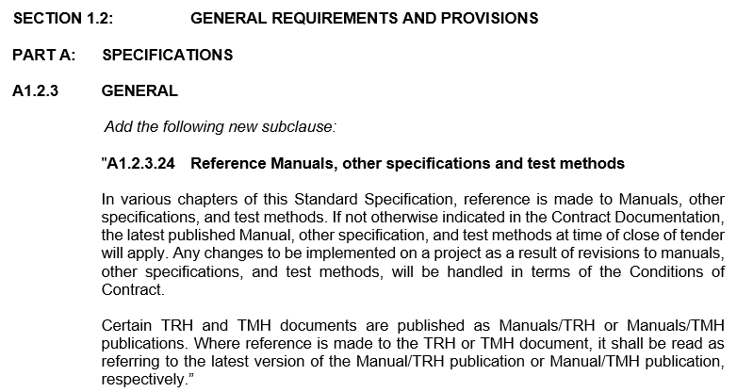
7. PROJECT SPECIFICATIONS
SECTION A2 – PROJECT SPECIFICATION AMENDMENTS TO THE COTO STANDARD SPECIFICATIONS

Slide 76
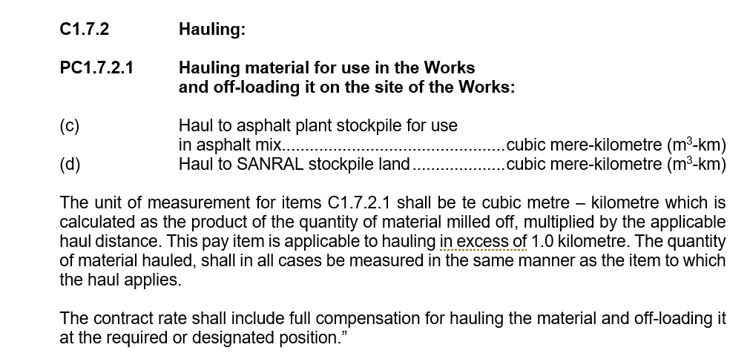
7. PROJECT SPECIFICATIONS
SECTION A2 – PROJECT SPECIFICATION AMENDMENTS TO THE COTO STANDARD SPECIFICATIONS

Slide 77
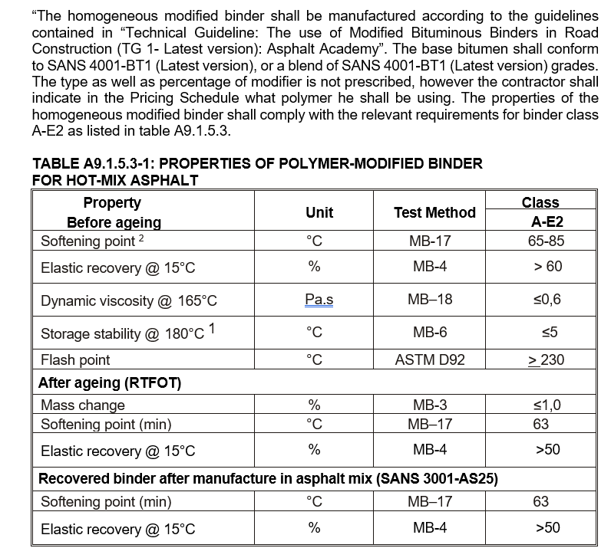
7. PROJECT SPECIFICATIONS
A9.1.5.2 Bituminous binders for asphalt mixes

Slide 78
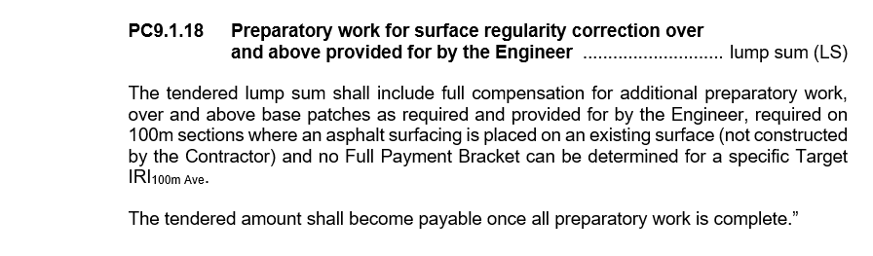
7. PROJECT SPECIFICATIONS
A9.1.5.2 Bituminous binders for asphalt mixes

Slide 79
7. PROJECT SPECIFICATIONS
SECTION B – SPECIFICATION DATA

Slide 80
7. PROJECT SPECIFICATIONS
SECTION B – SPECIFICATION DATA
Important new part of the COTO Document
Should be read in conjunction with and in addition to the relevant COTO Clauses and Payment Items
All Specification are equally important but the following sections are shown to highlight the importance of studying the Specification Data in great detail.

Slide 81
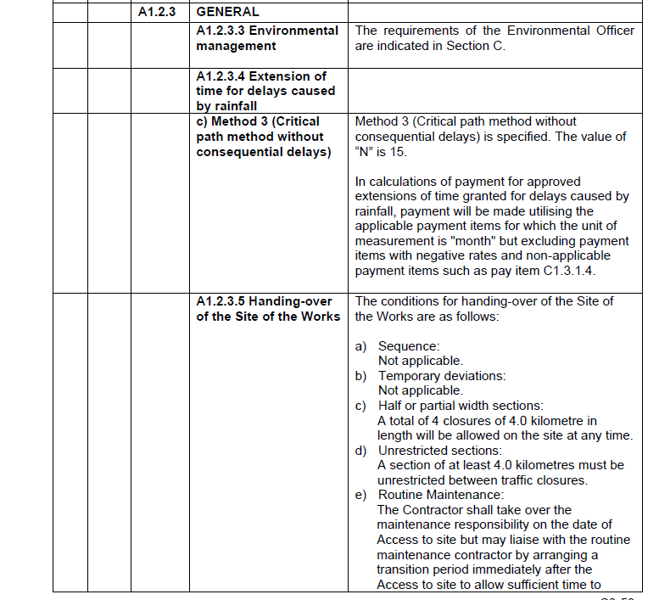
7. PROJECT SPECIFICATIONS
SECTION B – SPECIFICATION DATA

Slide 82
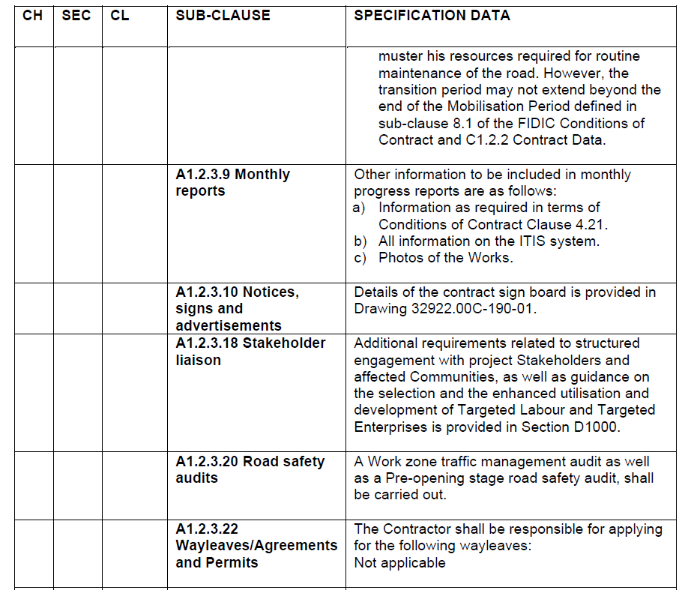
7. PROJECT SPECIFICATIONS
SECTION B – SPECIFICATION DATA

Slide 83
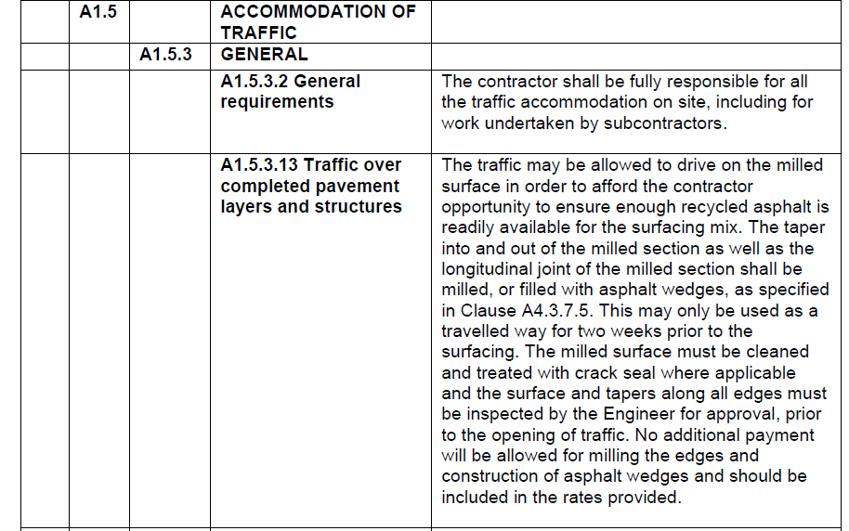
7. PROJECT SPECIFICATIONS
SECTION B – SPECIFICATION DATA

Slide 84
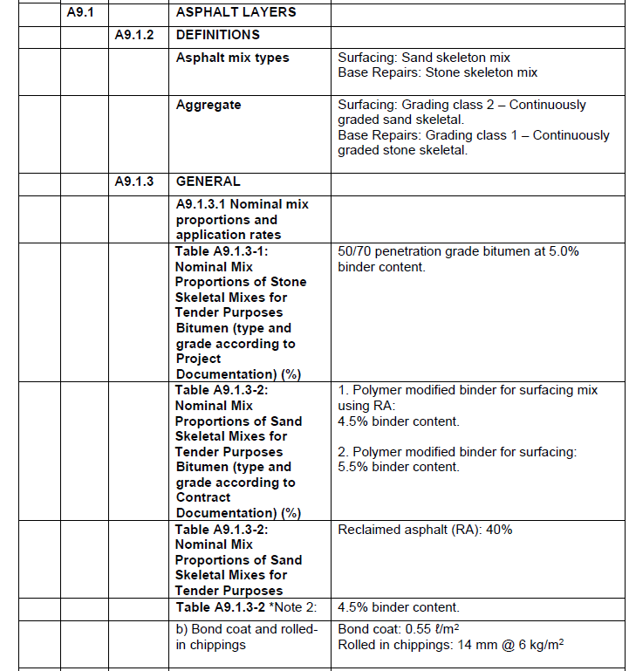
7. PROJECT SPECIFICATIONS
SECTION B – SPECIFICATION DATA

Slide 85
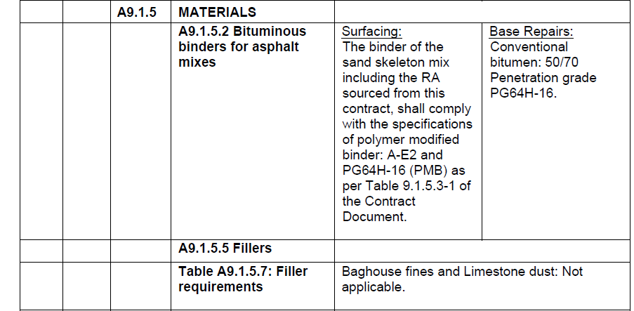
7. PROJECT SPECIFICATIONS
SECTION B – SPECIFICATION DATA

Slide 86
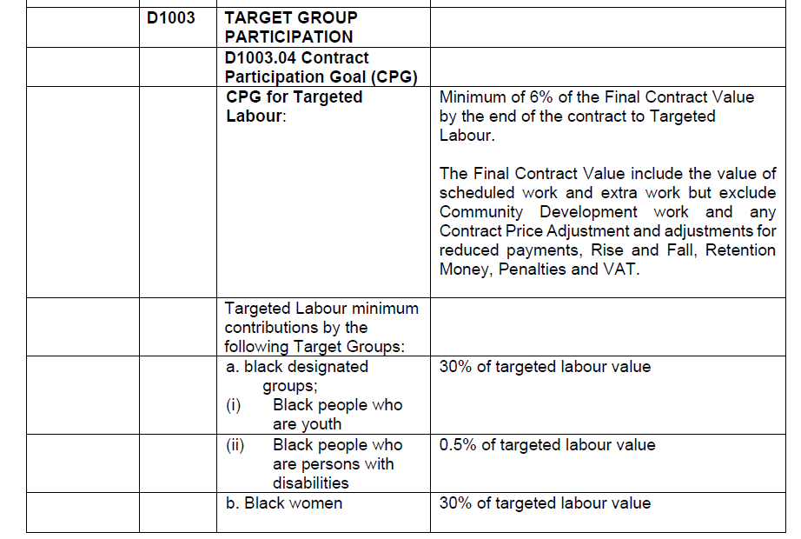
7. PROJECT SPECIFICATIONS
SECTION B – SPECIFICATION DATA

Slide 87
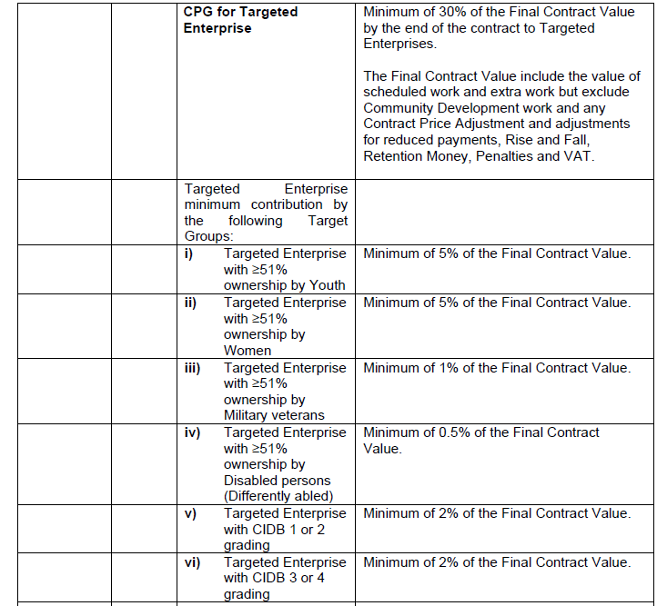
7. PROJECT SPECIFICATIONS
SECTION B – SPECIFICATION DATA
SANRAL STANDARD SPECIFICATION SECTIONS

Slide 88
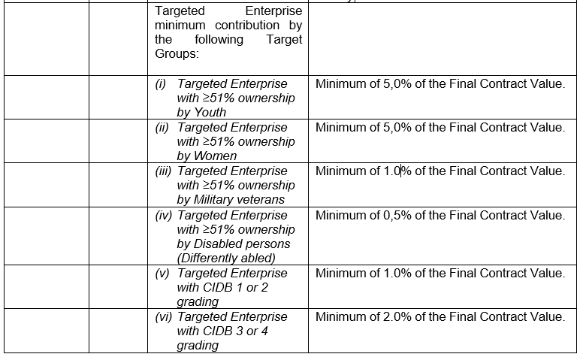
7. PROJECT SPECIFICATIONS
SECTION B – SPECIFICATION DATA
SANRAL STANDARD SPECIFICATION SECTIONS

Slide 89
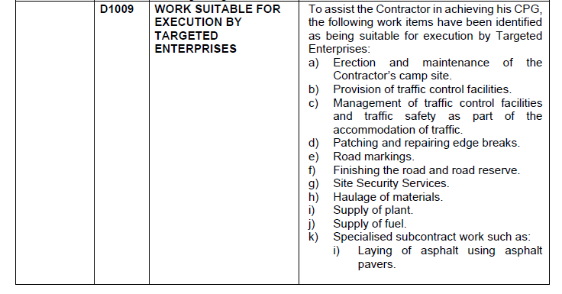
7. PROJECT SPECIFICATIONS
SECTION B – SPECIFICATION DATA
SANRAL STANDARD SPECIFICATION SECTIONS

Slide 90
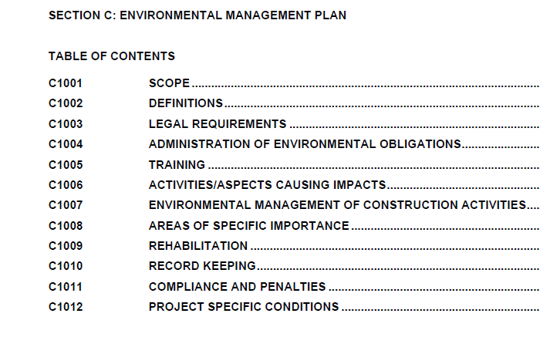
7. PROJECT SPECIFICATIONS
SECTION B – SPECIFICATION DATA
SANRAL STANDARD SPECIFICATION SECTIONS

Slide 91
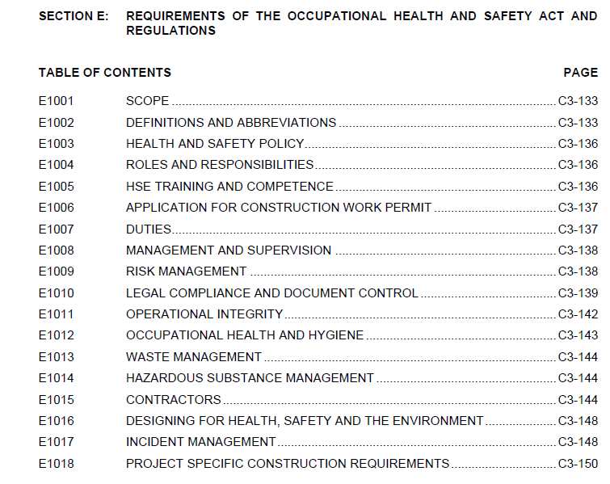
7. PROJECT SPECIFICATIONS
SECTION B – SPECIFICATION DATA
SANRAL STANDARD SPECIFICATION SECTIONS

Slide 92
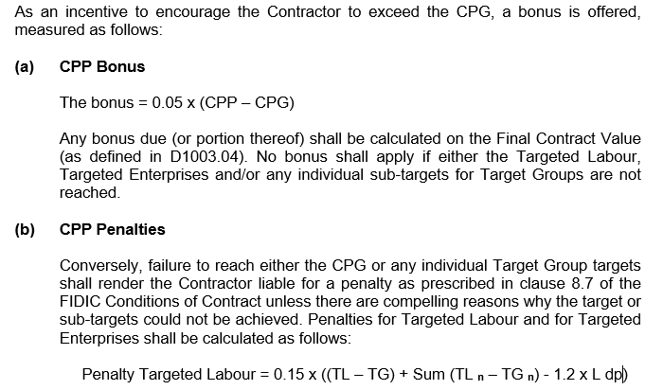
7. PROJECT SPECIFICATIONS
SECTION B – SPECIFICATION DATA
SANRAL STANDARD SPECIFICATION SECTIONS
D1003.05 Contract Participation Performance (CPP)

Slide 93
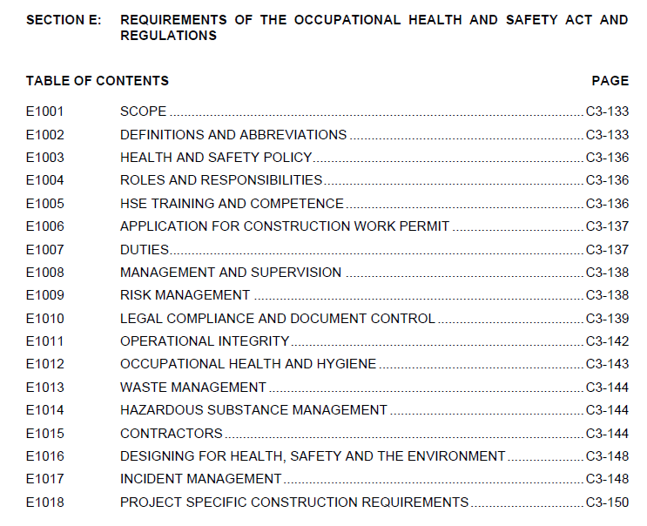
7. PROJECT SPECIFICATIONS
SECTION B – SPECIFICATION DATA
SANRAL STANDARD SPECIFICATION SECTIONS

Slide 94
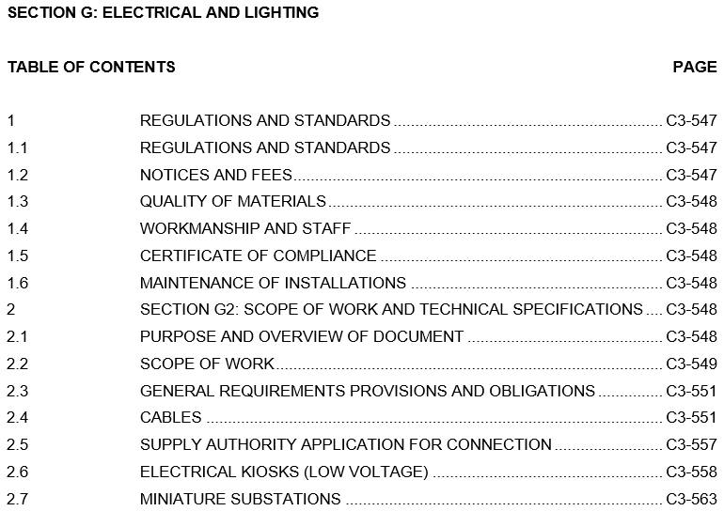
7. PROJECT SPECIFICATIONS
SECTION B – SPECIFICATION DATA
SANRAL STANDARD SPECIFICATION SECTIONS

Slide 95
8. CLOSURE
In conclusion we want to stress the following:
Traffic Accommodation Planning is important for safety and managing delays to the traveling public
Challenges involved in the new COTO system
Good luck & thank you

