Slide 1
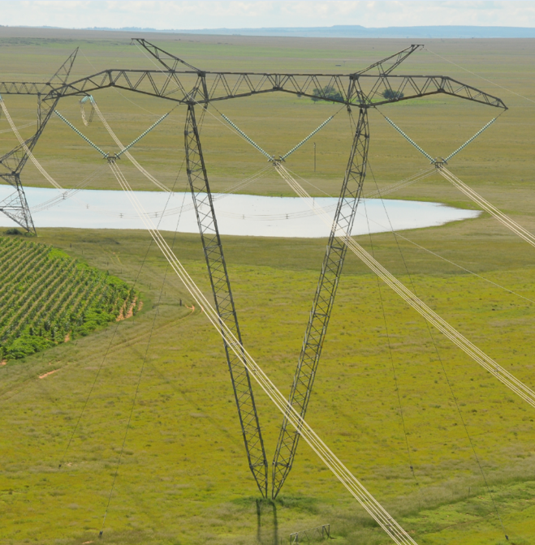
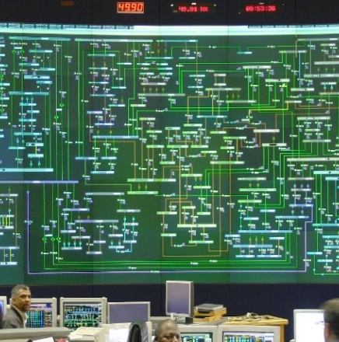
APOLLO CONVERTER STATION
Technical Background
Nitrogen Gas Clarification Meeting
Date: July 2025

Slide 2
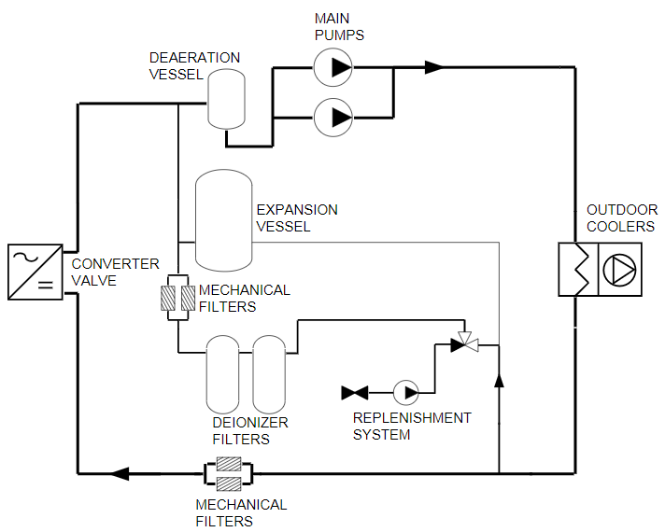
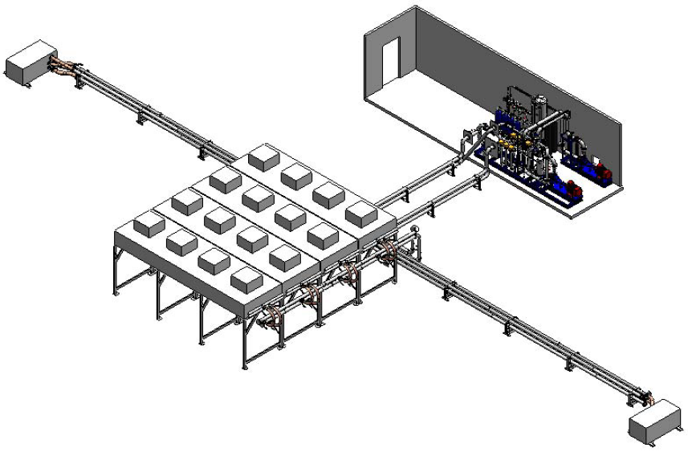
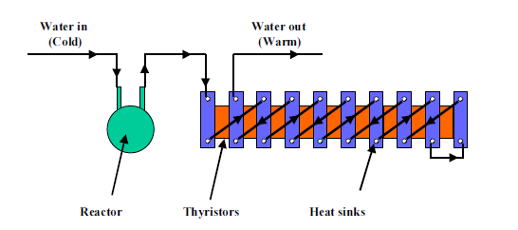
HVDC COMPONENTS – CONVERTER VALVE
Apollo Converter Station encompasses valve-cooling equipment that form part of the converter scheme cooling system. The main function of the valve cooling system is to dissipate the power losses generated in two bridges during the conversion of Power from DC to AC.

Slide 3
HVDC COMPONENTS – CONVERTER VALVE
An expansion vessel forms an important part of the water-cooling circuit. To keep the liquid fresh and with low conductivity, a small part of the main flow thus circulates through this vessel.
The expansion vessel is pressurized via a nitrogen cushion to achieve the system static pressure. The nitrogen cushion is pressurized automatically during operation by the pressure regulator which is connected to the nitrogen bottles/ cylinders.
In the cooling circuit, the system is designed to have one active and one redundant nitrogen cylinder. The two cylinders are usually installed in the system to ensure that when a low-pressure alarm is activated one can interchange the active nitrogen cylinder with the redundant cylinder with ease and at a reduced time thus causing minimal interruption to the system.

Slide 4
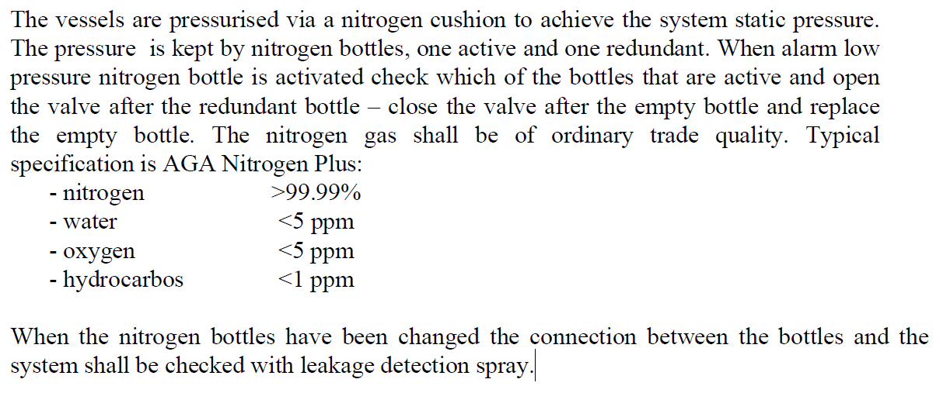
HVDC COMPONENTS – CONVERTER VALVE

Slide 5
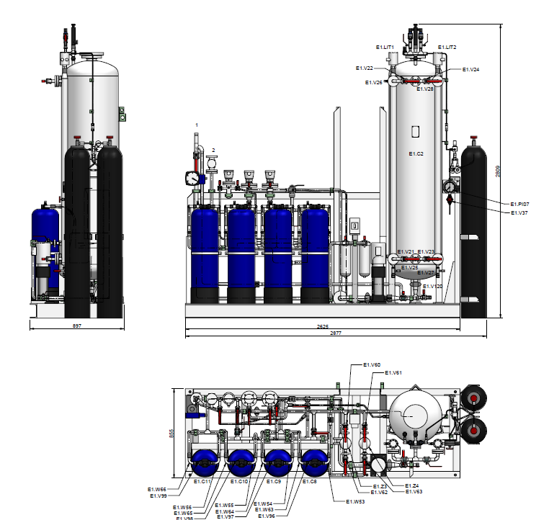
HVDC COMPONENTS – CONVERTER VALVE
The system requires a supply of 8 nitrogen gas cylinders in the system and 2 spares cylinders in the station at all time hence 10, 11kg nitrogen gas cylinders are required.
The service must include re-filling of the gas as and when required during period of Contract

Slide 6
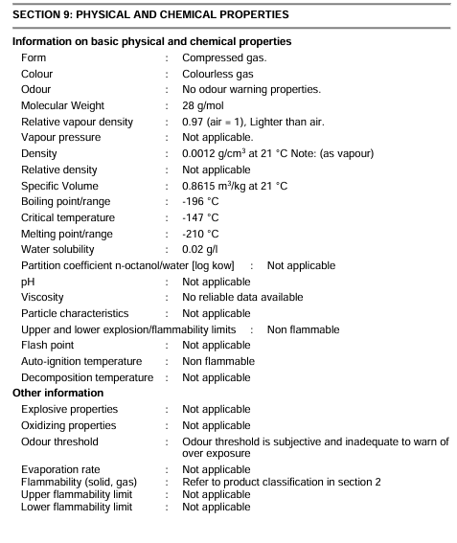
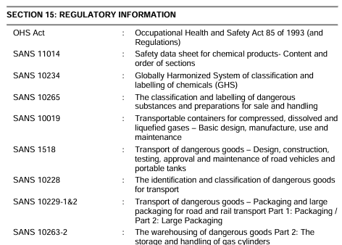
TECHNICAL REQUIREMENTS

Slide 7
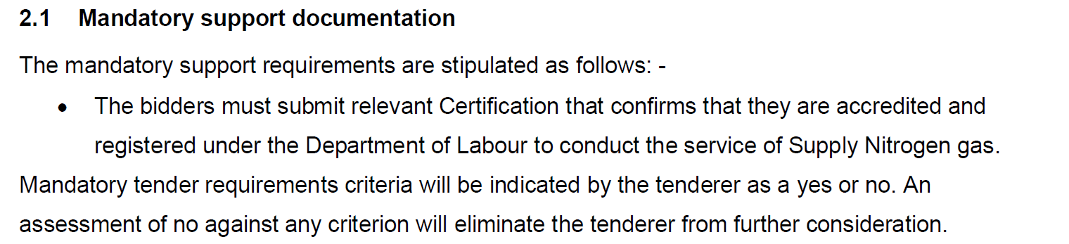
TECHNICAL REQUIREMENTS

Slide 8
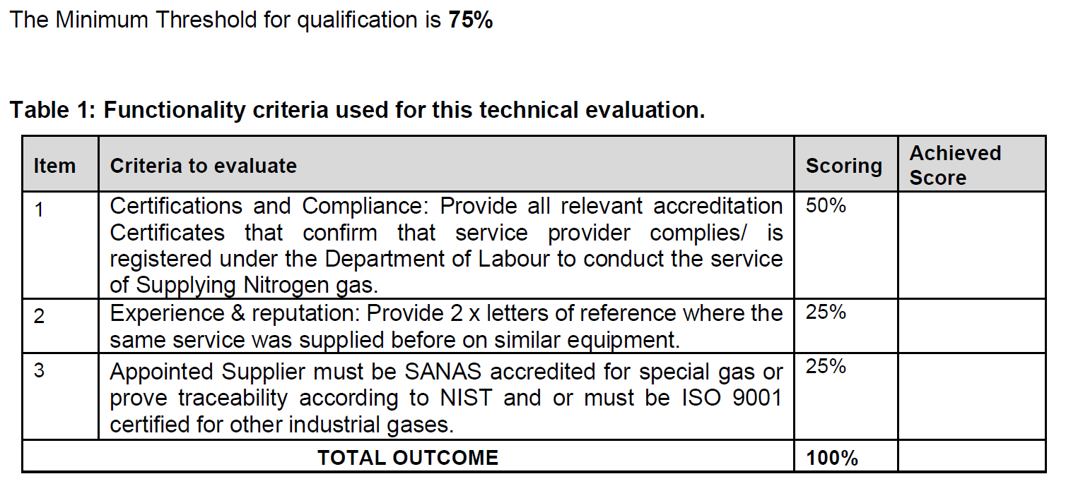
TECHNICAL REQUIREMENTS

Slide 9
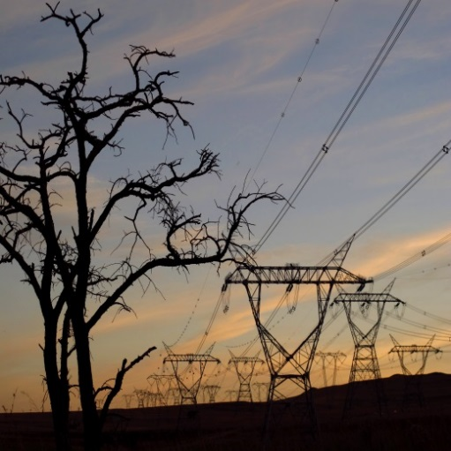
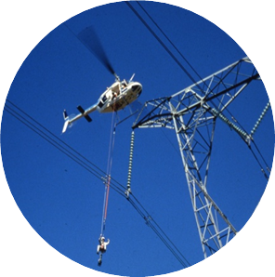
QUESTIONS ???

