Slide 1
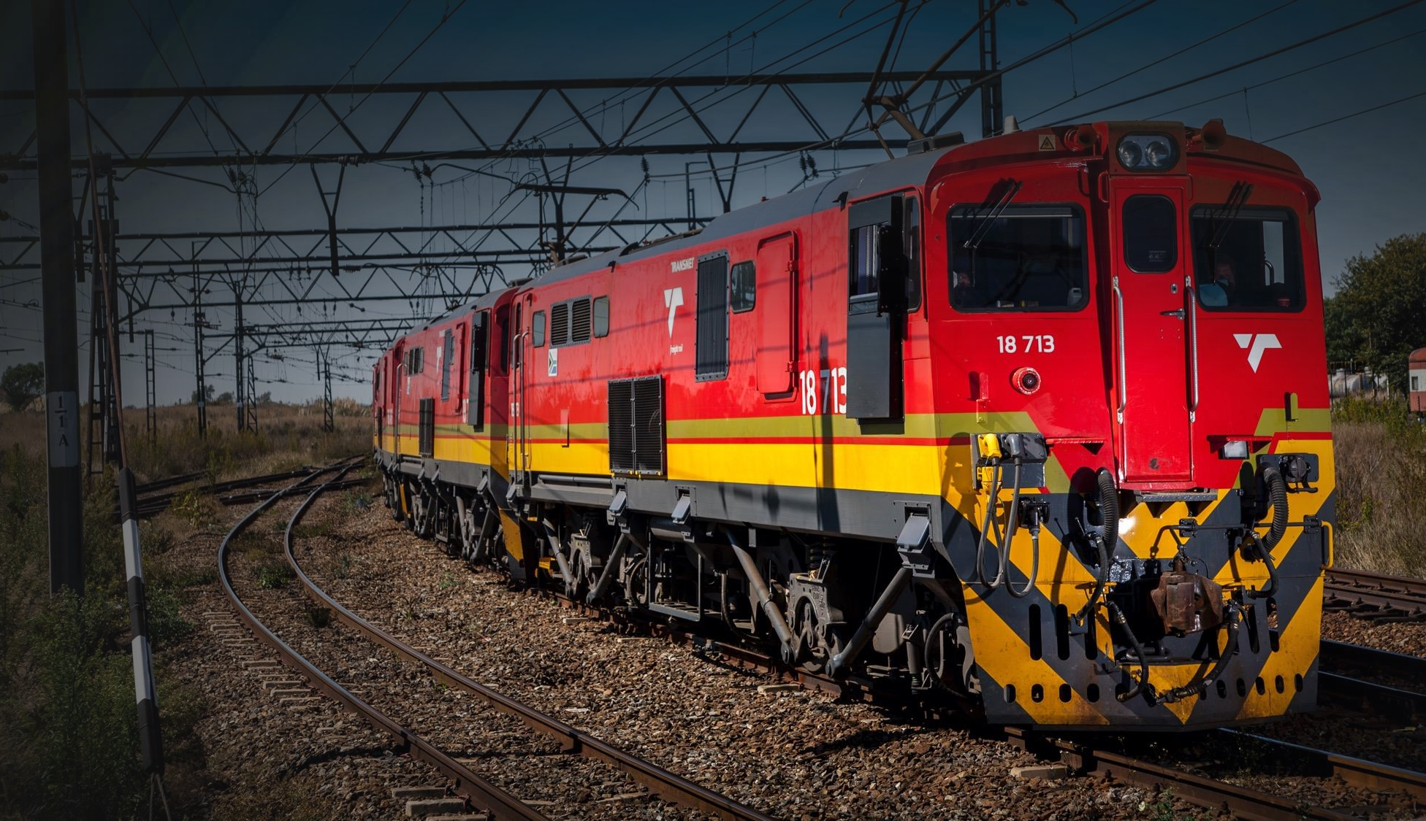

HOAC-HO-43080
RFP FOR THE FOR MAINTENANCE, MONITORING, VERIFICATION AND EMERGENCY REPAIRS OF THE IN-MOTION WEIGHBRIDGES COUNTRYWIDE FOR A PERIOD OF THREE (3) YEARS
ISSUE DATE : 27 FEBRUARY 2024
CLOSING DATE : 19 MARCH 2024
BID CLARIFICATION : 11 MARCH 2024
1

Slide 2
HOAC-HO-43080 TENDER DESCRIPTION
THE TENDER SHALL MAKE PROVISION TO:
The closing date for questions/bid clarifications is on the 27 February 2024.
Questions/bid clarifications prior to the closing of the RFP must be channeled through Gladys Mtambo via e-mail:- Gladys.mtambo@transnet.net;
Response to questions/bid clarifications will be sent to all Respondents.
The RFP closes punctually at 10:00 on 19 Tuesday March 2024.
Respondents must ensure all the required returnable documents are submitted with their proposals – Section 2: RETURNABLE DOCUMENTS NB: Mandatory and Essential documents page (25 & 26 of the RFP)

Slide 3
Mandatory documents
  SECTION 4: Quotation form
  SECTION 1 : SBDI Form

Slide 4
EVALUATION METHODOLOGY
6.1 Transnet will utilise the following methodology and criteria in selecting a preferred Service provider:
NB: Evaluation of the various stages will normally take place in a sequential manner. However, in order to expedite the process, Transnet reserves the right to conduct the different steps of the evaluation process in parallel. In such instances the evaluation of bidders at any given stage must not be interpreted to mean that bidders have necessarily passed any previous stage(s).
1
Transnet will utilize the following methodology and criteria in selecting a preferred Supplier
STAGE 2
STAGE 3
Step 1
Step 2
Step 3
Step 4
Step 5
Step 6
Step 7
Administrative responsiveness
Substantive responsiveness
MINIMUM THRESHOLDS
Weighted scoring / 100***
Returnable documents/ schedules
Functiona1 80 points
Minimum Threshold
Pre-qualification
Post tender negotiation with preferred bidder [2nd and 3rd ranked bidders (if required) in a sequential and not simultaneous manner] if pricing is not market-related
Selection of the preferred bidder.
(Objective criterion to justify award to someone other than the highest ranked bidder must have been stated in the bid documents and can be used at this stage, if applicable)
Price (80)
Specific goals (20)
Award of business and conclusion of contract
WEIGHTED SCORE
Technical / Functional criteria & weightings must be stipulated in the tender document

Slide 5
SUMMARY OF TECHNICAL SPECIFICATONS
The contract comprises of the following:
  Install a remote monitoring tool at the Site (as defined in Annexure B).
  Remotely monitor system reliability and availability (as defined in Annexure A) for commercial and safety use.
  Restore the system(s) at the Site.
  Do routine preventative maintenance.
  Do corrective preventative maintenance.
  Do system breakdown repairs.
  Calibration and verification of in-motion weighbridges.

Slide 6

THANK YOU
7

