Slide 1

TNPA/2024/08/0003/73199/RFP
DESCRIPTION OF THE WORKS: REPLACEMENT AND CONSTRUCTION OF THE NEW BULK ELECTRICAL INFRASTRUCTURE AT STURROCK DRY DOCK FOR THE PORT OF CAPE TOWN FOR A PERIOD OF TWO (2) YEAR
VENUE: TRAINING CENTRE, GROUND FLOOR, SOUTH ARM ROAD, PORT OF CAPE TOWN
DATE: 30 SEPTEMBER 2025
TIME: 10H00
PRESENTED BY: LUNGELWA MXOKOZELI
Notes:
Growth and Reinvent

Slide 2
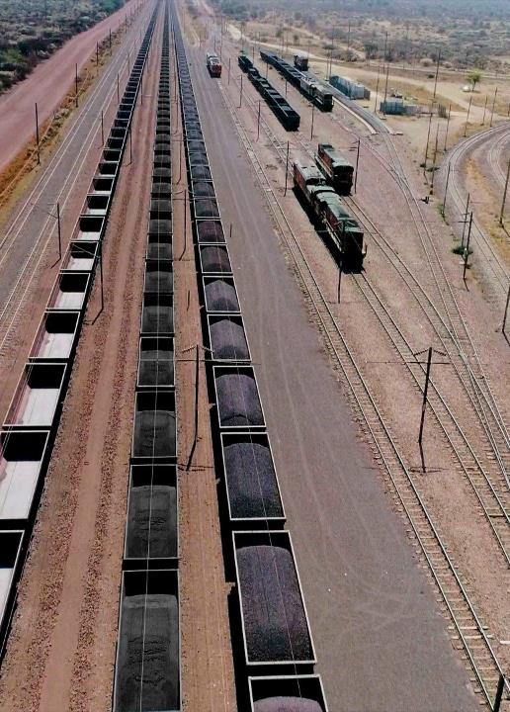
AGENDA ITEM
No. | Agenda Item | Presenter
1 | Welcome / Opening of meeting | Lungelwa Mxokozeli
2 | Safety Briefing | Jabulani Maluleka
3 | Introductions | Lungelwa Mxokozeli
4 | Background and Scope of work | Justice Ramulifho/Zukiswa Mpana
5 | Tendering Process & Tender Evaluation Procedure | Lungelwa Mxokozeli
6. | Technical Evaluation/Functionality | Technical Team
7. | Specific Goals | Salathiso Xoxo
8. | Bill of Quantities | Bukho Nqeketso
9. | Tender Data & Returnable Schedules | Lungelwa Mxokozeli
10. | C1.1: Contract Data Part 2: Data By the Contractor | Lungelwa Mxokozeli
11. | General | Lungelwa Mxokozeli
12. | Tender Closing | Lungelwa Mxokozeli
10 | Q&A | ALL
2

Slide 3
MEETING RULES
Please put cellphone on mute during the presentations;
Please ensure that you sign the attendance register clearly
All questions are to be raised after each presentation.
Kindly raise your hand to ask a question
TNPA will endeavor to answer all questions in the session and issue the briefing session minutes.
Questions are to be followed-up by email to TNPATenderenquiries3@transnet.net
Late comers will be allowed; however, nothing will be repeated for their benefit.
Attendees are encouraged to remain for the entire briefing session as important information pertaining to the RFP will be presented.

Slide 4
DISCLAIMER
The content of this presentation is for general information purposes only and should not be construed as creating an expectation of any nature whatsoever regarding the way forward relative to the issues under consideration.
Rights are fully reserved not to proceed in respect of the issues under consideration and to alter views expressed.
The basis upon which to proceed relative to the subject matter of this presentation, or not to proceed as the case may be, will be developed outside the ambit of this presentation and for this specific purpose the content of this presentation should not be relied upon. Any changes which affect tenderers will be communicated via addenda.
Please be guided accordingly.

Slide 5
WELCOME, MEETING PURPOSE AND OBJECTIVE
  Welcome and thank you for attending this clarification meeting
The purpose of this meeting is to clarify the RFP Tendering procedure, scope of work, deliverables and evaluation criteria
The objective of this meeting seeks to:
  Ensure that there is alignment between Transnet project expectations, RFP Tendering procedure, scope of work, deliverables as well as evaluation criteria.
  Ensure bidders submit comprehensive proposals that will allow Transnet to select best value supplier and delivery of the project successfully.
  To report any fraud, tip-offs anonymous: 0800 003 056 or transnet@tip-offs.com

Slide 6
RFP INVITATION TO BID
The RFP is available on National Treasury etender portal and Transnet website, free of charge.
This briefing session compulsory, Tenderers will be disqualified for failing to attend the compulsory briefing session.
All the questions and answers will be consolidated and uploaded onto the Transnet e-tender portal and National Treasury e-tender portal.
The closing date for this RFP is the 17 October 2025 @ 16h00 (The tender closes on the Transnet e-Tender Submission Portal: www.transnet.net )
Tenderers are required to ensure that electronic bid submissions are done at least a day before the closing date to prevent issues which they may encounter due to their internet speed, bandwidth or the size of the number of uploads they are submitting.
Tenderers must ensure the filenames of the documents intended for upload do not contain special characters, e.g. #, %, etc. The use of special characters will result in document upload failure for which Transnet does not accept responsibility. Only alphabetical or numerical characters shall be used in filenames

Slide 7
BACKGROUND & SCOPE OF WORKS

Slide 8
BACKGROUND
Sturrock Drydock
The facility consists of two key areas consisting of the bulk electrical infrastructure supply that supports the dry dock operations, namely: Graving Dock Substation & Pump House Substation, of which both these substations are located underground. These Substations are critical for the operation of all the mechanical equipment with in the dry docks including the capstans, cranes, shore supply, kiosks and pumps, which are essential for the docking of vessels within the dry dock.

Slide 9
BACKGROUND
The Transnet National Ports Authority (TNPA), Port of Cape Town took a decision following the feasibility exercise previously conducted, to replace all the bulk electrical infrastructure and subsequently construct one new above ground new substation, which will incorporate the two underground substations, housing all the new electrical equipment.

Slide 10
SCOPE OF WORKS
PART C3: The scope of this project is multidisciplinary consists of the following disciplines:
  ARCHITECTURAL Works
  ELECTRICAL Works (Heavy Current, Protection and Control & Instrumentation);
  MECHANICAL Works ( HVAC System, Fire Detection System & Fire Suppression System);
  STRUCTURAL Works
  CIVIL Works
  THE SCOPE OF THE ARCHITECTURE WORKS INCLUDES ( BUT IS NOT LIMITED TO)
  Construction of a new single-storey substation building to house electrical and mechanical infrastructure, including all associated facilities, and external works. (Architectural layout plans, sections, elevations, construction details and specifications are prepared for the above-mentioned works and provided as part of the tender document)

Slide 11
SCOPE OF WORKS
Execution of the architectural scope shall be done (but not be limited to) with the following in mind:
  All materials specified herein, wastage and supportive installation material shall be provided by the Contractor and understood as included in the relevant rates.
  Works to be executed by competent, certified, and registered Artisans, proof of which must be kept on site for duration of the Contract. Contractor shall provide all equipment necessary to execute the specified works and to monitor & control the quality
  All Dimensions, Heights and Levels indicated on attached drawings and documentations are based on surface examination of the site; The Contractor shall verify written dimensions on site prior to the manufacture or preparation of installation items. Discrepancies and implications must be escalated to the Architect as soon as it is realized.

Slide 12
SCOPE OF WORKS
  The Contractor shall timeously set-out all aspects of the works, identify any conflicts or services and obtain the Supervisor’s approval prior to commencing the works.
  At the end of each working day the site must be properly cleaned. All material on site must be properly stacked or stored during all times of every day during the works.

Slide 13
SCOPE OF WORKS
The electrical engineering scope entails the review, design, supply, delivery, installation and commissioning of the following and ensure that the designs are fully compliance; design liability remains with the Contractor.
The scope of the electrical power engineering works include:
  MV switchgears. (11.75kV and 3.3kV switchgears).
  4* Transformers (Dry Type Preferrable , 2 x 5 MVA 11.75/3.3kV and 2 x 3 MVA 11.75kV/400V )
  Low Voltage Distribution Board and 400V MCC Panels and Backup Power Supply
  Identify and detail the cable routing for(MV (11.75kV) Main Supply cable. MV (3.3kV) Cables from the Sub to 3.3kV MCC within the pump station. LV cables to feeds the LV loads within/along the Sturrock Dry dock areas and Cable management system within the tunnel)
  Cable Management System ( within the substation and the tunnel)
  Lighting and Small Power for Substation building and Cable Tunnel including all the associated infrastructure,
  Earthing and Lightning Protection
  Perform Protection study and Integrate the new substation into existing infrastructure
  Testing and Commissioning of the entire network.
  Decommissioning of the existing equipment (at Sturrock Dry Dock and Graving Dock underground substations, cabling within the tunnel. )

Slide 14
SCOPE OF WORKS
The control and instrumentation engineering scope entails the review, design, supply, delivery, installation and commissioning of the following and ensure that the designs are fully compliance; design liability remains with the Contractor.
The scope of the electrical power engineering works include.
The scope of the C&I engineering works include:
  Power Factor Correction
  The design, supply, installation, commissioning of communication equipment, cables, intelligent devices
  The Contractor shall design, supply, deliver, offload, and install the substation SCADA system. (remote terminals unit, workstation, HMI for the Sturrock Dry Dock Electrical Infrastructure Upgrade).

Slide 15
SCOPE OF WORKS
  The scope of the mechanical engineering works shall include supply, deliver, install, test and commission of the following:
  Firefighting system and Signage
  Supporting infrastructure required for all mechanical works.
  Ventilation system.
  Interlocks between HVAC system and Fire detection system.
  Air conditioning system (including the interface with the Fire detection system and hot water system)
  Control and actuation systems
  Painting and corrosion protection of Plant;
  Desing, supply, install, test and Commission of Fire Stops,
  The Contractor shall ensure that the gas suppression system installed has undergone a full computer simulated verification by an approved FK-5-1-12 provider and installer.
  Perform a door fan testing for the gas suppression system, to ensure the integrity of the room.

Slide 16
SCOPE OF WORKS
The Bidder is responsible for review the drawings as provided by the Employer in conjunction with annexure listed in C3 Scope of works and close all the gaps as identified and ensure that the designs are fully compliance and ready for construction, design liability remains with the Contractor.
The scope of the structural and civil engineering works include:
  Reinforced concrete beams and columns
  Brick wall and strip type foundations
  Reinforced concrete bases
  Surface bed
  Trenching
  Reinforced roof slab
  Foundations

Slide 17
SCOPE OF WORKS
No detailed design has been completed for Civil Engineering by the Employer. The detailed design shall form part of the Contractor’s design and ensure that the designs are fully compliance; design liability remains with the Contractor.
The scope of the civil engineering works include:
  Bulk Services design (water, sewer, etc)
  Stormwater design
  Platform design includes earthworks, access point and foundation details.
  Pipe and Chamber design (cable route that aligns with the proposed electrical routing).

Slide 18
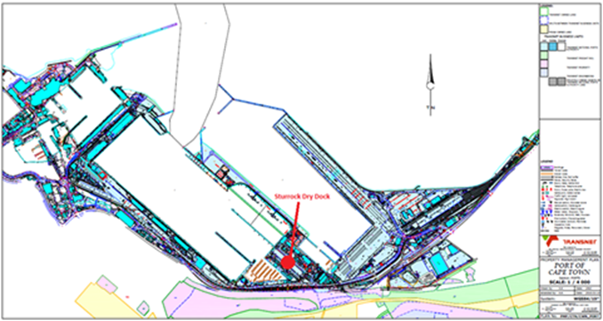
SITE INFORMATION
The Sturrock dry dock, situated towards the South Eastern end of the Port, is one of the two graving type dry docks in the Port of Cape Town shown below;
SDD Location on the Port of Cape Town

Slide 19
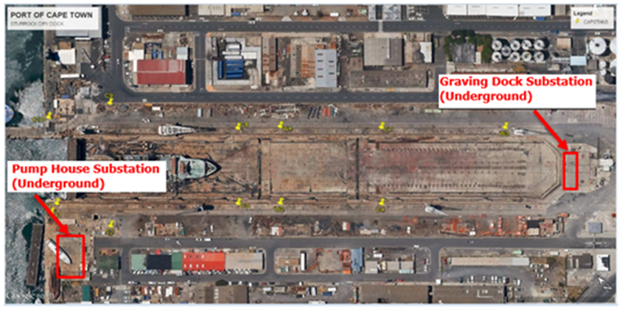
SITE INFORMATION
Depicted below is the location of the existing underground Graving Dock 11.75 / 0.400 kV and Pump House 11.75 /2.2/ 0.400 kV substations. The reticulation network is connected via a tunnel and ducting system.
SDD Overview depicting the 2 Substations

Slide 20

QUESTIONS AND ANSWERS

Slide 21
TENDERING PROCESS & TENDER EVALUATION PROCEDURE

Slide 22
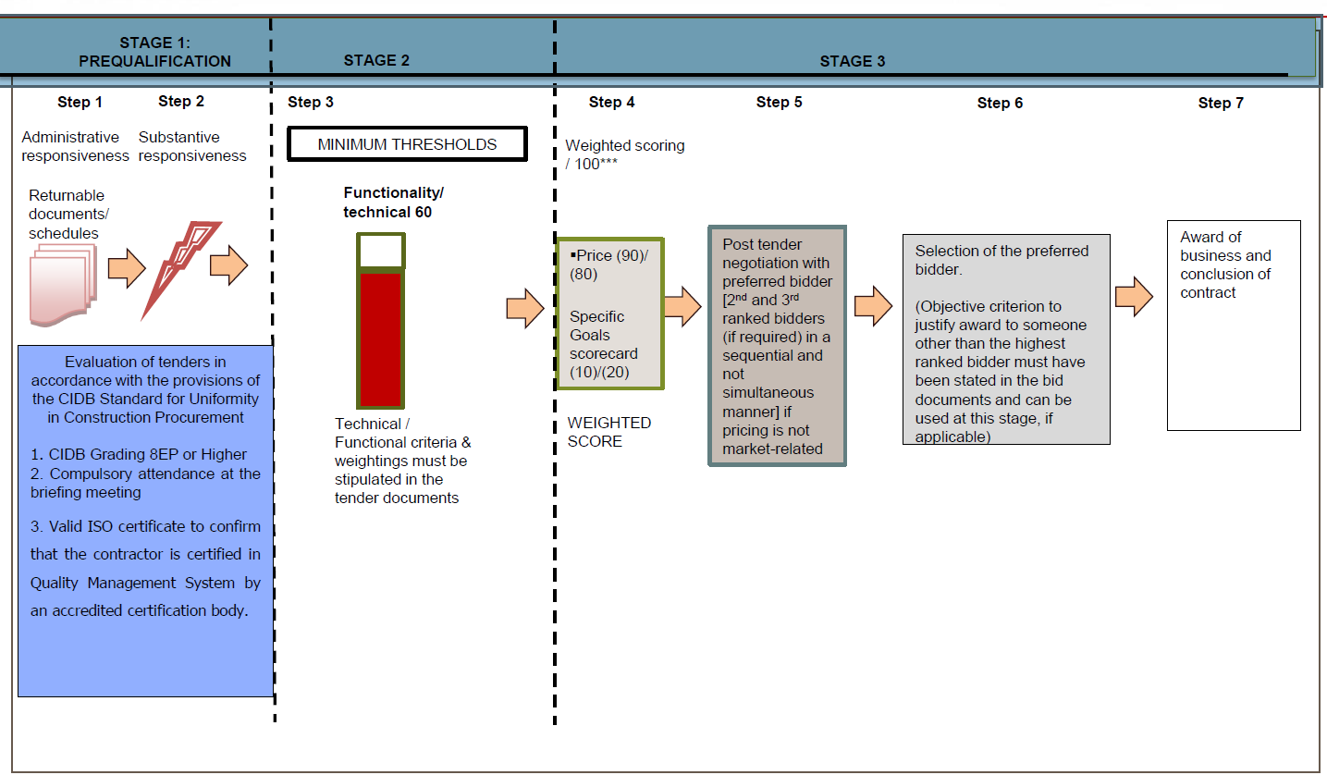
EVALUATION METHODOLOGY

Slide 23
STAGE ONE- STEP ONE(1):
Only those tenderers who satisfy the following eligibility criteria are eligible to submit tenders:
1. Stage One Step one(1): Eligibility with regards to attendance at the compulsory clarification meeting:
An authorised representative of the tendering entity or a representative of a tendering entity that intends to form a Joint Venture (JV) must attend the compulsory clarification meeting in terms C2.7.
Any tenderer that fails to meet the stipulated pre-qualifying criteria will be regarded as an unacceptable tender.

Slide 24
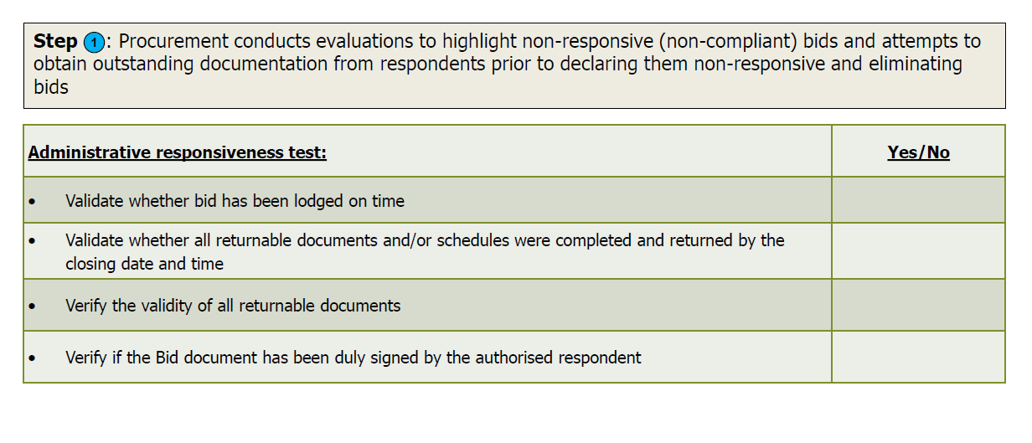
STAGE ONE- STEP ONE (1): TEST FOR ADMINISTRATIVE RESPONSIVENESS
The test for administrative responsiveness will include the following:

Slide 25
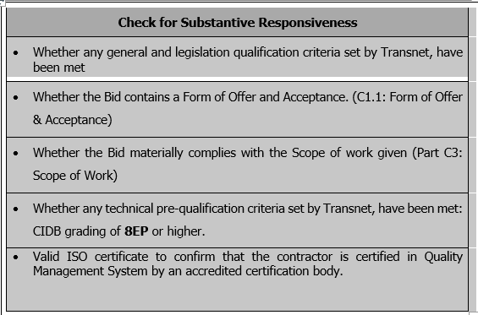
STAGE ONE – STEP TWO(2): TEST FOR SUBSTANTIVE RESPONSIVENESS TO RFP
The test for substantive responsiveness [Step THREE] must be passed for a Respondent’s proposal to progress to STAGE TWO for further evaluation

Slide 26
STAGE ONE – STEP TWO(2): TEST FOR SUBSTANTIVE RESPONSIVENESS
a) Eligibility in terms of the Construction Industry Development Board
Only those tenderers who are registered with the CIDB or are capable of being so prior to the evaluation of submissions, in a contractor grading designation of 8EP or higher class of construction work, are eligible to have their tenders evaluated.
b) Joint Venture (JV)
Joint ventures are eligible to submit tenders subject to the following:
1. every member of the joint venture is registered with the CIDB,
2. the lead partner has a contractor grading designation of not lower than one level below the required class of construction works under consideration and possesses the required recognition status; and
3. the combined Contractor grading designation calculated in accordance with the Construction Industry Development Regulations is equal to or higher than a Contractor grading designation determined in accordance with the sum tendered for a 8EP or higher class of construction work or a value determined in accordance with Regulation 25(1B) or 25(7A) of the Construction Industry Development Regulations
The tenderer shall provide a certified copy of its signed joint venture agreement
The test for substantive responsiveness [Step Two] must be passed for a Respondent’s proposal to progress to Step Three for further evaluation

Slide 27
QUESTIONS AND ANSWERS

Slide 28
STAGE THREE (3)
FUNCTIONALITY/TECHNICAL EVALUATION
2023
Date: June
Only those tenderers who attain the minimum number of evaluation points (60) will be eligible for further evaluation, failure to meet the minimum threshold will result in the tender being disqualified and removed from further consideration.

Slide 29
T2.2-03: COMPANY PREVIOUS EXPERIENCE
Note to tenderers:
The Tenderer is required to demonstrate a minimum of three (3) years’ experience on Construction of Electrical Substations. Tenderer to submit reference letters or completion certificates for the past projects involving the construction of electrical substations.
2. Project Timeline:
All projects submitted as reference must have been completed within the last 8 years from the date of tender submission.
The Tenderer shall submit the following: 1. Reference Letter or Completion Certificate shall have the following: a. Client's Company letterhead b. Client name and contact details c. Project description d. Year of project completion (Start & End Dates) e. Project duration f. Contract value g. Signed by the client 2. Project Timeline: All projects submitted as reference must have been completed within the last 8 years from the date of tender submission. | A letter or completion certificate that does not meet the above requirements is invalid even if it is submitted e.g (Reference letter or completion certificate not submitted or does not meet the minimum requirements indicated (client's company letterhead, client name and contact details, project description, year of project completion, duration, contract value, subcontractors, and signed by the client). | 0 | 20
 | Reference Letter/Completion Certificate from previous client for: - 1 x construction project of similar nature AND - 1 x design project of similar nature. | 20
 | Reference Letter/Completion Certificate from previous client for: - 2 x construction project of similar nature AND - 2 x design project of similar nature. | 40
 | Reference Letter/Completion Certificate from previous client for: - 3 x construction project of similar nature AND - 3 x comparable design project of similar nature. | 60
 | Reference Letter/Completion Certificate from previous client for: - 4 x comparable construction project of similar nature AND - 4 x comparable design project of similar nature. | 80
 | Reference Letter/Completion Certificate from previous client for: - 5 x comparable construction project of similar nature AND - 5 x comparable design project of similar nature. | 100

Slide 30
T2.2-04: KEY PERSONNEL EXPERIENCE, QUALIFICATIONS & REGISTRATION
T2.2-04: Evaluation Schedule: Key Personnel Experience, Qualifications and Registrations: (30 Points)
The bidder to provide detailed CVs of each key personnel with the following:
a) The roles and responsibilities for the works of each resource should be clearly stated.
b) Detailed experience in this specific construction activity and positions held, such as recent assignments inclusive of total duration that has a bearing on the scope of work.
c) The education, training (inter alia NEC3) and skills of the assigned staff in the specific sector, field, subject, etc. which is directly linked to the works. Relevant Qualifications (degrees, grades) and
d) Membership of professional societies and relevant professional registrations to be attached
The scoring of the Key Personnel Experience, Qualifications and Registrations will be as follows:
Bundling the 3 requirements is a challenge where they did not address 1 requirement, you may have a challenge of having a score as it is impractical to cater for all the scenarios and have scores for them
It is suggested to separate these requirements for clear objective evaluation – see example shared on email

Slide 31
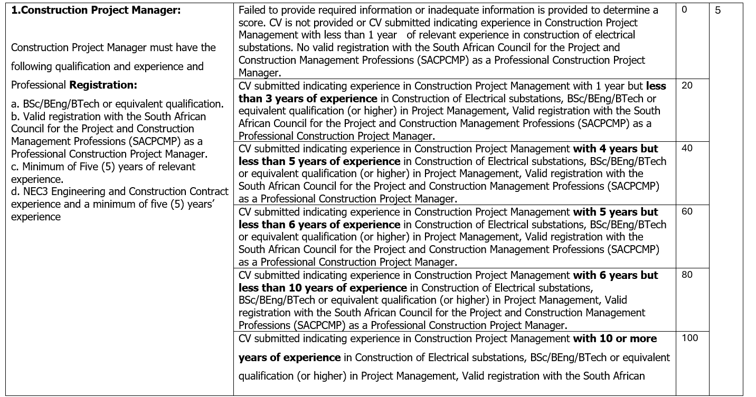
T2.2-04: KEY PERSONNEL EXPERIENCE, QUALIFICATIONS & REGISTRATION
.

Slide 32
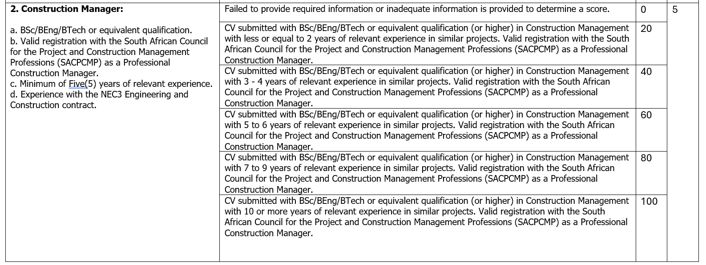

Slide 33
3. Civil Engineer or Civil Technologist a. BSc/BEng/BTech or equivalent qualification. b. Valid registration with the ECSA (Pr Eng / Pr Tech Eng) registered. c. Minimum of Eight (5) years of relevant experience in Civil Design. d. Experience with the NEC3 Engineering and Construction contract. | Failed to provide required information or inadequate information is provided to determine a score. No organogram submitted/ Functionality is not achieved. | 0 | 4
 | CV submitted with BSc/BEng/BTech or equivalent qualification (or higher) in Civil Engineering with less or equal to 2 years of relevant experience in similar projects. Valid registration with the Engineering council of South African Council (ECSA) as a Professional r Eng / Pr Tech Eng) registered. | 20
 | CV submitted with BSc/BEng/BTech or equivalent qualification (or higher) in Civil Engineering with 3 to 4 years of relevant experience in similar projects. Valid registration with the Engineering council of South African Council (ECSA) as a Professional Pr Eng / Pr Tech Eng/Pr Cert Eng) registered. | 40
 | CV submitted with BSc/BEng/BTech or equivalent qualification (or higher) in Civil Engineering with less than 5 to 6 years of relevant experience in similar projects. Valid registration with the Engineering council of South African Council (ECSA) as a Professional Pr Eng / Pr Tech Eng) registered. | 60
 | CV submitted with BSc/BEng/BTech or equivalent qualification (or higher) in Civil Engineering with less than 8 to 9 years of relevant experience in similar projects. Valid registration with the Engineering council of South African Council (ECSA) as a Professional Pr Eng / Pr Tech Eng) registered. | 80
 | CV submitted with BSc/BEng/BTech or equivalent qualification (or higher) in Civil Engineering with 10 or more years of relevant experience in similar projects. Valid registration with the Engineering council of South African Council (ECSA) as a Professional Pr Eng / Pr Tech Eng) registered. | 100

Slide 34
4. Electrical Engineer / Electrical Technologist a. Minimum Requirements BSc/BEng/BTech or equivalent qualification. b. Valid registration with the ECSA (Pr Eng / Pr Tech Eng/Pr Cert Eng) registered. c. Minimum of Six(6) or more years of relevant experience. d. Experience with the NEC3 Engineering and Construction contract. e. Must also have Substation Automation System experience. f. Electrician (A- Brown and Red Seal). | Failed to provide required information or inadequate information is provided to determine a score. No organogram submitted/ Functionality is not achieved. | 0 | 4
 | CV submitted with BSc/BEng/BTech or equivalent qualification (or higher) in Electrical Engineering with less or equal to 1- 3 years of relevant experience in similar projects. Valid registration with the Engineering council of South African Council (ECSA) as a Professional Pr Eng / Pr Tech Eng/Pr Cert Eng) registered. | 20
 | CV submitted with BSc/BEng/BTech or equivalent qualification (or higher) in Electrical Engineering with 4 to 5 years of relevant experience in similar projects. Valid registration with the Engineering council of South African Council (ECSA) as a Professional Pr Eng / Pr Tech Eng/Pr Cert Eng) registered. | 40
 | CV submitted with BSc/BEng/BTech or equivalent qualification (or higher) in Electrical Engineering 6 years of relevant experience in similar projects. Valid registration with the Engineering council of South African Council (ECSA) as a Professional Pr Eng / Pr Tech Eng/Pr Cert Eng) registered. | 60

Slide 35
5. Structural Engineer a. BSc/BEng/BTech or equivalent qualification. b. Valid registration with the ECSA (Pr Eng / Pr Tech Eng) registered. c. Five (5) or more years of relevant experience. d. Experience with the NEC3 Engineering and Construction contract. | Failed to provide required information or inadequate information is provided to determine a score. No organogram submitted/ Functionality is not achieved. | 0 | 4
 | CV submitted with BSc/BEng/BTech or equivalent qualification (or higher) in Structural Engineering with less or equal to 2 years of relevant experience in similar projects. Valid registration with the Engineering council of South African Council (ECSA) as a Professional r Eng / Pr Tech) registered. | 20
 | CV submitted with BSc/BEng/BTech or equivalent qualification (or higher) in Structural Engineering with 3 to 4 years of relevant experience in similar projects. Valid registration with the Engineering council of South African Council (ECSA) as a Professional Pr Eng / Pr Tech Eng) registered. | 40
 | CV submitted with BSc/BEng/BTech or equivalent qualification (or higher) in Structural Engineering with 5 to 6 years of relevant experience in similar projects. Valid registration with the Engineering council of South African Council (ECSA) as a Professional Pr Eng / Pr Tech) registered. | 60
 | CV submitted with BSc/BEng/BTech or equivalent qualification (or higher) in Structural Engineering with 7 to 9 years of relevant experience in similar projects. Valid registration with the Engineering council of South African Council (ECSA) as a Professional Pr Eng / Pr Tech Eng) registered. | 80
 | CV submitted with BSc/BEng/BTech or equivalent qualification (or higher) in Structural Engineering with 10 or more years of relevant experience in similar projects. Valid registration with the Engineering council of South African Council (ECSA) as a Professional Pr Eng / Pr Tech Eng) registered. | 100

Slide 36
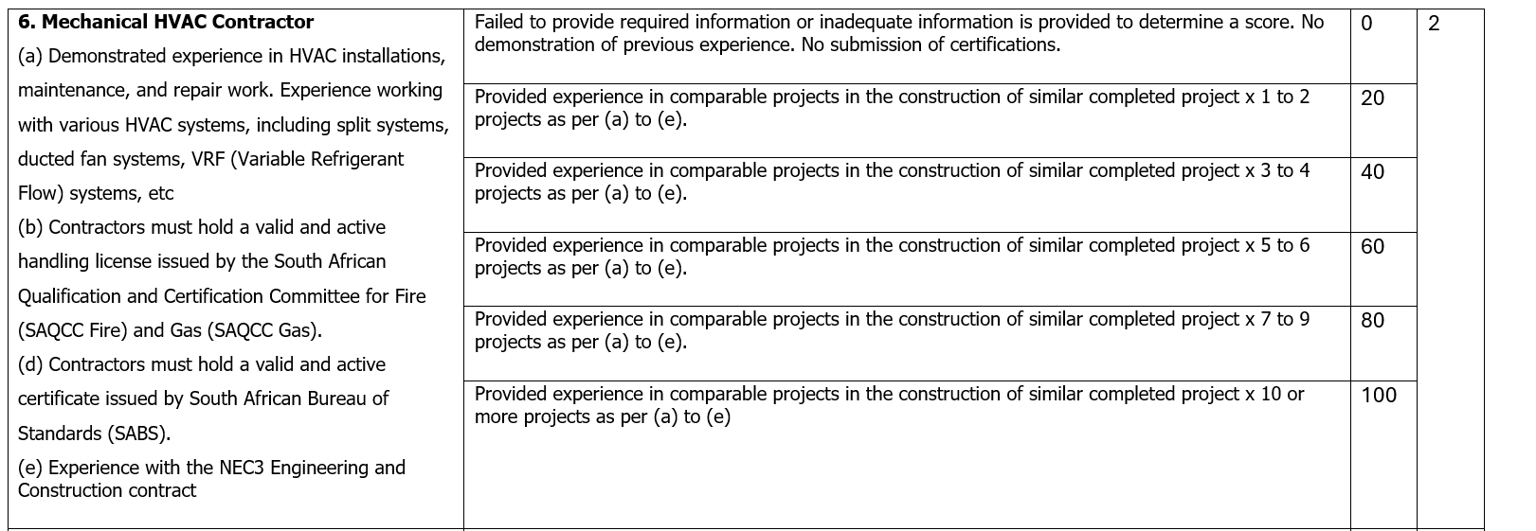

Slide 37
7. Mechanical Fire Contractor (a) Demonstrated experience in Fire installations, maintenance, and repair work. Experience working with various Fire systems, including gas suppression systems for FK-5-1-12 extinguishing agents, hose reels, hydrants, and fire extinguishers, as well as fire detection (panels, sensors, sirens, gas control and status units) systems, etc (b) Contractors must hold a valid and active handling license issued by the South African Qualification and Certification Committee for Fire (SAQCC Fire) and Gas (SAQCC Gas). (d) Contractors must hold a valid and active certificate issued by South African Bureau of Standards (SABS). (e) Experience with the NEC3 Engineering and Construction contract. | Failed to provide required information or inadequate information is provided to determine a score. No demonstration of previous experience. No submission of certifications. |  | 2
 | Provided experience in comparable projects in the construction of similar completed project x 1 to 2 projects as per (a) to (e).
 | Provided experience in comparable projects in the construction of similar completed project x 3 to 4 projects as per (a) to (e).
 | Provided experience in comparable projects in the construction of similar completed project x 5 to 6 projects as per (a) to (e).
 | Provided experience in comparable projects in the construction of similar completed project x 7 to 9 projects as per (a) to (e).
 | Provided experience in comparable projects in the construction of similar completed project x 10 or more project as per (a) to (e)

Slide 38
8. Architectural a. BSc/BEng/BTech/NDip or equivalent qualification. b. Eight (8) years or more years of relevant experience and experience with the NEC3 Engineering and Construction contract. | Failed to provide required information or inadequate information is provided to determine a score. CV is not provided or architectural personnel submitted indicating experience in architecture (substation buildings) with less than 1 year of relevant experience in architecture. | 0 | 4
 | CV of Architectural personnel submitted indicating experience in architecture (substation buildings) with 7 years but not more than 8 years of relevant experience in architectural works. | 20
 | CV of Architectural personnel submitted indicating experience in architecture (substation buildings) with 7 years but not more than 8 years of relevant experience in architectural works. | 40
 | CV of Architectural personnel submitted indicating experience in architecture (substation buildings) with 8 years but not more than 9 years of relevant experience in architectural works. | 60
 | CV of Architectural personnel submitted indicating experience in architecture (substation building) with 9 years but not more than 10 years of relevant experience in architectural works. | 80
 | CV of Architectural personnel submitted indicating experience in architecture (substation buildings) with 10 years or more years of relevant experience in architectural works. | 100

Slide 39
T2.2-05: QUALITY MANAGEMENT
T2.2-05: Evaluation Schedule: Quality Management Functionality Criteria (10 points)
Due consideration must be given to the deliverables required to execute and complete the contract as per the:
• TNPA-QUAL-REQ-14.1 _General Quality Requirements for Contractors and Suppliers (Annexure to the Scope of Works)
• ISO 9001:2015 Quality Management Systems (QMS) requirements or industry standard for quality management system and must include:
Project Quality Plan must be project specific and aligned to the TNPAQUAL- REQ-14.1_General Quality Requirements for Contractors and Suppliers.
CV of Quality Officer supplemented by Qualification - ISO 9001:2015 QMS training certificates (Implementation of QMS and Auditing). The Quality Officer MUST have a minimum of 3 years’ quality experience in construction projects.
Quality Control Plans must be in line with the scope of works detailing the Engineering works (i.e., Civil, structural, electrical, mechanical, Marine etc.) These QCP’s shall identify all inspections as detailed in the scope of works together with other tests and verifications required to demonstrate that the works comply with the scope of works, specifications, and drawings

Slide 40
T2.2-05: QUALITY MANAGEMENT
Project Quality Plan must be project specific and be aligned to the TNPAQUAL- REQ-14.1_General Quality Requirements for Contractors and Suppliers. 1. Scope of works 2. Control of external provided services​ 3. Design and development activities 4. Audits 5. Control of non-conforming outputs | No Submission/ Information submitted cannot be scored | 0 | 3
 | Project Quality Plan addresses one (1) of the five (5) PQP requirements. | 20
 | Project Quality Plan addresses two (2) of the five (5) PQP requirements. | 40
 | Project Quality Plan addresses three (3) of the five (5) PQP requirements. | 60
 | Project Quality Plan addresses four (4) of the five (5) PQP requirements. | 80
 | Project Quality Plan addresses all five (5) of the PQP requirements. | 100
Qualification Quality Diploma/Technical Diploma and ISO 9001:2015 QMS training certificates (Implementation of QMS and Auditing). | No Submission/ Information submitted cannot be scored | 0 | 2
 | Submitted Qualifications not relating to Quality/Engineering | 20
 | Quality Diploma/Techical Diploma and ISO 9001:2015 QMS training certificate (Implementation of QMS) | 40
 | Quality Diploma/Technical Diploma with ISO 9001:2015 QMS training certificate (Implementation of QMS and Auditing) | 60
 | Quality Diploma, Technical Diploma and ISO 9001:2015 QMS certificates (Implementation of QMS) | 80
 | Quality Diploma, Technical Diploma and ISO 9001:2015 QMS training certificates (Implementation of QMS and Auditing) | 100

Slide 41
T2.2-05: QUALITY MANAGEMENT
CV of Quality Officer The Quality Officer MUST have a minimum of 3 years’ quality experience in construction projects. | No Submission/ Information submitted cannot be scored | 0 | 2
 | One (1) year Quality experience in construction projects. | 20
 | Two (2) years Quality experience in construction projects. | 40
 | Three (3) years Quality experience in construction projects. | 60
 | Four (4)- ten (10) years Quality experience in construction projects. | 80
 | More than ten (10) years Quality experience in construction projects. | 100
Quality Control Plan (QCP) which includes the following requirements: 1. Sequence of activities 2.Procedure/code specifications 3. Intervention points 4. Field inspection checklist 5. Relevant signatories | No Submission/ Information submitted cannot be scored | 0 | 3
 | Quality Control Plan contains one (1) of the five (5) QCP requirements | 20
 | Quality Control Plan contains two (2) of the five (5) QCP requirements. | 40
 | Quality Control Plan contains three (3) of the five (5) QCP requirements | 60
 | Quality Control Plan contains four (4) of the five (5) QCP requirements. | 80
 | Quality Control Plan contains all five (5) of the QCP requirements. | 100

Slide 42
T2.2-06: HEALTH AND SAFETY MANAGEMENT
T2.2-06: Evaluation Schedule: Health and Safety Management (10 Points)
The Tenderer shall submit its Health and Safety documentation to the Employer at the time of tender, demonstrating the ability to manage health and safety relating to the scope of work:
Construction Health and Safety Officer/ Manager (Registration & Qualifications):Construction Health & Safety Officer/Manager must have a National Diploma in Safety Management, Environmental Health or other equivalent qualification (NQF Level 6) and must have a valid registration with SACPCMP as CHSO/CHSM.
Construction Health and Safety Officer/ Manager (Experience): Tenderer must submit a detailed CV with minimum of 5 years working experience in the construction projects as CHSO/CHSM.
Risk Assessment:The tenderer has submitted Risk Assessment Methodology and Risk Assessment, and submission of Risk Assessment indicating major activities of works and how the risks will be addressed and mitigated and must be in line with the scope of work (SoW):
1.1. Site Establishment 1.6. Fire Protection, Detection & Suppression System
1.2. Electrical Power Supply 1.7. Civil Works
1.3. Substation Automation System 1.8. Working on Heights
1.4. Battery Terminal Unit (BTU) 1.9. Demolition Works
1.5. HVAC System

Slide 43
T2.2-06: HEALTH AND SAFETY MANAGEMENT
Construction Health and Safety Officer/ Manager (Registration & Qualifications): Construction Health & Safety Officer/Manager must have a National Diploma in Safety Management, Environmental Health or other equivalent qualification (NQF Level 6) and must have a valid registration with SACPCMP as CHSO/CHSM. | No submission, No proof of valid SACPCMP registration or submission not as per requirements | 0 | 5
 | Valid proof of registration with SACPCMP, Health & Safety Short Courses (NQF Level 4) or any short course related to health and safety. | 20
 | Valid proof of registration with SACPCMP and SAMTRAC/NEBOSH certificate (NQF Level 5). | 40
 | Valid proof of registration with SACPCMP and National Diploma in Safety Management, Environmental Health or other equivalent qualification (NQF Level 6). | 60
 | Valid proof of registration with SACPCMP and Bachelor of Technology/Advanced Diploma in Safety Management, Environmental Health or other equivalent qualification (NQF Level 7). | 80
 | Valid proof of registration with SACPCMP and Bachelor of Technology/Advanced Diploma in Safety Management, Environmental Health or other equivalent qualification (NQF Level 7) and SAMTRAC/NEBOSH Certificate (NQF Level 5). | 100

Slide 44
T2.2-06: HEALTH AND SAFETY MANAGEMENT
Construction Health and Safety Officer/ Manager (Experience): Tenderer must submit a detailed CV with minimum of 5 years working experience in the construction projects as CHSO/CHSM. | No submission / information not available to determine experience or not as per requirements. | 0 | 2
 | Three (3) years or less of health and safety working experience in the construction environment. | 20
 | More than three (3) years but less than 5 years of health and safety working experience in the construction environment. | 40
 | Five (5) years’ health and safety working experience in the construction environment. | 60
 | Over five (5) years but less than seven (7) years' experience of health and safety working experience in the construction environment. | 80
 | More than seven (7) years’ health and safety working experience in the construction environment. | 100

Slide 45
T2.2-06: HEALTH AND SAFETY MANAGEMENT
Risk Assessment: The tenderer has submitted Risk Assessment Methodology and Risk Assessment, and submission of Risk Assessment indicating major activities of works and how the risks will be addressed and mitigated and must be in line with the scope of work (SoW): 1. Site Establishment 2. Electrical Power Supply 3. Substation Automation System 4. Battery Terminal Unit (BTU) 5. HVAC Systems 6. Fire Protection, Detection and Suppression Systems. 7. Civil Works 8. Working at Heights 9. Demolition Works | The Tenderer has submitted no information to determine a score or Risk Assessment submitted but not in line with the scope of work. | 0 | 3
 | The tenderer has submitted the Risk Assessment Methodology and Risk Assessment but one (1) - Three (3) major activities are provided that are in line with the scope of works. | 20
 | The tenderer has submitted the Risk Assessment Methodology and Risk Assessment, but four (4) major activities are provided that are in line with the scope of works. | 40
 | The tenderer has submitted the Risk Assessment Methodology and Risk Assessment but five (5) - seven (7) major activities are provided that are in line with the scope of works. | 60
 | The tenderer has submitted the Risk Assessment Methodology and Risk Assessment, but eight (8) major activities are provided that are in line with the scope of works. | 80
 | The tenderer has submitted the Risk Assessment Methodology and Risk Assessment, and all nine (9) major activities are provided that are in line with the scope of works. | 100

Slide 46
T2.2-07: ENVIRONMENTAL MANAGEMENT
The Tenderer must review the following documents in preparation to meeting the environmental requirements, namely:
Transnet Integrated Management System (TIMS) Policy Commitment Statement.
Transnet Construction Environmental and Sustainability Specification (CESS) TRN-IMS-GRP-GDL-014.4 Rev 3.0
Transnet Construction Environmental Management Standard Operating Procedure (CEM SOP). 009-TCC-CLO-SUS-11386 Rev 1.0
1. The tenderer must provide a project specific Environmental Management Plan. This plan must be clear on the following:
    a) A description of the environmental impacts that need to be avoided, managed and mitigated, a description of how those impacts will be avoided, managed and mitigated (impact management actions).
    b) The method and frequency of monitoring the implementation of the impact management actions.
    c) A description of how the environmental incidents will be managed on site.
    d) An indication of the roles and responsibilities in the implementation of the impact management actions. Records to be kept.
    e) How non-conformance/non-compliance will be dealt with.
    f) How non-conformance/non-compliance will be dealt with.

Slide 47
T2.2-07: ENVIRONMENTAL MANAGEMENT
2. The tenderer must provide an Environmental Policy signed by Top Management that displays the following key components, namely:
  Commitment to comply with all applicable environmental laws, regulations and standards.
  Commitment to pollution prevention
  Emphasize the organisation’s commitment to continual improvement in environmental performance.
  Address the sustainable use of resources/ resource conservation.
  Is communicated to all employees working for or on behalf of the Contractor.
3. Provide a CV showing environmental staff competencies, experience and environmental qualification (Degree/Diploma) relevant to environmental management functions, who will form part of the key environmental officer. (Proof of Qualification must be submitted).
4. The tenderer must provide a list of projects where construction environmental management duties have been executed including a brief description of such duties as listed on company’s experience reference letters. The format below must be used:

Slide 48
T2.2-07: ENVIRONMENTAL MANAGEMENT
Project Name | Start date | End Date | Brief Description of the Environmental Duties in the Project.
1
2
3
Etc.

Slide 49
T2.2-07: ENVIRONMENTAL MANAGEMENT
 | Environmental Management Plan | Environmental Policy | Environmental Officer Qualification | Environmental Officer Experience | List of projects where construction environmental management duties have been executed
Points | 3 | 1 | 2 | 2 | 2
Score 0 | The Tenderer has submitted no information to determine a score. | The Tenderer has submitted no information to determine a score. | The Tenderer has submitted no information or submitted Qualifications not in the Natural Science or Environmental Studies to determine a score. | Environmental officer has ‹1 year of relevant on-the- job experience. | The Tenderer has submitted no information to determine a score.
Score 20 | EMP only responds to 1-2 of the items listed under paragraph 1 in T2.2-07. | Policy addresses 1 of the required elements listed under paragraph 2 in T2.2-07. | Environmental officer is in possession of a relevant Certificate in Natural Science or Environmental Studies | Environmental officer has ≥1 year but ≤3 years of relevant on-the- job experience. | Tenderer has only executed environmental management duties in 1 project.
Score 40 | EMP only responds to 3 of the items listed under paragraph 1 in T2.2-07. | Policy addresses 2 of the required elements listed under paragraph 2 in T2.2-07. | Environmental officer is in possession of a Diploma in Natural Science or Environmental Studies | Environmental officer has >3 years but ≤4 years of relevant on-the- job experience. | Tenderer has only executed environmental management duties in 2 projects.
Score 60 | EMP only responds to 4 of the items listed under paragraph 1 in T2.2-07. | Policy addresses 3 of the required elements listed under paragraph 2 in T2.2-07. | Environmental officer is in possession of a Bachelor’s degree/ B Tech in Natural Science or Environmental Studies. | Environmental officer has >4 years but ≤8 years of relevant on-the- job experience. | Tenderer has only executed environmental management duties in 3 projects.
Score 80 | EMP only responds to 5 of the items listed under paragraph 1 in T2.2-07. | Policy addresses 4 of the required elements listed under paragraph 2 in T2.2-07. | Environmental officer is in possession of a Bachelor’s degree with Honours in Natural Science or Environmental Studies. | Environmental officer has >8 but ≤10 years relevant on-the-job experience. | Tenderer has only executed environmental management duties in 4 projects.
Score 100 | EMP responds to all the items listed under paragraph 1 in T2.2-07. | Policy addresses all of the required elements listed under paragraph 2 in T2.2-07. | Environmental officer is in possession of a master’s degree in Natural Science or Environmental Studies | Environmental officer has > 10 years of relevant on-the-job experience. | Tenderer has only executed environmental management duties in 5 projects.

Slide 50
T2.2-08: PROGRAMME
Evaluation Schedule: Programme (10 points)
The tenderer shall provide the proposed programme either in Primavera P6 or Microsoft Projects detailed to minimum of level 4
Ability to provide the services in terms of the Employer’s requirements within the required timeframe indicating, in a logical sequence, the order and timing of the services that will take place in order to Provide the Works clearly indicating the capacity & capability to achieve the dates stated in the Contract Data.
The Contractor clearly indicates in the schedule all key milestones, activities & information related to the following:
Float,
Time Risk Allowances,
Health and safety requirements,
Procedures set out in this contract,
Work by the Employer and Others,
Access to a part of the site if later than its access date,
Acceptances,
Plant & Materials and other things to be provided by the employer,
Information by Others,
starting date, access dates, Key Dates and Completion Date
planned Completion for each Key Date for each option and the complete works

Slide 51
T2.2-08: PROGRAMME
Evaluation Schedule: Programme (10 points)
The Tenderer must demonstrate the facility meets the minimum requirement. |  |  | The tenderer shall demonstrate the following:
 |  | Total 10 | No response | Very Poor | Poor | Acceptable Response | Good Response | Excellent Response
 |  |  | (0) | (20%) | (40%) | (60%) | (80%) | (100%)
Starting date and completion date are stated, and the programme does not exceed 12 months. (Shown Column and Gantt Chart) | 1 | 1 | No Response or Duration is not shown = 0% | Duration is 24 months or more = 20% | Duration is greater than 24 months but less than 25 months (Show Column or Gantt Chart) =40% | Duration is greater than 23 months but not more than 24 months (Show Column or Gantt Chart) =60% | Duration is greater than 22 months but less than 23 months (Show Column or Gantt Chart) =80% | Duration is less than 22 months (Show Column or Gantt Chart) =100%
Activities to be logically linked using critical path method (CPM). (Show the Critical path, Predecessors and Successors Column) | 2 | 2 | No response or programme does not link activities using CPM = 0 | Activities are not all linked, and open ends exceeds 10% = 20 | Activities are not all linked, and open ends are 10% or less = 40 | All Activities are Completely linked using CPM with no open ends except for Start and Finish activities, Hard Constraints not exceeding 5% of total Constraints = 60 | All Activities are Completely linked using CPM with no open ends except for Start and Finish activities, no hard Constraints and Soft constraints do not exceed 5% of total activities = 80 | All Activities are Completely linked using CPM with no open ends except for Start and Finish activities, no constraints) No open ends in between Predecessors and Successors on Sub critical and all activities linked and No linking on Work Breakdown Structure= 100

Slide 52
T2.2-08: PROGRAMME
Evaluation Schedule: Programme (10 points)
All activities as per level 4 | 3 | 2 | No response or partially complete or schedule submission is not level 4, 3 or 2 (i.e., Level 1) = 0 | The schedule is partially complete and detailed (level 2) = 20 | The schedule is detailed (level 3) = 40 | The schedule is complete and detailed (level 4) = 60 | The schedule is complete and detailed Level 4 and Basis of schedule submitted = 80 | The schedule is complete and detailed Level 4 and Basis of schedule submitted and Key Milestones = 100
The TNPA activities calendar on the schedule should represent the actual work week/month used. E.g., weekends, public holidays are marked as non-working days from start to finish date | 4 | 1 | No response = 0 | The TNPA activities calendar on the schedule should represent the actual Weekends or Public holidays are marked as working days from start to finish date = 20 | The TNPA activities calendar on the schedule should represent the actual Weekends are marked as working days from start to finish date = 40 | The TNPA activities calendar on the schedule should represent the actual Weekends, public holidays are marked as non-working days from start to finish date = 60 | The TNPA activities calendar on the schedule should represent the actual Weekends, public holidays, and builders break are marked as non-working days from start to finish date = 80 | The TNPA activities calendar on the schedule should represent the actual Weekends, public holidays, and builders' breaks are marked as non-working days and float from start to finish date = 100
All activity durations to be realistic and activities that can be measured in days, Weeks and Months. (Show the duration Column) | 5 | 2 | No response = 0 | All Activities durations to be realistic are broken down into Months (Show the duration Column) = 20 | All Activities durations to be realistic are broken down into Months and Weeks (Show the duration Column) = 40 | All activities durations to be realistic are broken down into Months, Weeks, and days (Show the duration Column) = 60 | All activities durations to be realistic are broken down into Weeks and days (Show the duration Column) = 80 | All activities durations to be realistic are broken down into days (Show the duration Column) = 100
Programme submission (Software) in PDF either Microsoft project or Primavera P6 | 6 | 2 | No response = 0 | Programme submitted not in Microsoft Project nor Primavera P6 nor Excel = 20 | Programme submitted in Excel =40 | Programme submitted in either Microsoft project or Primavera P6 =60 | Programme submitted in either Microsoft project or Primavera P6 including resource loading (Show the resource Column or Gantt Chart) =80 | Programme submitted in either Microsoft project or Primavera P6 including resource loading and cashflow forecast (Show the resource and cost Column or Gantt Chart) = 100

Slide 53
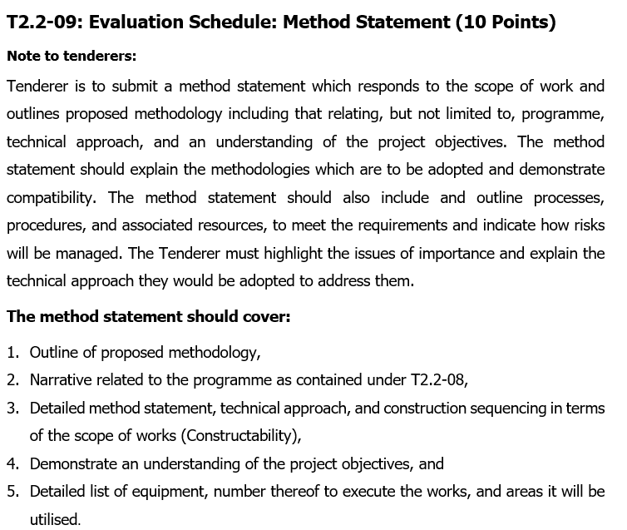
T2.2-09: METHOD STATEMENT

Slide 54
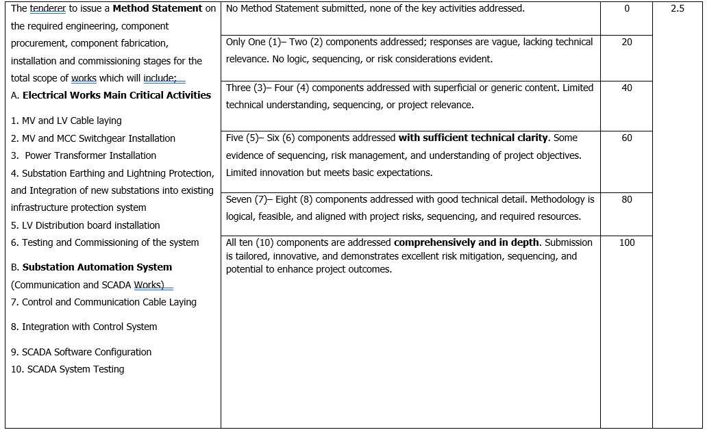
T2.2-09: METHOD STATEMENT Cont…..

Slide 55
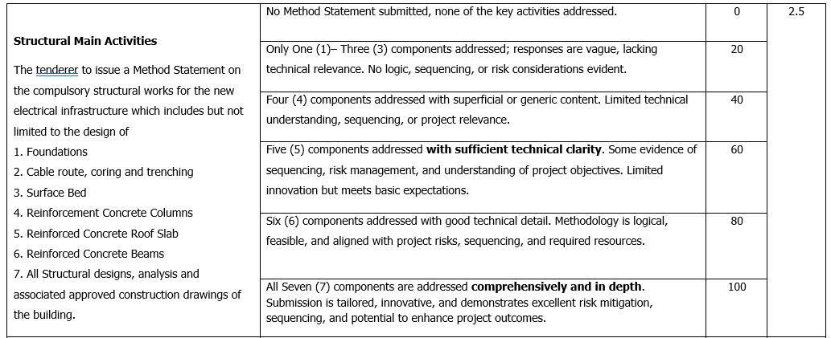
T2.2-09: METHOD STATEMENT Cont…..

Slide 56
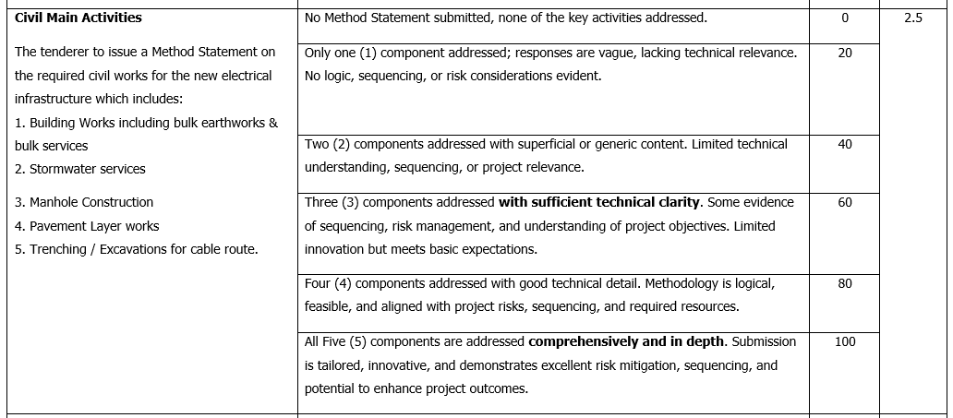
T2.2-09: METHOD STATEMENT Cont…..

Slide 57
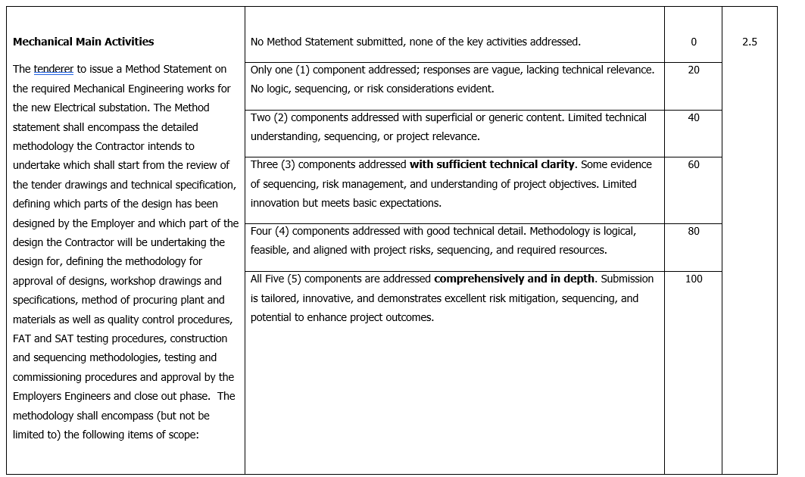
T2.2-09: METHOD STATEMENT Cont…..

Slide 58
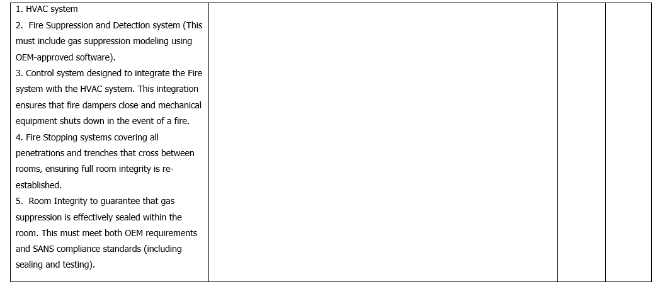
T2.2-09: METHOD STATEMENT Cont…..

Slide 59
QUESTIONS AND ANSWERS

Slide 60
STAGE FOUR (4)
SPECIFIC GOALS

Slide 61
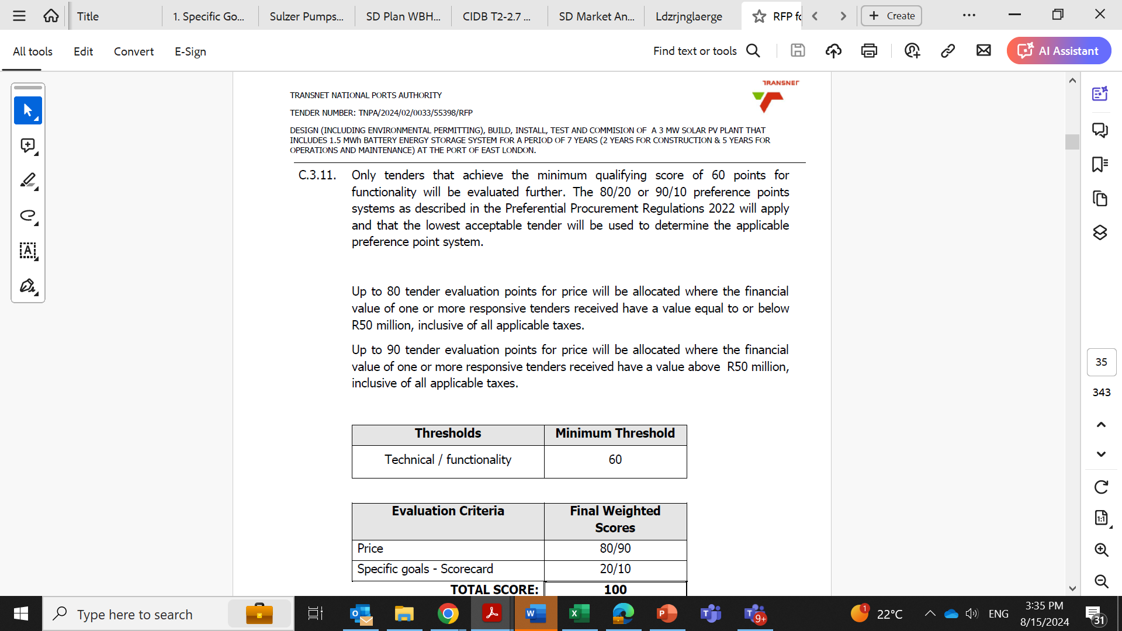
STAGE 4: PREFERENCE POINTS SYSTEM (80/20 or 90/10)
Page 30 of 411

Slide 62
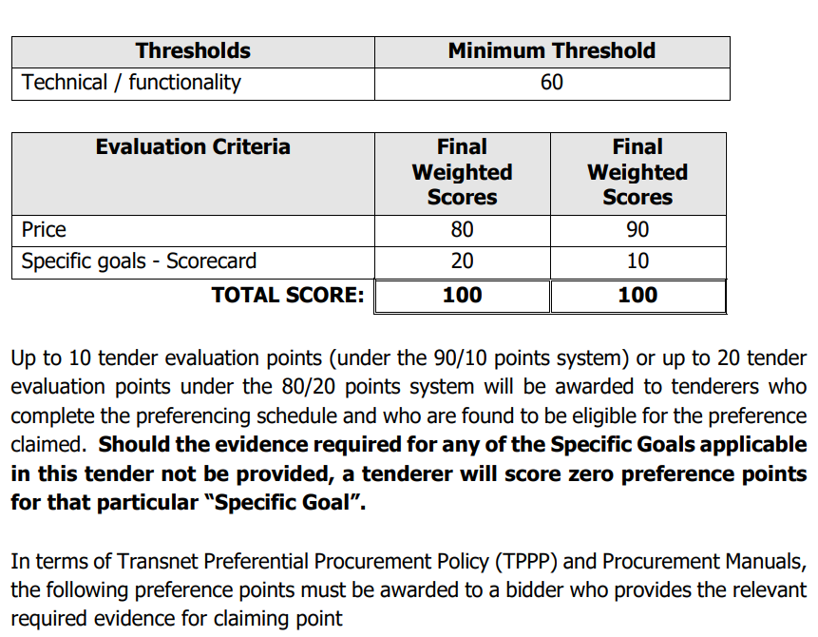
STAGE 4: PREFERENCE POINTS SYSTEM (80/20 or 90/10)………CONT.
Page 30 of 411

Slide 63
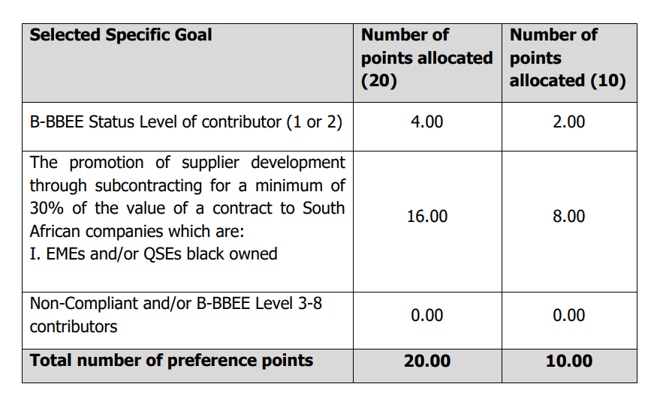
SELECTED SPECIFIC GOALS AND PREFERENCE POINTS
In terms of Transnet Preferential Procurement Policy (TPPP) and Procurement Manuals, the following preference points must be awarded to a bidder who provides the relevant required evidence for claiming points.
Page 31 of 411

Slide 64
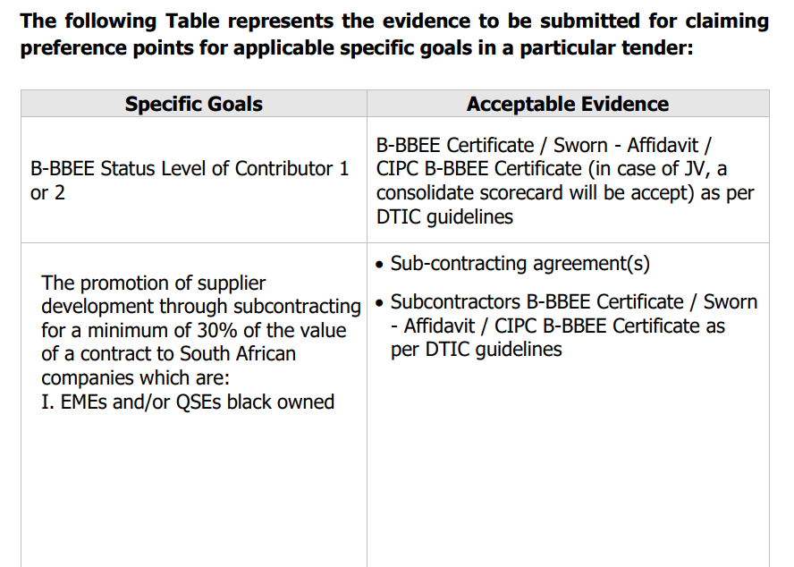
SPECIFIC GOALS AND ACCEPTABLE EVIDENCE REQUIRED
Page 31 of 411
Should the evidence required for any of the Specific Goals applicable in this tender not be provided, a tenderer will score zero preference points for that particular “Specific Goal”.

Slide 65
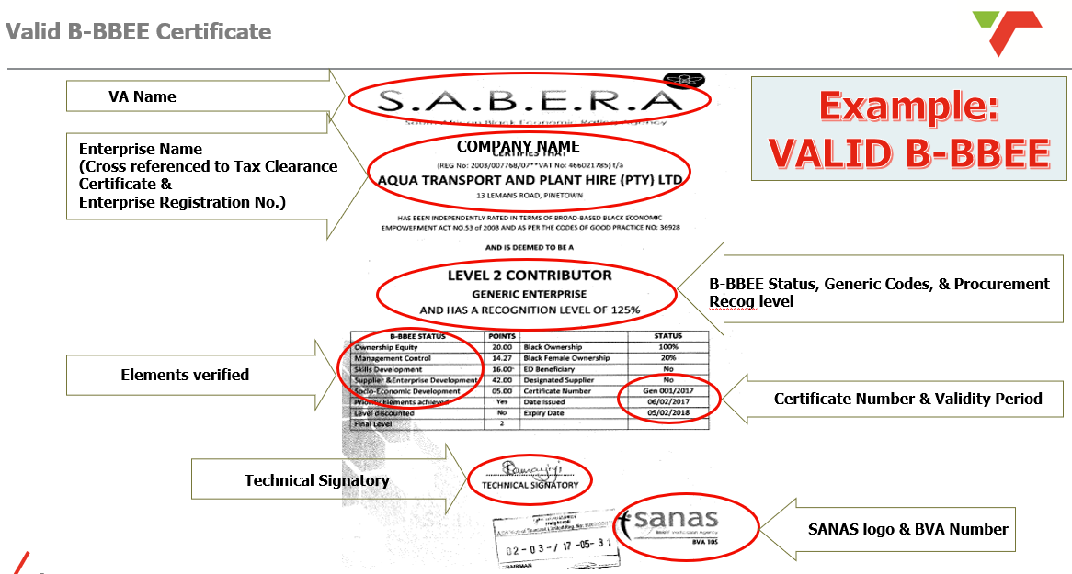
Key Pointers determining the validity of B-BBEE Certificate:

Slide 66
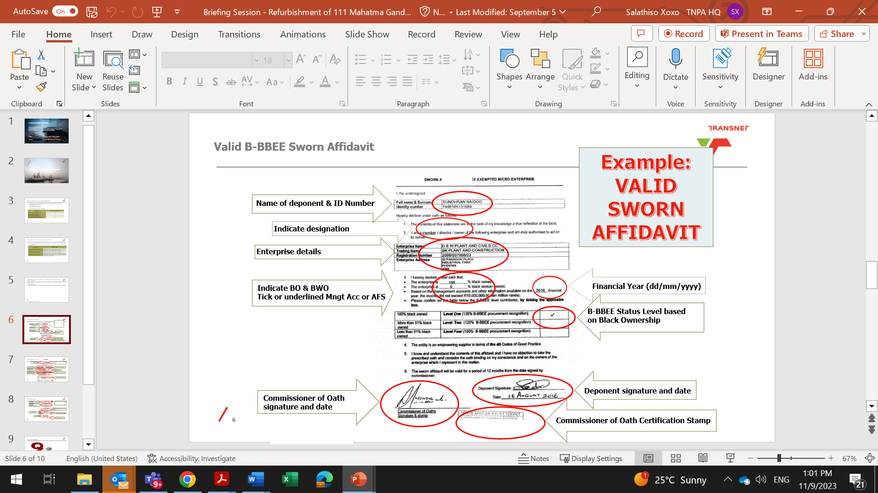
Key Pointers determining the validity of Sworn – Affidavit:

Slide 67
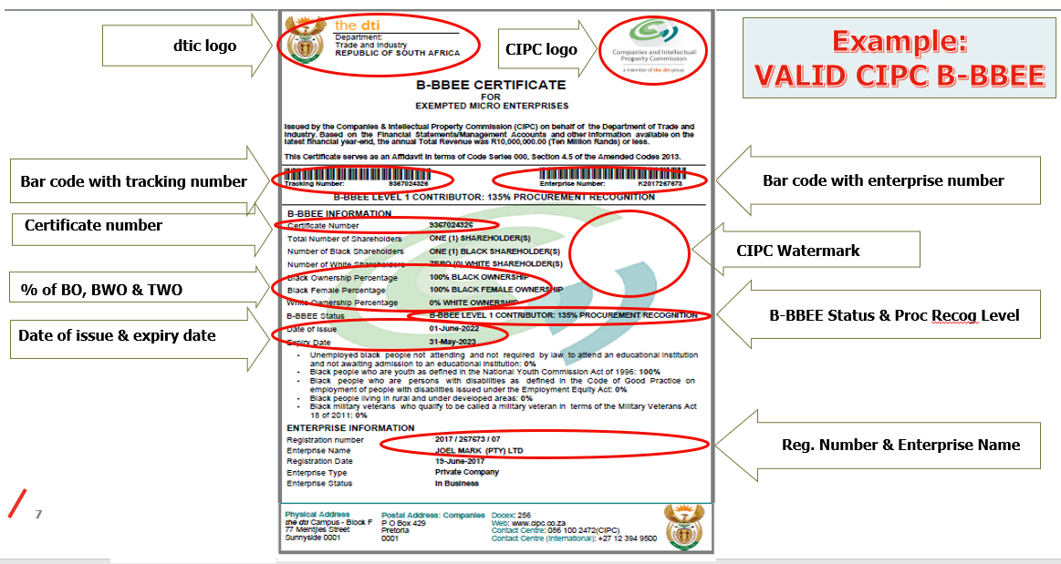
Key Pointers determining the validity of CIPC B-BBEE Certificate:

Slide 68
QUESTIONS AND ANSWERS

Slide 69
BILL OF QUANTITIES (BOQ)
2023
Date: June

Slide 70
Scope of Works (Based on BOQ)
The BOQ is divided into the following major sections:
Preliminaries & General – Contractor obligations, site establishment, compliance.
External & Earthworks – Excavation, trenching, and backfilling for services.
Concrete & Masonry – Foundations, bases, and ancillary structural works.
Electrical Works – Main scope: bulk electrical upgrade, distribution systems, cabling, lighting, earthing, and control.
Fire Protection & HVAC – Safety and auxiliary systems.
Paintwork & Waterproofing – Finishing elements.
Provisional Sums – Allowances for specialist works and unforeseen conditions.

Slide 71
Contractual Notes
Contract Type: Re-measurable, final value determined at project completion.
Payment Terms: 30 days period, Monthly valuations based on completed works.
Retention: 10% as per contract data and will be deducted in all payment certificates.
Price adjustment for inflation will only be applicable from September 2026 as the base date is September 2025.
Special Conditions: Contractors to note Employer’s right to adjust based on re-measurement.

Slide 72
BOQ Pricing Instructions
All items must be fully priced with unit rates and extensions (Totals).
Preliminaries must be broken down clearly (site establishment, insurances, compliance).
Electrical Works: Tenderers must include full material, labour, and testing costs.
Provisional Sums: To be carried forward as stated, not adjusted.
Rate build-ups may be requested for major items.

Slide 73
Submission Requirements
Format: Priced BOQ (PDF) + supporting documents.
Supporting Documents: Method statement, programme, schedule of rates, compliance certificates.

Slide 74
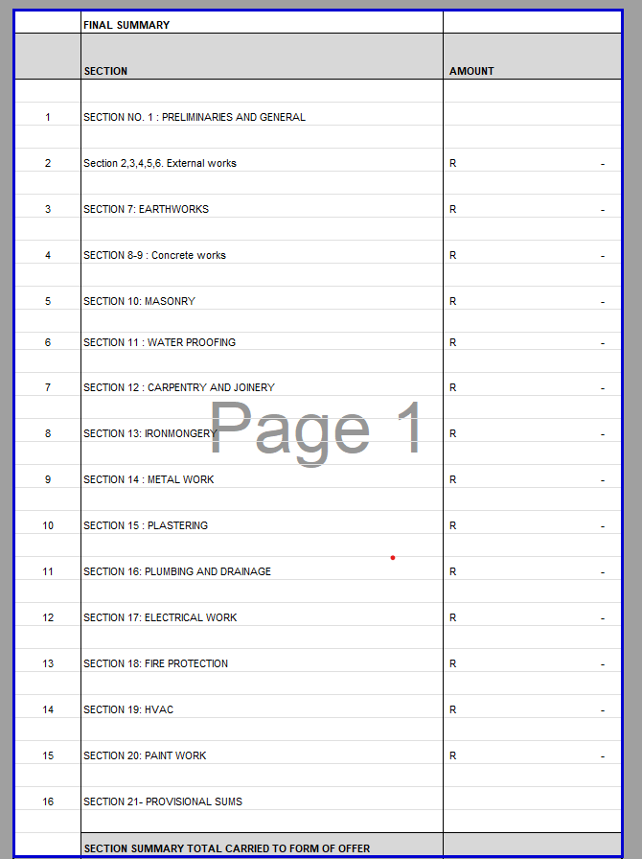
Bill of Quantities (BOQ) Summary

Slide 75
QUESTIONS AND ANSWERS

Slide 76
SUMMARY OF FINANCIAL AND SPECIFIC GOALS EVALUATION

Slide 77
SUMMARY - FINANCIAL AND SPECIFIC GOALS EVALUATION
The 80/20 or 90/10 preference points systems as described in the Preferential Procurement Regulations 2022 will apply and the lowest acceptable tender will be used to determine the applicable preference point system.
Preference points for this bid shall be awarded for:
  Price; and
  Specific goals.
The Finance and team shall conduct financial and price evaluation to check the following:
  Financial stability of the bidder
  If the bid price is market-related or falls within the budget
  The BOQ will be checked for any discrepancies and/or arithmetical errors.

Slide 78
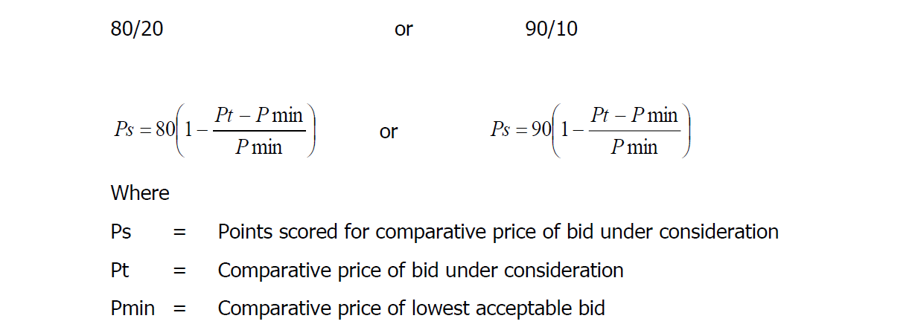
Step 5 : Weighted score
Evaluation Criteria | Final Weighted Scores
Price | 80/90
Specific Goals- Scorecard | 20/10
TOTAL SCORE: | 100

Slide 79
QUESTIONS AND ANSWERS

Slide 80
TENDER DATA AND RETURNABLES
80

Slide 81
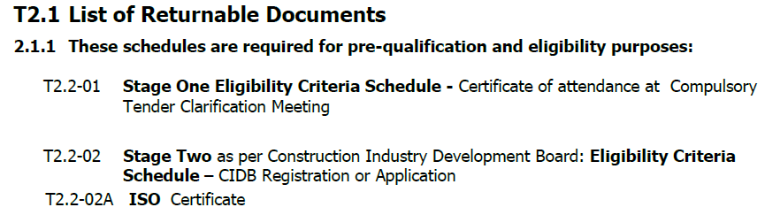
TENDER DATA AND RETURNABLES

Slide 82
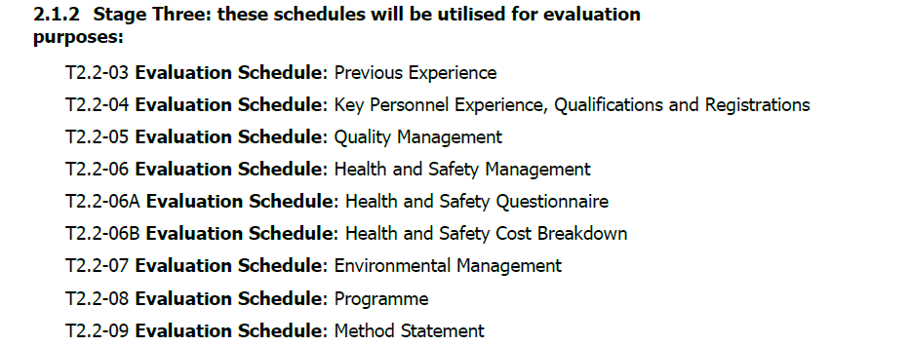
TENDER DATA AND RETURNABLES(Continued)

Slide 83
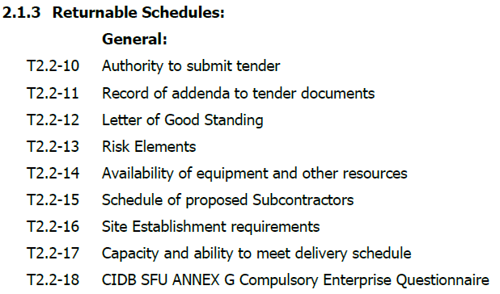
TENDER DATA AND RETURNABLES(Continued)

Slide 84

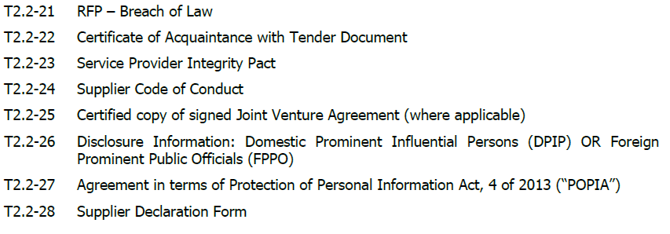
TENDER DATA AND RETURNABLES(Continued)

Slide 85
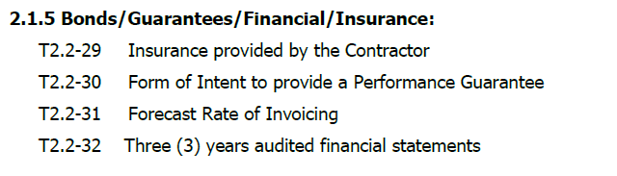
TENDER DATA AND RETURNABLES(Continued)

Slide 86
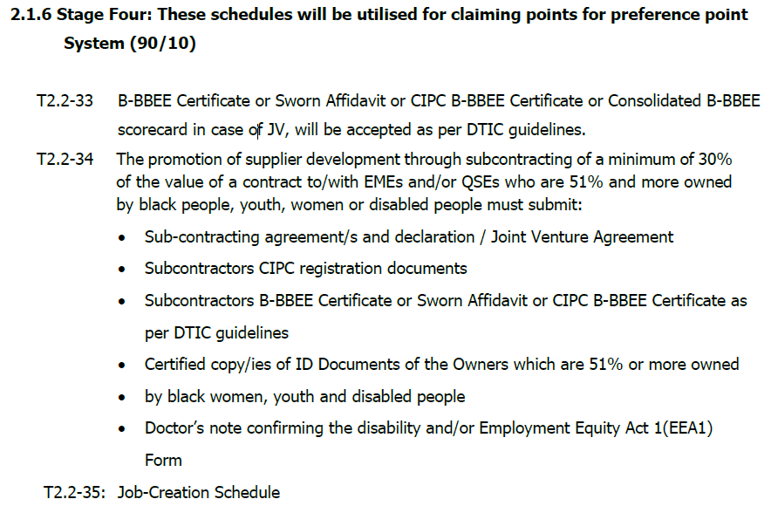
TENDER DATA AND RETURNABLES(Continued)

Slide 87
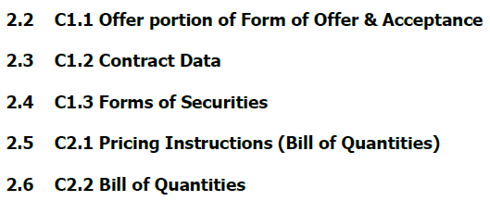
TENDER DATA AND RETURNABLES(Continued)

Slide 88
CONTRACT DATA
88

Slide 89
CONTRACT DATA
Form of agreement
  Form of contract: NEC ECC
  Main Clause: Option Ab Priced contract with bill of quantities
  W1: Dispute resolution procedure
  Secondary Clause:
    X1: Price adjustment for inflation
    X2: Changes in the law
    X7: Delay damages
    X13: Performance Bond
    X14: Advance Payment
    X16: Retention
    X18: Limitation of liability
    Z: Additional conditions of contract

Slide 90
QUESTIONS AND ANSWERS

Slide 91
RECAP/CONCLUSION
2023
Date: June

Slide 92
RECAP
RFP is available for downloading on the NT e-tender portal and Transnet e-tender website
All the questions should be forwarded to the tnpatendersenquiries3@transnet.net email and answers will be consolidated and uploaded onto the Transnet e-tender portal and National Treasury e-tender portal.
Cut-off time and date for questions and clarifications is 12pm, 5 working days before the closing date stated in the tender data.
The closing date for this RFP is 17 October 2025 @ 16h00 (The tender closes on the Transnet e-Tender Submission Portal: www.transnet.net )

Slide 93
THANK YOU ALL FOR ATTENDING;
THOSE INTERESTED LET’S PROCEED FOR SITE INSPECTION AND
ALL THE BEST OF LUCK WITH YOUR TENDER SUBMISSIONS .
TENDER
2023
Date: June

