Slide 1


Establishment of the NTCSA Professional Services Panels for various services on an as and when required basis for a period of three (3) years
Presented by: Proscoviour Ratsethana
Date: 10 April 2026

Slide 2
Contents
Welcome and Introduction
Safety and Evacuation Procedure
Declaration of Interest
Commercial Requirements
SDL and I Requirements
SHEQ Requirements
Scope of work and Functionality
BOQ

Slide 3
Commercial process
  All tenders to be evaluated for commercial compliance
  – All required documents must be submitted or else the tender will be disqualified
  -All tenders to be evaluated for functionality
  -All functional tenders will be evaluated on the 80/20 or 90/10 principle
4

Slide 4
Commercial process
      Prices will be scored out of 90 or 80 points
      10/20 points points for B-BBEE
  Single point of contact is Proscoviour Ratsethana
  (E-mail: mashamLa@ntcsa.co.za)
  Tel: 013 297 9357
  In terms of Eskom's Policy and Procedure, all questions and queries received will be answered in writing to all the bidders.
  Closing date is 20 April 2026 at 10H00 South African Standard Time.
  Late tenders will not be accepted.
4

Slide 5
Commercial process
Tender submission
Electronic Tender Submissions
-The tenderer must upload the tender via NTCSA Tender bulletin site on the NTCSA E- tendering page. The documents need to be uploaded under the folder Technical, Commercial, Financial, and other.
-All documents need to be submitted in a PDF format. The price list needs to be submitted in PDF and a copy in excel format
4

Slide 6
Commercial process
Tender submission
-No Zip/condense files can be uploaded
-No hard copy will be accepted
-If for some reason you resubmit your tender, then the latest version of the tender submitted will only be accepted and all previous submission/s will be null and void.
-Please ensure that the submission status is indicated as complete.
4

Slide 7
Commercial process
Tender submission
Supplier Help Manual guide is uploaded with the tender-on-tender portals. And video can be found on NTCSA E-Tendering page
4

Slide 8

Questions

Slide 9
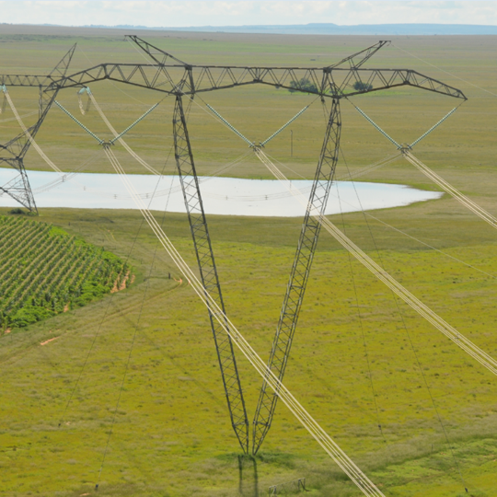
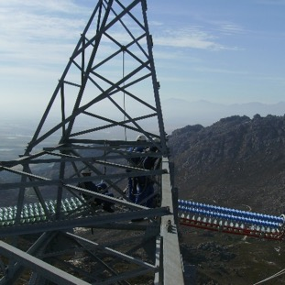
Conclusion

