Slide 1
TENDERERS CLARIFICATION BRIEFING PRESENTATION
EASTERN REGION
February 2023

Slide 2

The Briefing Presentation is provided in two parts:
Part A: SANRAL Presentation (Background & Tender conditions)
Part B: Consultant Presentation (Project Information)
Part C: Consultant Presentation (Contract & Specifications)

Slide 3

Contract: SANRAL N.001-192-2018/1NSC
NOMINATED SUB-CONTRACT FOR THE DESIGN, BUILD, OPERATIONS AND MAINTENANCE OF THE TOLL SYSTEM FOR THE OPERATIONS AND MAINTENANCE OF N1 SOUTH AND R30 TOLL PLAZAS ON NATIONAL ROUTE N1 AND R30
Tender documents are available at no cost in electronic format downloadable from SANRAL website
https://www.nra.co.za/sanraltenders/status?region_id=national
Tenderers must have access to Microsoft Office © 2013 and Acrobat Adobe © 9.0, or similar compatible software.

Slide 4
PLEASE NOTE:
THE SIGNATURE ON THE DULY COMPLETED AND SIGNED FORM A1 SHALL BE CONSIDERED PROOF THAT THE TENDERER ATTENDED THE WHOLE CLARIFICATION BRIEFING MEETING AND CLEARLY UNDERSTOOD ALL DIRECTIVES AND CLARIFICATIONS GIVEN IN THE PRESENTATION
ANY INCONSISTENCY BETWEEN THE PRESENTATION AND TENDER DOCUMENT, THE TENDER DOCUMENT SHALL PREVAIL UNLESS COMMUNICATED IN THE ADDENDUM

Slide 5
1. TENDERING PROCEDURES
PART T1: CONDITIONS OF TENDER AND TENDER DATA

Slide 6
CONDITIONS OF TENDER
The Conditions of Tender are the Standard Conditions of Tender as contained in Annexure C of the CIDB STANDARD FOR UNIFORMITY IN ENGINEERING AND CONSTRUCTION WORKS CONTRACTS as per Government Notice No. 423 published in Government Gazette No. 42622 of 08 AUGUST 2019 and as amended from time to time. (see www.cidb.org.za).
The Standard Conditions of Tender may be downloaded from the CIDB website on the following link: https://www.gov.za/sites/default/files/gcis_document/201908/42622gen423.pdf

Slide 7
IMPORTANT DATES
SUBBMISION OF FORM A1.1 | 24 January 2023
SUBMISSION OF QUERIES | Request clarifications at least 12 (twelve) working days before the closing date.
TENDER CLOSING DATE | 24 February 2023

Slide 8
TENDER DATA
Each item of data given is cross-referenced to the clause in the Standard and Special Conditions of Tender to which it mainly applies. The Tender Data shall have precedence in the interpretation of any ambiguity or inconsistency between it and the standard/special conditions of tender.
CLAUSE NUMBER | TENDER DATA
C.1.1 | The Employer is the South African National Road Agency SOC Limited (SANRAL). The Employer’s domicilium citandi et executandi (permanent physical business address) is: 48 Tambotie Avenue VAL DE GRACE 0184 The Employer’s address for communication relating to this project is: The Regional Manager (Eastern Region) Eastern Region 58 Van Eck Place Mkondeni Pietermaritzburg 3201

Slide 9
TENDER DATA
CLAUSE NUMBER | TENDER DATA
C.1.4 | The Employer’s Agent can be contacted as follows: procurementer7@sanral.co.za NB: All communication during tender stage should be addressed to the email above.
C.1.6.2.1 | Option 1 Price negotiations. If the price offered by a tenderer scoring the highest points is not market related, the Organ of state may not award the tender to that tenderer. The Organs of state may – Negotiate a market related price with the tender scoring the highest points or cancel the tender; If the tenderer does not agree to a market related price, negotiate a market related price with the tenderer scoring the second highest points or cancel the tender; If the tenderer scoring the second highest points does not agree to a market related price, negotiate a market related price with the tenderer scoring the third highest points or cancel the tender; If a market related price is not agreed as envisaged in paragraph b(iii), the organ of state must cancel the tender.

Slide 10
TENDER DATA
C.2.1 | Eligibility Only those tenderers who satisfy the following eligibility criteria are eligible to submit tenders: a) Prequalification Criteria for Preferential Procurement (Form C1.1) Only a tendering entity with a B-BBEE contributor status level of 1, 2, 3 or 4, are eligible to tender. The tenderer shall submit a valid B-BBEE certificate or Sworn Affidavit (where applicable) in compliance with the requirements of Tender Data C.3.11., as proof of eligibility. The tender will be declared non-responsive: If the B-BBEE Certificate is not submitted or submitted B-BBEE certificate is not valid; or b) If the B-BBEE Certificate is not submitted, and the tenderer has claimed a status point level; or c) If tenderer failed to submit a valid B-BBEE Certificate but claimed status level points; or d) If the tenderer submits a B-BBEE Certificate that is expired - but did claim preference points; or e) If the tenderer submits a B-BBEE Certificate that does not comply with requirements; or f) If the tenderer submits the Scorecard assessment report only; or g) If, in a case of a Joint Venture, the tenderer submits an unincorporated consolidated Joint Venture B-BBEE Certificate which is not project specific; or

Slide 11
C.2.1 (cont..) | h) If, in a case of a Joint Venture, the tenderer submits an unincorporated consolidated Joint Venture B-BBEE Certificate which does not have a contract description and / or a tender number; or i) If a tenderer only submits one B-BBEE certificate in one tender submission, where multiple tenders were issued by SANRAL; or j) If the BBBEE certificate or Sworn Affidavit is not submitted or not valid; or k) For a Sworn Affidavit; if i) EME (not start-up) submits a Sworn Affidavit with total revenue above R3million (contractors) instead of a B-BBEE Certificate, or ii) QSE submits Sworn Affidavit (consultants and contractors) instead of a BBBEE Certificate b) National Treasury Central Supplier Database (Form A3.4) Tenderers, or in the event of a Joint Venture, each member of the Joint Venture, shall be registered on the National Treasury Central Supplier Database at the closing date for tender submissions. Tenders received from such tenderers who do not comply with this requirement, will be declared non-responsive.

Slide 12
TENDER DATA
C.2.1 (cont.) | c) Tenderer’s Relevant Experience The tenderer must be able to show that he has relevant experience by providing information of at least: 3 (three) similar or relevant projects, but not necessarily a toll project(s), each to the value of at least R55 million which has either started or been completed within the last 15 (fifteen) years, or which is still ongoing (subject to the provisions of Form D5.1 and or Form D5.2). The relevant experience must be in at least 2 of the following key areas of which one is required to be ii) Development and/ or maintenance of a toll system (or sub-systems) (Form D5.1 & Form 5.2): i). Operations and maintenance of a toll project; ii). Development and/or maintenance of a toll system (or sub-systems); iii). Multi-disciplinary project management; iv). Development and maintenance of IT systems (not necessarily toll related) Failure to satisfy all the eligibility criteria shall result in a non-eligible tender. NB: Failure to meet ALL the stipulated eligibility criteria will result in a non-eligible tender.

Slide 13
TENDER DATA
C.2.6 | Acknowledge addenda Failure to apply instructions contained in addenda may render a tenderer’s offer non-responsive in terms of Condition of Tender C.3.8.
C.2.7 | Clarification meeting The signature on the duly completed and signed Form A1 shall be considered proof that the tenderer attended the whole clarification briefing session and clearly understood all directives and clarifications given in the session. NB. If the tenderer did attend the clarification meeting, there will still be required to sign Form A1 as proof that they have clearly understood all tendering procedures.

Slide 14
TENDER DATA
C.2.8 | Seeking clarification Request clarifications at least 12 working days before the closing date.
C.2.9 | Insurance No insurance is provided by the Employer.
C.2.10 | Tenderers are required to state the rates and currencies in Rand

Slide 15
TENDER DATA
CLAUSE NUMBER | TENDER DATA
C.2.12 | Alternative Offers An alternative tender offer shall only be considered from a tenderer whose postulated tender offer is the preferred tender A tenderer wishing to submit an alternative offer (excluding alternative offers of different contract duration, retention guarantees, discounted offers or different compliant material sources) shall first apply to the Employer’s agent for confirmation that the Employer’s standards and requirements envisaged in the design are not compromised or reduced. Such confirmation must have been provided by the Employer’s agent in writing within 10 working days after receipt of the application but not later than 5 working days before the date and time of tender closing given in Tender Data clause C.2.15, or as extended by an addendum sent to all tenderers. Also, not acceptable as alternative offers are alterations to contingency pay items provided in the bill of quantities (pricing schedule), fixed prices for individual items or a fixed price contract. If an alternative proposal is confirmed to be acceptable, calculations, drawings and all other pertinent technical information and characteristics as well as proposed modification of, or alternative to, the Pricing Data must be submitted with the alternative tender offer to enable the Employer to evaluate the efficacy of the alternative and its principal elements, to take a view on the degree to which the alternative complies with the Employer’s standards and requirements and to evaluate the acceptability of the pricing proposals.

Slide 16
TENDER DATA
C.2.12 | Alternative Offers (Continued) Calculations must be set in clear and logical sequence and must clearly reflect all design assumptions. Pricing Data must reflect all assumptions in the development of the pricing proposal. Acceptance of an alternative offer will mean acceptance in principle of the offer. It will be an obligation of the contract with the tenderer, in the event that the alternative is accepted, to accept full responsibility and liability that the alternative offer complies in all respects with the Employer’s standards and requirements.

Slide 17
TENDER DATA
C.2.13.2 | The returnable documents shall be electronically completed in their entirety, submitted on the issued software format or fully compatible format, unless otherwise specified. Option 1: Submission in the tender box Submit the tender offer electronically on a flash drive and printed hard copy of Form of Offer and summary of pricing schedule. (In the relevant MS Word 2013 and MS Excel 2013 format as issued, and not in .pdf format, except where so specified.)

Slide 18
TENDER DATA
C.2.13.3 | MAIN TENDER OFFER SUBMISSION Submission in the tender box Only the following needs to be submitted: Volume 3 – Scanned on a flash drive The following information has to be submitted on flash drive: The 1st file in pdf format which contains: • Scanned copy of Form of Offer (pdf) and printed hardcopy of Form of Offer • Scanned copies of all returnable schedules and attachments (pdf) A 2nd file in Excel format • Completed pricing schedule (scanned copy in .pdf and copy in Excel) and printed hardcopy of Summary of Pricing Schedule In the event of any discrepancy between the contents of the electronically priced schedule and the electronically provided pricing schedule in pdf format, the contents of the provided pdf format shall be taken as the valid contents. For the information provided by the tenderer as part of his submission, e.g. rates, the signed print-out shall be taken as the valid submission.

Slide 19
TENDER DATA
C.2.13.6 | A two-envelope procedure will apply as follows: Submission in the tender box A folder is provided marked “TECHNICAL PROPOSAL” Ensure that all returnable schedules listed in T2.1 List of Returnable Schedules for inclusion in the Technical Proposal and listed in the Technical Proposal folder are electronically completed on a USB Flash Drive Wherever it is a requirement to attach certificates or letters to the returnable schedules, these should be scanned in, on the Flash Drive in .pdf format. Contents of USB Flash Drive shall be printed and bound in hard copy. The completed Flash Drive, the printed and bound hard copy should be marked with the tenderer’s company name, the project number and description and marked “TECHNICAL PROPOSAL”. Scan and insert a valid B-BBEE certificate. Electronically sign the declaration in the folder. Insert the electronically completed Flash Drive, the printed and bound hard copy in an envelope marked “TECHNICAL PROPOSAL”.

Slide 20
TENDER DATA
C.2.13.6 (cont..) | A folder is provided marked “FINANCIAL PROPOSAL” a. Ensure that all returnable schedules listed in T2.1 List of Returnable Schedules for inclusion in the Financial Proposal and listed in the Financial Proposal folder are electronically completed on a Flash Drive (Contract Data and Pricing Schedule). Wherever it is a requirement to attach letters or certificates to the returnable schedules, these should be scanned in, on the USB Flash drive in .pdf format. Contents of Flash Drive shall be printed and bound in hard copy. The completed Flash Drive, the printed and bound hard copy should be marked with the tenderer’s company name, the project number and description and marked “FINANCIAL PROPOSAL”. b. Electronically sign the declaration in the folder. Complete and electronically sign the Form of Offer and scan into the folder. A draft copy of this form is provided. d. Scan and insert a copy of the Summary of Pricing Schedule into the folder. e. Insert the electronically completed Flash Drive and the printed and bound hard copy in an envelope marked “FINANCIAL PROPOSAL – DO NOT OPEN WITH TECHNICAL PROPOSAL”. 3. Each envelope shall state on the outside the Employer’s address, contract number and title as well as the Tenderer’s name, authorised representative’s name, postal address and contact telephone numbers.

Slide 21
TENDER DATA
C.2.13.6 (cont..) | 4. Seal both envelopes in an outer envelope with the words “TENDER” clearly marked and bearing the Employer’s name, contract number and description as well as the Tenderer’s authorised representative’s name, postal address and contact details. If a tenderer submits: One envelope with one document or one Flash Drive and printed hard copy (financial and technical); or Incorrectly labelled envelopes where the Financial Offer is labelled Technical, and the Technical Offer is labelled financial. The tender will be declared non-responsive.

Slide 22
TENDER DATA
CLAUSE NUMBER | TENDER DATA
C.2.13.6 | The closing date for submission of tender offers is 11h00 hours on Friday 24 February 2023.

Slide 23
TENDER DATA
C.2.14 | Information and data to be completed in all respects Provided that the omission is not a material omission, the Employer reserves the right to condone the omission and may waive any nonconformities in the tender. Provided that the omission is not a material omission, the Employer reserves the right to condone the omission and may request the tenderer to submit the necessary information or documentation, within a reasonable period of time, to rectify nonmaterial nonconformities in the tender related to documentation requirements.

Slide 24
TENDER DATA
C.2.15 | Closing time - Option 1 Submission in tender box The Employer’s address for delivery of tender offers and identification details to be shown on each tender offer package are: Location of tender box: SANRAL Eastern Region Office Physical address: 58 Van Eck Place, Mkondeni, Pietermaritzburg,3201 Identification details: Place the tender offer and flash drive in a package marked with the tenderer’s company name, the project number and description: TENDER: SANRAL N.001-192-2018/1NSC, NOMINATED SUBCONTRACT FOR THE DESIGN, BUILD, OPERATIONS AND MAINTENANCE OF THE TOLL SYSTEM FOR THE OPERATIONS AND MAINTENANCE OF N1 SOUTH AND R30 TOLL PLAZAS ON NATIONAL ROUTE N1 AND R30. Tenders must be submitted during hours (09:00 to 16:00) Monday to Friday at the Employer’s address. It is in the tenderer’s interest to ensure that the delivery of the tender offer is recorded in the Employer’s tenders received register and deposited in the tender box. Tenders must be submitted before, 11h00 hours on Friday, 24 February 2023.

Slide 25
TENDER DATA
C.2.16.1 | The tender offer validity period is: 24 Weeks.
C.2.16.3 | Withdrawal of tender Where a tenderer, at any time after the opening of his tender offer but prior to entering into a contract based on his tender offer: a) withdraws his tender; gives notice of his inability to execute the contract in terms of his tender; or fails to comply with a request made in terms of C.2.17, C.2.18 or C.3.9; such tenderer shall be barred from tendering on any of the Employer’s tenders for a period to be determined by the Employer, but not less than 6 (six) months from a date determined by the Employer. This sanction also applies to tenders under evaluation and not yet awarded. The Employer may fully or partly exempt a tenderer from the provisions of these conditions if he is of the opinion that the circumstances justify the exemption.

Slide 26
TENDER DATA
C.2.18 | Other material Any additional information requested under this clause must be provided within 5 (five) working days of date of request.
C.3.1 | The Employer shall respond to clarifications received up to 12 (twelve) working days before tender closing time.
C.3.2 | The Employer shall issue addenda until 10 (ten) working days before tender closing time.

Slide 27
TENDER DATA
C.3.4 | Tender Opening The time and location for opening of the tender offer are: Time: 11h00 on 24 February 2023 Location: Tender opening can be viewed through live streaming and link will be provided to tenderers that have submitted the Form A1.1.
C.3.7 | Grounds For Rejecting a tender offer in case of corrupt or fraudulent practices Prior to disqualification, the tenderer shall make representations within 14 (fourteen) days as to why the tender submitted should not be disqualified and as to why the tenderer should not be restricted by the National Treasury from conducting any business with any Organ of State for a period not exceeding 10 (ten) years. In the event of disqualification, the Employer may, at its sole discretion, claim damages from the tenderer and impose a specified period during which tender offers will not be accepted from the offending tenderer and the Employer shall inform the National Treasury and CIDB writing.

Slide 28
TENDER DATA
C.3.9 | Arithmetical errors, omissions, discrepancies and imbalanced unit rates Check responsive tenders for discrepancies between amounts in words and amounts in figures. Where there is a discrepancy between the amounts in figures and the amount in words, the amount appearing in the summary to the Pricing Schedule shall govern. Check responsive tender offers for: the gross misplacement of the decimal point in any unit rate; omissions made in completing the Pricing Schedule or Bills of Quantities; or arithmetic errors in: line item totals resulting from the product of a unit rate and a quantity in Bills of Quantities or Schedules of Prices; or the summation of the prices; imbalanced unit rates. Notify shortlisted tenderers of all errors, omissions or imbalanced rates that are iden­tified in their tender offers.

Slide 29
TENDER DATA
C.3.9 Continued | Where the tenderer elects to confirm the errors, omissions or im­balanced rates the tender offer shall be corrected as follows: if Bills of Quantities or Pricing Schedules apply and there is an error in the line item total resulting from the product of the unit rate and the quantity, the unit rate shall govern and the line item total shall be corrected. Where there is an obviously gross misplacement of the decimal point in the unit rate, the line item total as quoted and the unit rate shall be corrected. Where there is an error in the total of the prices either as a result of other corrections required by this checking process or in the tenderer’s addition of prices, the total of the prices shall be corrected. c) Where the unit rates are imbalanced, adjust such rates by increasing or decreasing them and selected others while retaining the total of the prices derived after any other corrections made under (a) and (b) above. Where there is an omission of a line item, no correction is possible and the offer may be declared non-responsive. Declare as non-responsive and reject any offer from a tenderer who elects not to accept the corrections proposed and subject the tenderer to the sanction under C.2.16.2. The tenderer is required to submit balanced unit rates for Rate Only items in the Pricing Schedule. The rates submitted for these items will be taken into account in the evaluation of tenders.

Slide 30
TENDER DATA
C.3.11 | Evaluation of tender offers The following formula will be used to calculate the points for price: Ps =80(1-(Pt-Pm)/Pm) Where: Ps is the points scored for price of tender under consideration. Pt is the price of the tender under consideration; and Pm is the price of the lowest acceptable tender. Ps =90(1-(Pt-Pm)/Pm) Where: Ps is the points scored for price of tender under consideration. Pt is the price of the tender under consideration; and Pm is the price of the lowest acceptable tender.

Slide 31
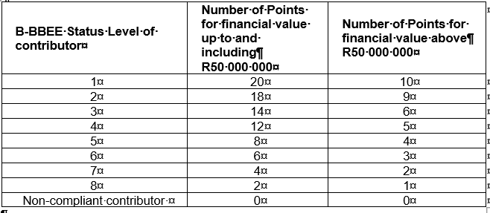
TENDER DATA
C.3.11 (continued) | Points out of 10 for preference awarded will be according to a tenderer’s B-BBEE status level of contributor and summarised in the table below:

Slide 32
TENDER DATA
C.3.11 (cont) | Eligibility for B-BEE points is subject to the following conditions:
Eligibility for B-BEE points is subject to the following conditions:
A tenderer’s scorecard shall be a B-BBEE Certificate issued in accordance with:
The amended Codes of Good Practice published in Notice 303 of 2019 of Government Gazette No. 42496 issued on 31 May 2019 by the Department of Trade and Industry: or
the amended Construction Sector Codes published in Notice 931 of 2017 of Government Gazette No. 41287 on 1 December 2017 by the Department of Trade and Industry. If Measured Entity operates in more than one sector or sub-sector, the scorecard for the sector or sub-sector in which the majority of its core activities (measured in terms of Annual Revenue) are located will be acceptable; or
The Information and Communication Technology (ICT) Sector Codes (Government Gazette No. 40407); or
The Financial Sector (Government Gazette No. 35914); or
The Integrated Transport Sector Codes (Government Gazette No. 23511).

Slide 33
TENDER DATA
C.3.11 (cont) | The scorecard shall be submitted as a certificate attached to Returnable Schedule Form C1; and 3. The certificate shall: be valid at the tender closing date; and have been issued by a verification agency accredited by the South African National Accreditation System (SANAS); or be in the form of a sworn affidavit or a certificate issued by the Companies and Intellectual Property Commission in the case of an Exempted Micro Enterprise (EME) with a total annual revenue of less than R3 million if issued in accordance with the amended Construction Sector Codes published in Notice 931 of 2017 of Government Gazette No. 41287 on 1 December 2017 by the Department of Trade and Industry; and have a date of issue less than 12 (twelve) months prior to the original advertised tender closing date (see Tender Data C.2.15); and

Slide 34
TENDER DATA
C.3.11 (cont) | 4. A valid BBBEE Certificates shall contain: Name of enterprise as per enterprise registration documents issued by CIPC, and enterprise business address. Value-Added Tax number, where applicable. The B-BBEE Scorecard against which the certificate is issued, indicating all elements and scores achieved for each element. The actual score achieved must be linked to the total points as per the relevant Codes. B-BBEE status with corresponding procurement recognition level. The relevant Codes used to issue the B-BBEE verification certificate. Date of issue and expiry (e.g. 9 June 2018 to 8 June 2019). Where a measured entity was subjected to a re-verification process, due to material change, the B-BBEE Verification Certificate must reflect the initial date of issue, date of re-issue and the initial date of expiry. Re-verification does not extend the lifespan of the B-BBEE Verification Certificate. Financial period which was used to issue the B-BBEE Verification Certificate.

Slide 35
TENDER DATA
C.3.11 (cont) | 5. A valid Sworn Affidavit shall contain: - Name/s of deponent as they appear in the identity document and the identity number. - Designation of the deponent as either the director, owner or member must be indicated in order to know that person is duly authorized to depose of an affidavit. - Name of enterprise as per enterprise registration documents issued by the CIPC, where applicable, and enterprise business address. - Percentage black ownership, black female ownership and whether they fall within a designated group. - Indicate total revenue for the year under review and whether it is based on audited financial statements or management accounts. - Financial year-end as per the enterprise’s registration documents, which was used to determine the total revenue. The valid format of the Financial Year-End is Day/Month/Year - B-BBEE status level. An enterprise can only have one status level. - Date deponent signed and date of Commissioner of Oath must be the same. - Commissioner of Oath cannot be an employee or ex officio of the enterprise because, a person cannot by law, commission a sworn affidavit in which they have an interest, and .

Slide 36
TENDER DATA
C.3.11 (cont) | Compliance with any other information requested to be attached to Returnable Schedule Form C1; and In the event of a Joint Venture (JV), a project-specific consolidated (SANRAL project number indicated) valid B-BBEE verification certificate in the name of the JV, issued by a verification agency accredited by the South African National Accreditation System (SANAS) shall be submitted. Sub-Regulation 6(5) and 7(5) If the tender documents indicate that the tenderer intends subcontracting more than 25% of the value of the contract to any other person not qualifying for at least the status level that the tenderer qualifies for, 0 (zero) points for preference shall be awarded, unless the intended subcontractor is an EME that has the capability to execute the subcontract and the value of the work is below the EME threshold.

Slide 37
TENDER DATA
C.3.11 (cont) | Criteria for breaking deadlock If two or more tenders score the same number of points and these tenders are also the highest ranked tenders, the tender with the highest preference points will be recommended for award. If functionality is part of the evaluation process and two or more tenders score equal total points and equal preference points, the tender that scored the highest points for functionality will be recommended for award. If two or more tenders score the same number of financial points and preference points and these tenders are also the highest ranked tenders, the tenderer to be recommended for award will be decided by the drawing of lots.

Slide 38
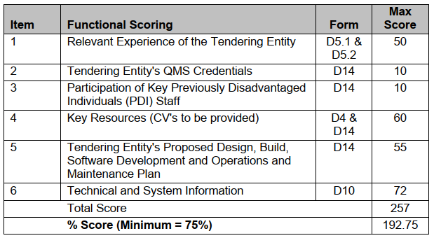
TENDER DATA
C.3.11 (cont) | The quality criteria, maximum score and scoring mechanism in respect of each of the criteria are as follows: A quality scoring is as follows:

Slide 39
TENDER DATA
C3.13 | Acceptance of a tender offer The conditions stated in clauses C.3.13(a) to ((f) of the Conditions of Tender as well as the following additional clauses C.3.13(g) to (k) shall be applied as objective criteria in terms of section 2(1)(f) of the Preferential Procurement Policy Framework Act, 2000 and as compelling and justifiable reasons in the evaluation under Conditions of Tender clause C.3.11: the Tenderer or any of its directors is not listed on the Register of Tender Defaulters in terms of the Prevention and Combating of Corrupt Activities Act of 2004 as a person prohibited from doing business with the public sector; the Tenderer has not abused the Employer’s supply chain management system; the Tenderer has not failed to perform on any previous contract and has not been given a written notice to this effect; and the Tenderer is tax compliant. The recommended Tenderer who becomes non-compliant, prior to award, shall be notified and must become compliant within 7 working days of the date of being notified. A recommended Tenderer who remains non-compliant after the 7 working days of being notified, shall be declared non-responsive. the Tenderer is registered and in good standing with the compensation fund or with a licensed compensation insurer. The licensed compensation insurer shall be approved by Department of Labour in terms of Section 80 of the Compensation for Injury and Disease Act, 1993 (Act No. 130 of 1993).

Slide 40
TENDER DATA
C.3.13 (continued) | In addition to the requirements under paragraph (b) of the Conditions of Tender, in the event that a due diligence is performed as part of the tender evaluation, the due diligence report will be used to evaluate the tenderer’s ability to perform the contract as stated in paragraph (b). The due diligence will evaluate the overall risk associated with the tender. The due diligence will take into consideration the following: - Assessment of financial statements to assess the financial position of the tenderer and its ability to obtain the necessary guarantees or insurances, - Evaluation of managerial and technical ability & available resources in relation to the proposed tender, - Integrity Risk Evaluation, - Operations, Activities, Locations and Key Customers, - Reference checks from previous clients, and - Risk rating (i.e. High Risk, Medium to High risk, Medium risk or Low risk) of the tenderer In order to assess technical ability, the Tenderer shall be requested to provide the following quantities of work completed satisfactorily and certified by the Engineer to demonstrate capacity and capability in relation to the proposed tender:

Slide 41
TENDER DATA
C.3.16 | Registration of the award SANRAL will notify unsuccessful tenderers when the tender process has been concluded. Any unsuccessful tenderer may request a debriefing in writing as specified in clause C.3.19.
C.3.17 | The Employer will provide 1 (one) signed contract document to the Service Provider
C.3.18 | All requests shall be in writing.
Additional conditions of tender clauses:
SC.3.19 | Jurisdiction Unless stated otherwise in the Tender Data, each tenderer and the Employer undertake to accept the jurisdiction of the law courts of the Republic of South Africa.

Slide 42
2. TENDERING PROCEDURES
PART T2: RETURNABLE SCHEDULES

Slide 43
PART T2: RETURNABLE SCHEDULES
Notes to tenderer:
1. Returnable schedules are separated into the following categories:
i) Forms, certificates and schedules for completion by the tenderer for use in the quantitative and qualitative evaluation of the tender (Forms A-E).
ii) A list of all returnable documents for completion by the tenderer (Form F1)
Failure to submit fully completed relevant returnable documents may render such a tender offer non-responsive.
Signatures in each returnable form represents a declaration that the Tenderer vouch for the accuracy and correctness of the information provided.
In event of wilful misrepresentation by a Tenderer:
The Employer will request a representation within 14 days why the tenderer should not be disqualified and reported to NT for restriction for a period not exceeding 10 years or
The Employer has the discretionary right under FIDIC Particular Condition 15.2(g) to terminate the contract.
5. These forms must be completed in non-erasable ink and any alterations made prior to tender closure countersigned by an authorised signatory.

Slide 44
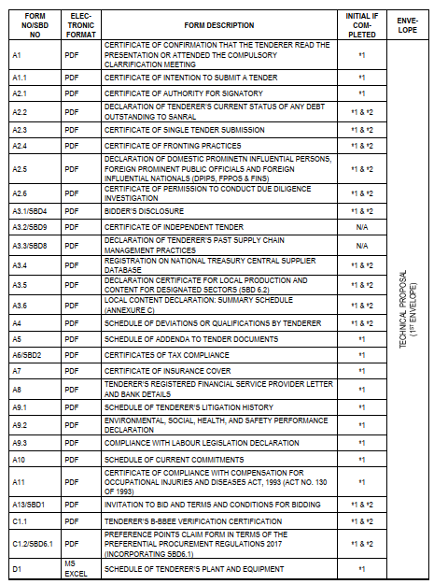
T.2.1 LIST OF RETURNABLE SCHEDULES

Slide 45
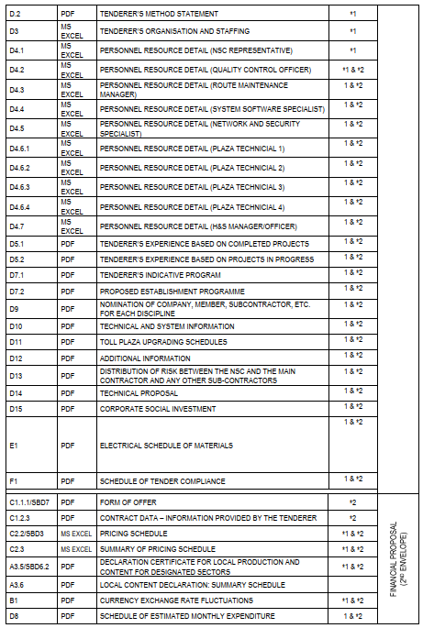
T.2.1 LIST OF RETURNABLE SCHEDULES - Cont

Slide 46
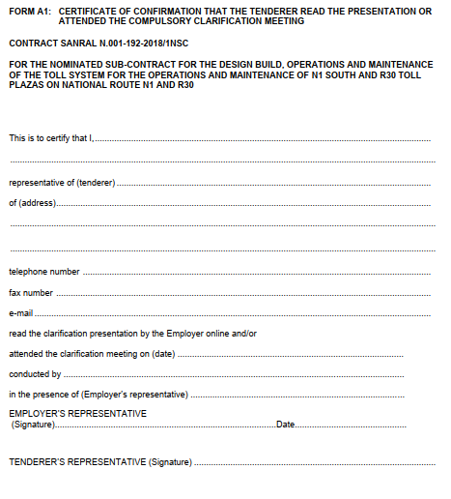
RETURNABLE SCHEDULE
FORM A1
CERTIFICATE CONFIRMING THAT THE TENDERER ATTENDED THE TENDER
CLARIFICATION MEETING

Slide 47
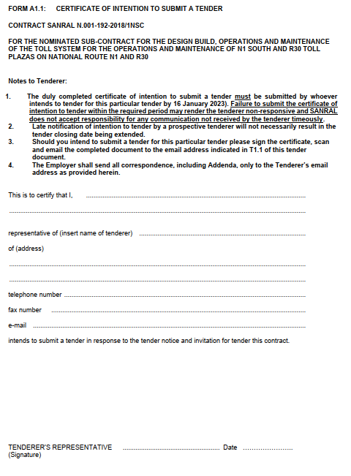
RETURNABLE SCHEDULE
FORM A1.1
CERTIFICATE OF INTENTION TO SUBMIT A TENDER

Slide 48
FORM A2.1: CERTIFICATE OF AUTHORITY FOR SIGNATORY
The signatory for the tenderer shall confirm his/her authority thereto by attaching on the tendering company’s letterhead a duly signed and dated copy of the relevant resolution of the board of directors/partners
2. In the event of a joint venture, a certificate is required from each member of the JV clearly setting out:
- authority for signatory,
- undertaking to formally enter into a joint venture contract should an award be made to the joint venture,
- name of designated lead member of the intended joint venture, as required by tender condition C.2.13.2.
3. The resolution in form A2.1 is given as an example of an acceptable format for authorisation, but submission of this page with the example completed shall not be accepted as authorisation of the tenderer’s signatory.

Slide 49
TYPICAL ERRORS IN PREVIOUS SUBMISSIONS
BOQ in Excel format not included either in the original or Copy.
Completed or in progress Projects are not meeting minimum value required or not of similar scope
Form A8 Letter from Financial Service provider is not project specific or older than three months
Key Personnel do not meet minimum requirements.
BBBEE Score Cards (non complaint will result in a none responsive offer).
Separate scorecards for JV submissions
Joint Venture score cards which are not project specific
Do not ZIP files to the Flash drive. Do not PASSWORD PROTECT files to the Flash drive.
Check contents of your Flash drive before submitting the tender.

Slide 50
4. PROJECT DETAILS - DESCRIPTION OF WORKS (CONSULTANT)

Slide 51
THANK YOU

