Slide 1
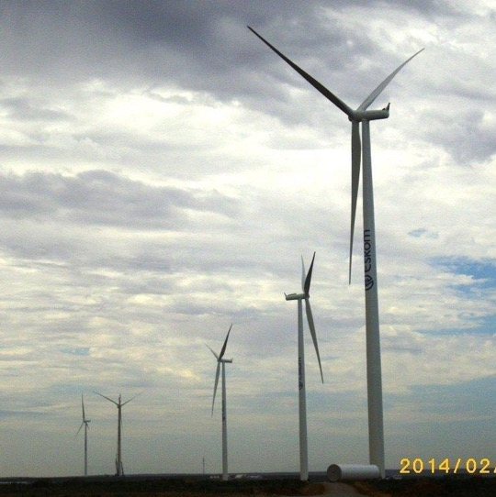
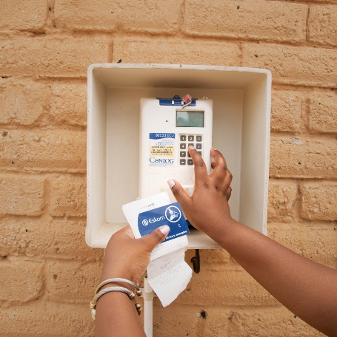
THE PROVISION OF PROFESSIONAL SERVICES ENABLEMENT PROVIDER FOR A PERIOD OF 6 YEARS
Non-Compulsory Tender Clarification Meeting
Virtual Meeting – MS Teams
Martin Nndwammbi
29 August 2025

Slide 2
Agenda:
Description | Responsibility
1. Opening, Welcome and Apologies | Chair
2. Health and Safety: Evacuation procedure | Andile Ngidi
3. Introduction of Eskom Representatives & Tenderers | All
4. Purpose of the session | Chair
5. Acceptance of Agenda | Chair/Team
6.1. Technical | Abigail Booth
6.2. Safety Health and Environmental (SHE) | Andile Ngidi
6.3. Quality | Pierre Coulson/Lungisani Xaba
6.4. Supplier Development & Localization (SD&L) | Gabriel Mkhonza
6.5. Finance spreadsheet/Pricing | Tebogo Jempe
 | Michael Ndima
 | Takalani Singo
6.6. Commercial | Chair
7. Question and answers | All
8. General | All
Closure

Slide 3
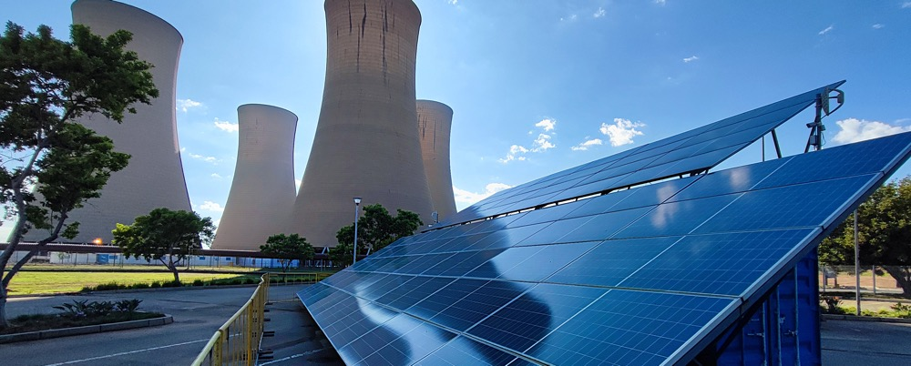
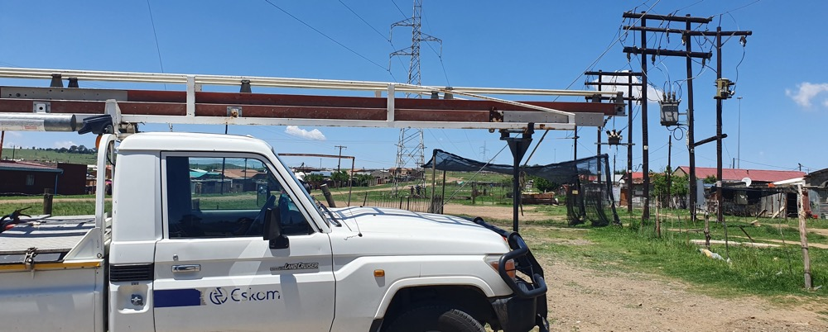
SAFETY TALK

Slide 4
Purpose of The Session:
The purpose of the session is to guide tenderers on how to respond to the enquiry by:
Providing a high level understanding and clarity of Eskom’s tendering requirements;
Providing response to the clarification questions already received from tenderers and
Providing a forum for Q & A.

Slide 5
Commercial Requirements Tender Clarification
Presented by: Martin Nndwammbi

Slide 6
Invitation to Tender (ITT) / Request for Proposal (RFP) Commercial Process
RFP ISSUE TO
OPEN MARKET
Tender Bulletin, CIDB iTender &
NT eTendering portals
NON-COMPULSORY TENDER CLARIFICATION & COMPULSORY SITE MEETING
TENDER CLOSING
TENDER EVALUATIONS
(Main & Alt tenders)
CONTRACT EXECUTION
CONTRACT AWARD
NEGOTIATIONS
INTERNAL & EXTERNAL GOVERNANCE AND APPROVALS

Slide 7
Eskom’s Standard Conditions of Tender
Parties
The Employer, the Eskom Representative and each eligible tenderer submitting a tender shall act timeously, ethically and in a manner which is fair, equitable, transparent, competitive and cost-effective.
Eskom's rights to accept or reject any tender
Eskom may accept or reject any variation, deviation, tender, or alternative tender, and may cancel the tender process and reject all tenders at any time prior to the formation of a contract. Eskom or the Eskom Representative will not accept or incur any liability to a tenderer for such cancellation and rejection but will give written reasons for the action upon written request to do so. Eskom reserves the right to accept the whole of any part of any tender.
Cost of tendering
Accept that Eskom will not compensate the tenderer for any costs incurred in the preparation and submission of a tender, or the negotiation of any contract, including the costs of any testing necessary to demonstrate that aspects of the tender satisfy the evaluation criteria.

Slide 8
Eskom’s Standard Conditions of Tender Cont…
Eskom’s right to negotiate
Eskom reserves the right to enter into mandated negotiations with any one or more selected tenderer(s) in accordance with Eskom’s approved procurement policies and procedures.
A contract may not be awarded to the tenderer who does not meet all contractual requirements.
After the cancellation of the tender process or the rejection of all tenders Eskom may abandon the proposed work and services, have it performed in any other manner, or re-issue a similar invitation to tender at any time.
Eskom’s right to exclude any tenderer should a tenderer’s participation in the tendering process cause Eskom to suffer any reputational damages.

Slide 9
Eskom’s Standard Conditions of Tender Cont…
The following guidelines are to be observed when putting together the bid.
The response to the mandatory and functional criteria are to be separated and clearly marked.
The bid documentation contents is to indexed as per criteria numbering.
Each entry in the contents page must include a hyperlink to its respective section.
All images used must be readable and in context.
When reference is made to cost of a project, indicate the total cost of project and the cost of your respective portion of said project.
Where explanations are required, the explanations must be concise
All references quoted must be relevant to the scope.
When referring to past projects, prior to going into detail, include a table that mentions the project, date completed, cost and scope.
When providing years of experience for dedicated staff, A summary table is to be included to indicate, name, position, years of experience and as total average years of experience.
If there is not information provided for a given criteria then the score will be 0 for that particular criteria.

Slide 10
Eskom’s Standard Conditions of Tender Cont…
Tenderers are Eligible to submit a tender if: See Clause 2.1-Eligibility, of the Tender Data. (Page 7).
The tenderer (whether a single company or a structure similar to a Joint Venture) complies with the eligibility criteria stated in the Tender Data and the tenderer, or any of his principals, is not under any restriction to do business with Eskom/State Owned Companies, does not have the nationality of a country on any international sanctions list, is not is a restricted tenderer by National Treasury. See Clause 2.1 of the Tender Data.
A tenderer must not have a conflict of interest.
Tenderers must be registered on National Treasury CSD (except Foreign Suppliers)
The proposal shall be submitted in English Language and all correspondence would be in the same language.

Slide 11
APPLICATION FOR A TAX CLEARANCE – FOREIGN SUPPLIERS
PROCESS
The following process is prescribed by SARS to obtain tax clearance for a foreign supplier:
1. Eskom must complete the “BIDDING PROCEDURE ENQUIRIES MAY BE DIRECTED TO” and “TECHNICAL ENQUIRIES MAY BE DIRECTED TO” sections of the SBD1 Form.(Annexure H of the RFP).
2. Once the SBD1 Form is fully completed and signed by the supplier, Eskom must email it to: GovernmentInstitute@sars.gov.za
3. SARS will then issue a letter to Eskom confirming whether the foreign supplier is liable to be registered for tax in South Africa. SARS has advised that the turnaround time is 21 working days.

Slide 12
ITT / RFP Process and Evaluation Criteria
Tender Closing Date: 12 Sept 2025 at 10h00am SA Time.
Evaluation Methodology and Criteria:
A four-step evaluation process is applicable and will be conducted as follows ( in terms of PPPFA)
1. Basic Compliance ( List of all Returnable Documents) Clause 3.9 (Page 8)
Mandatory Requirements ( Disqualifiable) Page 14-19
2. Functionality/ Technical Evaluations; Page 14-19
3. Price & preference points 90/10 overall; Page 14-19
Price 90% and Specific goals/ Preference points/ B-BBEE Certificate 10%
4. Contractual Requirements. Page 14-19

Slide 13
ITT / RFP Process - Overview
Tenderers are advised to visit Eskom website and NT eTendering Portal ON A DAILY basis for updated information / addenda. Tender notification will be placed as and when new information is loaded on the tender bulletin indicating the date and document number;
Last date to submit clarifications: (5) working days before the deadline for tender submission;
Ensure clarification requests are clear and concise to enable Eskom to provide a comprehensive response;
Please indicate if the question posed is unique to your proposal (confidential); The questions and responses will be shared with everyone who attended the compulsory Site Visit and loaded on the NT e-Tender and Eskom Bulletin.
The deadline for tender submission is 10:00 AM (GMT+02:00) Harare, Pretoria (as per the Telkom signal) on 12 Sept 2025; and
Tender Validity: is 3 (three) months from Tender closing Date.

Slide 14
ITT / RFP Process - Overview Cont…
The deadline for the submission of Tenders is: Date: 12 Sept 2025 Time: 10h00 (South African Standard Time) Late Tenders will not be accepted Tenders are uploaded via Eskom Tender bulletin site on the Eskom E- tendering page using the below kink; https://etendering.eskom.co.za Please note it is the responsibility of the supplier to ensure that the tender is submitted before the closing time. Electronic Tender Submissions The tenderer must upload the tender via Eskom Tender bulletin site on the Eskom E- tendering page. The documents need to be uploaded under the folder Technical, Commercial, Financial, and other. All documents need to be submitted in a PDF and Excel format (The limit is 50MB per file and total submission of 900MB per submissions). The price list needs to be submitted in PDF and a copy in excel format. No Zip/condense files can be uploaded No hard copy will be accepted If for some reason you resubmit your tender, then the latest version of the tender submitted will only be accepted and all previous submission/s will be null and void. Please ensure that the submission status is indicated as complete. Supplier Help Manual guide and video can be found on Eskom E-Tendering page.

Slide 15

ITT / RFP Process
Response Format 2/2
Alternative tenders are not ALLOWED.
i.e Where more that one tender submission is received under the same supplier/ consultant name, this will be recorded
Note: if tender submissions are not substantially the same or are of the same date and where alternative tenders are NOT ALLOWED then none of the tender submissions will be considered and both will be rejected as non–responsive.
If Tender submission are substantially the same, the latest dated one will be presumed to replace the earlier dated submission.
Notes:
C3 List of Eskom Policies and Procedures related to the Tender, does not form part of the tender returnables, unless otherwise stated

Slide 16
ITT / RFP Process
Response Format 2/3
The Tender must be indexed and structured for any tender into the bellow separate sections namely:
1. Commercial (As per Commercial Tender Returnable) Page 14-19.
2.Technical (As per Technical Tender Returnable)Appendix A and A1
3. Finance (As per Finance Price Schedule Returnable) Appendix B
4. SD & L (As per SD & L Tender Returnable) Appendix C
5. SAFETY AND HEALTH (As per SHE Tender Returnable) Appendix D
6. Quality (As per Quality Tender Returnable). Appendix E
7. Environment (As per Environmental Tender Returnable) Appendix F
Note: The documents are supplied free of charge. Can be downloaded by visiting www.eskom.co.za; Eskom Tender Bulletin.
Notes:
C3 List of Eskom Policies and Procedures related to the Tender, does not form part of the tender returnables, unless otherwise stated

Slide 17

ITT/RFP Process - Communication
One point of communication between Eskom and tenderer
es
The Eskom Representative is :
  Name: Mr. Martin Nndwammbi
  Address: Megawatt Park, Maxwell Drive, Sunninghill
  Tel: +27 11 800 5234
  E-mail: Nndwamtm@eskom.co.za
  All communication / clarifications in writing and in the English language to: Nndwamtm@eskom.co.za

Slide 18
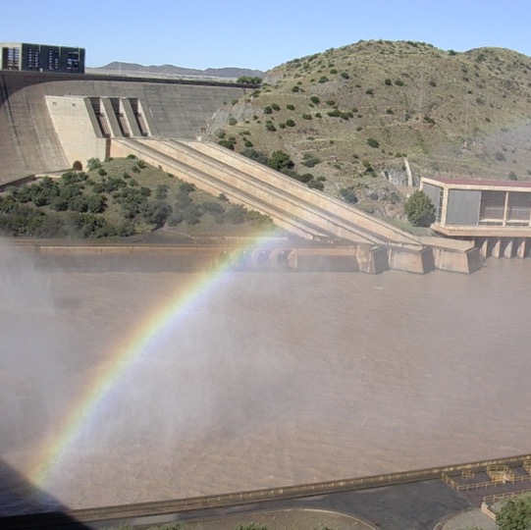

Conclusion

