Slide 1

NON-COMPULSORY BRIEFING SESSION: TEN0000000043/GTAC 009-2025-26
For the establishment of a Technical Advisory Hub Panel of Technical Advisors for a period of 5 years
16 July 2025, 10:00 - 12:00

Slide 2

Context and Strategic Shift
Previously: Long-term advisors through direct appointments
Now: New resourcing model using a flexible panel
Purpose: Assemble project-specific teams from the panel
Importance: Key enabler for GTAC's Technical Advisory Hub

Slide 3
Purpose of the Tender
Establish a panel of experienced technical advisors
Support GTAC’s Technical Advisory Hub over a 5-year period
Framework agreement contracts will be entered into
Contract advisors on a per-assignment basis using Instructions to Perform Work (IPW)

Slide 4
Panel Scope and Duration
Framework Agreement: 5 years
12 advisory categories (some with sub-categories)
Panel includes Tier I and Tier II advisors
Scope detailed in the Terms of Reference (ToR)

Slide 5
Tier Structure
Tier I (Senior Advisors): ≥12 years – Lead and manage assignments
Tier II (Advisors/Analysts): ≥10 years – Provide support under guidance
Some categories require only Tier I, some Tier II, others both

Slide 6
Admin Support to Tier I Senior Advisors
No technical experience required; no CV submission needed
Fully managed by the Senior Advisor
Provides logistical and project support such as:
    Organising meetings and interviews
    Basic administration and record keeping
    Data collection and preliminary research
    Drafting presentations
If the Senior Advisor undertakes these tasks themselves, the admin rate will apply

Slide 7
Categories of Required Services
Organisational Design and Development
Governance, Policy and Legal Advice
Procurement Advice
Change Management
Process Facilitation
Comprehensive Spending Reviews
Spending Review Capacity Building
Data and Statistical Analysis
ICT, Systems Development and Business Processes
Economics and Public Finance
Programme Management
Monitoring and Evaluation

Slide 8
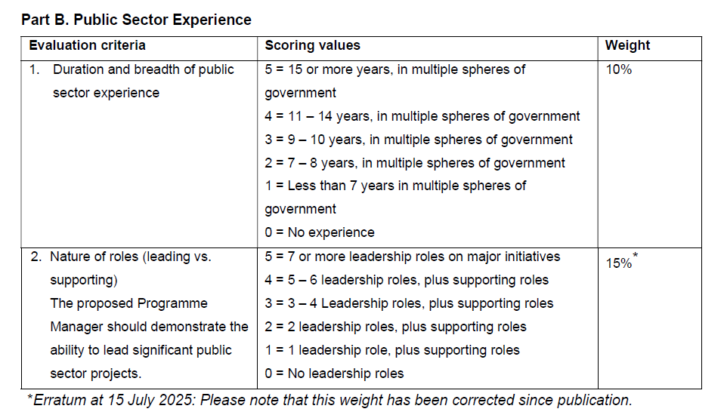
Important Correction – Erratum Category 11

Slide 9
e-Procurement Submission Guidelines
Start early – system requires detailed inputs
Please save your progress regularly to avoid data loss
Bidders may return to the system multiple times to complete different sections at their convenience
It is not necessary to complete the fields in a strict sequential order
Only attach required documents: Qualifications, SAQA accreditation (for international qualifications), CV declaration consent form, SBD 1
Submit max 3 CVs per category per bidder (only the first 3 CVs per category per bidder will be evaluated)

Slide 10
Key Reminders
Review ToR for category requirements
Please note Erratum Category 11
Ensure CV information is complete and relevant

