Slide 1
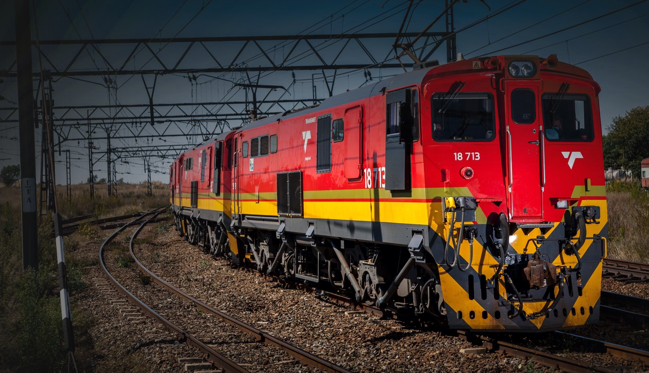
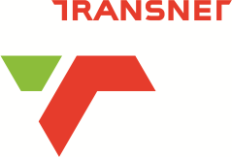
HOAC-HO-HOAC-HO-38741
RFP TRUCKS FOR THE TRANSPORTATION OF ESKOM’S CONTAINERISED COAL FROM THE GROOTVLEI CONTAINER TERMINAL TO THE ESKOM FOR A PERIOD OF THREE MONTHS
ISSUE DATE : 04 OCTOBER 2022
CLOSING DATE :18 OCTOBER 2022
BID CLARIFICATION : 10 OCTOBER 2022
1

Slide 2
HOAC HO 37443 TENDER DESCRIPTION
THE TENDER SHALL MAKE PROVISION TO:
The closing date for questions/bid clarifications is on the 10 October 2022.
Questions/bid clarifications prior to the closing of the RFP must be channeled through Gladys Mtambo via e-mail:- Gladys.mtambo@transnet.net;
Response to questions/bid clarifications will be sent to all Respondents.
Proposals must be submitted in duplicates, one original and one copy.
The RFP closes punctually at 10:00 on Tuesday 18 October2022.
Respondents must ensure all the required returnable documents are submitted with their proposals – Section 2: RETURNABLE DOCUMENTS NB: Mandatory and Essential documents page (29, 30 & 31 of the RFP)

Slide 3
Mandatory documents
  SECTION 4: Quotation form
  SECTION 1 : SBDI Form
  ANNEXURE G: Technical Submission/Questionnaire
  Proof of CSD

Slide 4
EVALUATION METHODOLOGY
6.1 Transnet will utilise the following methodology and criteria in selecting a preferred Service provider:
NB: Evaluation of the various stages will normally take place in a sequential manner. However, in order to expedite the process, Transnet reserves the right to conduct the different steps of the evaluation process in parallel. In such instances the evaluation of bidders at any given stage must not be interpreted to mean that bidders have necessarily passed any previous stage(s).
1
Transnet will utilise the following methodology and criteria in selecting a preferred Service provider:
Transnet will utilize the following methodology and criteria in selecting a preferred Supplier
STAGE 1:
TEST FOR RESPONSIVENESS
STAGE 2
STAGE 3
Step 1
Step 2
Step 3
Step 4
Step 5
Step 6
Step 7
Administrative responsiveness
Substantive responsiveness
MINIMUM THRESHOLDS
Weighted scoring / 100***
Returnable documents/ schedules
Functionality/ technical
70 points
Minimum Threshold
Pre-qualification
Post tender negotiation with preferred bidder [2nd and 3rd ranked bidders (if required) in a sequential and not simultaneous manner] if pricing is not market-related
Selection of the preferred bidder.
(Objective criterion to justify award to someone other than the highest ranked bidder must have been stated in the bid documents and can be used at this stage, if applicable)
Price (80)
B-BBEE scorecard (20)
Award of business and conclusion of contract
Step 2: Preferential Procurement prequalification criteria that only one or more of the following may participate:
WEIGHTED SCORE
Technical Pre-qualification Criteria/minimum requirements:
-BBBEE Level 4 or better
Technical / Functional criteria & weightings must be stipulated in the tender document

Slide 5
BACKGROUND
Eskom, the state-owned power utility, is the primary base load power producer and distributor in South Africa. This power is generated mainly from fossil fuels namely coal, totalling an annual 88m metric tonnes. Historically the power stations were constructed in close proximity to coal mines supplying coal to the power stations with overland conveyor systems being the primary method of transporting coal from the mine to the power station stockyards. Over recent years, the sources of coal supply to power stations have changed, resulting in a modal shift of transportation for several power stations to predominantly road. Although conveyors are still the major transporter, approximately 36Mtpa is currently transported by road, 3Mtpa by rail and the rest by conveyor system.
An important centre of Eskom’s power production lies in the coal fields of Mpumalanga where nine coal-fired power stations have been constructed. Three power stations, namely Camden, Grootvlei and Komati were decommissioned in the late 1980’s. Due to the country’s increased demand for electricity, Eskom re-commissioned these stations on a short term and bring them back into operation and has now recently further extended their operations. It is estimated that a total of 32Mtpa of coal will be supplied by rail to five power stations in the area, namely Majuba, Camden, Tutuka Grootvlei and Hendrina.
The high tonnages of Eskom coal on the national and provincial roads are highly problematic to the South African community in terms of environmental impact and physical degradation of the road network. The Government, and in particular the Department of Public Enterprises, as the sole shareholder of Transnet and Eskom, has a social responsibility to move bulk and heavy products by rail, thereby easing the congestion on the South African road network, reducing the rapid deterioration of roads, and reducing the carbon emission levels generated through the road transportation of products from production areas to destinations.

Slide 6
BACKGROUND
For these reasons the government has made a strategic decision, requesting Eskom and Transnet Freight Rail, as the major stakeholders, to provide a joint strategy for the migration of at least 80% of coal tonnages, totalling 32Mtpa, from road to rail.
Transnet Freight Rail, the largest freight moving company in South Africa, wholly owned by RSA government has managed to generate significant rail volumes through its route-to-market capabilities created for customers to mass evacuate bulk commodities from origin to destination in domestic, reginal, and international flows. This growth in rail volumes has been achieved through the introduction of supply chain solutions that create value to customers and give them competitive advantages.
An opportunity exists to sustain the existing containerised business by increasing the transportation of Eskom’s coal, in open-top containers from coal mines to power stations in line with the 10-year demand file projections and commitments.

Slide 7
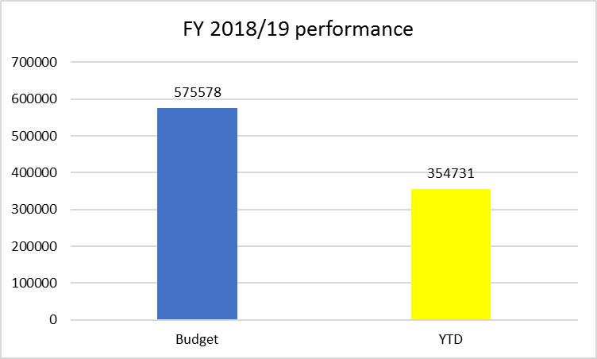
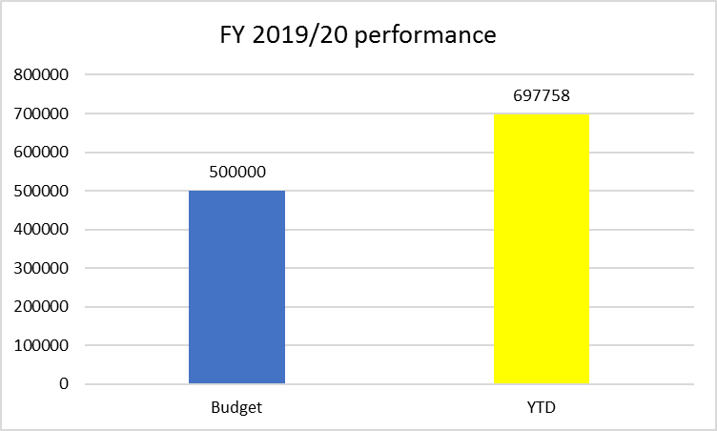
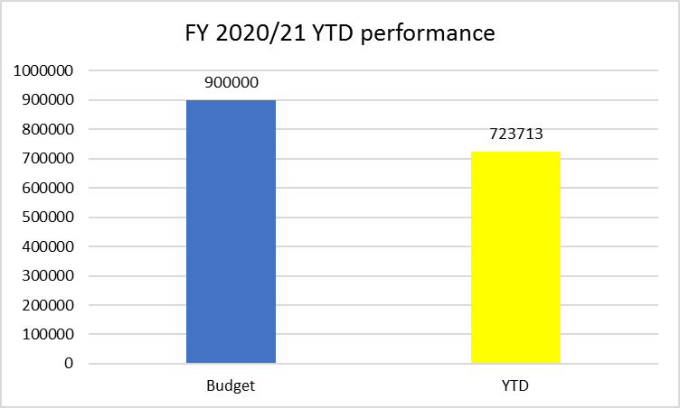
Operational performance
TFR delivers 7 trains a week on average
11 trains is highest number of trains delivered in a week (achieved for 4 weeks in FY2020/21)
Eskom’s weekly demand has been 14 trains per week. TFR only managed to achieve up to the maximum of 11 trains per week(44 wagons train)
Operational challenges that prevents TFR from meeting Eskom’s demand will be mentioned in this report

Slide 8
Offloading siding
Major issues - Hard Surface problems
1. Reduced capacity for offloading wagons due to deteriorating surface
2. Slow movement of vehicles and damage to vehicles due to bad surface conditions
3. TFR Northcor Operations has not made funds available for maintenance. RME quotation for maintenance of the surface was not signed
Major issues – Lighting solution for night working
5. The project for installation of permanent power supply to enable night time working has not started
6. Lights have not been fixed and handed over to Heidelberg maintenance depot

Slide 9

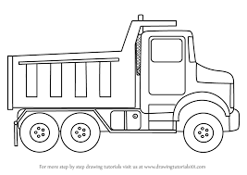
Operating model
The service was designed to run 50 x wagon container trains from Arbor loading siding to Grootvlei terminal (206km of rail leg)
Reach stackers are used for offloading of loaded containers to the road trucks at Grootvlei terminal
The offloaded containers are road hauled from the Grootvlei terminal to Grootvlei power station.
Departure | Destination | Crew | Locomotives | Wagons
Arbor | Clewer | Witbank | Diesel | 50
Clewer | Balfour | Welgedag | Electric | 50
Balfour | Grootvlei | Balfour | Diesel (RDP) | 50
Forfar siding
Witbank
NB: 42 wagons are currently being offloaded due to surface problems at Grootvlei terminal
Welgedatcht
Ogies
Grootvlei Power Station
Balfour
Grootvlei terminal

Slide 10
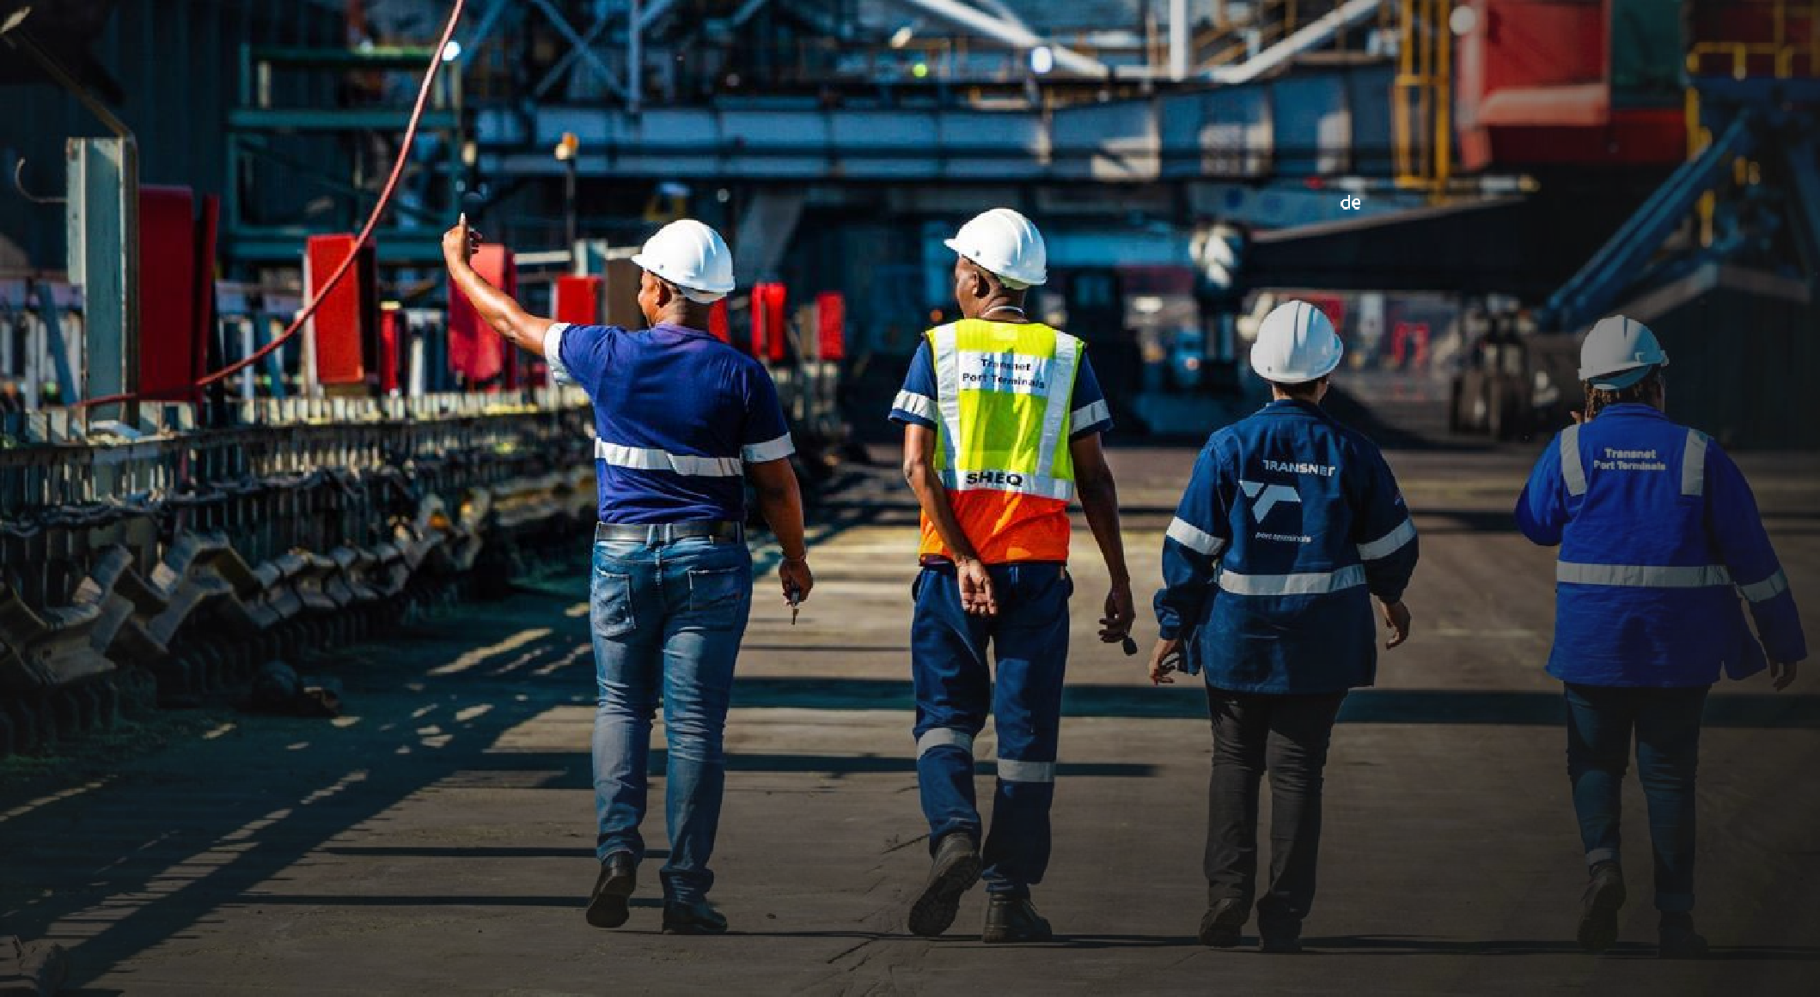
THANK YOU
7

