Slide 1
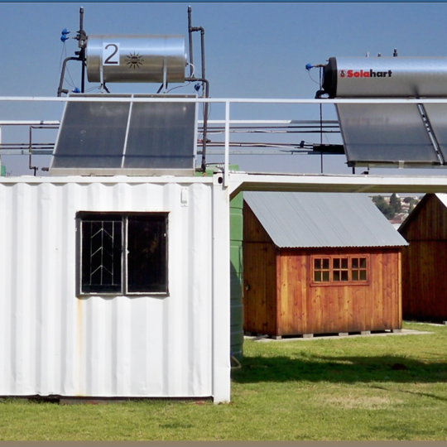
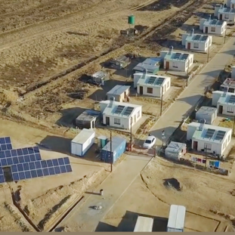
Waste to Energy Test Facility: Clarification Meeting
18 August 2026

Slide 2
Content
Location
Scope – Functional
Scope – Contractors
Tender Evaluation
Request for proposals for the design, supply, construction and commissioning of a 50-100kW thermal Waste to Energy Test Facility

Slide 3
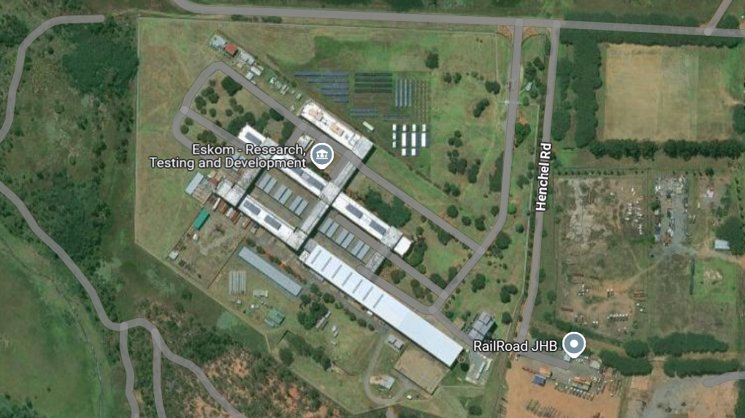
Location

Slide 4
Scope - Functional
The required thermal Waste to Energy Testing Facility shall:
Have a maximum thermal input of approximately 50 to 100 kW. This is dependent on the site evaluation.
Process different types of representative waste streams.
Evaluate combustion efficiency and thermal performance.
The designed and built plant must comply to meet environmental compliance.
Produce performance data for future scale-up.
Support research, development, and training activities.
Enable future modifications for alternative fuel and co-firing studies.
The facility shall be designed to accommodate the following feedstock composition:
  Wood, Paper, Cardboard, Nonrecyclable Plastic, Textile Rubber, Leather, biomass as well as coal.
The design shall include preprocessing, drying and feeding as well as flue gas cleaning equipment.
The design shall include consideration for combustion testing and emissions testing that incorporates direct injection sorbets for research purposes.
The design shall include flue-gas cleaning equipment with consideration of the feedstock and NEMA Act (National Environmental Management) requirements.
The design shall be in line with applicable South African National Standards (SANS).

Slide 5
Tender Document
Scope:
E3322CXMWP_Invitation to Tender_Waste to Energy Test Facility_04 August 2026
Tender Evaluation:
TECHNICAL EVALUATION CRITERIA
Costing:
Refer to NEC pricing option
NEC:
NEC ECC3_Waste_ to_Energy_EPC_Contract

Slide 6
Tender Evaluation: Mandatory Criteria
Mandatory Technical Evaluation Criteria (gatekeepers) are ‘must meet’ criteria. These criteria shall not be weighted, or point scored but shall be assessed on a Yes/No basis as to whether or not the criteria are met. An assessment of ‘No’ against any criterion shall technically disqualify the tenderer and shall not be further evaluated against Qualitative Criteria.
Ref | Mandatory Technical Criteria Description | Motivation for use of Criteria
1. | Ability to design and construct an integrated waste reception, drying/feed preparation, incineration, flue gas treatment, stack monitoring, instrumentation and data acquisition facility. | Technical proposal, process description, preliminary PFD, preliminary GA layout and equipment list.
2. | Compliance with applicable South African environmental, safety and engineering requirements including NEMA, relevant SANS requirements and Eskom site requirements. | Compliance matrix and proposed approach to statutory approvals, environmental compliance, occupational health and safety, and emissions management.

Slide 7
Tender Evaluation: Qualitative Criteria
Qualitative Technical Evaluation Criteria are weighted evaluation criteria used to identify the highest technically ranked tenderer after determining that all the Mandatory Evaluation Criteria have been met. The Qualitative Evaluation Criteria are weighted to reflect the relevant importance of each criterion. The minimum weighted final score (threshold) required for a tender to be considered from a technical perspective is 70%.
No. | Criteria | Weight
1. | Company experience and reference projects | 20 %
2. | Technical solution, methodology and design approach | 25 %
3. | Resource capability and key personnel | 20%
4. | Project programme and delivery capability | 15%
5. | Compliance, safety, quality and environmental Management | 10%
6. | Commissioning, performance testing, documentation and Training | 10%

Slide 8
Tender Evaluation: Qualitative Criteria
Ref | Criteria | Wt.
Company experience and reference projects
1. | Evidence of completed projects of similar complexity involving waste-toenergy, incineration, thermal treatment,combustion systems, flue gas treatment, pilot/test/commercial plants. Returnables must include project name, client, scope, value, start and completion dates, commissioning status and traceable references. | 20
Technical solution, methodology and design approach
2. | Assessment of proposed technical solution for the 50 to 100 kW test facility, including but not limited to waste reception, storage, drying/feed preparation, controlled incineration, flue gas treatment, stack/emissions monitoring, instrumentation, control and data acquisition. | 25
 | Resource capability and key personnel
3. | Relevant qualified and experienced personnel for civil/structural, mechanical, electrical, control and instrumentation, process/chemical engineering, project management, construction supervision, SHEQ an commissioning. CVs, statutory registrations where applicable and project roles must be provided. | 20
Project programme and delivery capability
4. | Detailed programme for design, procurement, construction, installation, commissioning, performance testing, documentation handover and training. The programme must identify critical path activities, interfaces, assumptions and key risks. | 15
Compliance, safety, quality and environmental Management
5. | Approach to statutory compliance, environmental management, emissions control, occupational health and safety, QA/QC, inspection and testing, risk management. | 10
 | Commissioning, performance testing, documentation and Training
6. | Commissioning plan, performance test procedure, acceptance criteria, operating and maintenance manuals/plans, training plan and post-commissioning support. | 10

Slide 9
Questions

