Slide 1
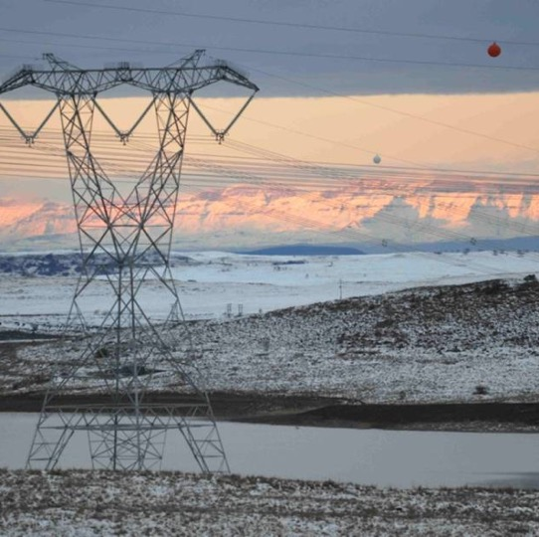

Cleaning Contract
Presented By: Tumi Shai
Date: 09 October 2025

Slide 2
Scope of work
THE PROVISION OF CLEANING SERVICE, PEST CONTROL, GARDENING AND HYGIENE SERVICE FOR THE BLOEMFONTEIN, WELKOM /SASOLBURG, EAST LONDON AND PORT ELIZABETH CLN’S WITHIN THE SOUTHERN GRID ON AND AS AND WHEN REQUIRED BASIS FOR A PERIOD OF 60 MONTHS.
The substations under Bloemfontein are as follows:
Harvard substation
Beta Substation
Perseus substation
Luckhoff substation
Merapi substation
Serumula substation
Boundary substation
The home centre is Harvard substation in Koppie Road, Bainsvlei.

Slide 3
Scope of work - continue
The substations under Welkom and Sasolburg CLN are as follows:
Everest substation
Theseus substation
Leander substation
Sorata substation
Makalu substation
Scafel substation
Lethabo substation
Mercury substation
The home centre is Leander substation on 01 Blemheim Avenue, Riebeec Stad, Welkom 9469.

Slide 4
Scope of work - continue
The substations under East London CLN are as follows:
Buffalo Substation
Delphi Substation
Neptune Substation
Pembroke Substation
Vuyani Substation
The home Centre is Palm Square Business Park, Birchwood House, Beacon Bay, East London, 5201
The substations under Port Elizabeth CLN are as follows
Poisedon substation
Dedisa substation/ Grassridge substation
The home Centre is c/o Langehoven & Cape Road, Port Elizabeth, 6057

Slide 5
Scope of work - continue
The Scope of Work entails keeping the workplace clean and tidy in the following respects:
Cleaning the kitchen areas
Cleaning the cookware in the kitchens
Cleaning the recreation areas
Cleaning the office areas
Cleaning of ablution units
Cleaning the windows
Cleaner Service (Full-time Cleaners; Weekend Cleaners)
Supply and Delivery of cleaning Hygiene Consumables
Once off installation of hygiene equipment’s (if required
The Contractor will provide hygiene services and inspect all hygiene equipment while performing their duties and report any defective or damaged hygiene equipment to the NTCSA
Once off installation of hygiene equipment’s (if required)
Pest control
Waste management

Slide 6
Scope of work - continue
Gardening
Sweeping the floors
Maintaining the garden
Cleaning the dust bins
The Contractor is responsible for delivering cleaning, gardening, hygiene, pest control, gardening and waste management services according to a predetermined frequency and responding to exceptional circumstances as directed by the Employer (Service Manager).
The Contractor shall provide all labour, administration and management, equipment, tools, supplies and material required to perform the gardening, cleaning, and pest services specified herein.
NB: THE EXACT SITES FOR THIS CONTRACT WILL BE CONFIRMED ON TASK ORDER STAGE.
Working times
Monday - Friday: 7:00am to 15:30pm
Saturday, Sunday and Public Holidays: 08:00am to 12:00pm (if required)
NTCSA reserves the right to instruct the Contractor to change working times based on business requirements

Slide 7
Technical Criteria

Slide 8
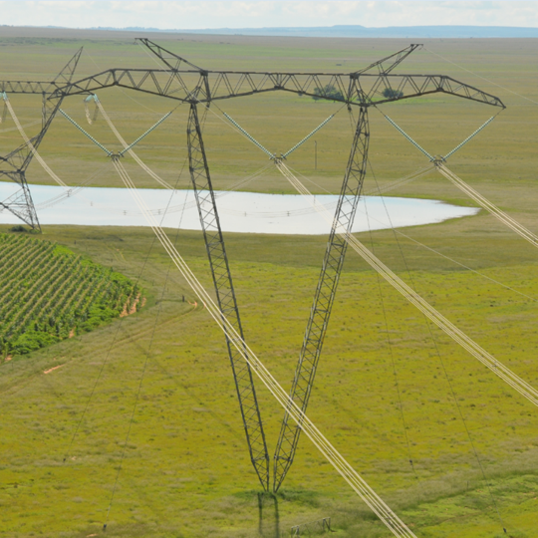
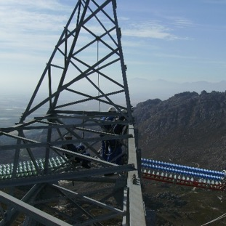
Conclusion

