Slide 1


eTendering : Supplier awareness

Slide 2



eTendering Solution for Formal Tendering - for high value items

Slide 3
Formal Tendering - for high value items
Purpose:
Developed for all Tender Offices nationwide for electronic receipt and management of tender documents (returnables).
Will eventually be replaced by Digital Procurement.
Key Features:
Web-based platform for suppliers to upload tender documents for tenders advertised on the Tender Bulletin system.
Replaces manual submission at Eskom tender offices.
Functions as an electronic tender box for document uploads.
Supplier Access:
Registration required before access is granted.
OTP verification via cell phone and email.
Benefits:
Paperless process – suppliers can submit tenders from anywhere.
Eliminates need for travel to Eskom offices or sites.

Slide 4
How to access Supplier videos

Slide 5
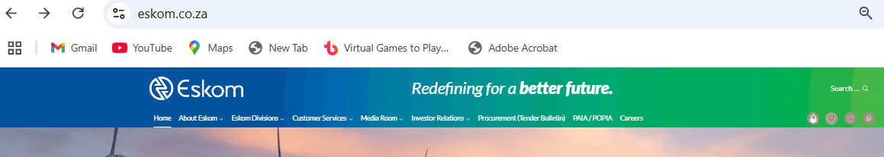
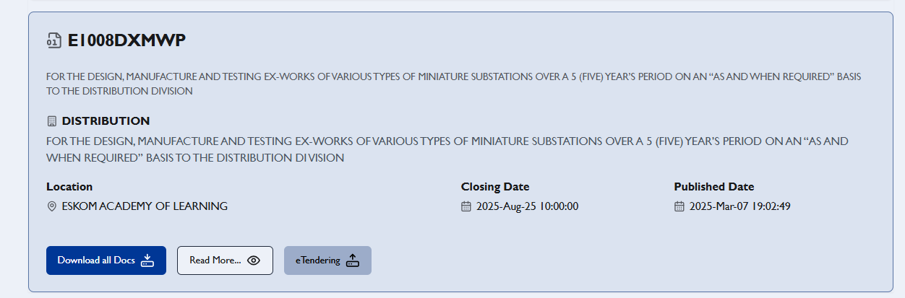
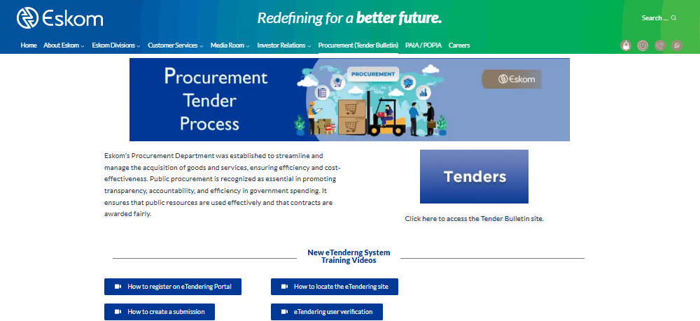
How to access the supplier video’s
2a
2b
1

Slide 6
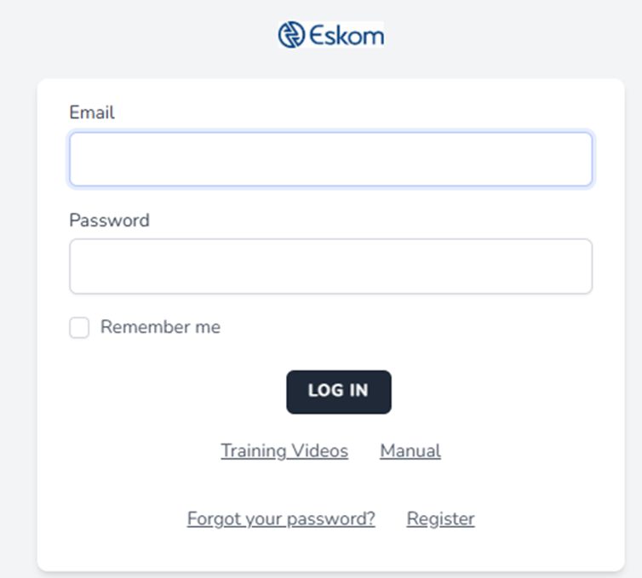
How to access supplier video’s, user manual and a bit more info
2 c

Slide 7
Visual of eTendering System

Slide 8
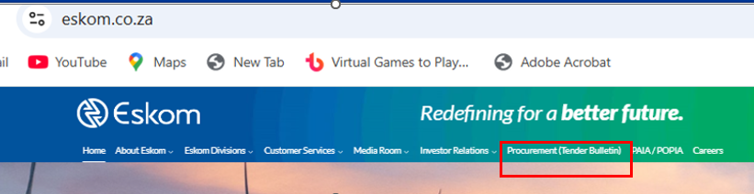
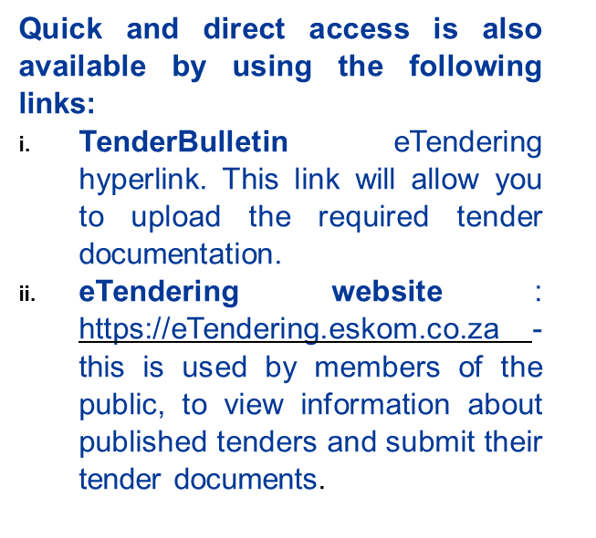
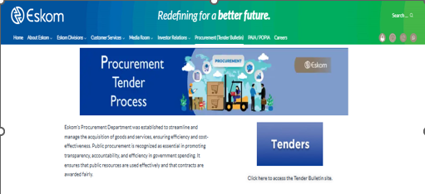
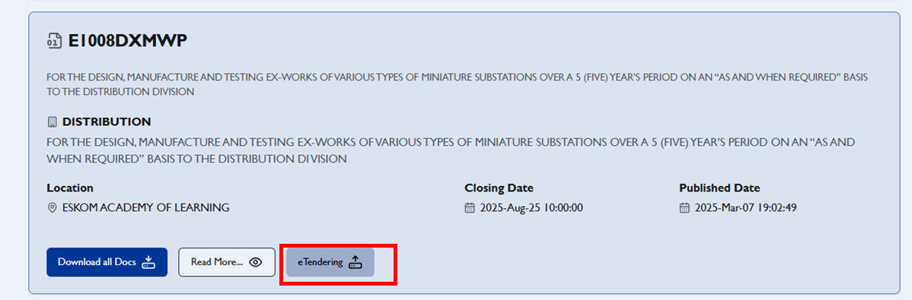
How to access the eTendering site
1
1 a
2
1 b
1 c

Slide 9
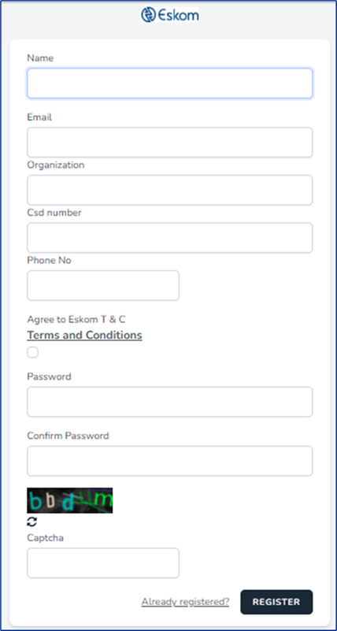
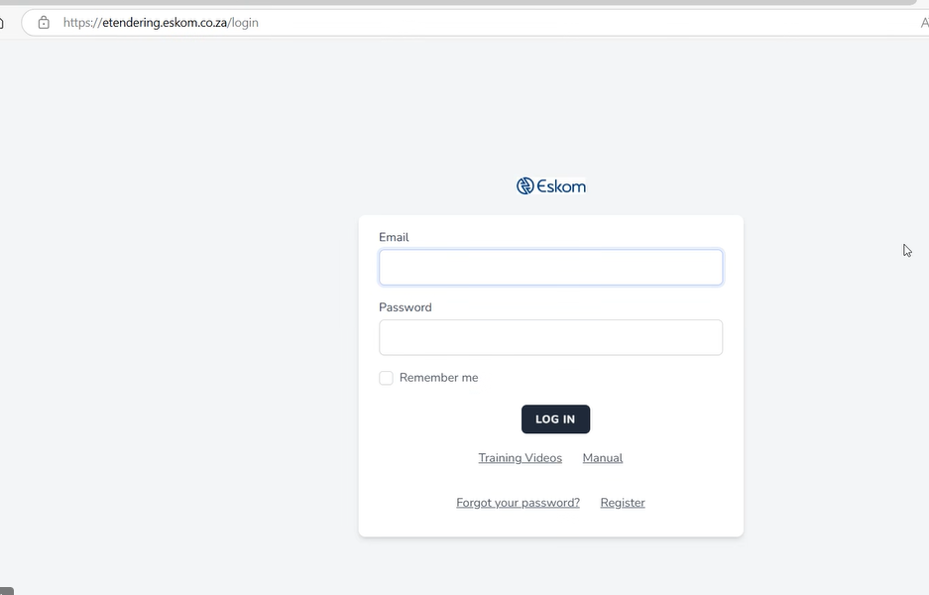
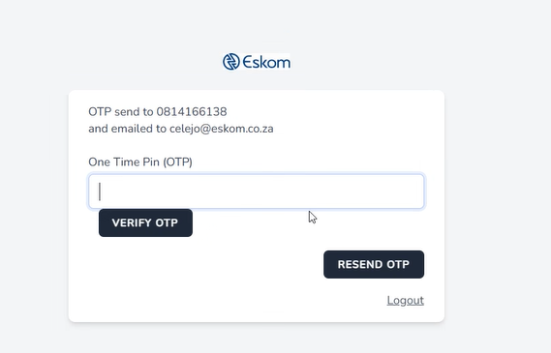
How to register & log in
To register
If already registered, then to sign in
OTP pin will be sent via email or sms

Slide 10
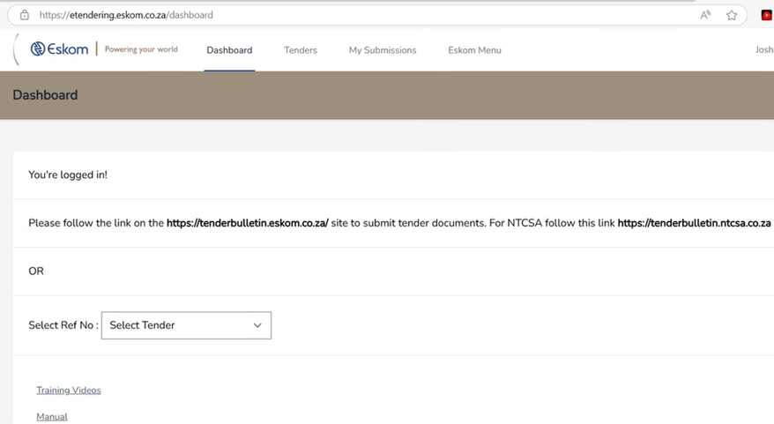
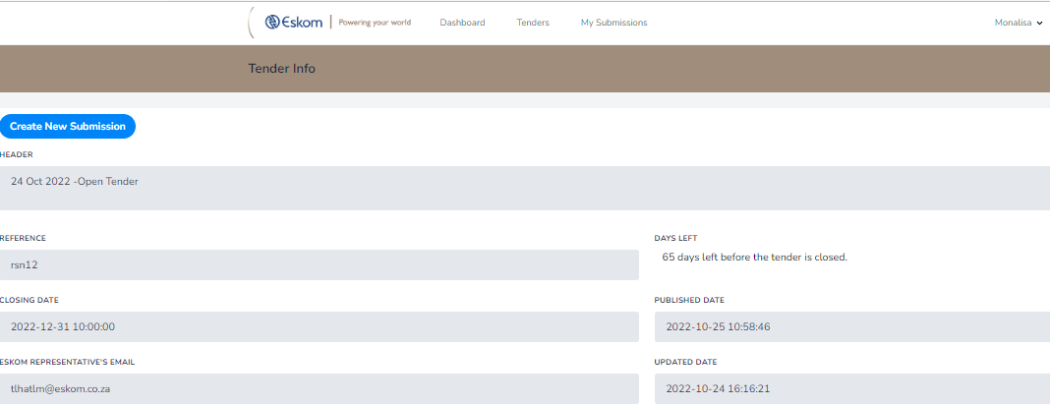
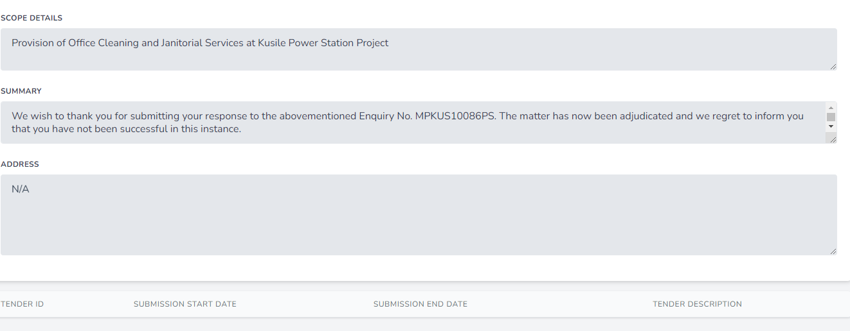
How to create a new submission
A page with the preferred Tender information is displayed before tender documentation can be submitted.
“Create New Submission” button is used to submit required Tender documents.

Slide 11
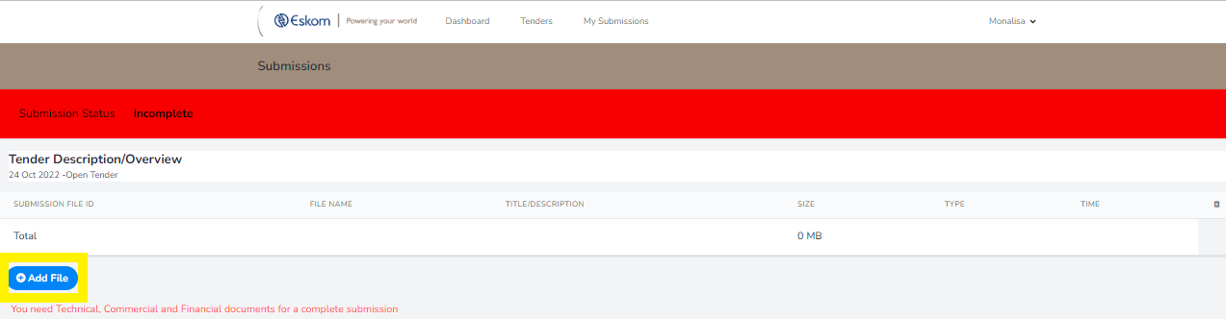
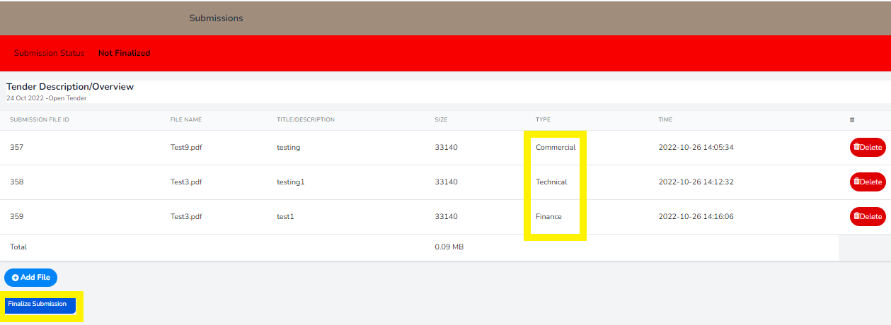
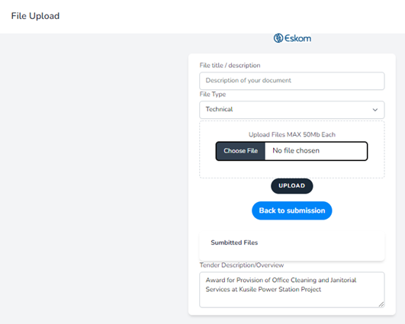
How to upload documents
1
3
2
Upload required tender documents by:
Giving the file a name
Select the listed file type e.g.: Technical, commercial, finance and etc
Choose the file you need to upload
Then click on the “Upload” button

Slide 12
Important information
Folder Structure:
  Upload documents under:
  Technical | Commercial | Financial | Other
2. File Requirements:
  Format: PDF only (unless stated otherwise, e.g., price list in PDF & Excel)
  Size Limit:
    500MB per file
    4GB total per submission
  No ZIP/Compressed files
  No hard copies accepted
3. Submission Process:
  Ensure status shows Complete before final submission.
4. Resubmission:
  Only the latest version will be valid; previous submissions are invalid.
5. Tenderers must ensure files are readable and not corrupt.
6. Submission must be finalized before closing date and time.
7. Important:
  Electronic submission only via Eskom Tender Bulletin site.
  Invitation to Tender document determines submission requirements.

Slide 13


Questions & Thank you

