Slide 1

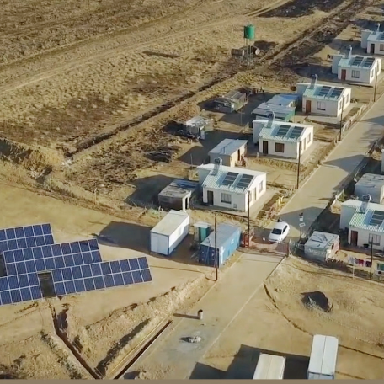
RHF : Environmental Commercial Requirements
Compiled By: Nondwe Khanye
Date: 28 May 2025

Slide 2
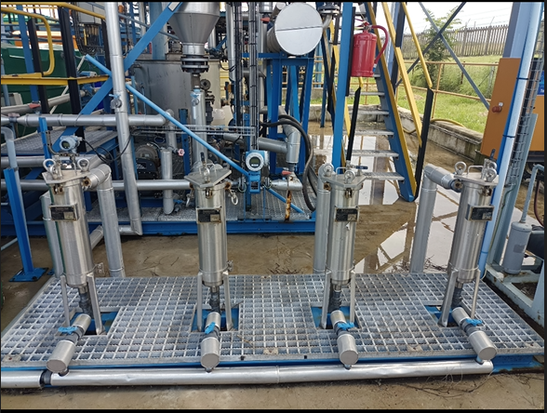

Contents
List of Returnables
Signed Environmental Policy
Environmental Aspect and Impact Register
Environmental Management Plan

Slide 3
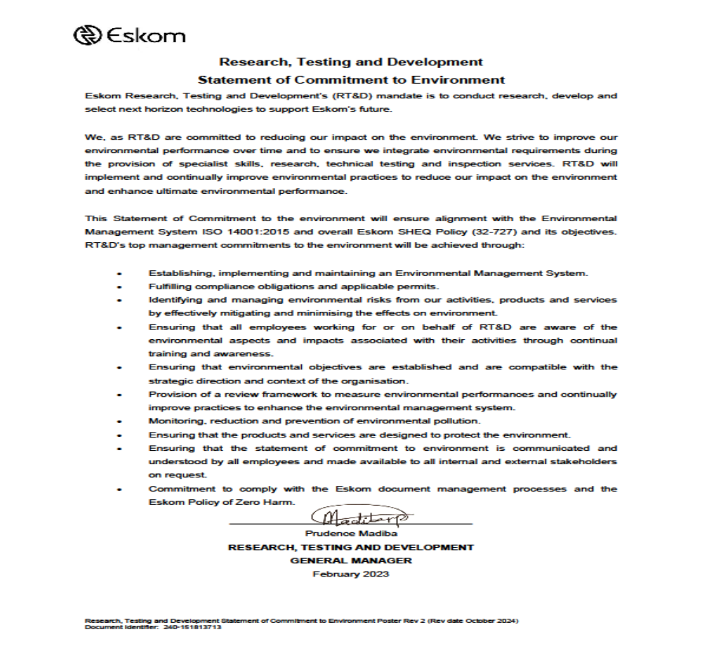
Environmental Policy
Environmental Policy
The contractor must submit a signed Environmental Policy. The policy should demonstrate your organization (top management)’s commitment to protection of the environment which is not only intended to prevent adverse environmental impacts through prevention of pollution, but to protect the natural environment from harm and degradation arising from the organisation’s activities, products and services . The policy must also demonstrate commitment to compliance with legal and other requirements, prevent pollution and continually improve environmental performance..

Slide 4
Environmental Aspect and Impact Register as per scope of work
The supplier shall determine the aspects related to the scope of work. Aspect is an element of organization’s activity, products or service which may interact with the environment and may cause negative or positive impact. While impact – refers to any change on the environment whether adverse or beneficiary. Changes to the environment, either adverse or beneficial, that result wholly or partially from environmental aspects are called environmental impacts. The environmental impact can occur at local, regional and global scales, and also can be direct, indirect or cumulative by nature. The relationship between environmental aspects and environmental impacts is one of cause and effect.
Activity | Aspect | Impact | Rating Environmental Impact |  |  | Regulatory requirement | Mitigation Measures |  | Performance Indicators | Monitoring | Responsible person | Date Completed/ Remarks
 |  |  | Likelihood | Magnitude | Significance rating
General matters essential to the planning phase
Working with hazardous substances | Spillages and storage | Soil and/or water pollution | 1 | 1 | 1 | National Water Act 36 of 1998. National Environmental Management Act 107 of 1998 | 1. A site which has minimal impact on the immediate and surrounding environment must be selected: A preliminary investigation must be done as to the situation of this site. 2. Aspects such as slope and distance from water bodies must be taken into consideration to minimize erosion and pollution of surface water. | 1. All hazardous substances must be stored in a suitable container and must be clearly marked with warning labels. 2. Employees handling such materials must be trained to do so. 3. MSDS for all hazardous substances used on site must be available on site. | Incident reports, Complaints from I & AP’s register | Will be noted in project reviews, ECO visits | Contractor/ Project manager

Slide 5
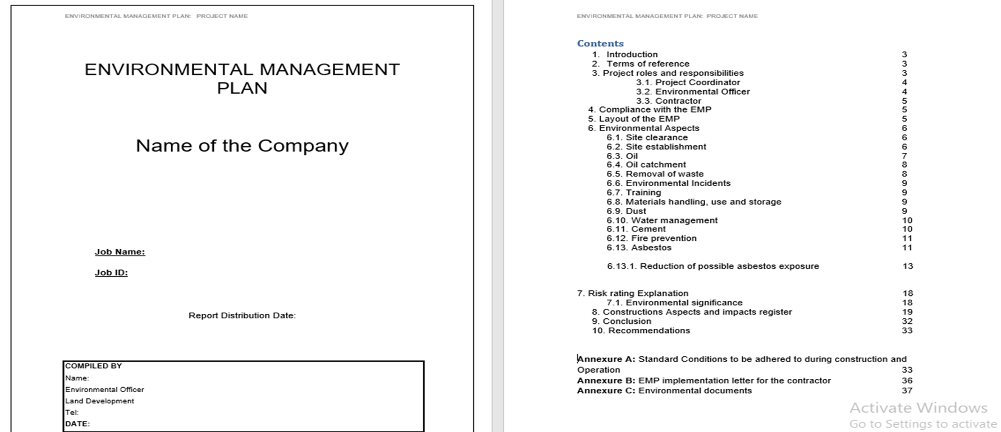
Environmental Management Plan (EMP) as per scope of work
Environmental Management Plan (EMP)
The supplier must develop environmental management plan that demonstrate how activities which have potential to cause environmental impacts will be management during the lifespan of a project.
Environmental Management Plan as per the scope of work must have but not limited to the following;
Waste management
Environmental Incident management
Emergency preparedness plan
Dust and noise management

Slide 6
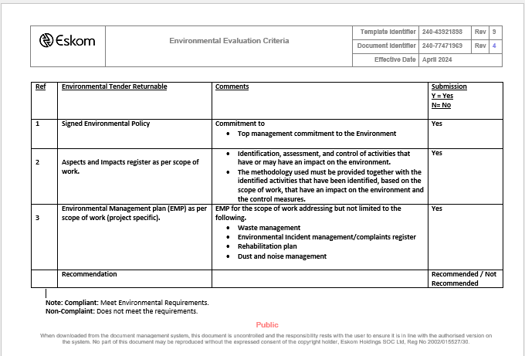
Environmental Evaluation Criteria

Slide 7


Thank You

