Slide 1


Presented by: Hlekani Motjiyeng
14 May 2026
IT Professional Services related to the development of an NTCSA Digital Transformation Strategy.

Slide 2
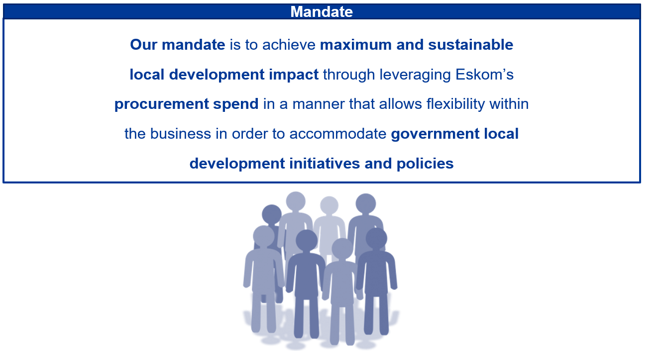
Eskom Supplier Development and Localisation Mandate

Slide 3
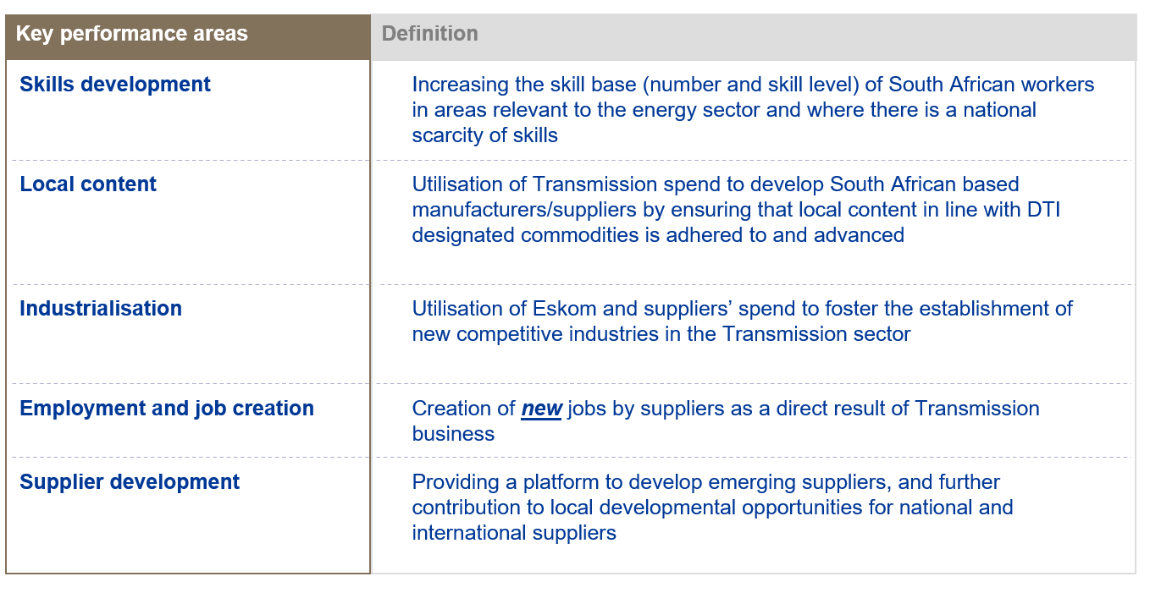
SD&L measures impact along 5 key performance areas
S

Slide 4
Evaluation criteria
The 80:20 or 90:10 rule will apply in this project:
B-BBEE = 20 or 10
Price = 80 or 90

Slide 5
Preference Points B-BBEE

Slide 6
B-BBEE requirements
The certificate must be valid.
Verification Agency must be SANAS accredited.
There should be a logo of SANAS on the certificate.
QSEs and EMEs – Sworn affidavit is acceptable

Slide 7
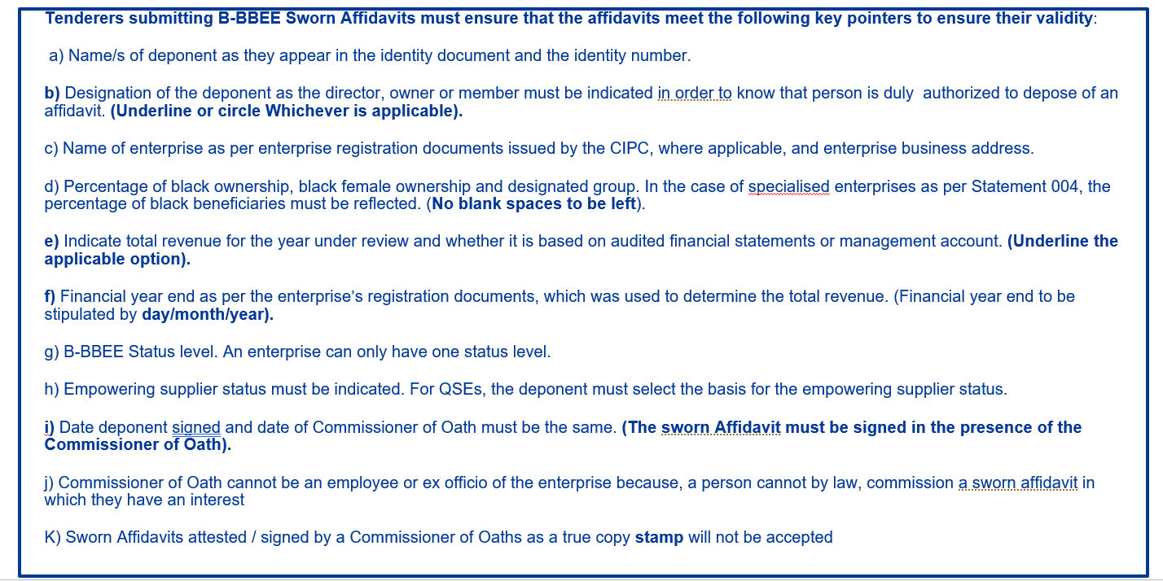
Validity of a BBBEE affidavit

Slide 8
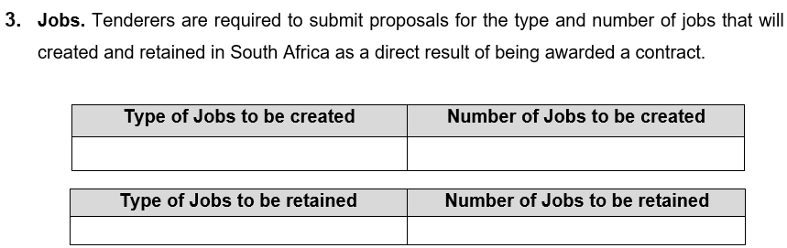
SDL&I Contractual requirement/undertakings

Slide 9
Skills development
Criteria | Eskom Target | Tenderer Commitment
University or University of technology student bursary
***For every 3 Million rand spend the contracted supplier will be required to contribute R30 000 towards Engineering student bursary.

Slide 10
Monitoring ation (Not a weighted Criteria)
Implementation schedule to be submitted within a month of contract signing.
Quarterly or monthly reports on progress of implementation of SD&L to be submitted to the PM.
SDL&I penalty (2.5% retention / Performance Bond)

Slide 11

Implementation schedule to be submitted within a month of contract signing.
Quarterly or monthly reports on progress of implementation of SD&L to be submitted to the PM.
SDL&I penalty (2.5% retention / Performance Bond)

Slide 12
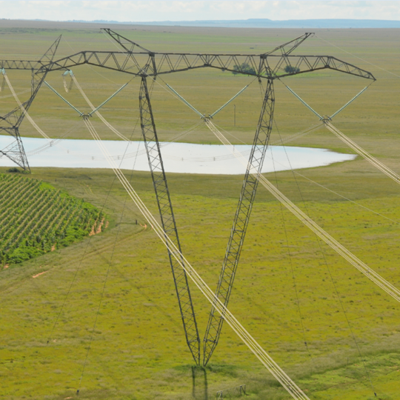
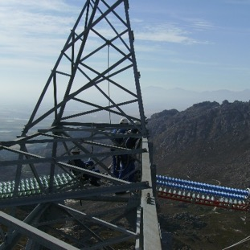
Conclusion

