Slide 1
NON-COMPULSORY CLARIFICATION MEETING
16 April 2025
10H00AM
MS Teams
TENDER NUMBER : E1068GXMPKUS
Kusile Power Station Provision of Safe and Reliable Transportation for Eskom Generation Employees for a duration of 5 years.

Slide 2
CLARIFICATION MEETING
16 April 2025
10H00AM
AGENDA
Registration – Attendance register – Declaration of interest
Safety Evacuation – Safety Representative
Welcome and Objectives – Commercial Representative
Eskom Commercial Process – Commercial Representative
Project Background – Technical Representative
Technical Evaluation Process – Technical Representative
SDL&I – Supplier Development and Localization Representative
Quality Requirements – Quality Representative
Safety Requirements – Safety Representative
Finance – Finance Representative
Questions and answers

Slide 3
Welcome: Session Objective
The session will focus on providing clarity on any tender related queries which should assist prospective tenderers to submit responsive tenders that are commercially, technically and financially acceptable.
We will endeavor to:
Provide a guideline on commercial/ Basic compliance requirements
Explain the evaluation criteria (Functionality)
Explain the objective criteria's
Provide the forum for Q&A and clarify any ambiguities.

Slide 4
Eskom Procurement Representative
Name: KGOPOTSO MASILELA
Tel Number: 013 680 3210
Email: MASILEKP@ESKOM.CO.ZA
NB: All queries and communication should only be directed to the above appointed Eskom Procurement Representative.

Slide 5
Commercial Process – Submission Deadline
Clarification queries closing date: 5 working days before the deadline for proposal submission
Submission closing time: 10h00 SA Telkom time (GMT +2). (No late submission will be accepted under any circumstances. NB: Any late submission will be rejected

Slide 6
Commercial Process – Submission Deadline
Tender Issue Date: 02 April 2025
Submission Deadline/ Closing Date of the tender: 30 April 2025
Tender Validity Period: 180 days from closing date
Non-Compulsory Clarification: 16 April 2025@10h00am (MS Teams)

Slide 7
Commercial Process – Submission requirements
Updates and Clarifications: Tenderers are urged to continually check the Eskom Tender Bulletin and the National Treasury Website (e-tender) for important updates pertaining the tender in questions i.e. minutes, notices, clarifications, addendums etc.
Electronic copy of the tender in a PDF format. The price list needs to be submitted in PDF and a copy in excel format (The limit is 50MB per file and total submission of 900MB per submission)
Submit electronically via e-tendering. Failure to submit the tender via e-tending will not be considered.

Slide 8
Tender Information
Tenders are to submitted as per below:
Meet the eligibility criteria for a tenderer.
Submit electronically via e-tendering. Failure to submit the tender via e-tending will not be considered.
Submission of the mandatory commercial tender returnables as at stipulated deadlines.
Electronic copy of the tender in a PDF format. The price list needs to be submitted in PDF and a copy in excel format (The limit is 50MB per file and total submission of 900MB per submission)

Slide 9
Evaluation Process – As prescribed in terms of the PPPFA Act of 5 2000 and its Regulation. Tenderers are to note the steps for evaluation
A six-step evaluation will be conducted, namely:
Responsive Tender (Basic Compliance)/ Commercial Mandatory Requirements
Functionality (Technical Evaluation criteria)
Price and Preference (PPPFA)
Objective Criteria’s - (Commercial Non-Mandatory requirements, SDL&I, Quality, Safety, Environment and Financial requirements)
Negotiations where applicable
Contract award
NB: Failure to submit the mandatory requirements, the contractor will automatically be disqualified.

Slide 10
PRICE LIST
Contractors are required to price for the whole of the contract.
The price list is attached on the NEC3 Term Service Contract

Slide 11
Objective Criteria - Contractual Returnables
NB: Contractual Requirements Returnable means that tenderers will be given an opportunity to submit once, within ten (10) calendar days the outstanding Contractual Requirements Returnable which they would have missed or not submitted during the tender close out. Only those tenderers who submitted/responded within the specified time will be considered and those who did not respond will be rendered non-responsive. Commercial, Financial, Supplier Development Localisation and Industrialisation, Health and Safety, Environmental and Quality will only evaluate the shortlisted suppliers who passed/complied with the mandatory requirements.

Slide 12
Objective Criteria - Mandatory Commercial Requirements for contract awards
Mandatory commercial returnables are stipulated in the invitation to tender and are to be submitted with the tender

Slide 13
Project Background as per the scope of work by Technical Representative
The scope of work is detailed as follows:
The provision of safe and reliable transportation for Generation Kusile Power Station employees in and around eMalahleni (Witbank), Ogies, Phola – Wilge, Bronkhorstspruit, Delmas, Pretoria, Benoni, Middleburg and Kwa-Ndebele from home to work and from work to home. This will require 49 X 13-seater minibuses as per works information below (Bullet point 2) and including disinfecting and sanitizing of minibuses once every 3 months from 01 May 2025 to 30 Apr 2030. The following replacement vehicles will be made available by the service provider on an as and when required basis: 6 X 13-Seater minibuses

Slide 14
Scope of work by Technical Representative
Scope / Description | Frequency | Estimated km Travelled per Day
Non-Shift Employees Home-Work-Home Transport
Route A: 13-Seater minibus Starting at Hlalanikahle | Daily (Mon – Fri) | 90 km
Route B: 13-Seater minibus Starting at KwaGuqa | Daily (Mon – Fri) | 90 km
Route C: 13-Seater minibus Starting at Witbank Location | Daily (Mon – Fri) | 90km
Route D: 13-Seater minibus Starting at Bronkhorstspruit dam via Cultura Park | Daily (Mon – Fri) | 90km
Route E: 13-Seater minibus Starting at Bronkhorstspruit CBD & Masada | Daily (Mon – Fri) | 90 km
Route F: 13-Seater minibus Starting at Bronkhorstspruit CBD | Daily (Mon – Fri) | 90 km

Slide 15
Functionality Evaluation Criteria – Technical Representative
Route G: 13-Seater minibus Starting at Kwa-Ndebele | Daily (Mon – Fri) | 140 km
Route H: 13-Seater minibus Starting at Phola Location via Wilge & Bravo | Daily (Mon – Fri) | 90km
Route I: 13-Seater minibus Starting at Delmas | Daily (Mon – Fri) | 100 km
Route J: 13-Seater Minibus Starting at The Grove Mall (Pretoria East) | Daily (Mon – Fri) | 140 km
Route K: 13-Seater Minibus Starting at The Grove Mall (Pretoria East) | Daily (Mon – Fri) | 140 km
Route L: 13-Seater Minibus Starting at The Grove Mall (Pretoria East) | Daily (Mon – Fri) | 140 km
Route M: 13-Seater Minibus Starting at The Grove Mall (Pretoria East) | Daily (Mon – Fri) | 140 km
Route N: 13-Seater Minibus Starting at Lake Side Mall (Benoni) | Daily (Mon – Fri) | 140 km
Route O: 13-Seater Minibus Starting at Lake Side Mall (Benoni) | Daily (Mon – Fri) | 140 km
Route P: 13-Seater Minibus Starting at Lake Side Mall (Benoni) | Daily (Mon – Fri) | 140 km

Slide 16
Functionality Evaluation Criteria – Technical Representative
Route Q: 13-Seater Minibus Starting at Middleburg Mall | Daily (Mon – Fri) | 140 km
Route R: 13-Seater Minibus Starting at Middleburg Mall | Daily (Mon – Fri) | 140 km
Route S: 13-Seater Minibus Starting at Middleburg Mall | Daily (Mon – Fri | 90 km
Route T: 13-Seater Minibus Starting at Deljudor via Klipfontein | Daily (Mon – Fri | 90 km
Route U: 13-Seater Minibus Starting at Deljudor ext. 10 via Klipfontein | Daily (Mon – Fri) | 90 km
Route V: 13-Seater Minibus Starting at Duvha Park | Daily (Mon – Fri) | 90 km
Route W: 13-Seater Minibus Starting at Ryno Ridge | Daily (Mon – Fri) | 90 km
Route X: 13-Seater Minibus Starting at Tasbet | Daily (Mon – Fri) | 90 km
Route Y: 13-Seater Minibus Starting at Tasbet 1 | Daily (Mon – Fri) | 90 km

Slide 17
Functionality Evaluation Criteria – Technical Representative
Route Z: 13-Seater Minibus Starting at Tasbet 2 | Daily (Mon – Fri) | 90 km
Route AA: 13-Seater Minibus Starting at Tasbet 3 | Daily (Mon – Fri) | 90 km
Route BB: 13-Seater Minibus Starting at Klarinet | Daily (Mon – Fri) | 90 km
Route CC: 13-Seater Minibus Starting at Clearwater/Panorama | Daily (Mon – Fri) | 90 km
Route DD: 13-Seater Minibus Starting at Jakaroo Park/Panorama | Daily (Mon – Fri) | 90 km
Route EE: 13-Seater Minibus Starting at Downtown/Die Hoewel | Daily (Mon – Fri) | 90 km
Route FF: 13-Seater Minibus Starting at Moddel Park | Daily (Mon – Fri) | 90 km
Route GG: 13-Seater Minibus Starting at Highveld Mall/ Deljudor | Daily (Mon – Fri) | 90 km

Slide 18
Functionality Evaluation Criteria – Technical Representative
Operating; Chemical Services and Protective Services Shift Employees Home-Work-Home Transport (Mon – Sun incl holidays) 4 trips per Day
Route A: 13-Seater Minibus Starting at Tasbet 1;2;3 at 05:00 and 17:00 | Daily | 200 km
Route B: 13-Seater Minibus Starting at Duvha Park/Klipfontein at 05:00 and 17:00 | Daily | 200 km
Route C: 13-Seater Minibus Starting at Klarinet via Downtown at 05:00 and 17:00 | Daily | 200 km
Route D: 13-Seater Minibus Starting at Clearwater/ Deljudor via downtown at 05:00 and 17:00 | Daily | 180 km

Slide 19
Functionality Evaluation Criteria – Technical Representative
Route E: 13-Seater Minibus Starting at Witbank Location at 05:00 and 17:00 | Daily | 200 km
Route F: 13-Seater Minibus Starting at Phola Park at 05:00 and 17:00 | Daily | 200 km
Route G: 13-Seater Minibus Starting at Bronkhorstspruit at 05:00 and 17:00 | Daily | 200 km
Route H: 13-Seater Minibus Starting at Middelburg mall at 05:00 and 17:00 | Daily | 400 km

Slide 20
Functionality Evaluation Criteria – Technical Representative
Operating; Chemical Services and Protective Services Training (Mon – Thursday)
Route A: 13-Seater Minibus Starting at Tasbet 1;2;3 | Daily | 90 km
Route B: 13-Seater Minibus Starting at Duvha Park/Klipfontein | Daily | 90 km
Route C: 13-Seater Minibus Starting at Klarinet via Downtown | Daily | 90 km
Route D: 13-Seater Minibus Starting at Clearwater/ Deljudor via Downtown | Daily | 90 km
Route E: 13-Seater Minibus Starting at Witbank Location | Daily | 90 km
Route F: 13-Seater Minibus Starting at Phola Park | Daily | 80 km
Route G: 13-Seater Minibus Starting at Bronkhorstspruit | Daily | 80 km
Route H: 13-Seater Minibus Starting at Middelburg mall | Daily | 140 km

Slide 21
Functionality Evaluation Criteria – Technical Representative
The minimum weighted final score (threshold) required for a tender to be considered from a technical perspective is 70%.
CRITERIA WEIGHTING
TECHNICAL THRESHOLD 70%
Experiences (Driver Capability) 14%
National Driver’s with PDP 6%
Drivers to have a minimum of Three years driving Experiences (5 points)
Drivers to have a minimum of Two years driving Experiences (4 points)
Drivers to have a minimum of One year driving Experiences (2 points)
Advanced Driving Training 3%

Slide 22
Functionality Evaluation Criteria – Technical Representative
Vehicle Capability 46%
Standard Vehicles minimum Safety specifications:
Factory - fitted antilock brake system (ABS) 4%
Factory - fitted driver and passenger airbags 4%
Factory - fitted alarm/immobiliser 3%
Factory - fitted power steering 3%
Factory - fitted air conditioner 3%
Factory - fitted audio system - radio/CD player 3%

Slide 23
Functionality Evaluation Criteria – Technical Representative
A fully equipped First Aid box 3%
A fully equipped Fire Extinguisher 3%
Tyres as per manufacturer's specifications for the intended purpose. They must be commercial steel-belt tyres 8-3% 3%
2 X Emergency warning triangles 3%
Three - point safety belts for every seat 3%
Factory fitted safety belt warning light or signal 3%
No fold-up or jockey seat 2%
There must be a speed warning sign at the back of every minibus 2%
Yellow reflective tape that must be fitted as per the National Road Traffic Act specification 2%

Slide 24
Functionality Evaluation Criteria – Technical Representative
The driver's seat must be adjustable. The driver's compartment must be portioned as per the National Road Traffic 1%
The minibus must have at least two identified emergency exits for every 12 (twelve) passengers 1%
Vehicle Document Requirements 30%
Car registration documents 10%
Local Permit (Obtaining from Dept. of Transport) 5%
Taxi association letter where you’ll be operating (routes tendered for) 15%
Insurance/ Passenger Liabilities 10%
Proof of insurance from accredited insurance company 10%
Total Weight 100%

Slide 25
Objective Criteria (SDL&I) – SD&L Representative
NB: The following documents are required to claim preference points,
Valid B-BBEE certificate issued by a SANAS accredited verification agency / sworn affidavit / CIPS affidavit
Proof of ownership / shareholding (preferably CIPC documentation) inclusive of shareholding breakdown
Certified ID copies of shareholder(s)
Proof of Disability (where applicable)

Slide 26
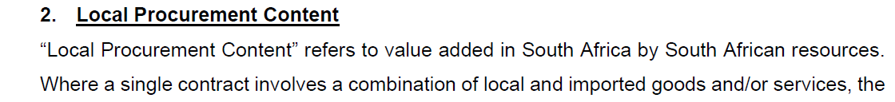
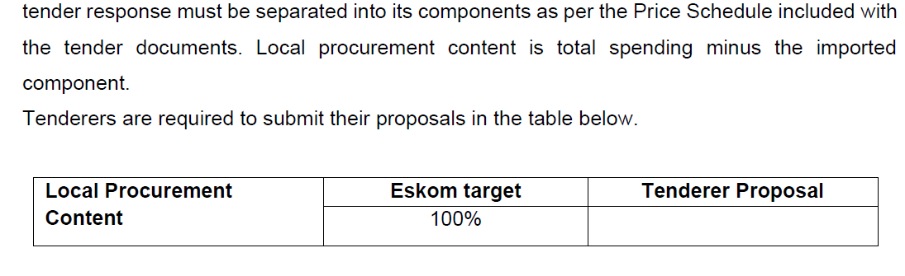
Objective Criteria (SDL&I) – SD&L Representative

Slide 27
Objective Criteria (SDL&I) – SD&L Representative
SKILLS DEVELOPMENT
Tenderers are required to submit proposals in a table below for developing the skills of unemployed candidates in the country. Skills development is intended to address Eskom’s core, scarce and critical skills and the scarce and critical skills.
Skill type/ Occupation | Eskom target | Entry level | Output | Tenderers proposal
Drivers license | 4 per route | Grade 12 | PDRP
CSI: Target of 2% of the contract value

Slide 28
Safety Objectives – Safety Representative
Annexure B: SHE requirement for tender enquiries;
Annexure C
OHS plan must be aligned with the OHS specification and scope of work.
Costing for Safety Health and Environmental management (the following are minimum requirements but not limited, medical fitness assessment, PPE, Trainings);
Baseline Risk Assessment (BRA: Identification, assessment and management of OHS risks related to the scope of work. The methodology used for the risk assessment must be provided together with the BRA.
Valid Letter of Good Standing;
policy signed by CEO/ MD; and

Slide 29
Safety Objectives – Safety Representative
OHS Competency (Consider scope of work, risks, SHE plan and applicability) CV,s and qualifications / certificates
Upon contract awarding, the successful contractor should submit a safety file within 2 weeks prior the commencement of activities on site. The safety file must be as per the issued OHS specification.

Slide 30
Quality Objectives – Quality Representative
Eskom’s position is to partner with suppliers who fully demonstrate commitment to the development, implementation, and maintenance of a quality management system (QMS) that conforms to the requirements of ISO 9001 standard. This transaction falls under category 4 of the quality requirements.
Below quality tender returnables required:
Section A
Quality Method Statement based on scope
Approved quality policy
Approved quality Objectives

Slide 31
Quality Objectives – Quality Representative
Section B
B.1 Documented information for defined roles, responsibilities and authorities - Organization chart and Responsibility matrix (must include but not limited to quality management function/role)
B.2 Documented information for Control of Externally Provided Processes, Products and Services - Must include criteria for evaluation, selection, monitoring of performance, and re-evaluation of external providers (Clause 8.4 of ISO 9001:2015)
Section E
E.1 Form A is completed and signed

Slide 32
Environmental Objectives – Environmental Representative
Aspect and impact register or an environmental management plan (relevant to the scope of work)
Environmental Management System Certificate (if certified) if not, an environmental management system manual or procedures
Waste Management Procedure or work instruction.
Proof of training of persons performing activities that could have significant impact on the environment.
Environmental Policy that is in line with ISO 14001:2015 signed by the CEO or co of the company.
Proof of training of persons performing activities that could have significant impact on the environment.

Slide 33
Financial Objectives
An analysis of the tenderers financial statements will be conducted for the purposes of establishing the tenderers financial viability and ability to meet all its contractual obligations for the duration of the contract, should the tenderer be awarded the contract.
Where applicable a financial evaluation will be conducted by Eskom to further evaluate the financial viability of the tenderer. (incl. formal treasury evaluation)

Slide 34
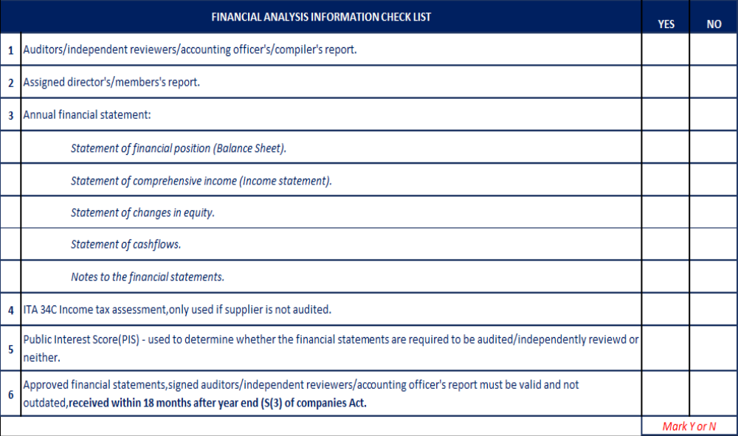
Finance Checklist

Slide 35
End of the presentation
Questions
and
Answers

