Slide 1
Clarification Meeting: Concrete Drums
Presented by: Koeberg Nuclear Operating Unit
26.05.2025

Slide 2
Safety Talk
In the event of an emergency
If you are working from home, ensure you:
  evacuate to a safe area,
  call the necessary authorities and
  wait for the all clear before returning to your workstation
If you are situated in an office environment:
  Listen for the type of alarm and/or an announcement
  Nuclear Emergency:
  Stay inside the building and await further instructions
  If potassium tablets need to be handed out, this will be done by the muster coordinator
  Fire or Bomb threat:
  Ensure all doors and windows are closed, and electrical supply is switched off
  In the event of a bomb threat, please open all windows and doors and do not touch electrical supplies/appliances
  Muster outside the building and upwind.
Be aware of your surroundings and know where the emergency exists are.

Slide 3
Scope:
Provision of concrete waste disposal drums on an as and when required basis according to Technical Specification DSG-318-003 and DSG-318-011 for a period of 5 years.
Background:
Concrete Drums, sand and stone form a crucial part of Koeberg’s day to day Radiation waste disposal activities. Due to the repetitive nature of purchases for these items, and the criticality of having these products on site at time that waste disposal activities start, it was determined that there is a great need for a supply contract to be established.

Slide 4
Contract items:
0160392 - BIN WST: NUCLEAR DISPOSAL; CONC
0160391 - BIN WST: NUCLEAR DISPOSAL; CONC
DSG-318-003, REV 7D ( PART 5 AND 8); 0312/87Q\Q2:LS:NC:NEV; BIN, WASTE; DRUM C1; MNF: CAPE CONCRETE ( OEM); TYPE: NUCLEAR DISPOSAL; ID 1.12 X HT 1.3 M; 210 L CAP; MAT: CONCRETE; REQUIREMENTS FOR DRUM MANUFACTURING AND TESTING; KBA:PT 355/50.001A KBY; AS PER DRAWING PT 344/50.0007 A; FUNC LOC: CONSUMABLE; CAPE CONCRETE SUPPLIER TO NOTIFY PROCUREMENT/STORES AND RADWASTE 2DAYS BEFORE ANY DELIVERY IS PHYSICALLY MADE TO KOEBERG
DSG-318-003, REV 7D ( PART 5 AND 8); 0312/87Q\Q2:LS:NC:NEV; C2 CONCRETE DRUM; MNF: CAPE CONCRETE( OEM); TYPE: NUCLEAR DISPOSAL; ID 778 X OD 1400 X LG 1300 MM, INNER LG: 700 MM, 210 L DRUM ; MAT: CONCRETE; AS PER DRAWING PT 355/50.007 B; SUPPLIER TO NOTIFY PROCUREMENT/STORES AND RADWASTE 2 DAYS BEFORE ANY DELIVERY IS PHYSICALLY MADE TO KOEBERG (KBA0905n10005)

Slide 5
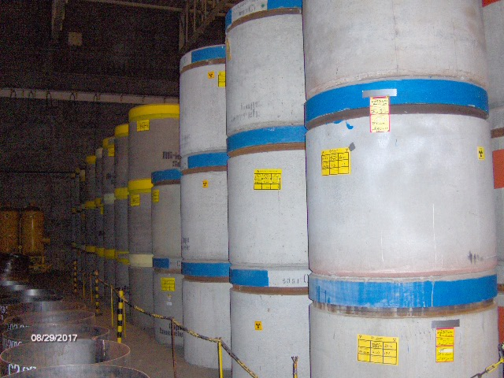
C1 DRUMS STACKED IN STORAGE AREA

Slide 6
Contract items:
0160388 - BIN WST: NUCLEAR; CONC
0160389 - BIN WST: NUCLEAR DISPOSAL; CONC
DSG-318-003 REV 7D (PART 5 AND 8); 0312/87Q;Q2:LS:NC:NEV; ( REQUIREMENTS FOR DRUM MANUFACTURING AND TESTING ); C2F CONCRETE DRUM; P/N C2; MNF: CAPE CONCRETE (OEM); TYPE: NUCLEAR; ID 778 X OD 1400 X LG 1300 MM; MAT: CONCRETE; INNER LG: 700 MM; AS PER DRAWING PT 355/50.007 E; SUPPLIER TO NOTIFY PROCUREMENT/STORES AND RADWASTE 2 DAYS BEFORE ANY DELIVERY IS PHYSICALLY MADE TO KOEBERG
DSG-318-003 REV 7D PART 5 AND 8 (CONCRETE. REQUIREMENTS FOR DRUM MANUFACTURING AND TESTING); 0312/87Q;Q2:LS:NC:NEV; C4 CONCRETE DRUM; P/N: C4; MNF: CAPE CONCRETE (OEM); TYPE: NUCLEAR DISPOSAL; ID 780 X OD 1100 X LG 1300 MM, INNER LG: 780 MM, 210 L; MAT: CONCRETE; AS PER DRAWING PT 355/50.007 D; SUPPLIER TO NOTIFY PROCUREMENT/STORES AND RADWASTE 2DAYS BEFORE ANY DELIVERY IS PHYSICALLY MADE TO KOEBERG

Slide 7
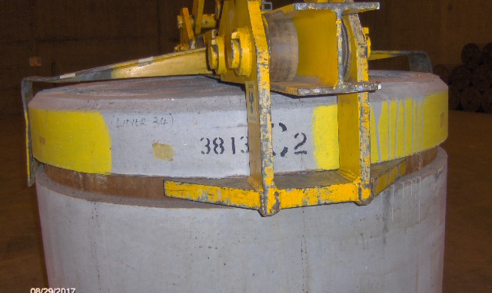
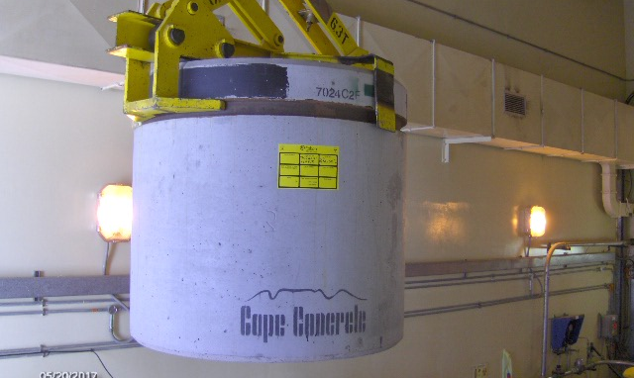
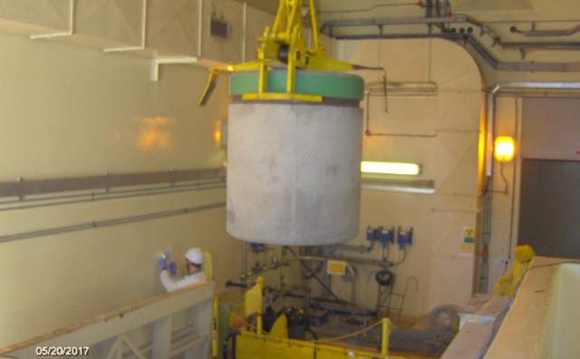
DRUM HANDLING

Slide 8
Contract items:
0114742 - SAND:DUNE; TONS
0114727 - STONE: POLISHING; LIME DOLOMITIC
DSG 318-003 REV 7B; 240-126286740; 0029/99Q;Q3:NSF:NC: NEV; DUNE SAND;+ CRUSHER DUST OR EQUIVALENT. WATER DEMAND LESS THAN 170L/M3. TESTING REQUIRED AS PER SANS 1083, GRADING, DUST CONTENT, FINENESS MODULE, CHLORIDE CONTENT, ORGANIC IMPURITIES, PRESENCE OF SUGAR, SOLUBLE DELETERIOUS IMPURITIES, CLAY AND SILT CONTENT, SAND EQUIVALENT AND DRY SHRINKAGE. SAND TO BE PACKED IN 1 TON TUFF BAGS WITH BOTTOM CHUTE; EACH BAG TO BE LABELLED WITH A BATCH NUMBER AND DATE OF DELIVERY. SUPPLIER TO NOTIFY PROCUREMENT / STORES AND RADWASTE 2 DAYS BEFORE ANY DELIVERY IS PHYSICALLY MADE TO KOEBERG. PLEASE NOTIFY SECURITY IF DELIVERY IS TO BE MADE AFTER HOURS
C.O.C + ( TESTING REQUIREMENT AS PER SPEC DSG-318-003 7D; 0040/88Q; Q5:NSF:NC:NEV; CRUSHED GRANITE IS PREFERRED WITH AN AAR VALUE THAT MEETS REQUIREMENTS (TEST CERTIFICATE). NOMINAL AGGREGATE SIZE FOR CAPPING MATERIAL IS 13.2MM IN ACCORDANCE WITH SANS 1083. GRADING, MOISTURE CONTENT, DUST CONTENT, 10% FACT VALUE, DRY SHRINKAGE AND AKALI-AGGREGATE. STONE TO BE PACKED IN 1 TON TUFF BAGS WITH BOTTOM CHUTE. EACH BAG TO BE LABELLED WITH A BATCH NUMBER AND DATE OF DELIVERY. DOLOMITIC LIMESTONE; DIMEN: 3,15 TO 8,0MM; SUPPLIER TO NOTIFY PROCUREMENT/STORES AND RADWASTE 2DAYS BEFORE ANY DELIVERY IS PHYSICALLY MADE TO KOEBERG. LIMESTONE HAS TO BE BAGGED AND THE BAGS WILL BE PROVIDED BY KOEBERG; PLEASE NOTIFY SECURITY IF DELIVERY IS TO BE MADE AFTER HOURS)

Slide 9
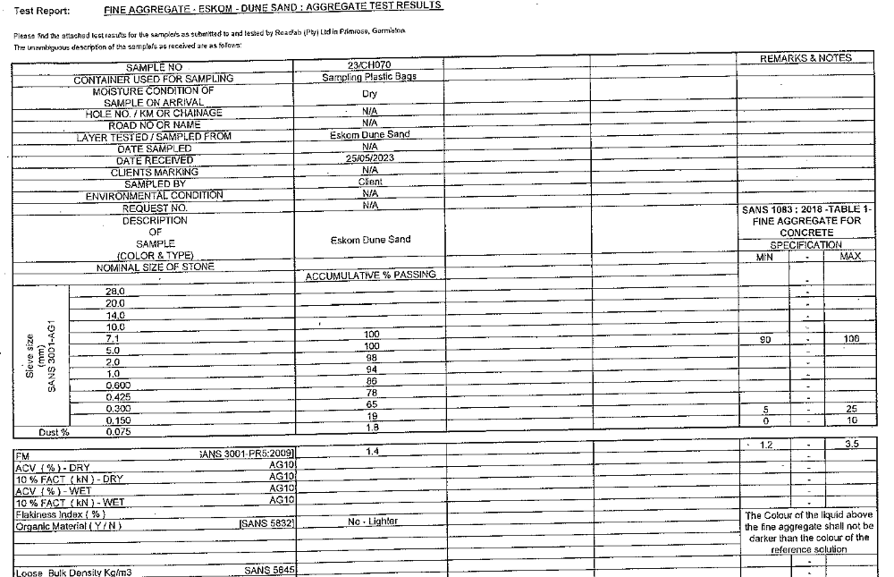
LABORATORY REPORTS

Slide 10
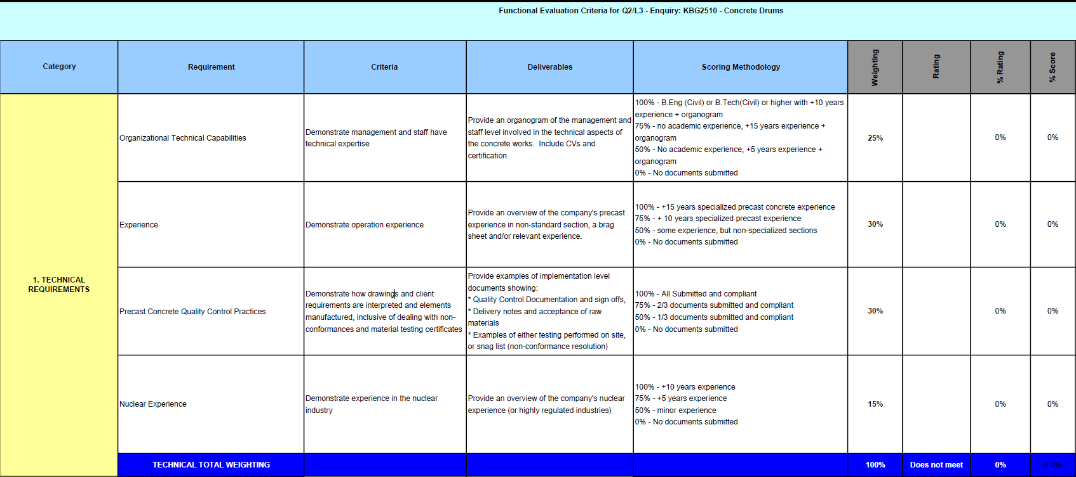
Functional Evaluation Criteria

Slide 11
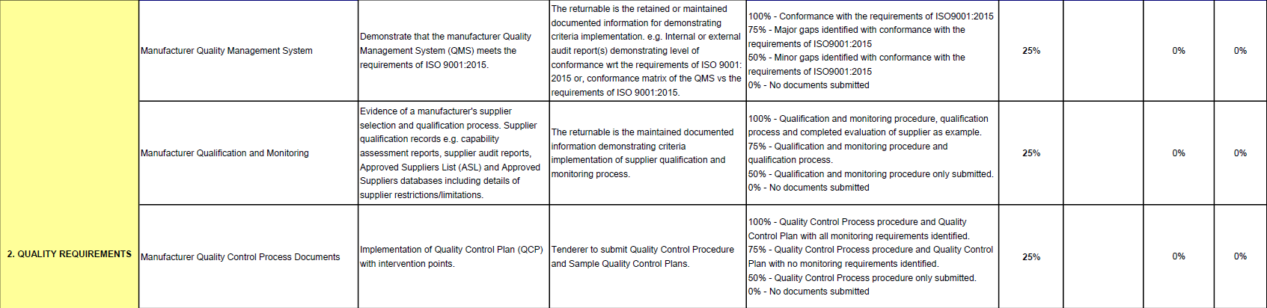
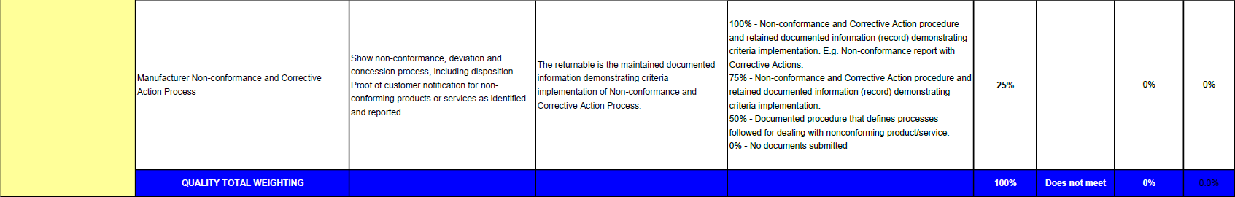
Functional Evaluation Criteria

Slide 12
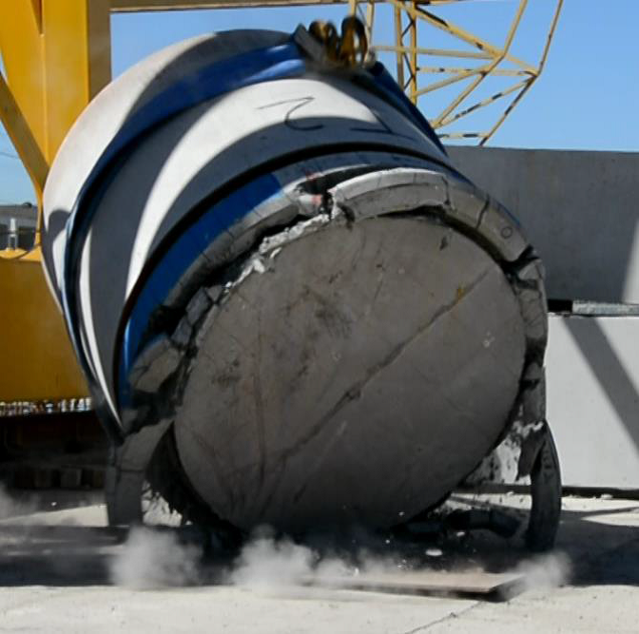
DROP TEST ON A C1 DRUM

Slide 13
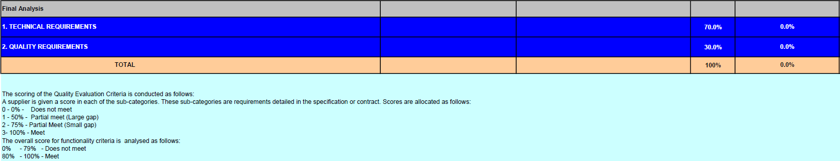
Functional Evaluation Criteria – overall score

Slide 14
Close Out:
This platform is open for any clarification questions you may have.
Rashaad will take you through the process, should you have any further question after this clarification meeting.

