Slide 1
CONTRACT SANRAL R.061-030-2016/2S
CONSULTING ENGINEERING SERVICES FOR THE SUPERVISION OF THE SPECIAL MAINTENANCE ON NATIONAL ROUTE R61 SECTION 3 FROM KM 50.8 TO KM 75.5
Clarification Presentation Online
Tender documents are available at no cost in electronic format downloadable from SANRAL website https://www.nra.co.za/service-provider-zone/tenders/open-tenders/.Tenderers must have access to Microsoft Office © 2013 and Acrobat Adobe © 9.0, or similar compatible software.
All Enquiries: ProcurementSR4@sanral.co.za

Slide 2
PLEASE NOTE:
The contents of the presentation are intended merely as a summary to highlight some of the important aspects of the contract documents.
ANY INCONSISTENCY BETWEEN THE PRESENTATION AND TENDER DOCUMENT, THE TENDER DOCUMENT SHALL PREVAIL UNLESS COMMUNICATED IN AN ADDENDUM

Slide 3
CONTENT
TENDER NOTICE AND INVITATION TO TENDER
COMPOSITION OF THE TENDER DOCUMENT
CONDITIONS OF TENDER
EVALUATION PROCESS
TIPS FOR SUBMITTING YOUR TENDER DOCUMENTS SUCCESFULLY
SCOPE OF WORKS
Notes:
Highlighted certain sections in the document
Any specifics or amendments
Onus still vest with tenderers to fully familiarize themselves with the doc.
Just under 60 slides so will run through it quite quick.
The presentation will be shared.

Slide 4
1. TENDER NOTICE AND INVITATION TO TENDER

Slide 5

TENDER DOCUMENTS
Tender documents are available from 23 May 2023 at no cost in electronic format downloadable from the SANRAL’s website by following the link https://www.nra.co.za/sanral-tenders/status?region_id=national
Tenderers must have access to Microsoft © Office 2013 and Acrobat Adobe © 9.0 or similar compatible software.
Tenderers must submit, via email, the duly completed Form A1.1 Certificate of Intention to Submit a Tender prior to Friday, 2 June 2023. Failure to submit this certificate would result in the tenderer not receiving addenda or additional issued information and may result in the tenderer being non-responsive.
Notes:
Dates checked and updated

Slide 6
A tenderer’s clarification briefing presentation (this one) is available to be downloaded from the SANRAL website by the following link https://www.nra.co.za/sanral-tenders/status?region_id=national.
.
Notes:
Dates checked and updated

Slide 7
COMPLETION AND DELIVERY OF TENDERS
The closing time for receipt of tenders is 11:00 on Friday, 30 June 2023.
Closing venue: Southern Region Offices, 20 Shoreward Drive, Bay West Gqeberha, 6025
Telegraphic, telephonic, telex, e-mail, facsimile and late tenders will not be accepted.
Tenders may only be submitted in the format as stated in the Tender Data.
Queries relating to issues arising from these documents may be addressed to:
e-mail: ProcurementSR4@sanral.co.za
* Please quote the project number in the subject line.*
Notes:
Dates checked and updated

Slide 8
2. COMPOSITION OF THE TENDER DOCUMENT

Slide 9
COMPOSITION OF TENDER DOCUMENT
T1 TENDERING PROCEDUREDS | T2 RETURNABLE SCHEDULE | C1 AGREEMENTS & CONRACTS DATA | C2 PRICING DATA | C3 SCOPE OF WORK | C4 PROJECT INFORMATION | C5: Annexures
T.1.1 Tender Notice & Invitation to Tender (incorporating SBD1) | T2.1 List of Returnable Schedules | C1.1 Form of Offer and Acceptance | C2.1 Pricing Instructions (assumptions) | C3 Scope of Work | C4 Project Information | Annexures
T1.2 Tender Data | T.2.2 Returnable Schedules | C1.2 Contract Data | C2.2 Pricing Schedules / Bills of Quantities
Notes:
Allows for Book 1 to 3 – prepared as 1 Book

Slide 10
INFORMATION IN THE TENDER FOLDER
Tender Content
  Tender Document in pdf
  Appendices to Tender as referred to in Part C4 in relevant formats
Technical Proposal
  Returnable Schedules (Forms A1 – A15) MS Word format
  Consultant Technical submission (Forms B1–B7) in MS Excel format
3. Financial Proposal
  Consultant Financial submission in MS Excel format
  Form of Offer MS Word format
  Contract Data – Information provided by Tenderer MS Word format
4. Clarification Meeting Presentation
  Presentations in pdf. (3 April 2023 and 12 June 2023)

Slide 11
3. CONDITIONS OF TENDER

Slide 12
T1.2 TENDER DATA
Note to tenderer:
The conditions of tender are the standard conditions of tender as contained in Annexure C of the CIDB STANDARD FOR UNIFORMITY IN ENGINEERING AND CONSTRUCTION WORKS CONTRACTS as per Government Notice No. 423 published in Government Gazette No. 42622 of 08 AUGUST 2019 and as amended from time to time. (see www.cidb.org.za).
https://www.cidb.org.za/wp-content/uploads/2021/07/Standard-for-Uniformity-August-2019.pdf
The standard conditions of tender make several references to the tender data for details that apply specifically to this tender. The tender data shall have precedence in the interpretation of any ambiguity or inconsistency between the tender data and the standard conditions of tender.
Each item of data given below is cross-referenced to the clause marked “C” in the abovementioned Standard Conditions of Tender.
Notes:
Standard

Slide 13
Part T1.2: Tender Data
Clause Number | Tender Data
C.1.4 | Communication and employer’s agent The Employer’s Agent during the tender period be contacted at: ProcurementSR4@sanral.co.za
Notes to Tenderer: Kindly note communication must be in writing and only addressed to the email address provided. Any communication received in any other form or to any other email address will not be regarded as an official clarification query and therefore not responded to.
Notes:
Updated email address throughout

Slide 14
Part T1.2: Tender Data
Clause Number | Tender Data
C.2.1,1 | Eligibility Only those tenderers who satisfy the following eligibility criteria are eligible to submit tenders C.2.1.a – Key Persons C2.1.b – National Treasury Central Supplier Database C2.1.c – B-BBEE Level (Generic Addendum – Addendum No.4)
Notes to Tenderer: Each Eligibility Criteria is discussed individually in detail Failure to satisfy all the eligibility criteria will result in a non-eligible tender Obligation is on tenderers to ensure compliance to eligibility criteria as no additional documents will be accepted after tender closing. B-BBEE level - Deleted as Eligibility Criteria – Addendum No.4
Notes:
I think our numbering was off in the tender doc. The content is fine. May need to include in addendum 1.

Slide 15
Part T1.2: Tender Data
Clause Number | Tender Data
C.2.8 | Seek clarification Request clarifications at least 12 working days before the closing date
C.3.1 C.3.1.1 | Respond to requests from the tenderer The employer shall respond to clarifications received up to 12 working days before tender closing date. The Employer shall respond to any clarifications from the tenderers emanating from addenda until 3 working days before tender closing date.
Notes to Tenderer: No clarification queries, including on the Bill of Quantities, will be responded to if received after 12 working days before the tender closing date Tenderers are therefore encouraged to go through tender documents in preparation for the clarification meeting.
Notes:
Standard

Slide 16
Part T1.2: Tender Data
Clause Number | Tender Data
C.3.2 | Issue Addenda The Employer shall issue addenda until ten (10) working days before tender closing date
Notes to Tenderer: Clarification emanating from addenda will be responded to until 3 working days before the tender closing date. Addenda Addendum No.1 – 03 April 2023 Addendum No.2 – 21 April 2023 Addendum No.3 – 12 May 2023 Addendum No 4 (Generic Addendum) – 22 May 2023
Notes:
Standard

Slide 17
Part T1.2: Tender Data (continued …)
Clause No | Tender Data
C.2.15.1 | The Employer’s address for delivery of tender offers and identification details to be shown on each tender offer package are: Location of tender box: Reception Area Physical address: The South African National Roads Agency SOC Ltd, No 20 Shoreward Drive , Bay West , Gqeberha, 6025 Identification details: Mark the envelope with the tenderer’s company name, the project number and description: TENDER N.002-190-2025/1F: CONSULTING ENGINEERING SERVICES FOR THE IMPROVEMENT OF NATIONAL ROUTE N2, SECTION 19X, FROM MTHATHA (KM0.00) TO NQADU (KM22.00) Tenders must be submitted during hours (09:00 to 16:00) Monday to Friday at the Employer’s address. It is in the tenderer’s interest to ensure that the delivery of the tender offer is recorded in the Employer’s tenders received register and deposited in the tender box It is the tenderer’s responsibility to ensure that the tender is submitted before tender closing date and time. SANRAL will not take responsibility for late submissions caused by system errors and or busy networks
Notes to Tenderer: Tenderers to allow sufficient time on the closing date to comply with access control and administration.
Notes:
Does not say “TENDER” in doc, may be just include in addendum 1.

Slide 18
Part T1.2: Tender Data (continued …)
Clause No | Tender Data
C.2.16.2 | Tender Validity Should the tenderer not accept the validity extension or if the tenderer does not withdraw a condition attached to a conditional acceptance, this shall result in a non-responsive tender or the tender is considered to have made an election to exclude itself from the tender process.
Notes:
Standard

Slide 19
Part T1.2: Tender Data (continued …)
Clause No | Tender Data
C.3.9 | Arithmetical errors, omissions, discrepancies and imbalanced unit rates. Where there is a discrepancy between the amounts in figures and the amount in words, the amount appearing in the summary to the Pricing Schedule shall govern. Notify shortlisted tenderers of all errors, omissions or imbalanced rates that are identified in their tender offers. Where the tenderer elects to confirm the correction of the errors, omissions or re-balancing of imbalanced rates, the tender offer shall be corrected as per C3.9. Where there is an omission of a line-item, no correction is possible, and the offer may be declared non-responsive. Declare as non-responsive and reject any offer from a tenderer who elects not to accept the corrections proposed and/or fails to justify or balance the imbalanced rates to the satisfaction of the Employer. The tenderer is required to submit balanced unit rates for Rate Only items in the Pricing Schedule. The rates submitted for these items will be taken into account in the evaluation of tenders.
Notes:
Standard

Slide 20
Part T1.2: Tender Data (continued …)
Clause No | Tender Data
C.3.9 | Arithmetical errors, omissions, discrepancies and imbalanced unit rates. (Continued form previous slide).
Notes to Tenderer: The tenderer will be declared non-responsive if : The Form of Offer is submitted but the Pricing Schedule is omitted, where rate only items are applicable If the Bill of Quantities is incomplete and does not balance back to the form of offer. If a signed Form of Offer is submitted with an incomplete pricing schedule that does not balance back to the Form of Offer and only summary of Pricing Schedule submitted; then the rates cannot be evaluated, and the tender shall be declared non-responsive.

Slide 21
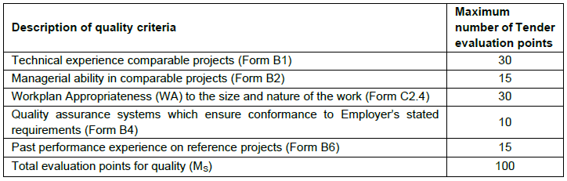
Part T1.2: Tender Data (continued …)
Clause No | Tender Data
C.3.11 | Evaluating Quality / Functionality The minimum number of evaluation points for quality is not less than 80. If a Tenderer scores less than 10 points for sub-contracting they will be deemed non-responsive and will not be evaluated further. - Addendum No.4 The following key persons shall form part of the quality criteria: Project Leader “Shall be a permanent staff member of the tenderer”
Notes to Tenderer: An explanation of the evaluation methodology is provided as part of Returnable Schedule Form B2.
Notes:
75 is correct

Slide 22
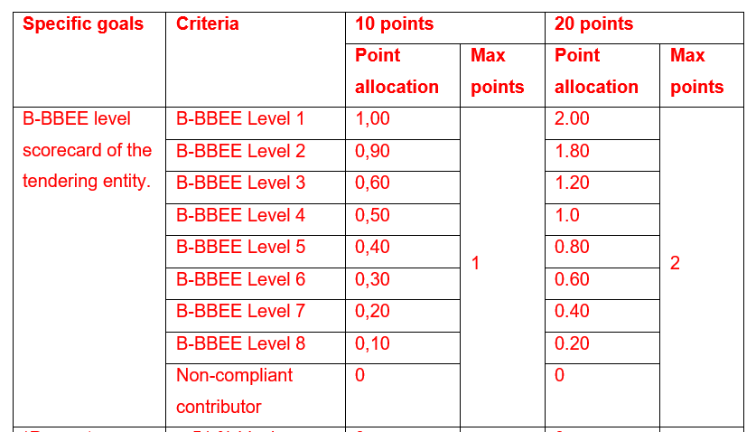
Part T1.2: Tender Data (continued …)
Clause No | Tender Data
C.3.11 | Evaluating Preference - Scoring Preference (Specific Goals) Points for specific goals will be awarded according to the table below:
Notes to Tenderer: C3.11 Delete & replace with Addendum No.4 Scoring Preference – BBBEE certificate, Black Ownership & Subcontracting

Slide 23
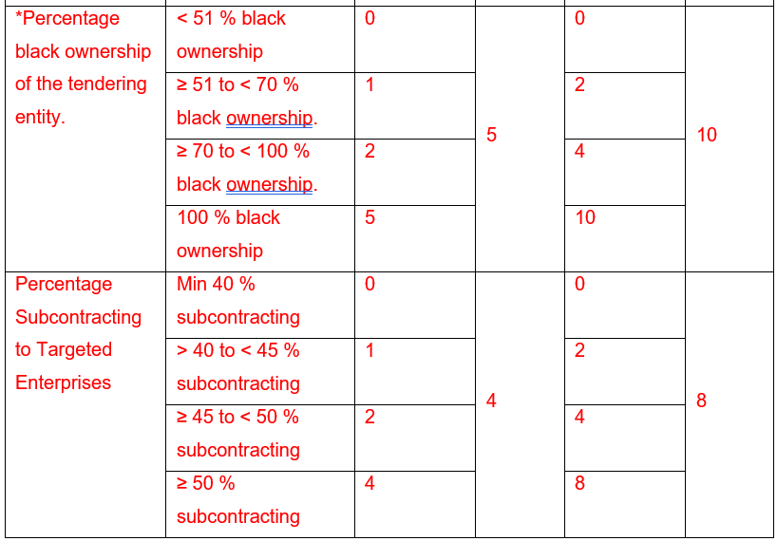
Part T1.2: Tender Data (continued …)
Clause No | Tender Data
C.3.11 | Scoring Preference (Specific Goals) Points for specific goals will be awarded according to the table below:
Notes to Tenderer:

Slide 24
T2.1 LIST OF RETURNABLE SCHEDULES
Notes to tenderer:
1. Returnable schedules have been based on the CIDB Standard for Uniformity in Construction Procurement and incorporate National Treasury requirements within them. Returnable schedules areseparated into the following categories:
Forms, certificates and schedules for completion by the tenderer for use in the quantitative and qualitative evaluation of the tender (Forms A, B, C and D).
Failure to fully complete the relevant returnable documents shall render such a tender offer to be declared non-responsive.
3. Tenderers shall note that their signatures appended to each returnable form represents a declaration that they vouch for the accuracy and correctness of the information provided, including the information provided by candidates proposed for the specified key positions

Slide 25
T2.1 LIST OF RETURNABLE SCHEDULES
Notwithstanding any check or audit conducted by or on behalf of the Employer, the information provided in the returnable documents is accepted in good faith and as justification for entering into a contract with a tenderer. If subsequently any information is found to be incorrect such discovery shall be taken as willful misrepresentation by that tenderer to induce the contract. In such event the Employer has the discretionary right under contract condition 8.4 to terminate the contract.
In such event:
  the Employer shall inform the tenderer and give the tenderer an opportunity to make representations within 14 days as to why the tender submitted should not be disqualified and as to why the tenderer should not be restricted by the National Treasury from conducting any business with any organ of state for a period not exceeding 10 years;
  if the Employer has already entered into a contract with the Tenderer, the Employer has the discretionary right under Standard Conditions of Contract for Professional Services, clause 8.4, to Terminate the Contract.

Slide 26
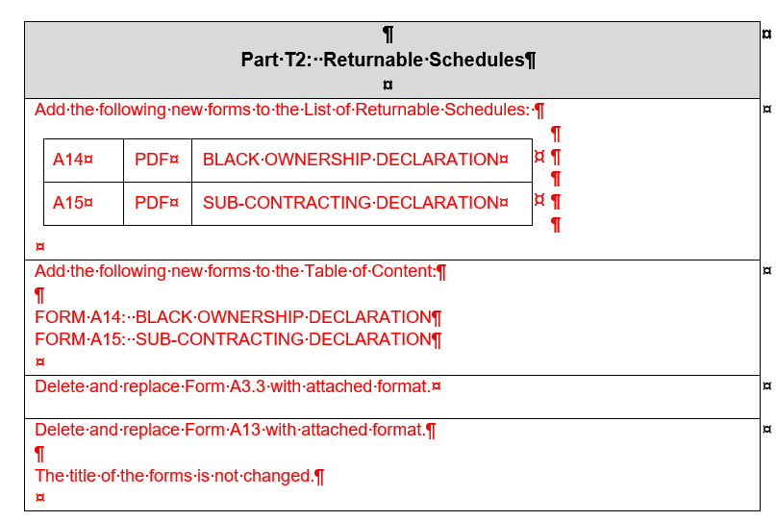
T2 RETURNABLE SCHEDULES

Slide 27
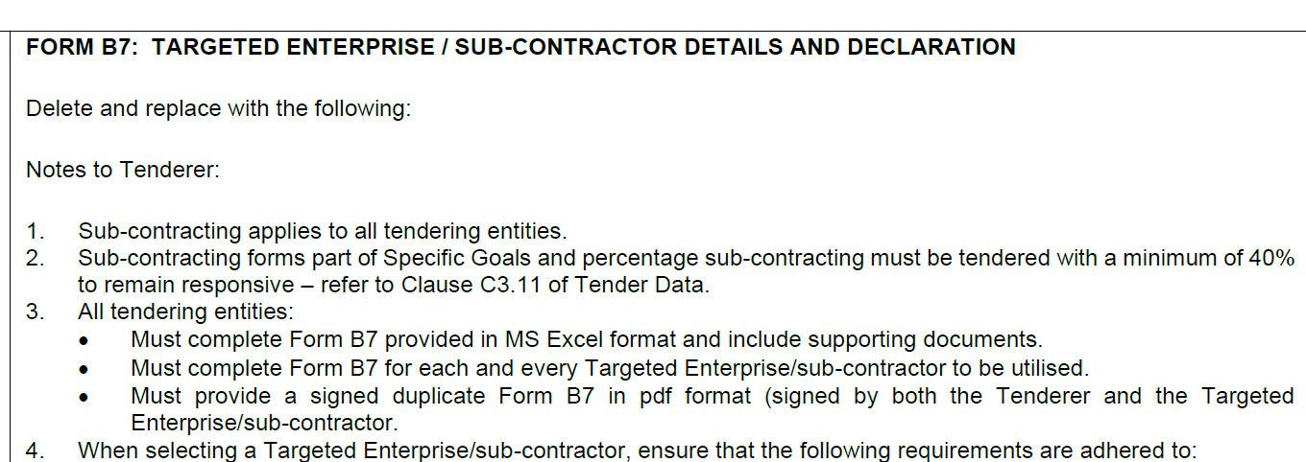
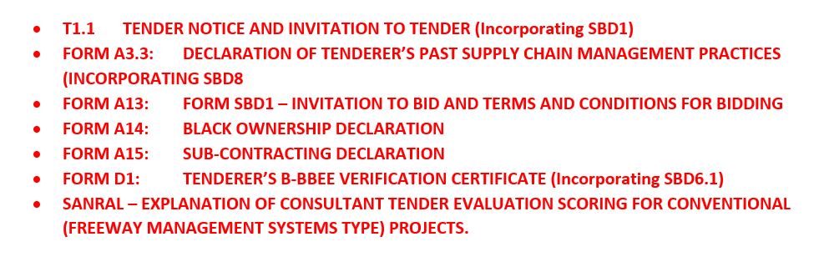
T2 RETURNABLE SCHEDULES

Slide 28
4. EVALUATION PROCESS

Slide 29
C.2.1 ELIGIBILITY CRITERIA
Item | Description | Required
a) | Key Persons. | Meet the minimum requirements for the key persons as stated in the Scope of Works in Clause C3.1.11: Personnel requirements, excluding C3.1.11 (f) which is dealt with under Tender Data C.3.13 (k). If the proposed Key Persons do not meet the stipulated minimum requirements for the tender, the tender will be declared non-responsive.
Item | Description | Required
b) | Registered on National Treasury Central Supplier Database. | Tenderers, or in the event of a Joint Venture (JV), each member of the JV, shall be registered on the National Treasury Central Supplier Database at the closing date for tender submissions. If not registered as verified online at tender closing, the tenderer will be declared non-responsive.
Notes:
Standard

Slide 30
C3.11 BBBEE REQUIREMENTS
PLEASE NOTE THE FOLLOWING NON-COMPLIANCE TO BBBEE REQUIREMENTS THAT WILL NEGATIVELY IMPACT EVALUATION SCORING:
If the B-BBEE Certificate is not submitted or submitted B-BBEE certificate is not valid; or
If the B-BBEE Certificate is not submitted, and the tenderer has claimed a status point level; or
If tenderer failed to submit a valid B-BBEE Certificate but claimed status level points; or
If the tenderer submits a B-BBEE Certificate that is expired - but did claim preference points; or
If the tenderer submits a B-BBEE Certificate that does not comply with requirements; or
If the tenderer submits the Scorecard assessment report only; or
If, in a case of a Joint Venture, the tenderer submits an unincorporated consolidated Joint Venture B-BBEE Certificate which is not project specific; or

Slide 31
C3.11 BBBEE REQUIREMENTS
PLEASE NOTE THE FOLLOWING NON-COMPLIANCE TO BBBEE REQUIREMENTS WILL NEGATIVELY IMPACT EVALUATION SCORING:
If, in a case of a Joint Venture, the tenderer submits an unincorporated consolidated Joint Venture B-BBEE Certificate which does not have a contract description and / or a tender number; or
If a tenderer only submits one B-BBEE certificate in one tender submission, where multiple tenders were issued by SANRAL; or
If the BBBEE certificate or Sworn Affidavit is not submitted or not valid; or
for a Sworn Affidavit; if
i. EME (not start-up) submits a Sworn Affidavit with total revenue above R1,8 million instead of a B-BBEE Certificate.
or
ii. QSE submits Sworn Affidavit (consultants and contractors) instead of a B-BBEE Certificate

Slide 32
C3.11 BBBEE REQUIREMENTS
PLEASE NOTE THE FOLLOWING NON-COMPLIANCE TO BBBEE REQUIREMENTS WILL NEGATIVELY IMPACT EVALUATION SCORING:
For unincorporated JV certificates, the size of the company must be indicated on the JV certificate (e.g., EME, QSE, etc.)
TENDERERS THAT ARE SUBMITTING A SWORN AFFIDAVIT AS PROOF OF BBBEE STATUS MUST USE THE ACSC TEMPLATE AS PROVIDED IN THE NEXT SLIDE. FAILURE TO USE THIS TEMPLATE WILL RESULT IN DISQUALIFICATION FROM FURTHER EVALUATION.

Slide 33
C3.11 BBBEE REQUIREMENTS
A VALID B-BBEE SWORN AFFIDAVIT SHALL CONTAIN:
Name/s of deponent as they appear in the identity document and the identity number.
Designation of the deponent as either the director, owner or member must be indicated in order to know that person is duly authorised to depose of an affidavit.
Name of enterprise as per enterprise registration documents issued by the CIPC, where applicable, and enterprise business address.
Percentage black ownership, black female ownership and whether they fall within a designated group.
Indicate total revenue for the year under review and whether it is based on audited financial statements or management accounts.
Financial year-end as per the enterprise’s registration documents, which was used to determine the total revenue. The valid format of the Financial Year-End is Day/Month/Year
B-BBEE status level. An enterprise can only have one status level.
Date deponent signed, and date of Commissioner of Oath must be the same.
Commissioner of Oath cannot be an employee or ex officio of the enterprise because, a person cannot by law, commission a sworn affidavit in which they have an interest.

Slide 34
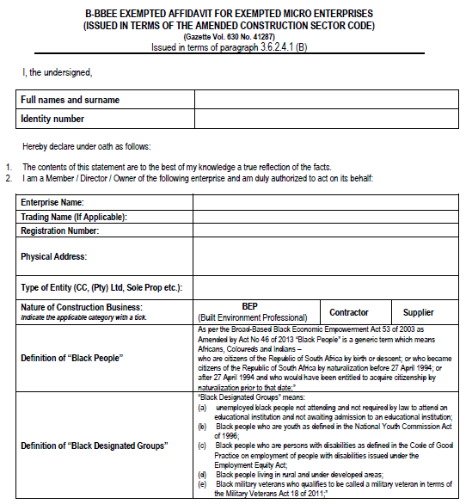
TEMPLATE FOR ACSC SWORN AFFIDAVIT
This must be completed
The correct position must be selected
This must be completed
The correct legal name must be completed
The correct trading name must be completed
The correct registration number must be completed
Only this option in applicable for this tender

Slide 35
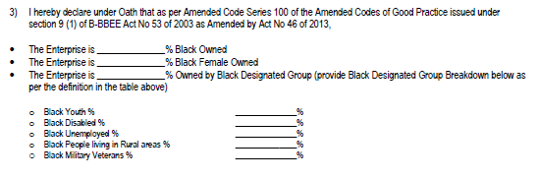
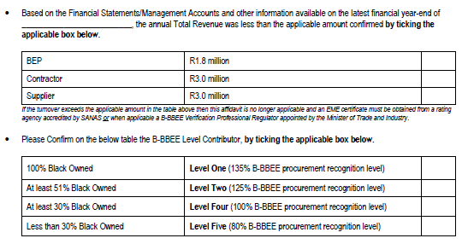
TEMPLATE FOR ACSC SWORN AFFIDAVIT
This must be completed
This must be completed if applicable, if not please indicate with zero (0)
This must be completed with Day, month & year
e.g.:31 March 2016/17
This must be completed by means of selecting one option
This must be completed by means of selecting one option

Slide 36
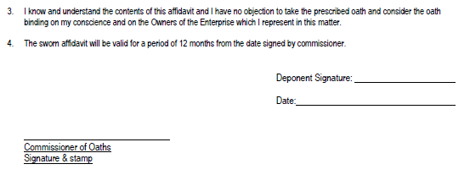
TEMPLATE FOR ACSC SWORN AFFIDAVIT
+ Date
These two dates must be on the same date

Slide 37
COMPLIANCE EVALUATION
Item | Description | Required
1 | Compliance Evaluation | The tenderer must complete, sign, attach supporting documents and comply with the requirements of Returnable Schedules Part T2 of the tender document. Tenderers must complete all declarations and complete correct information and sign. Failure to declare the correct information on declaration forms will render the tenderer non-responsive.

Slide 38
PRICE AND PREFERENCE
Tenderers who meet the Eligibility and Compliance, Technical and Financial requirements shall be evaluated for Price and Preference.
IN ORDER TO SCORE THE POINTS FOR PRICE, THE PRICING SCHEDULE MUST BE COMPLETED IN FULL
COMPLETE PRICING SCHEDULE ON EXCEL SPREADSHEET PROVIDED
SUMMARY SCHEDULE MUST BE COMPLETED AND SIGNED
Tendering ZERO RATES may pose a risk to the employer and your tender may be regarded as an unacceptable tender.

Slide 39
5. TIPS FROM SCM FOR SUBMITTING A TENDER

Slide 40
TIPS FOR SUBMITTING YOUR TENDER DOCUMENTS SUCCESFULLY
Please ensure that whosoever delivers your tender documents at SANRAL, comply with the access control requirements.
When using a courier company, ensure that the delivery to SANRAL is before the specified closing time.
The courier MUST complete the correct register using your company name and not their courier company name.
Tender documents MUST be submitted electronically on a flash drive as per C.2.13.
Clearly mark all the envelopes legibly, using the correct Tender number.
For multiple tenders closing at the same time, ensure that the correct tender submission match the project number and description of the envelope.

Slide 41
6. TECHNICAL : SCOPE OF WORKS

Slide 42
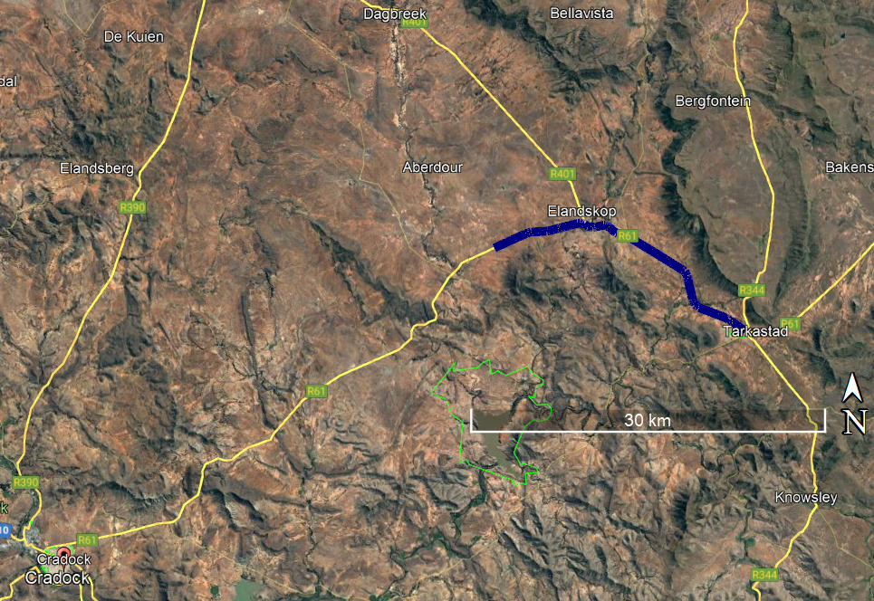
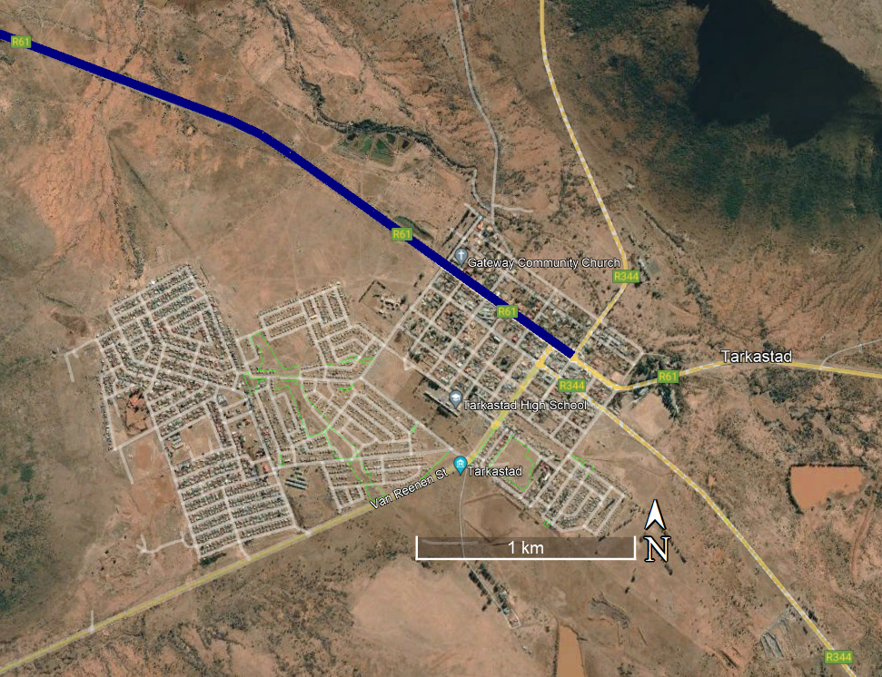
OVERVIEW
LOCALITY PLAN

Slide 43

OVERVIEW
Description of the works:
Extent: The project is located on the R61 Section 3 starting between Cradock and Tarkastad at km 50.8 and ends at km 75.5 in Tarkastad. The National route R61 is a two lane single carriageway road in a rural area in the Eastern Cape Province.
Previous works: The works was partly completed by a previous contractor. The total road length is approximately 24.7 km. The pavement and Cape Seal (first slurry layer only) of 12km have been completed by the previous contractor.
Ancillary works: Most of the ancillary works over the entire project length have not been completed and will be completed under this project.
Traffic accommodation: Stop and go

Slide 44
OVERVIEW
Description of the works:
Road works:
The sufaced width will be increased from 2 x 3,0m lanes with gravel shoulders to 2 x 3,7m lanes with 0.5m surfaced shoulders on either side.
Road building materials will be obtained from the existing the Phase 1 Quarry located at km 39.00 on the R61 Section 3. The quarry will have to be rehabilitated after utilisation thereof.
In-situ reworking, reconstruction and widening of existing pavement layers as required with cement stabilised sub-base (C4) and emulsion and cement (BSM) treated base.
Surfacing of new road width using a 20mm Cape seal with two layers of slurry. The three sections already constructed by the previous contractor still require application of the second slurry.
Temporary base and a single seal will be constructed in one of the directions (RHS) to accommodate traffic while the permanent works is being constructed in the opposite direction (LHS)

Slide 45
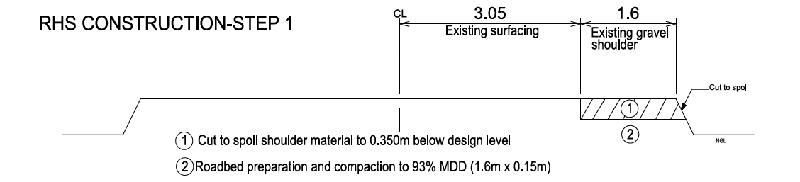
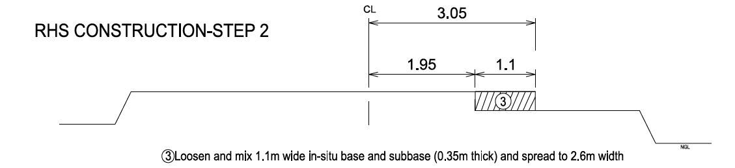
CONSTRUCTION SEQUENCE

Slide 46
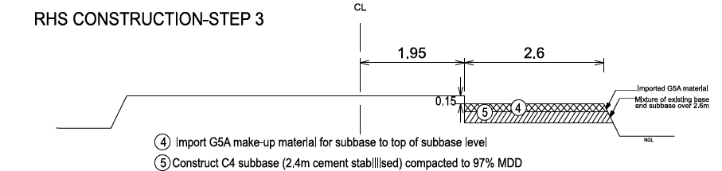
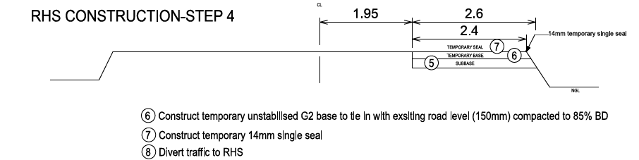
CONSTRUCTION SEQUENCE

Slide 47
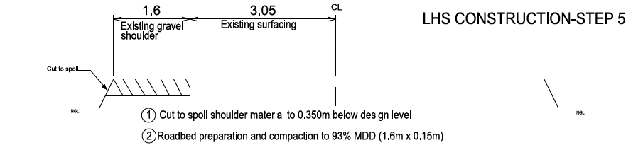
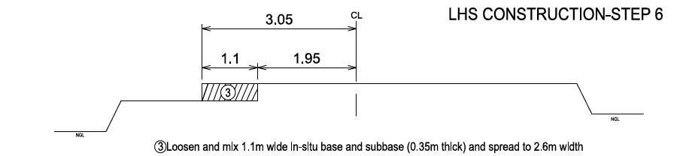
CONSTRUCTION SEQUENCE

Slide 48
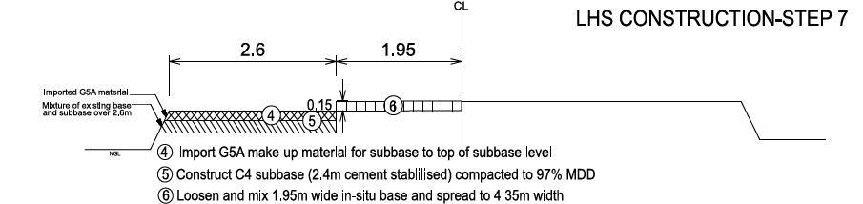
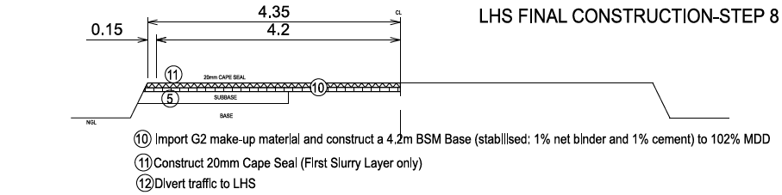
CONSTRUCTION SEQUENCE

Slide 49
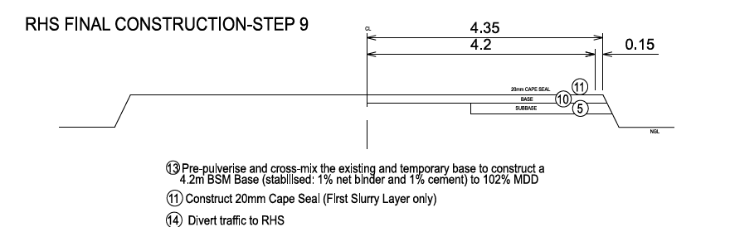
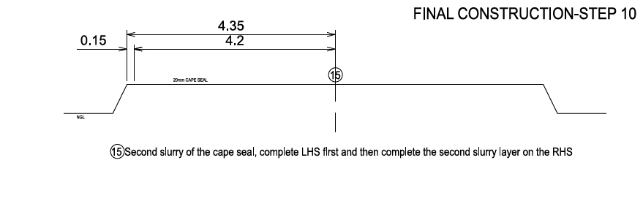
CONSTRUCTION SEQUENCE

Slide 50
All Queries related to this tender are to be addressed only to the SANRAL Procurement Officer:
  E-Mail: ProcurementSR4@sanral.co.za

Slide 51
THANK YOU

