Slide 1
Tender Briefing Meeting
THE MIDDLE LETABA WATER DEVELOPMENT PROJECT (MLWDP) – TERMS OF REFERENCE
Presented by: P Jugdawooh
Date: 22 September 2026

Slide 2
INTRODUCTION AND BACKGROUND
The Middle Letaba Catchment forms part of the Letaba River system in Limpopo Province.​
The Middle Letaba Dam rarely reaches full capacity, resulting in water shortages.​
This Study investigates options to augment water supply to the Middle Letaba Dam.​
Project aims to improve water security for communities and irrigation users.​
Estimated study duration: 15 months.​

Slide 3
STUDY AREA
The Study Area covers the following catchments and areas:
  Klein Letaba River Catchment (potential dam, weir and conveyance routes).​
  Middle Letaba River Catchment and existing users.​
  Middle Letaba Dam as receiving resource.​
  Nsami Dam as destination of conveyance system.​

Slide 4
STUDY OBJECTIVE
As far as interventions for the Middle Letaba Dam is concerned, there are currently the following five (5) phases.
Phase 1: Borehole refurbishment and groundwater development.​
Phase 2: Klein Letaba weir and 23 km pipeline.​
Phase 3: New dam development (Crystalfontein or Majosi).​
Phase 4: Replace/refurbish 60 km canal to Nsami Dam.​
Phase 5: Future transfers from Mutale and Groot Letaba catchments.​

Slide 5
STUDY STAGES
Study Stage 1 - Inception Stage: Deliverables: Inception Report including an update of the proposed scope of work, methodology, budget, study program and cashflow. It is anticipated that the Inception Report shall be completed within three (3) months
Study Stage 2 - Pre-feasibility Stage: Deliverables: Pre-Feasibility Study Main Report together with all applicable and agreed supporting reports. Study Phase 2 shall be completed within twelve (12) months after Study Phase 1.

Slide 6
IMPORTANT TERMS OF ENGAGEMENT
Upon completion of each Study Phase, the Client shall be entitled to decide at its sole discretion to either proceed with further Phases or to terminate the study at this stage.
Remuneration for any work undertaken will be based on approved Contract task budget of actual deliverables as approved by the Client, and not on time.
The final invoice for reports will only be payable once reports are signed of and hard copies, word and pdf versions have been handed over.
Two percent (2%) of the total contract amount will be retained and will be paid after the delivery and approval of all reports in the specified format.
There will strictly be NO Provisional Sums allowed when bidding.

Slide 7
WATER AUGMENTATION OPTIONS
Options: The following four (4) options have been selected for evaluation at pre-feasibility stage for phase 2 and 3:
(i) Proposed Dam Project i.e. Crystalfontein or Majosi Dam on the Klein Letaba River.
(ii) Proposed Weir and Pipeline in the Klein Letaba River.
(iii) Combination of the proposed dam and weir with conveyance pipeline (the Weir shall be downstream of the dam).
(iv) Any other option considered by the PSP that shall meet the objective of the study (phase 2 and 3).

Slide 8
WATER CONVEYANCE OPTIONS
Options: The following four (4) options have been selected for evaluation at pre-feasibility stage for phase 4:
(i) Refurbish the existing canal conveyance system;
(ii) Replace the existing canal system with a pipeline (for this option the optimal conveyance route must be investigated);
(iii) A new canal conveyance system (for this option the optimal conveyance route must be investigated);
(iv) Any other option considered by the PSP that shall meet the objective of the study (phase 4).

Slide 9
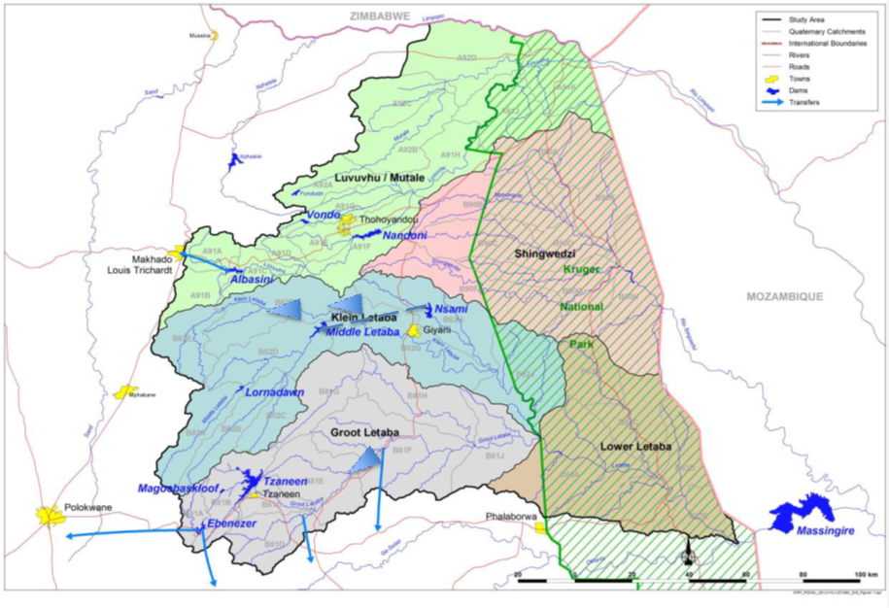
WATER AUGMENTATION AND CONVEYANCE OPTIONS
Luvuvhu-Letaba Catchment with the proposed Crystalfontein and Majosi Dams indicated along the Klein Letaba River as well as the location of Nsami Dam.

Slide 10
SCOPE OF SERVICES – STUDY PHASE 1: INCEPTION STAGE
The appointed PSP will be required to undertake a thorough research and review of all the relevant previous study reports, as well as all other available information, and to become familiar with the Luvuvhu and Letaba Water Supply System and the Limpopo Management Area.
It will be necessary to update and maintain a list of current and completed studies and their relevance to this assignment.
The PSP will be required to liaise and engage with all relevant stakeholders and key role players in preparation and execution of the study.
The Inception Report shall be produced and finalised within 3 months from the commencement date. The final Inception Report will form part of the contract and will constitute the agreed final Terms of Reference (ToR) for the study.

Slide 11
SCOPE OF SERVICES – STUDY PHASE 2: PRE-FEASIBILITY STAGE
The main purpose of this phase is to undertake the necessary pre-feasibility level investigations and comparative analyses of all possible water resource development options, or hybrids thereof, for the Middle Letaba Water Development Project
Water Requirements
Environmental Screening
Updating Rainfall Data
Sedimentation Screening
Geophysics Investigation

Slide 12
SCOPE OF SERVICES – STUDY PHASE 2: PRE-FEASIBILITY STAGE…(cont)
Identification and Analyses of Water Resource Development and Conveynace Options
Dam and Conveyance Type and Site Selection
Pre-feasibility Design
Preliminary Water Resource Assessment for Hydropower generation potential
Land Acquisition
Meetings with Key Stakeholders and Interested and Affected Parties
Deliverables: Pre-feasibility Study Reports

Slide 13
SCOPE OF SERVICES – OTHER CONCURRENT TASKS
Economic and socio-economic analysis.​
Legal, institutional, financial and operational assessment.​
Stakeholder engagement and public participation.​
Capacity building and training.​

Slide 14
PROJECT MEETINGS
Meeting | PSP Obligations
Study Management Committee (SMC), excluding Inception Meetings | Arrangements for Meetings; Attendance; PowerPoint Presentations of Study Progress, as well as Minute Taking and Distribution.
Study Steering Committee (SSC) and/or Stakeholder Meetings | Arrangements for Meetings; Attendance; PowerPoint Presentations of Study Progress, as well as Minute Taking and Distribution.
Presentation to the DWS Management | High-Quality PowerPoint Presentations by One or Two Study Team Members.
Meetings with Key Stakeholders (Arranged by the PSP) | Arrangements for Meetings; Attendance; PowerPoint Presentations of Study Progress, as well as Minute Taking and Distribution. Arrange refreshments.
Liaison with Role Players (Municipalities, other Government Departments, etc.) | Arrangements for Meetings; Attendance; PowerPoint Presentations of Study Progress, as well as Minute Taking and Distribution.

Slide 15
SCOPE OF SERVICES – OTHER DELIVERABLES
Study Main Report.​
Book of Drawings and Maps.​
Project Summary Report.​
Close-out Report.​
Digital GIS package.​
Capacity Building and Training outputs.​

Slide 16
STUDY PROGRAMME
The appointed PSP for this Study is required to develop a Detailed Programme for this Study to be completed within fifteen (15) months. The Study Programme must be prepared with MS Project and not with MS Excel. A detailed Study Programme, broken down to specific tasks and time allocated for each task must be submitted and the critical path shall be indicated. The Study Programme must indicate all study landmarks and target dates for deliverables.

Slide 17
EXTERNAL SPECIALIST REVIEWER
The bidder shall price based on historical estimates from similar studies, to appoint an External Specialist Reviewer, as required.
The Amount for the External Specialist Reviewer shall be included in the Financial Proposal by all the Bidders to cover these costs. Furthermore, Bidders must make provision in their Financial Proposals for assisting the DWS with the Procurement (Specifications, Evaluation of Quotations and Recommendations) of the Services of the Specialist Reviewer as a percentage (%) of the Amount and for the Management of Payments to the Specialist Reviewer as a percentage (%) of the Amount through the appointed PSP’s invoices. The man hours utilised must be stipulated for this task to ensure alignment between the resource input and cost.

Slide 18
DELIVERABLES
Deliverables such as reports, presentations, analyses, letters, minutes of meetings, and databases must be provided in Microsoft applications and in PDF format (where applicable). The text for all documents shall be in Arial 11 font at 1.5 spacing unless otherwise stated or agreed.
Provision must also be made to submit deliverables, such as reports and letters, in hard copy format if required. The format of reports must be confirmed with the DWS before issuing final versions of reports. Reports are typically submitted as the First Draft, Draft Final and Final Version.
A Guideline of the Deliverables Required for this Study is provided in Table 9.1 of the TOR, which is not an exhaustive and final list. This list must be read in conjunction with the other sections of the ToR. Bidders should scrutinize the list, as well as relevant sections of the ToR, and submit an Updated Comprehensive List of the Expected Deliverables for this Study in the Technical Proposal.

Slide 19
PROJECT PROPOSAL
Bidders are required to submit, at their own cost, a Proposal (Bid), which consists of the following documents:
Standard Bidding Documents, as specified in the TOR;
A Technical Proposal, to demonstrate the capability of the Bidder to perform the full scope of this Study as presented in the Terms of Reference (ToR), and
A Financial Proposal, to provide the cost to undertake this Study:
  Breakdown of Deliverables and Associated Costs
  Value Added Tax
  Escalation of Professional Fees, including Disbursements
  Monthly Cash Flow for the contract period based on the Work Programme
  Breakdown of Professional Fees

Slide 20
Thank you

